Slide 1




G
ENDER
C
LASSIFICATION
-Sumit Maharjan

Slide 2
G
C
Information Preview
ENDER
LASSIFICATION
Gender classification is a classification to determine a person’s gender, ie. male or female, based on his or her biometric clues.
Usually facial images are used to extract features and then a classifier is applied to the extracted features to learn a gender recognizer.
But in this project we are provided the large amount of data through which we can used to classify how many of them are Male and female.
The information provided to us are: forehead width in cm, forehead height in cm, gender, nose wide, nose long ,etc.

Slide 3
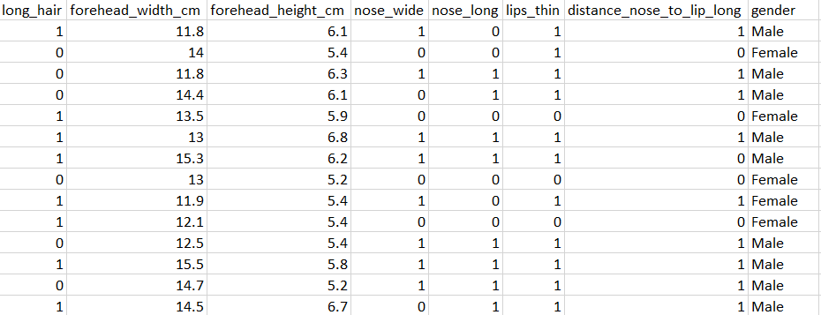
Tools Used
Information Preview

Slide 4



Information Preview
Tools Used
Work Flow
DATA….

Slide 5
Tools Used
DEMO
Work Flow
import all the necessary libraries.
load the data.
perform EDA (Exploratory data analysis):
i)NUM values
a. either Remove /fill
ii) Duplicate Rows-Remove
iii) Visualization
4. Feature Engineering(which features to select)
a. one-hot Encoding / label Encoding
5. split the data into independent and dependent features(x , y)
6. Split the data into train and test set(x-train, y-train)
(x-test, y-test)
7. Create the instance of the model
(eg.lr-model=linear Regression(i))
8. Fill the data into algorithm
9. Check the matrices(loss/Accuracy).
DATA….

Slide 6
DEMO

Slide 7
Thank You

