Slide 1

Employee Management system using c++
-By Anish Chauhan

Slide 2
INTRODUCTION TO C++
C++ is a powerful, high-performance programming language that extends the capabilities of C with object-oriented and generic programming features. Developed by Bjarne Stroustrup in 1983, C++ combines low-level memory manipulation with high-level abstraction, making it versatile for a wide range of applications.
Key Features:
Object-Oriented Programming (OOP): Supports classes, inheritance, polymorphism, and encapsulation.
Performance: Offers fine control over hardware and system resources.
Portability: Code can run on various platforms with minimal changes.
Standard Library: Includes data structures, algorithms, and utilities that simplify programming.
Extensibility: Allows custom definitions for complex data types and templates for generic programming.

Slide 3
Key OOP concepts used in the project
Inheritance: RegularEmployee and Manager inherit from the base Employee class using hierarchical inheritance.
Polymorphism:
Method Overriding:
Both RegularEmployee and Manager override the display method from the Employee class to provide specialized output.
Method Overloading:
Multiple updateEmployee methods in the Employee class demonstrate function overloading based on parameter types.
Encapsulation: Employee class encapsulates attributes (name, age, salary) and provides methods (display, updateEmployee) to access or modify them. Private attributes like dept in the Manager class ensure data is not accessed directly.
Abstraction: High-level abstraction is achieved through the Employee class, which serves as a common blueprint for RegularEmployee and Manager.

Slide 4
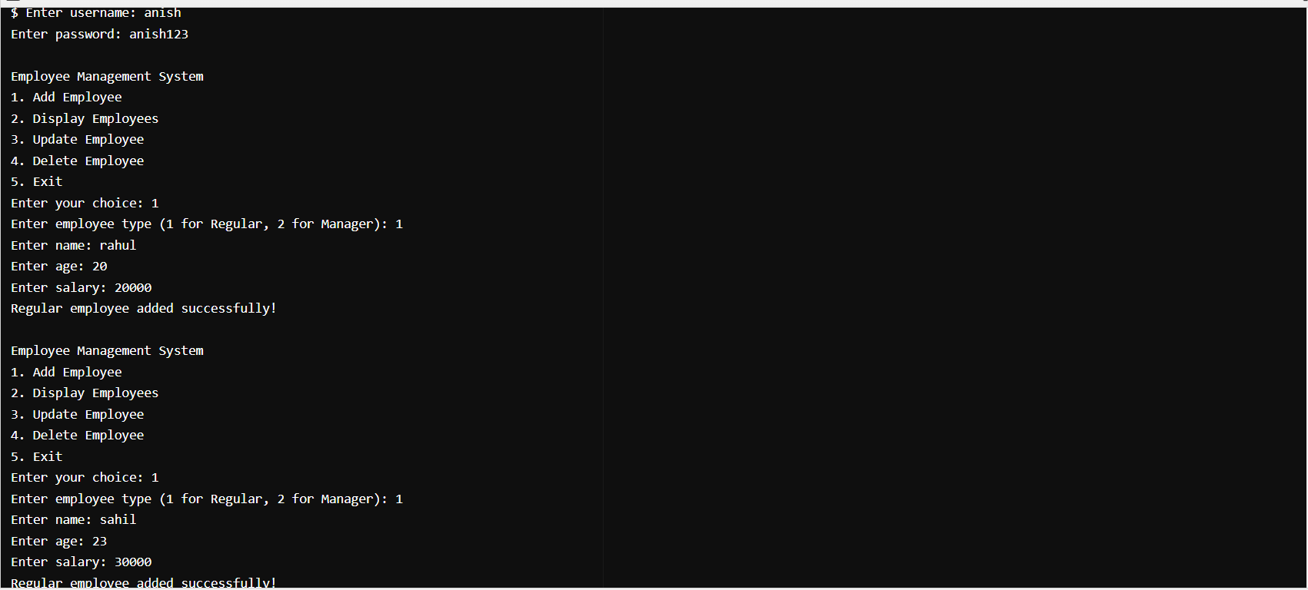
Outputs

Slide 5
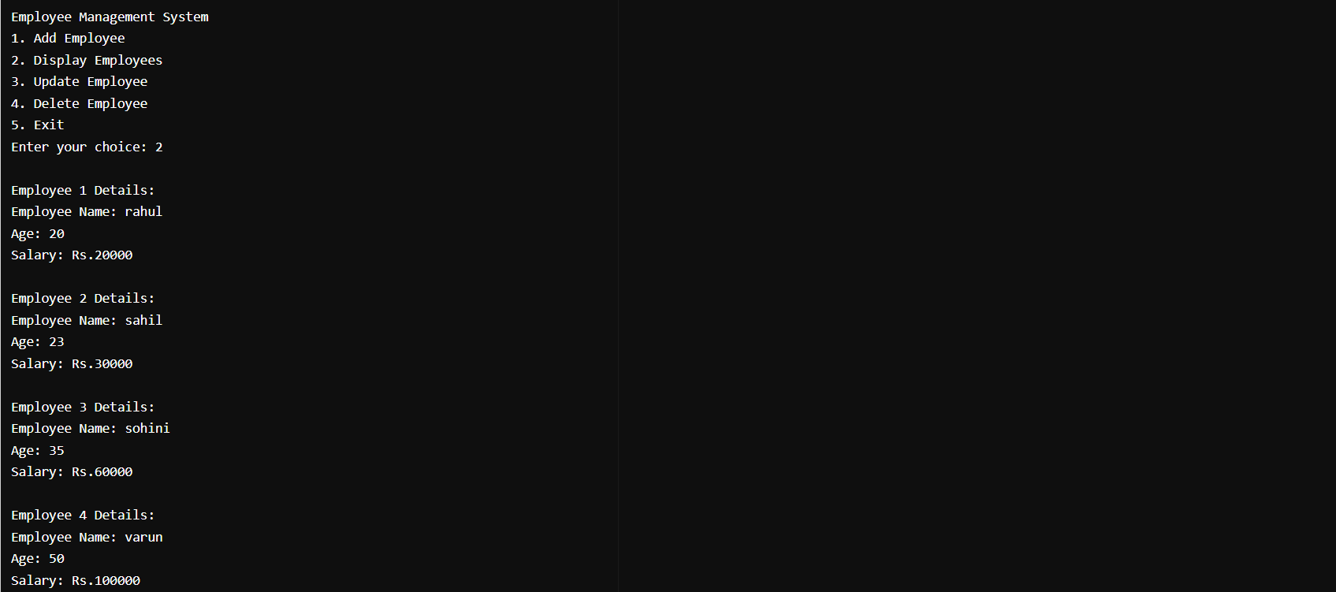

Slide 6
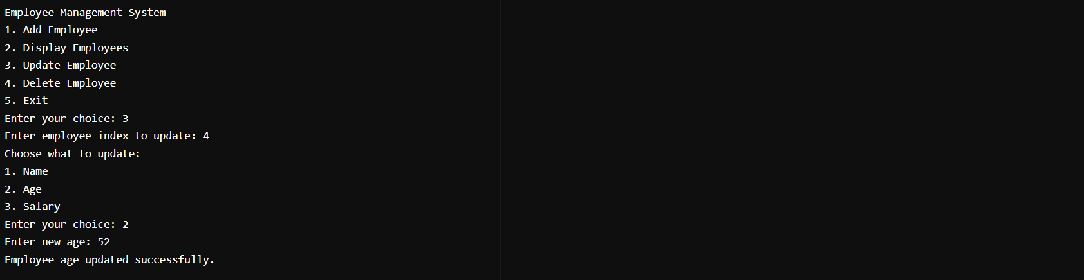

Slide 7
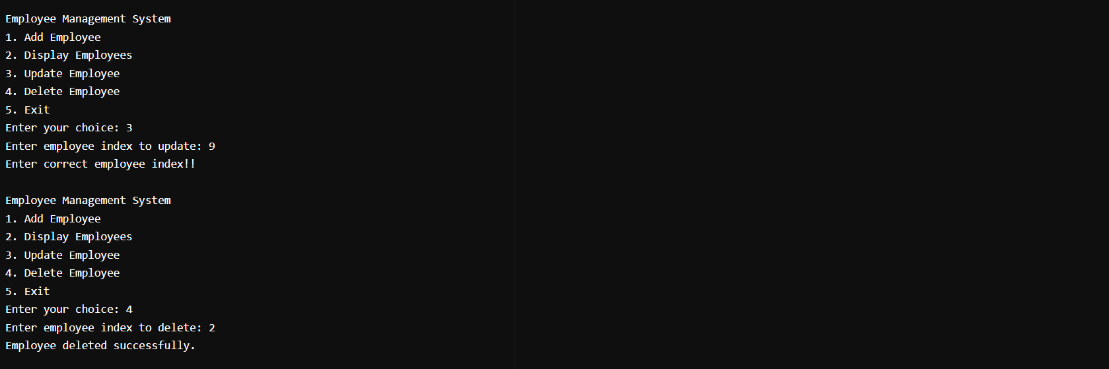

Slide 8
THANK YOU!!

