Slide 1
HS 4114
Music Analysis through Computing
Name | Department | Roll Number
Anutsup Bhattacharya | HSS | 22D0714
Anish Mukundlal Chaurasiya | CMInDS | 180260007
Course Project
Final Project

Slide 2
Task
Detecting Singer's Tonic using Background Tanpura

Slide 3
What is a Tanpura?
“The tanpura (Sanskrit: तंबूरा, romanized: Taṃbūrā), also referred to as tambura and tanpuri, is a long-necked plucked string instrument, originating in India, found in various forms in Indian music.^{[1]}
It does not play melody, but rather supports and sustains the melody of another instrument or singer by providing a continuous harmonic bourdon or drone. A tanpura is not played in rhythm with the soloist or percussionist…”[1]
https://en.wikipedia.org/wiki/Tanpura

Slide 4
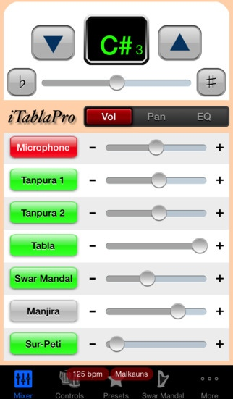
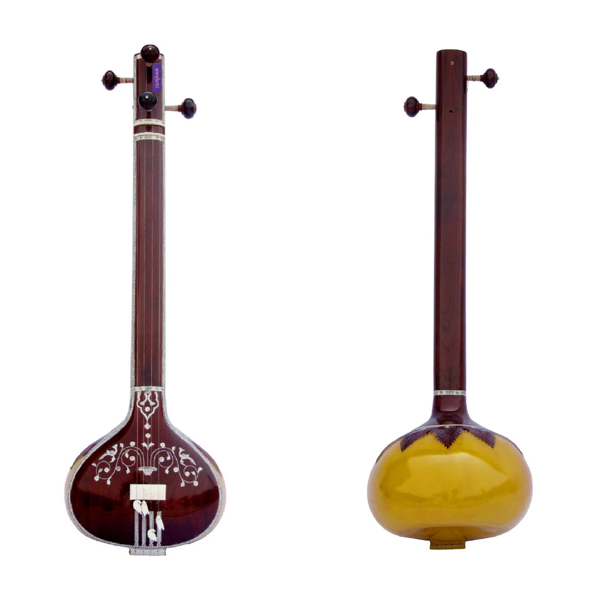
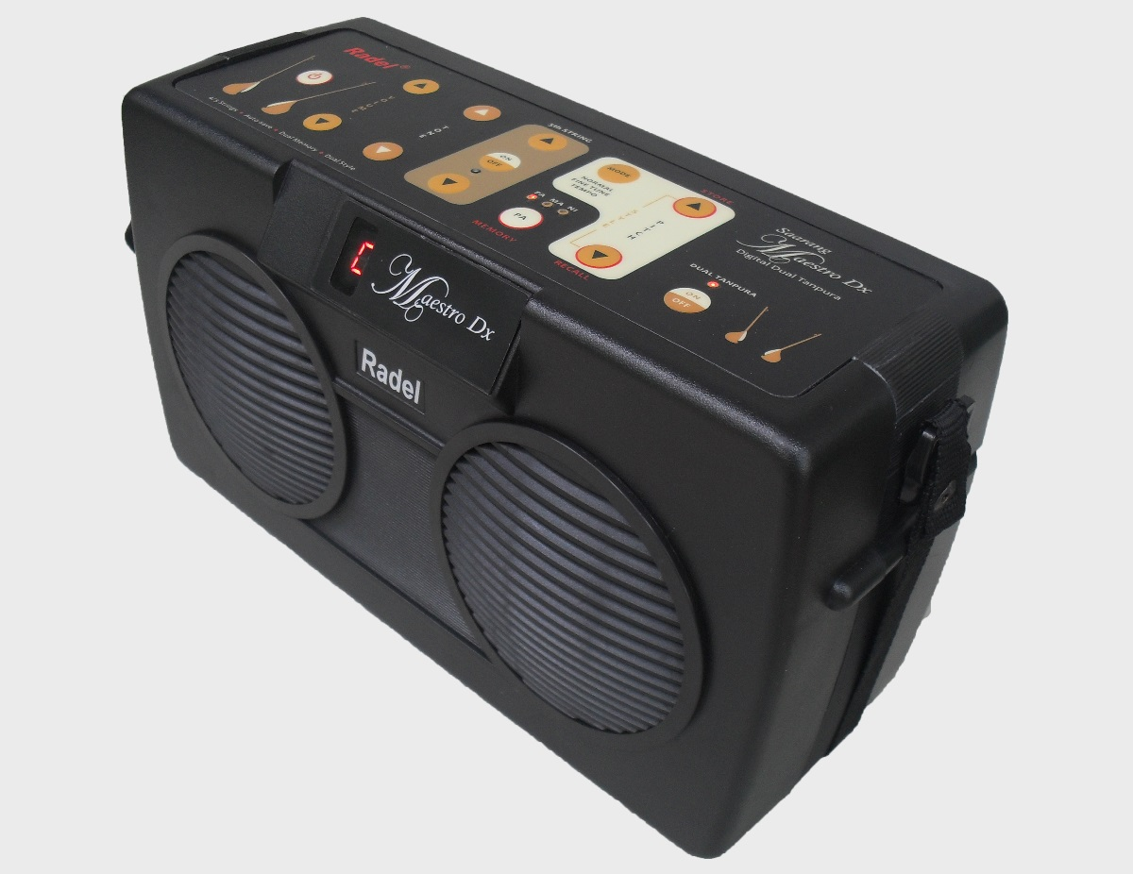
Dataset

Slide 5
Approach
Preprocessing: First, we will preprocess the audio file to remove noise, filter out unwanted frequencies, and normalize the signal.
Ideally, technically-sound modern recordings are used which do not need preprocessing.
The tanpura has three Sa and one other note (mostly Pa or Ni). We take the most frequently occurring note in the tanpura (the two Sa strings).
Some of the recordings even have two tanpuras strung together, which make it more complex.
To take different sample sizes of the recording and find the differences in the results.
Identify the drone pitch: We will take the most frequently occurring note as the note pitch, which we will get through the pitch-detection algorithm

Slide 6
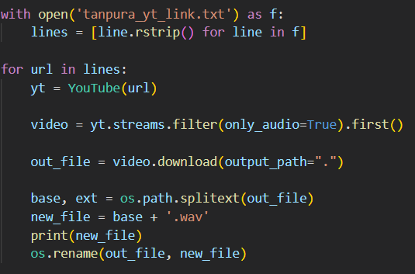
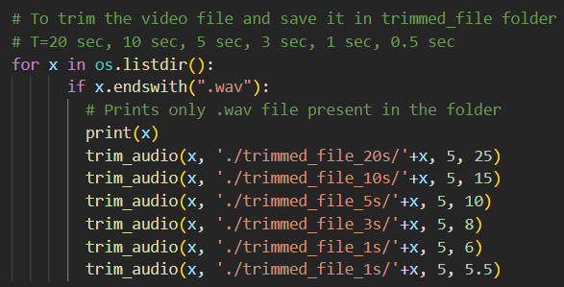
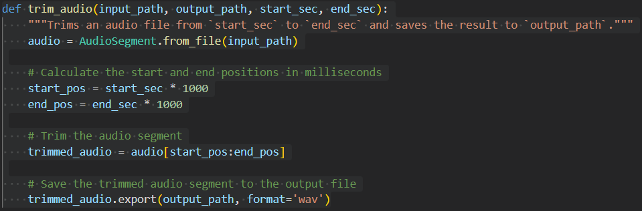
Code snippets(1)

Slide 7
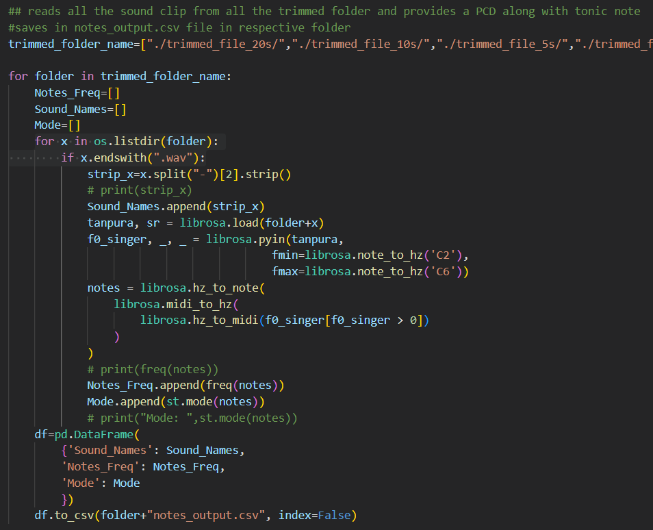
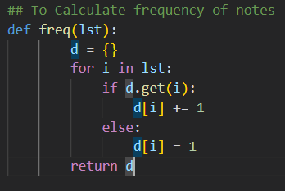
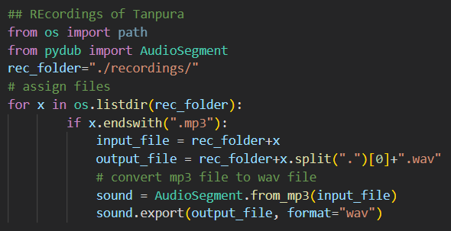
Code snippets(2)

Slide 8

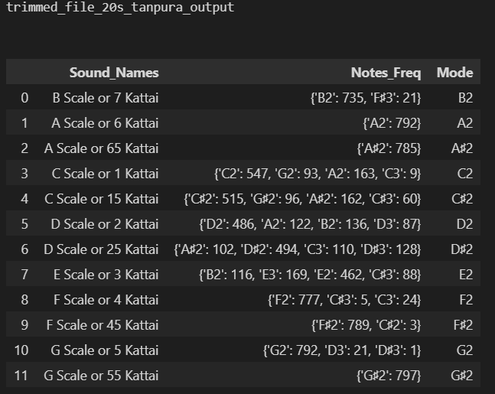
Results (1)
B Scale or 7 Kattai
A Scale or 6 Kattai
A Scale or 65 Kattai
C Scale or 1 Kattai
C Scale or 15 Kattai
D Scale or 2 Kattai
D Scale or 25 Kattai
E Scale or 3 Kattai
F Scale or 4 Kattai
F Scale or 45 Kattai
G Scale or 5 Kattai
G Scale or 55 Kattai

Slide 9
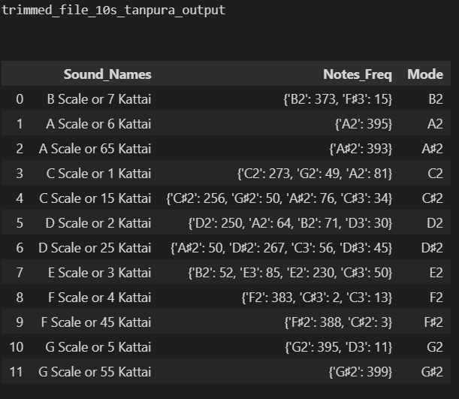
Results (2)

Slide 10
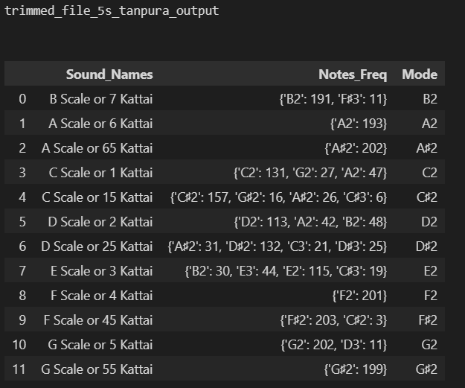
Results (3)

Slide 11
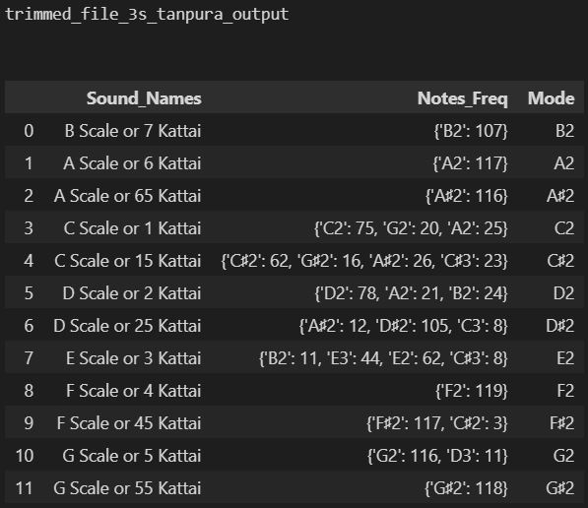
Results (4)

Slide 12
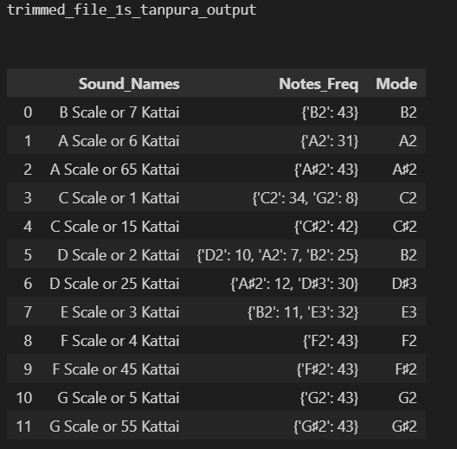
Results (5)

Slide 13
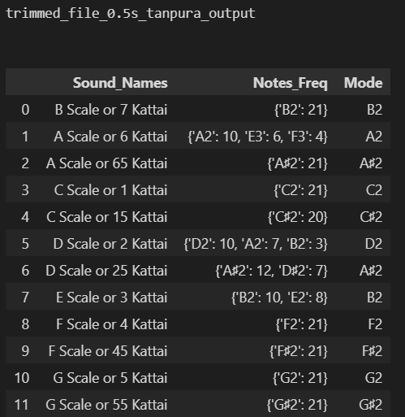
Results (6)

Slide 14
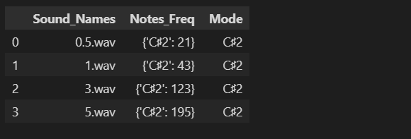
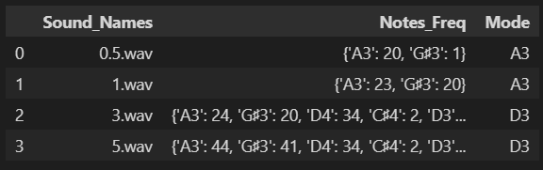
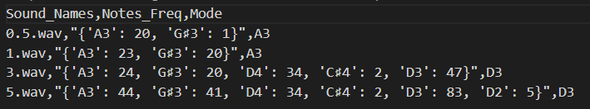
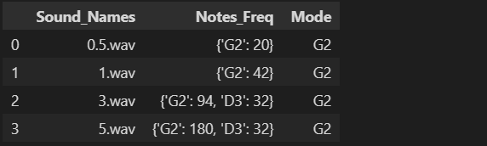
Results (7)
C# 0.5 s
C# 1s
C# 3s
C# 5s
C# 0.5 s
D 0.5s
D 1s
D 3s
D 5s
G 0.5s
G 1s
G 3 s
G 5s

Slide 15
Topic covered in class
Pitch Detection Algorithm (librosa.pyin())
Frame wise decomposition
PCD

Slide 16
Summary
We were successfully able to detect the tonic of the background tanpura with 1s, 3s, 5s, 10s and 20s sound clips
For 0.5 s we might get an error which was seen in one out three different rec sample
Written a optimised and scalable code which can be further worked on to make a python module for easy use
Link to Google slide: https://docs.google.com/presentation/d/1lRPyetFc9wOjCi0ChZ6Xf-xLyxqPbhEETNxfN6MjwTo/edit?usp=sharing

Slide 17
Thank you !

