Slide 1

Water Potability (Classification problem) ME 781 Course Project
Anish Chaurasiya 180260007
Ajay Raj K 184106007
Akshay Deshmukh 205280008
Karishma Ghosh 203300011
Vivek Hatzade 205280007

Slide 2
Project Objective
To classify whether water is potable for drinking based on pH value, hardness of water, TDS (Total dissolved solids)value, Chloramines and sulphates content, conductivity, Total Organic Carbon (TOC), Trihalomethanes and turbidity of water.
To perform intense EDA and compare various classification models based on their prediction accuracy and effectiveness.
This aims at the tapping of the cumulative effect of contaminants on the potability of water which is often overlooked

Slide 3
Problem definition
The presence of contaminants such as sewage waste, heavy metal, fertilizers, pesticides can be the cause of many illnesses in humans such as gastrointestinal illness, reproductive problems, and neurological disorders. Individuals with weakened immune systems may be at greater risk.
Water testing is important for monitoring the safety of drinking water, investigation of disease outbreaks, validation process and preventive measures, especially in a country like India where 40% of the population is not expected to have clean water by 2030.

Slide 4
Technology landscape assessment
In some regions, it has been shown that investments in water supply and sanitation can yield a net economic benefit, since the reductions in adverse health effects and health care costs outweigh the costs of undertaking the interventions.
The general procedure for water quality assessment pivots around the investigative analysis followed by comparison to defined levels of each parameter, which neglects the obvious cumulative effect of chemicals/contaminants
Replacing Manual interventions with the deployed model could reduce overall cost of the project.

Slide 5
Project Plan
Week 1: EDA
Week 2: Understanding various classification algorithms
Week 3: Implementing classification models
Week 4: Analysing Outputs and making final Project report

Slide 6
Project Plan
Important Features to be used:
pH value,
hardness of water,
TDS (Total dissolved solids)value
Chloramines and sulfates content
conductivity,
Total Organic Carbon (TOC)
Trihalomethanes
turbidity of water
Models to be Investigated:
Logistic Regression
Support Vector Machine
K-Nearest Neighbours
Decision Trees
Gaussian naive Bayes
Random Forest
Model Comparison
Accuracy
Precision
F1 Score
AdaBoost Classifier
Bagging Classifier
Extra Trees Classifier
Light Gradient Boosting Machine
CatBoost Classifier
ANN
XGBoost Classifier
Stochastic Gradient Descent Classifier
Passive Aggressive Classifier
Ridge Classifier
Gradient Boosting Classifier
Perceptron

Slide 7
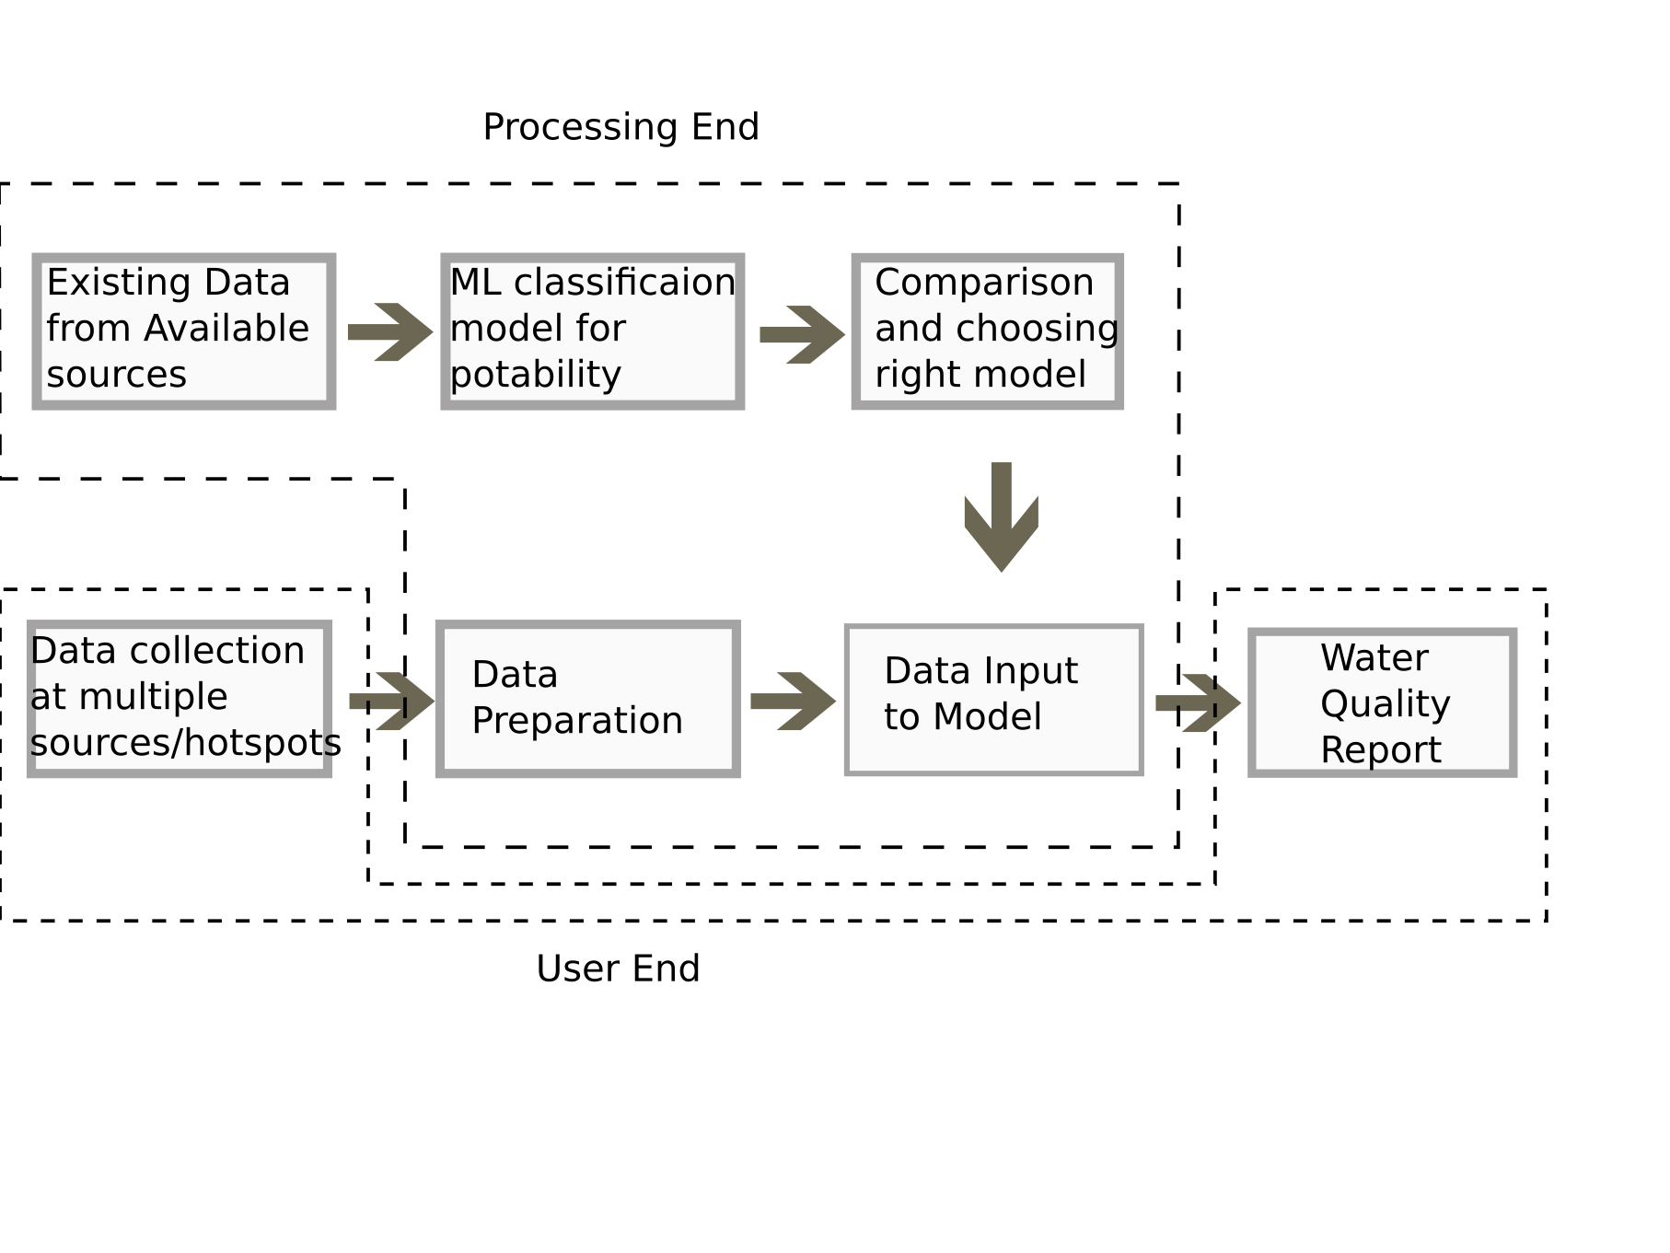
Conceptual Design

Slide 8
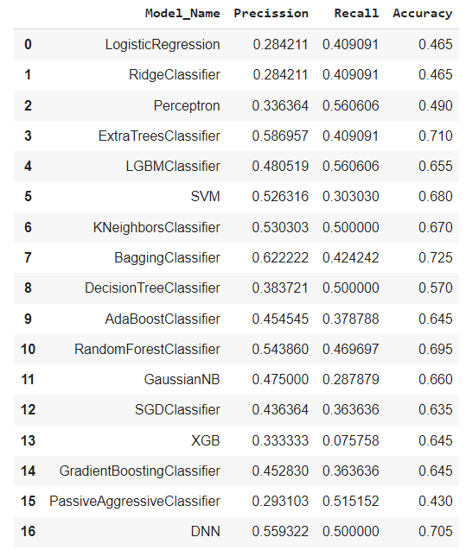
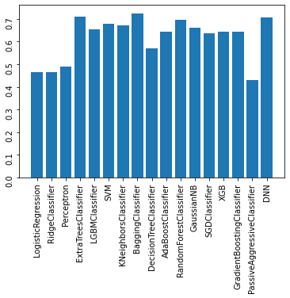
Model Training and Testing

Slide 9
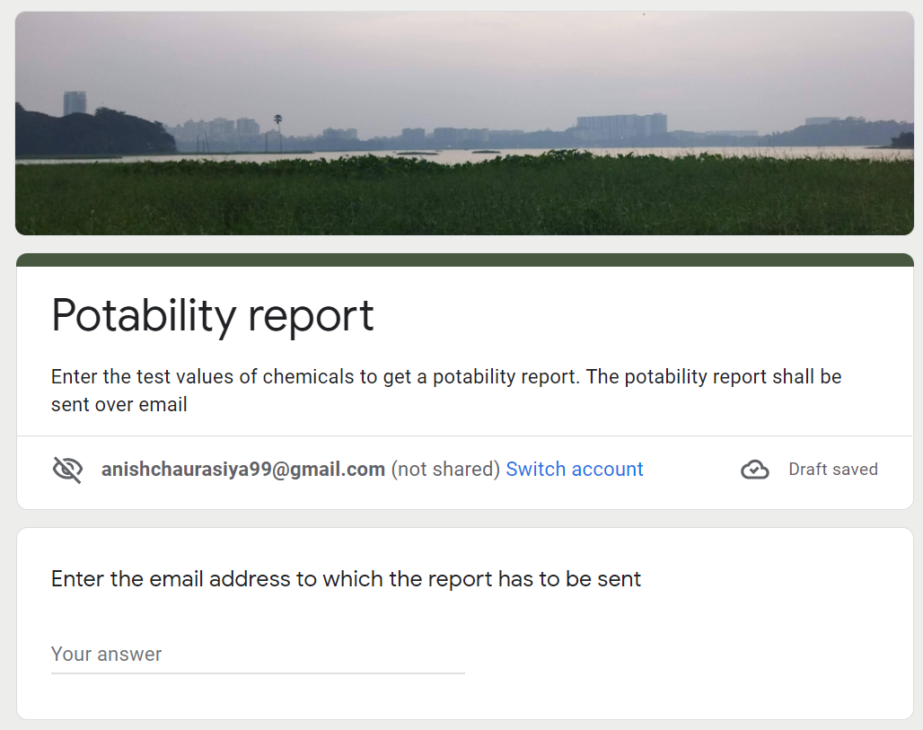
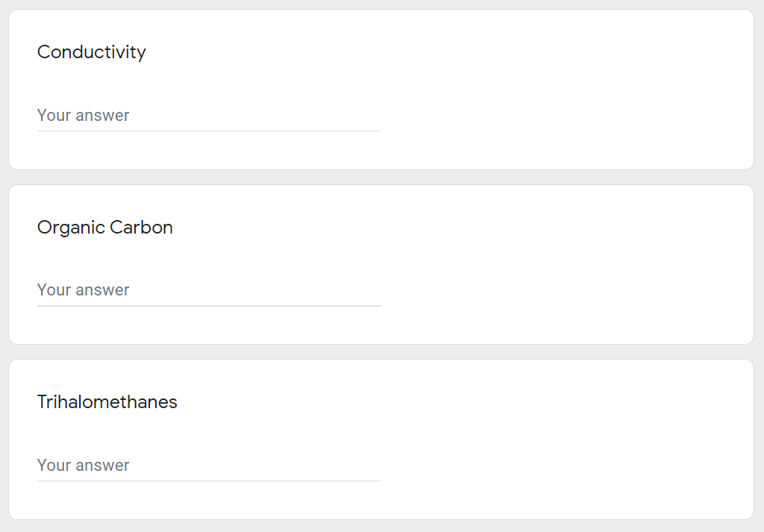
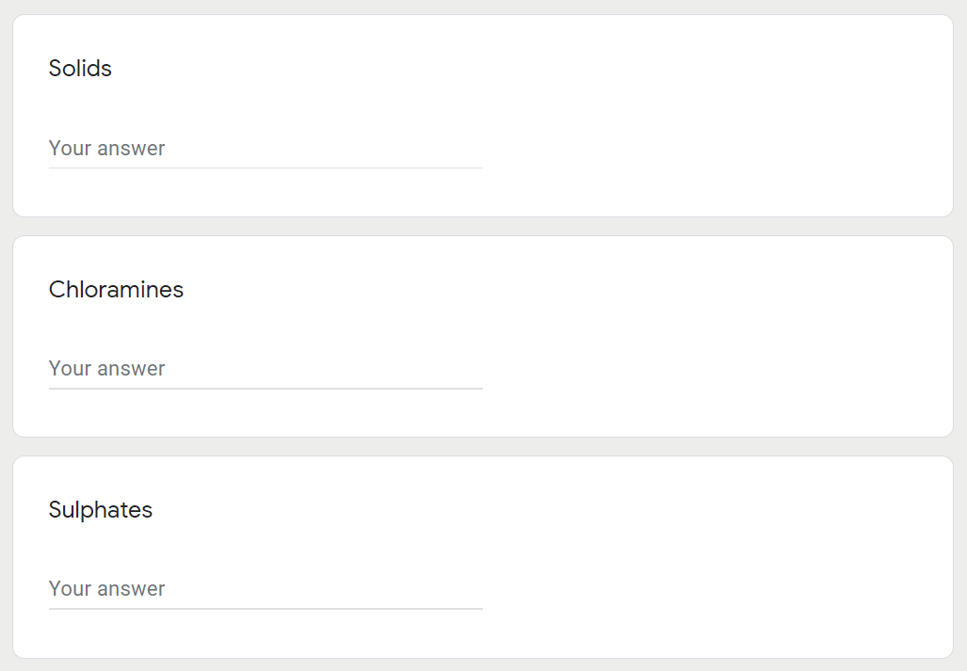
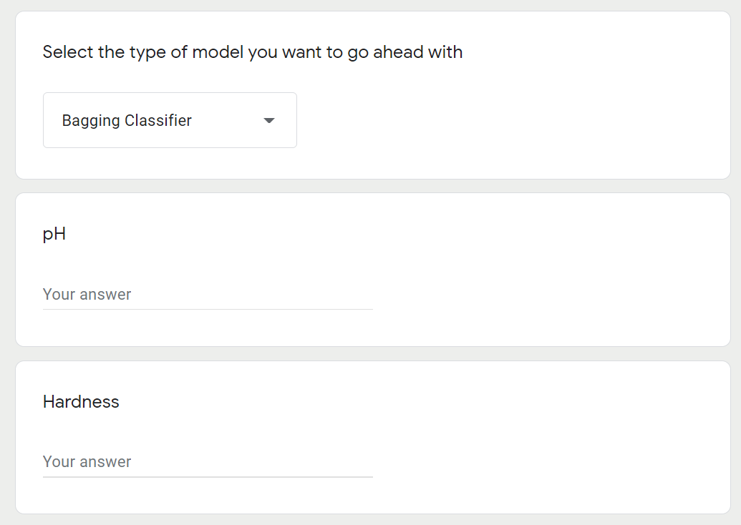
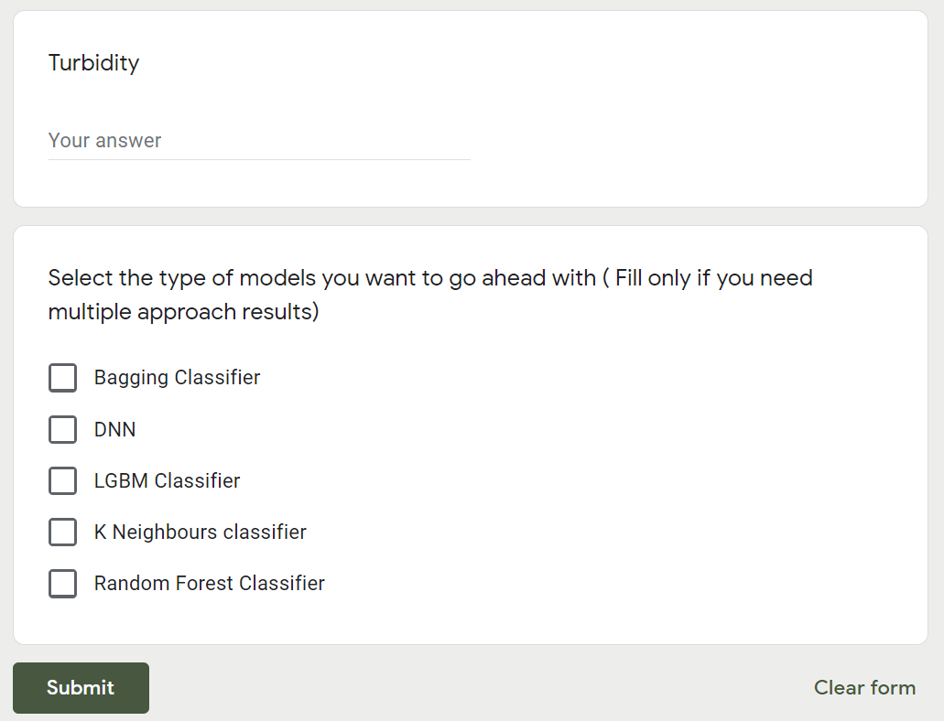
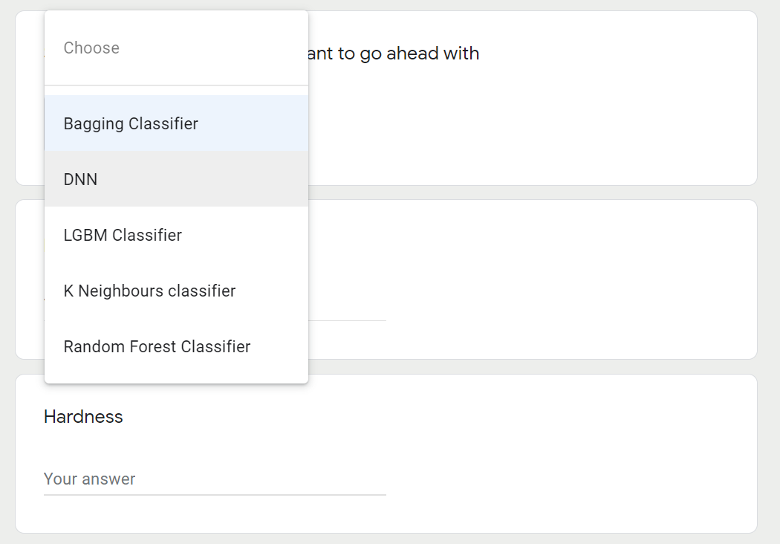
Screenshots of User interface:

Slide 10
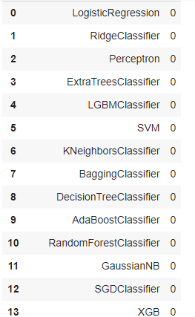
Unit Testing Report
An output with the prediction value corresponding to each machine learning model will be displayed.
'0' corresponds to water is not potable whereas '1' corresponds to water is potable.

