Slide 1

COMPUTER NETWORKS
19ECE311
Design & Implementation of a Secure Office LAN
-RIP Routing, ACLs, SSH Encryption

Slide 2
Purpose: To create and simulate a secure Local Area Network (LAN) that represents a typical office environment with multiple departments interconnected.
Simulation Tool: Cisco Packet Tracer
Implemented:
RIP v2 (Routing Information Protocol) for dynamic routing.
SSH (Secure Shell) for encrypted remote access.
Password protection at console, VTY, and enable levels.
Access Control Lists (ACLs) for traffic control and internal security.
Topology: A Mesh Topology connecting 3 routers (R0, R1, R2) ensures redundancy and multiple paths for data.
Project Overview
Network Design
& Topology
IP Addressing
Scheme
Routing Protocol
-RIP v2

Slide 3
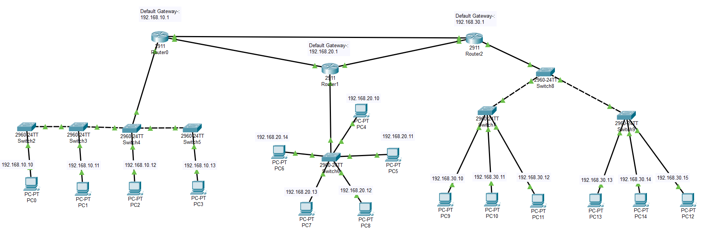
Routers: R0, R1, and R2 form a triangle (full mesh) using GigabitEthernet interfaces.
LANs: Each router connects to a separate LAN (e.g., R0 for HR, R1 for Admin, R2 for IT).
Router Connections:
R0 ↔ R1
R1 ↔ R2
R2 ↔ R0
Diagram:
Project Overview
Network Design
& Topology
IP Addressing
Scheme
Routing Protocol
-RIP v2
SSH & Device
Security

Slide 4
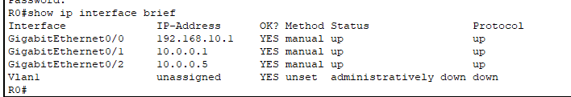
Project Overview
LAN Subnets:
R0 LAN: 192.168.10.0/24
R1 LAN: 192.168.20.0/24
R2 LAN: 192.168.30.0/24
Inter-router Links :
Use /30 subnets to minimize waste:
R0–R1: 10.0.0.0/30
R1–R2: 10.0.0.4/30
R2–R0: 10.0.0.8/30
IP Table: Include a screenshot from CPT showing interface IPs of routers and PCs.
Network Design
& Topology
IP Addressing
Scheme
Routing Protocol
-RIP v2
SSH & Device
Security
Password Encryption
Access Control Lists

Slide 5
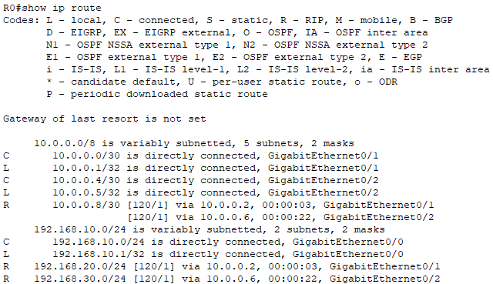
Project Overview
Reason for RIP v2:
Easy to configure.
Efficient for small, flat networks.
Supports CIDR (Classless Inter-Domain Routing) and subnetting.
Configuration Steps:
router rip
version 2
network 192.168.10.0
network 192.168.20.0
network 192.168.30.0
network 10.0.0.0
Verification:
Use show ip route to check that RIP has populated the routing table.
Include a screenshot showing RIP routes with “R” next to them.
Network Design
& Topology
IP Addressing
Scheme
Routing Protocol
-RIP v2
SSH & Device
Security
Password Encryption
Access Control Lists
ACL Testing & Results

Slide 6
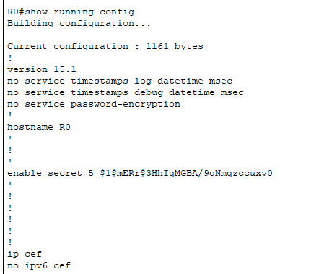
Project Overview
Network Design
& Topology
IP Addressing
Scheme
SSH Configuration Steps:
Set hostname and domain:
hostname R0
ip domain-name example.com
Create user:
username admin privilege 15 secret admin123
Generate RSA keys:
crypto key generate rsa
Choose key size: 1024 bits
Configure VTY lines:
line vty 0 4
login local
transport input ssh
Verification: Use PC terminal or PuTTY to SSH into router using IP address.
Routing Protocol
-RIP v2
SSH & Device
Security
Password Encryption
Access Control Lists
ACL Testing & Results
Additional Features
Considered

Slide 7
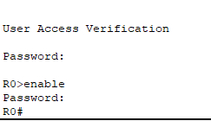
Network Design
& Topology
IP Addressing
Scheme
Enable Secret:
More secure than plain-text enable password.
Usage:
enable secret mysecurepassword
Encrypt all passwords:
service password-encryption
Console Password:
line console 0
password myconsolepass
login
Prevents unauthorized CLI access.
Routing Protocol
-RIP v2
SSH & Device
Security
Password Encryption
Access Control Lists
ACL Testing & Results
Additional Features
Considered

Slide 8
IP Addressing
Scheme
Routing Protocol
-RIP v2
SSH & Device
Security
Goal: Restrict access from R2's LAN (IT) to R1's LAN (Admin).
ACL Configuration:
access-list 20 deny ip 192.168.30.0 0.0.0.255 192.168.20.0 0.0.0.255 access-list 20 permit ip any any
interface g0/0
ip access-group 20 in
Explanation:
Denies packets from 192.168.30.0/24 to 192.168.20.0/24.
Allows all other traffic.
Where Applied: On R1’s G0/0 interface (facing LAN).
Password Encryption
Access Control Lists
ACL Testing & Results
Additional Features
Considered
Outcomes &
Learnings

Slide 9
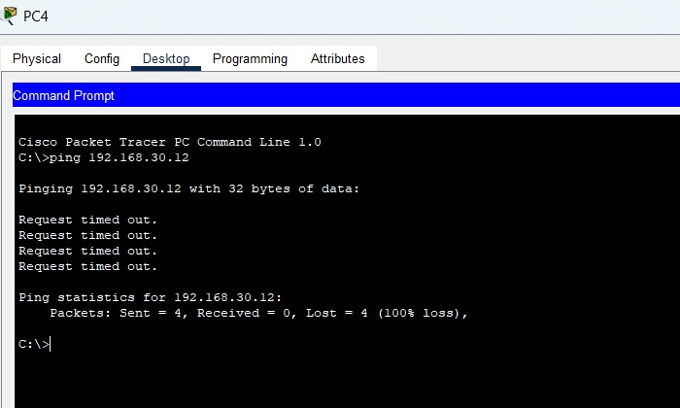
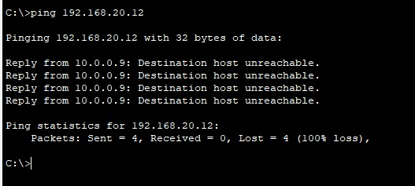
IP Addressing
Scheme
Routing Protocol
-RIP v2
SSH & Device
Security
Password Encryption
ACL blocking between R1 and R2
Access Control Lists
ACL Testing & Results
Additional Features
Considered
ACL blocking between R2 and R1
Outcomes &
Learnings

Slide 10
Routing Protocol
-RIP v2
SSH & Device
Security
Password Encryption
Ping Tests:
R2 → R1 PC: Blocked
R0 ↔ R1 / R2: Allowed
Commands Used:
ping 192.168.20.x from R2 PC (fail)
ping 192.168.20.x from R0 PC (pass)
Verification:
show access-lists
This displays hit counts on the ACL rules to confirm the match.
Access Control Lists
ACL Testing & Results
Additional Features
Considered
Challenges Faced
Outcomes &
Learnings

Slide 11
SSH & Device
Security
Password Encryption
Access Control Lists
✅ DHCP Snooping – Explored to prevent rogue DHCP servers but not implemented.
✅ Syslog – Helpful for logging events, explored.
✅ Port Security – Can restrict switch ports to specific MACs.
❌ VLANs – Not implemented due to single LAN per router.
❌ GRE VPN – Attempted but caused routing/ACL conflicts, hence excluded.
ACL Testing & Results
Additional Features
Considered
Challenges Faced
Outcomes &
Learnings

Slide 12
Password Encryption
Access Control Lists
ACL Testing & Results
ACL Matching: Ensuring correct wildcard masks and matching source-destination IPs.
ACL Direction: Confusion over inbound (in) vs outbound (out) interfaces.
SSH Testing: Needed accurate IP, credentials, and port availability.
GRE VPN: Conflicted with ACLs and caused unreachable routes, required rollback.
Additional Features
Considered
Challenges Faced
Outcomes &
Learnings

Slide 13
Access Control Lists
ACL Testing & Results
Additional Features
Considered
Successfully simulated a secure and functional LAN network.
Understood and implemented:
Routing protocols
Secure remote access (SSH)
Password encryption
Traffic restriction via ACL
Gained hands-on knowledge of network planning, configuration, and troubleshooting.
Learned layered security techniques in networking (physical, data link, and network layer).
Challenges Faced
Outcomes &
Learnings

Slide 14
T
H
A
N
K
Y
O
U

