Slide 1
Diabetes Prediction
using Machine Learning
ML Project • Early Disease Detection System
Dataset: Pima Indians Diabetes Database | Kaggle / NIDDK
Anish Deshmukh (23FE10CSE00779). Aayush Chandel (23FE10CSE00530)

Slide 2
Introduction & Problem Statement
The Challenge
Our Solution
500M+
people globally have diabetes
~50%
remain undiagnosed
Predict diabetes risk
from 8 clinical measurements using 4 ML models:
✔ Logistic Regression
✔ Decision Tree
✔ K-Nearest Neighbors
✔ Random Forest
Goal: Enable early detection before symptoms appear — saving lives through timely intervention

Slide 3
Dataset Description
768
8
Binary
NIDDK
Patient Records
Clinical Features
Classification Task
Source Institution
Clinical Features (Independent Variables)
Feature | Description
Pregnancies | Number of times pregnant
Glucose | Plasma glucose (2-hr oral glucose test) — Most predictive!
BloodPressure | Diastolic blood pressure (mm Hg)
SkinThickness | Triceps skin fold thickness (mm)
Insulin | 2-Hour serum insulin (mu U/ml)
BMI | Body Mass Index — weight/height²
DiabetesPedigreeFunction | Genetic risk score based on family history
Age | Age in years (all patients ≥ 21)

Slide 4
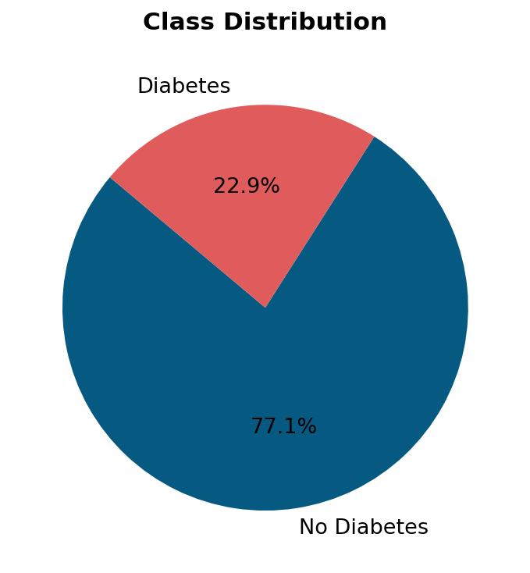
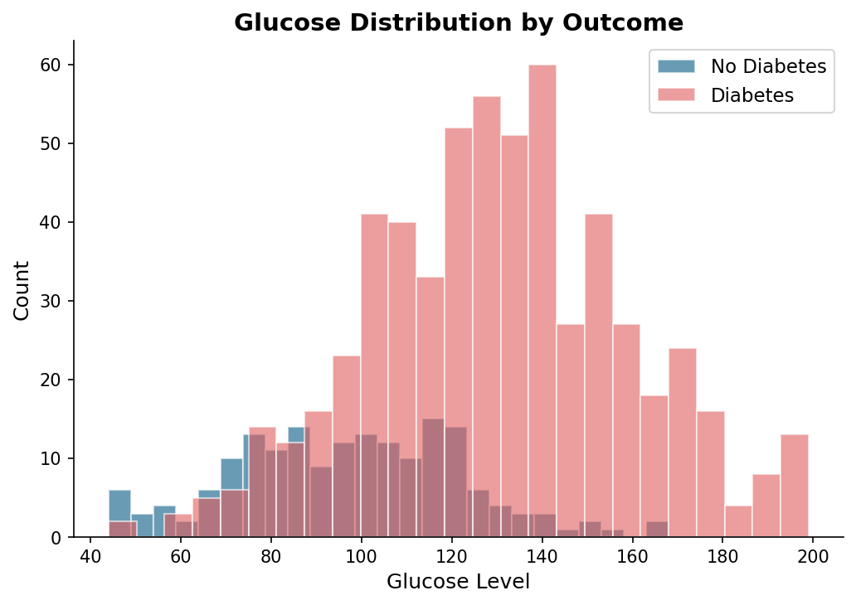
Exploratory Data Analysis
Class Distribution
Glucose Distribution by Outcome
Key Finding: Diabetic patients show significantly higher glucose levels — Glucose is the strongest predictor

Slide 5
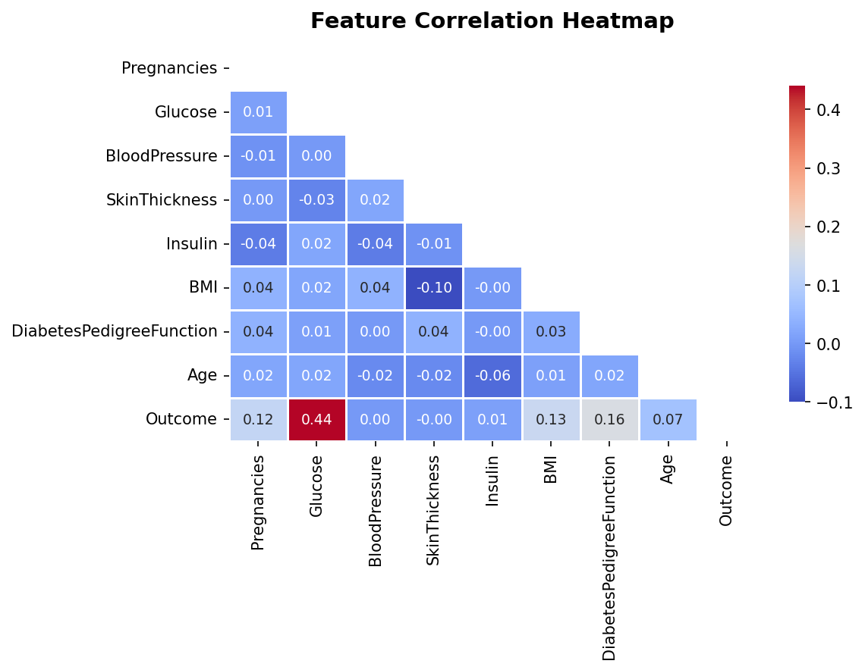
Feature Correlation Analysis
Key Correlations
with Outcome
Glucose
0.47
BMI
0.29
Age
0.24
Pregnancies
0.22
DiabetesPedigree
0.17
Insulin
0.13

Slide 6
Algorithm: Random Forest Classifier
1
Bootstrap Sampling
2
Train N Decision Trees
Random subsets of training data created by sampling with replacement
Each subset trains an independent decision tree on a feature subset
3
Random Feature Selection
4
Majority Voting
At each split, only a random subset of features is evaluated
Final class = mode of all tree predictions: ŷ = mode{y₁, y₂, ..., yₙ}
Primary model chosen for its ability to handle non-linear relationships, provide feature importances, and resist overfitting

Slide 7
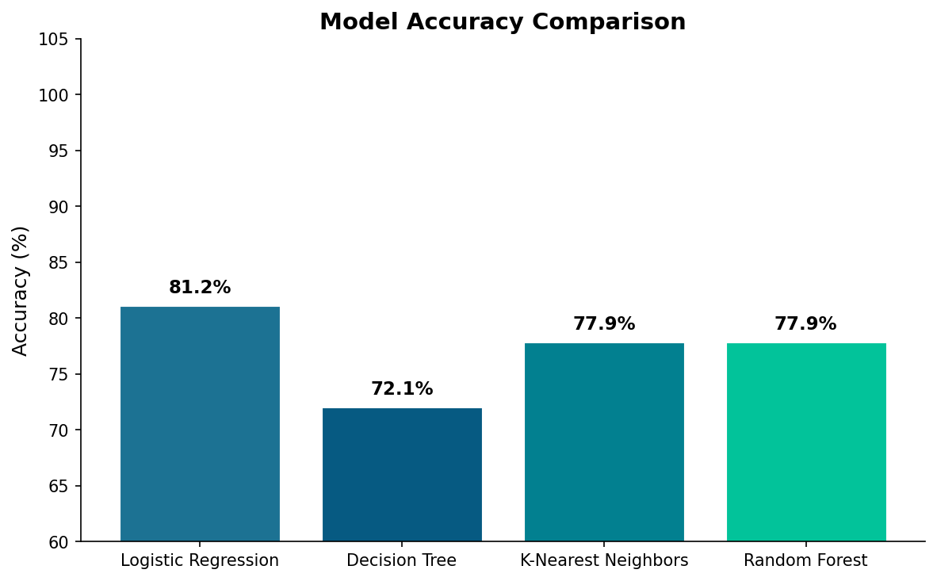
Model Evaluation Results
Model | Accuracy | Precision | Recall | F1 Score | ROC-AUC
Logistic Regression ★ | 81.17% | 85.16% | 91.60% | 88.26% | 0.7974
Decision Tree | 72.08% | 84.55% | 78.15% | 81.22% | 0.6502
K-Nearest Neighbors | 77.92% | 83.46% | 89.08% | 86.18% | 0.7324
Random Forest | 77.92% | 83.46% | 89.08% | 86.18% | 0.7595

Slide 8
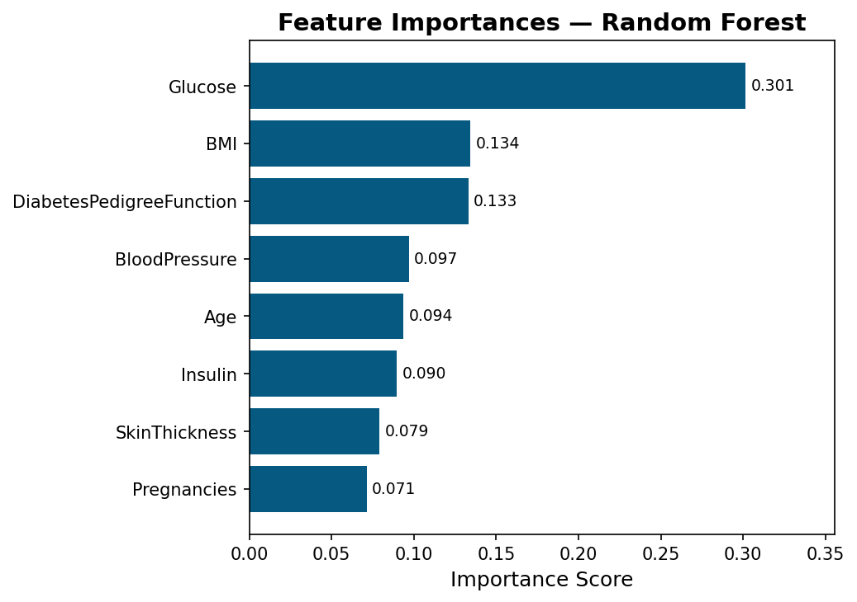
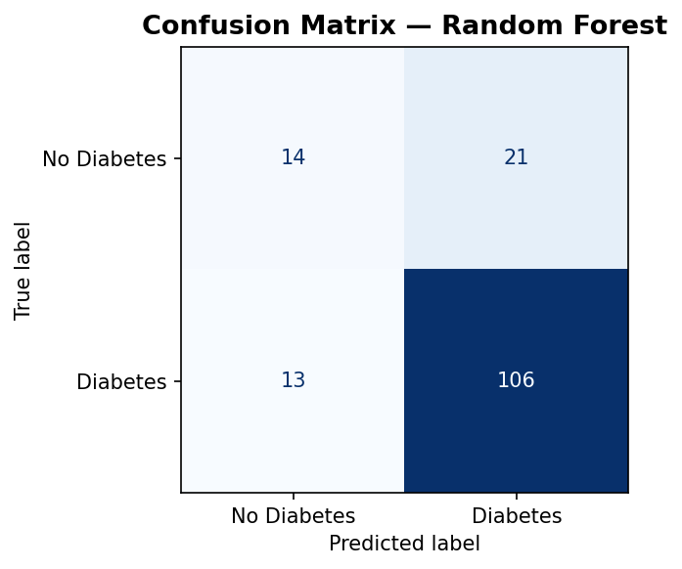
Feature Importance & Confusion Matrix
Feature Importances — Random Forest
Confusion Matrix
★ Glucose is the #1 predictor
★ BMI & Pedigree are key secondary factors

Slide 9
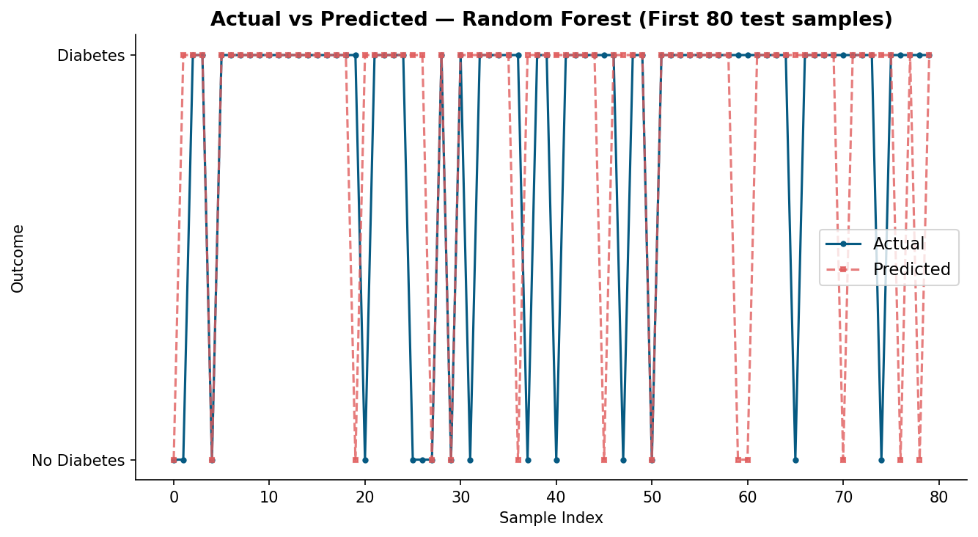
Actual vs Predicted — Random Forest
The predicted values closely track actual outcomes — the model accurately identifies both diabetic and non-diabetic patients with minimal misclassification.

Slide 10
Observations & Conclusion
Key Observations
Conclusion
• Logistic Regression achieved highest accuracy (81.2%)
ML models can effectively predict diabetes from clinical data. Random Forest is recommended for real-world screening due to high recall and AUC.
• Random Forest best for recall + AUC — safer for medical screening
• Glucose is the single most important diagnostic feature
Future Work
• BMI, DPF, and Age are strong secondary predictors
▸ Real-time health monitoring API
• High recall (0.89) minimizes false negatives — critical in medicine
▸ XGBoost / Deep Learning models
• Decision Tree showed signs of overfitting (lowest AUC: 0.65)
▸ SMOTE for class imbalance
▸ Include HbA1c, diet, activity data

Slide 11
Thank You
Questions & Discussion
Dataset: Pima Indians Diabetes Database | Kaggle / NIDDK

