Slide 1
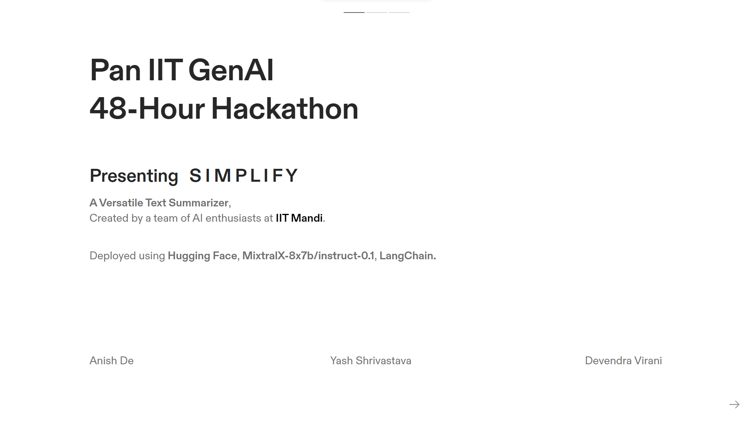
`
Chatbot → https://huggingface.co/spaces/anishde/SIMPLIFY_text_summarizer
GitHub → https://github.com/anishde007/S-I-M-P-L-I-F-Y

Slide 2
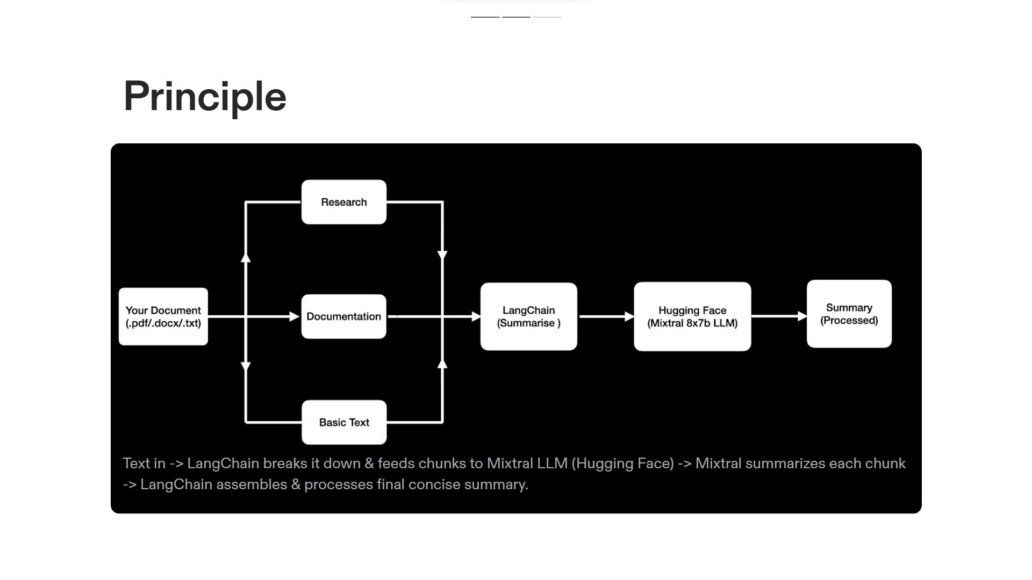

Slide 3
