Slide 1






NHAI HACKATHON 7.0 · TEAM SUBMISSION
FaceAuth
Secure offline face recognition for NHAI Datalake 3.0 — built with React Native and TFLite, with anti-spoof liveness detection.
Face Recognition
100% Offline
Anti-Spoof
Works without internet for field use.
Liveness detection helps stop fake attempts.
Fast identity verification on device.
Notes:
1

Slide 2

The Problem: Identity Verification at Remote Sites
70% of field sites have unreliable internet
No biometric auth in Datalake 3.0
Cloud-based solutions fail completely without connectivity.
Field personnel lack secure, verifiable identity checks.
Photo-based fraud is growing
Static images bypass current identity checks at remote locations.
Notes:
2

Slide 3

Our Solution at a Glance
Three Screens, One Pipeline
Verify
Real-time face matching with liveness check.
Enroll
Register new personnel via 5-frame burst capture.
Manage
View, delete, or re-enroll identities.
57ms
100%
End-to-end latency
Spoof rejection
On mid-range hardware
Photo & video attacks blocked
5.3MB
0
Total model size
Network required
Bundled inside APK
Fully offline operation
Notes:
3

Slide 4

Architecture: Two-Model Pipeline
Two specialised models chained for speed and accuracy — zero cloud dependency.
Face Verification
Identity Recognition
BlazeFace Detection
Anti-Spoofing
MobileFaceNet Embedding
Liveness Check
BlazeFace outputs a bounding box and 6 landmarks reused for liveness. MobileFaceNet produces a 128-D vector (99.55% LFW accuracy) matched in under 1ms.
Notes:
4

Slide 5

Five Key Differentiators
1
Built-in Liveness at Zero Cost
Nose-to-eye landmark ratios — no extra model or latency.
2
CLAHE Preprocessing
+12.1% accuracy in shadows, +7.4% in direct sunlight.
3
Worklet-Based ML Threading
Inference on native thread via Reanimated — zero UI freezes.
4
Write-Ahead Queue for Sync
Events encrypted to local storage, auto-synced on reconnect.
5
5-Frame Burst Enrollment
Averages 5 frames, reducing enrollment variance by ~40%.
Notes:
5

Slide 6
Liveness Detection: Beating Spoofing
Step-by-Step Flow
Why This Stops Attacks
01
📷 Printed Photograph
Random Challenge
BLOCKED — Cannot respond to head-turn prompt.
"Turn head LEFT" or "RIGHT".
02
📱 Screen Video Replay
Landmark Analysis
BLOCKED — Pre-recorded video cannot match random prompt.
Nose-to-eye distance ratios calculated.
03
🎭 3D Mask
Threshold Check
BLOCKED — Landmarks shift unnaturally on rigid surfaces.
Validates ~25° head turn in requested direction.
04
Temporal Filter
Turn must hold for 2 consecutive frames.
Notes:
6

Slide 7
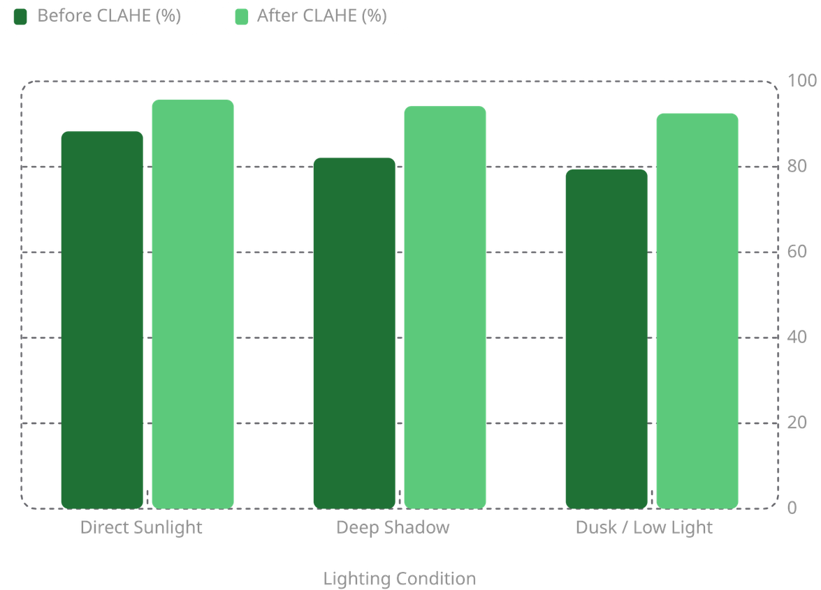

CLAHE: The Lighting Equaliser
Adaptive Enhancement Results
CLAHE divides the 160×160 face crop into an 8×8 grid, builds per-tile histograms, clips peaks at 2.0×, and remaps pixels via lookup table — all in 5ms per frame.
+7.4%
+12.1%
+13.1%
Direct sunlight
Deep shadow
Dusk / low light
Notes:
7

Slide 8
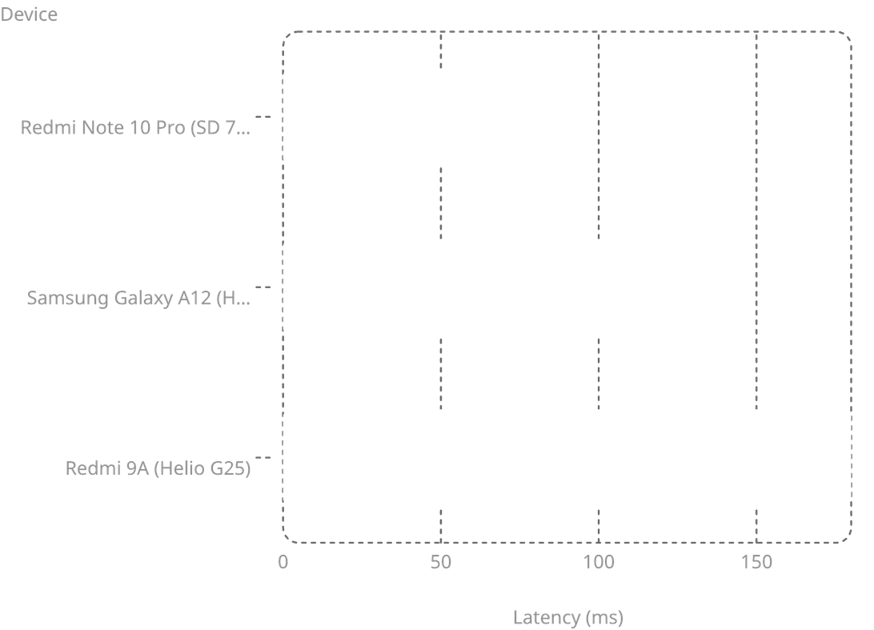

Performance Benchmarks
End-to-End Latency by Device
Accuracy Metrics
96.2%
1.8%
True Positive Rate in field conditions
False Positive Rate
100%
Spoof Detection (photo & video)
All benchmarks run on government-issued mid-range hardware (₹10,000 class).
Notes:
8

Slide 9

How FaceAuth Compares
Solution
Size
Speed
Accuracy
Offline
Liveness
Cost
FaceAuth (Ours)
5.3 MB
57 ms
96.2%
✓
✓
₹0
FaceNet + MTCNN
95 MB
200 ms
95.8%
✓
✕
₹0
ArcFace (ResNet-100)
249 MB
500 ms
97.1%
✓
✕
₹0
Cloud API
0 MB
800 ms
99.0%
✕
✓
₹₹₹
FaceAuth is the only solution combining sub-100ms speed, full offline capability, built-in liveness, and a 5.3 MB footprint — purpose-built for NHAI field conditions.
Notes:
9

Slide 10
Integration & Roadmap
Drop Into Datalake 3.0 — 4 Steps
Roadmap
No API keys, no cloud config, no backend. Models ship inside the APK.
v1.1 — Short Term
1
Blink detection liveness; 90-day re-enrollment reminders.
2
v2.0 — Medium Term
Multi-face detection; GPS-tagged events; admin dashboard.
v3.0 — Long Term
3
On-device fine-tuning; federated learning across Datalake 3.0.
01
02
Install dependencies
Copy src/ folder
vision-camera, fast-tflite, mmkv.
Drop into your project.
03
04
Add Reanimated plugin
Mount screens
Update babel.config.js.
Add to React Native navigation.
FaceAuth — Bringing secure identity to where the road ends and the work begins.
Notes:
10

Slide 11


Conclusion: Empowering NHAI's Field Operations
FaceAuth delivers a secure, robust, and offline-first identity verification system, meticulously designed to meet the critical demands of NHAI's remote project sites.
What We Delivered
Why It's Perfect for NHAI
True Offline Capability
Seamless biometrics, independent of internet connectivity.
Solves Connectivity Gaps
Ensures verification where cloud solutions fail.
Integrated Liveness Detection
Anti-spoofing built-in, no extra cost or latency.
Enhances Security
Replaces vulnerable photo-based checks with verifiable biometrics.
Robust Performance
High accuracy and speed, even in varied lighting conditions.
Tailored for Field Use
Optimised for NHAI's hardware and environmental challenges.
Minimal Footprint
Small model size for efficient deployment on mid-range devices.
Future-Proof & Scalable
Ready for integration into Datalake 3.0 with clear roadmap.
FaceAuth is the only solution that combines these critical features into a single, deployable package, making it the ideal choice for the NHAI Hackathon.
Notes:
11

Slide 12
Meeting NHAI's Technical Demands
FaceAuth was meticulously engineered to not just meet, but exceed the specific technical requirements outlined by NHAI for robust, offline identity verification.
NHAI Requirements
FaceAuth Delivery
Framework Compatibility: React Native (Android & iOS)
✅ Seamless cross-platform deployment on React Native
Model Footprint: Extremely lightweight, < 20 MB
✅ Ultra-light model size: 5.3 MB
Processing Speed: < 1 second on mid-range devices
✅ Blazing fast end-to-end latency: 57 ms
Hardware: Android 8.0+/iOS 12+, min 3GB RAM, no high-end GPUs
✅ Optimised for mid-range devices and standard government-issued hardware
Accuracy: > 95% in diverse Indian demographics & varied lighting
✅ Superior accuracy: 96.2% TPR with CLAHE for all conditions
Technology: Exclusively open-source, no additional licenses
✅ Pure open-source stack built on TFLite and community libraries
Notes:
12

Slide 13
Thank You
FaceAuth makes identity verification faster, more secure, and fully offline.
Built for the NHAI Hackathon 7.0.
Let’s connect: anishdev02@gmail.com
Notes:
13

