Slide 1
Seminar
Name | Anish N Shetty, Preethi S R
Branch | Computing Technologies and Virtualization
Registration Number | 171041005, 171041009
Topic | Network Orchestration using Openflow
Guide | Mr. Mohan Kumar J
Panel Members | Mr. Mohan Kumar J Mr. Sathyanarayan Shenoy Mr. Samarendra Bhat
Notes:
1

Slide 2
CONTENTS
Introduction
Objective
Softwares used
Mininet based architecutre
Setting up OpenVSwitch
Cloud based controller
Architecture using VirtualBox
Firewall Application
Firewall
Usecases
References

Slide 3
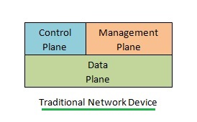
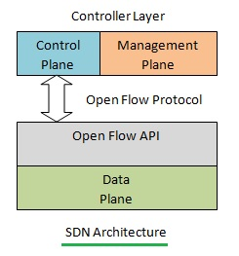
INTRODUCTION
Traditional Networking:
They are Static and inflexible networks.
They possess little agility and flexibility.
Control Plane operations are done on device itself
Software Defined Networking:
They are dynamic and flexible networks.
They provides a high degree of agility
Control Plane operations can be done on a remote device

Slide 4
OBJECTIVE
To develop a firewall application which makes use of the concepts of Software Defined Networking concepts. The application is build such that it can enable firewall on multiple devices, while only one of those devices need to be managed, thereby reducing operational complexity.

Slide 5

Network Functions Virtualization:
Network Functions Virtualization is a term that is used in the carrier space to reference a close to parallel vision to SDN, with the focus being on reducing the deployment costs of services. Instead of relying on a physical hardware appliance to provide a specific function, it would abstract this function to a generic server platform. Some of those functions could be:
Firewall
Load Balancing
NAT
Port Mirroring

Slide 6
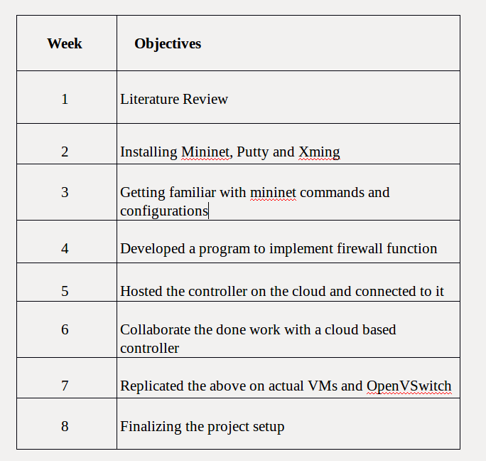
WEEKLY PROGRESS

Slide 7
SOFTWARES USED
Mininet
POX controller
OpenVSwitch
VirtualBox
Putty
Xming Server
Amazon EC2

Slide 8
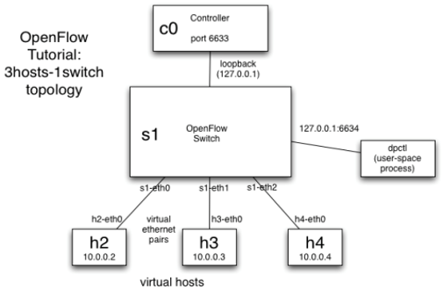
MININET BASED ARCHITECTURE

Slide 9
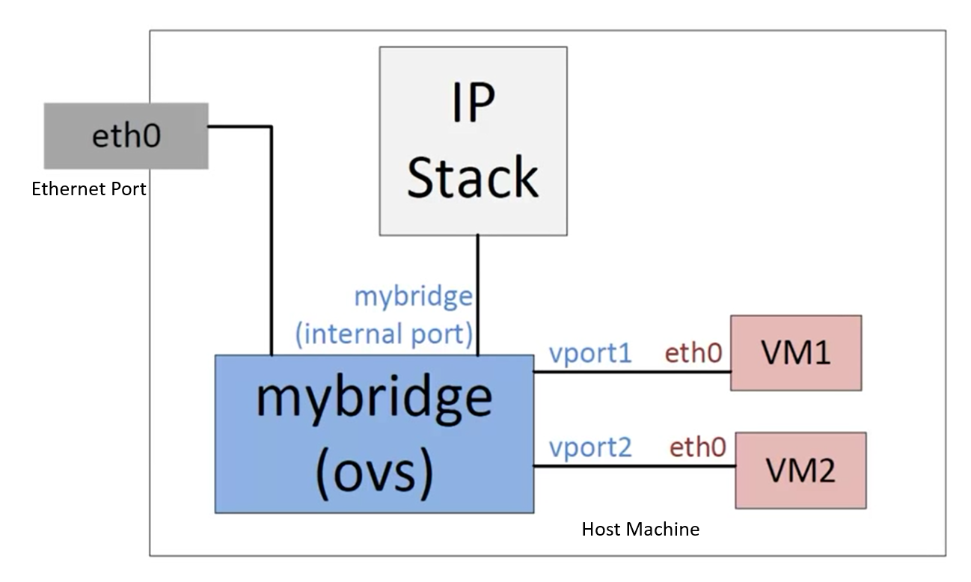
SETTING UP OPENVSWITCH
OpenVSwitch connected to eth0 port
And it also contains contains 2 tap ports
These tap ports can be used by VMs to gain connectivity with the rest of the network.

Slide 10
CLOUD BASED CONTROLLER
A Virtual Machine is created on the cloud using Amazon EC2 services.
On the Virtual Machine, POX controller is downloaded
POX controller provides the APIs for communications with the switches
Using POX controller, we can build network applications specific to our need.

Slide 11
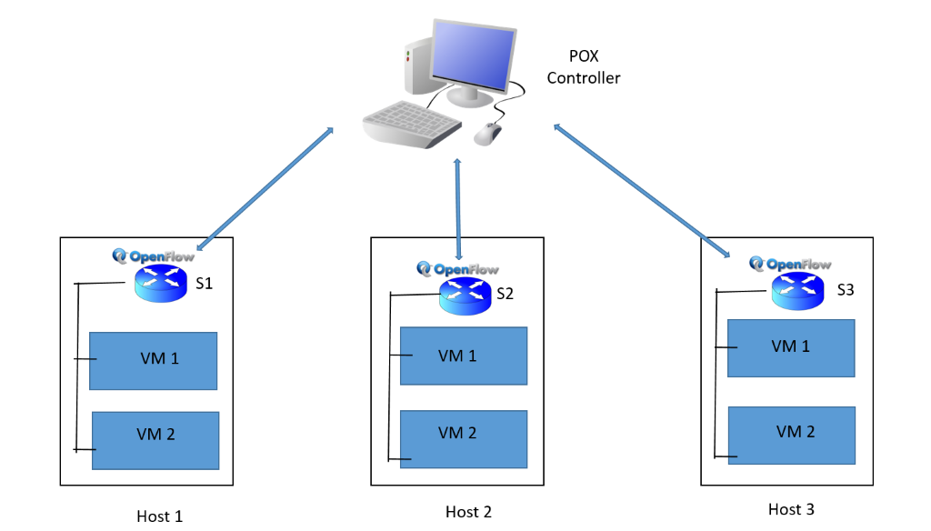
ARCHITECTURE USING VIRTUALBOX
The setup contains the following components:
6 physical machines
1 controller
3 switches
6 VMs

Slide 12
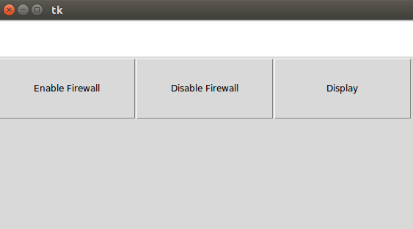
FIREWALL APPLICATION
Enable firewall adds the website or host to the firewall list
Disable firewall removes the website or host from the firewall list
Displays the list of blocked websites and hosts

Slide 13
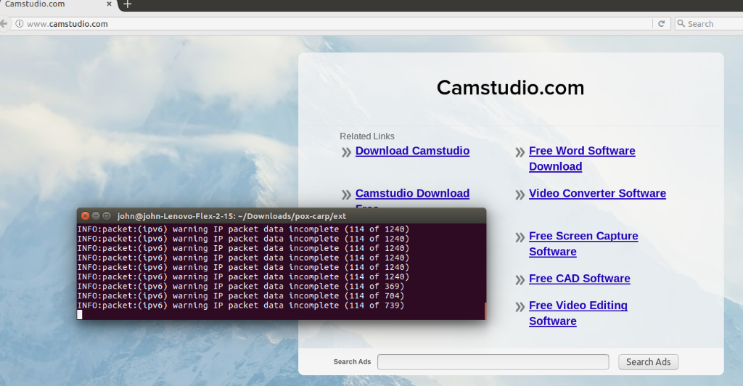
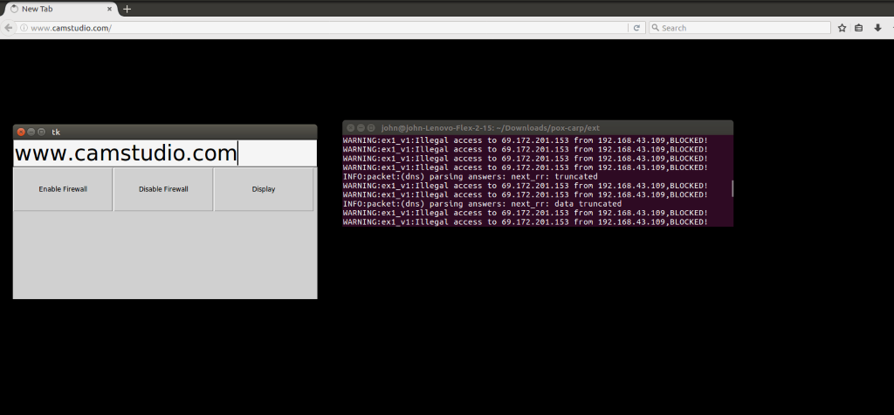
FIREWALL
Before
After

Slide 14
USECASES
Institutions or organizations where firewall needs to be implemented
Small offices or homes where certain websites have to be blocked at certain times
Organizations having multiple branches spanned over different location can make use of a single controller hosted on a cloud.

Slide 15
REFERENCES
[1] SDxCentral, “Understanding the SDN architecture,” 2016, [Online; accessed 5-July-2017]. [Online]. Available:
https://www.sdxcentral.com/sdn/definitions/inside-sdn-architecture/
[2] Wikipedia, “Openflow — wikipedia, the free encyclopedia,” 2016, [Online;accessed 5-July-2017]. [Online]. Available: https://en.wikipedia.org/w/index.php?title=OpenFlow&oldid=725008443
[3] N. H. B. H. Bob Lantz and V. Jeyakumar. (2015) Introduction to mininet. [Online].
Available: https://github.com/mininet/mininet/wiki/Introduction-to-Mininet
[4] Amazon Elastic Compute Cloud Documentation (2017) [Online;accessed 10-Oct-2017].[Online] Available:
https://aws.amazon.com/documentation/ec2/
[5] POX Wiki,(2013) [Online;accessed 01-Oct-2017].[Online] Available
https://openflow.stanford.edu/display/ONL/POX+Wiki

Slide 16
THANK YOU!

