Slide 1

WEEK 2 · STATUS REVIEW
The IT Security Agent Learns Judgment
From a matcher that finds flaws → to a model that scores confidence, ranks by real-world risk, and treats every vendor fairly.
Responsible AI & Data Ethics · SS2026
Notes:
Open with energy. 'Last week we built a scanner that finds known vulnerabilities. This week it learned three kinds of judgment: how sure it is, what to fix first, and whether it treats every vendor fairly.' Pause on the title. Don't read the subtitle verbatim — paraphrase it.

Slide 2

THE ASSIGNMENT
Three Required Goals — and Where We Went Deeper
Baseline model
Risk analysis
Fairness analysis
Turn the matcher into a
confidence-scored, evaluable model
A register where every risk's
status is grounded in a real number
Measure whether detection
depends on who made the software
+ Where we went beyond the brief
Threat-intel prioritization — KEV + EPSS: severity ≠ priority. We rank by what's actually being exploited.
Fairness as an equity fix — We reframed a coverage patch as a measured fix for vendor bias — 66pp → 0pp.
Confidence-based routing — AUTO / SUGGEST / FLAG — the model knows when to defer to a human.
Honest residual risk — We name what's still unmeasured instead of overselling the result.
IT Security Agent · Week 2
2
Notes:
Move through the three required goals quickly — about 15 seconds. Then slow down for the additions we made beyond the brief. Say the KEV/EPSS line and the 66-to-0 line with emphasis — those are the two takeaways worth remembering.

Slide 3

GOAL 1 · BASELINE MODEL
A Matcher Fires Yes/No. A Model Gives a Score.
We turned the deterministic matcher into an evaluable model with a transparent, four-signal confidence score — no black box, every term inspectable.
Match path
Version specificity
Input source
Vendor known
CPE + range is stricter
than the fallback
Exact pin > bounded
range > wildcard
SBOM parse beats
OCR screenshot
Named vendor cuts
cross-product hits
weight 0.40
weight 0.25
weight 0.20
weight 0.15
The score decides who acts — model or human
AUTO
SUGGEST
FLAG
confidence ≥ 0.75 auto-report
0.50 – 0.75 human confirms
< 0.50 human must review
IT Security Agent · Week 2
3
Notes:
Key line: 'A matcher fires yes or no. A model gives a score you can rank, threshold, and evaluate.' Walk the four signals quickly — the point is they're all inspectable, not magic. Then land the routing: 'the score isn't decoration — it decides whether the model acts on its own or hands off to a human.' That's the responsible-AI hook.

Slide 4

GOING DEEPER · THREAT INTEL
Severity Is Not Priority
CVSS says how bad a flaw is in theory. KEV and EPSS say whether it's actually being exploited right now. The agent ranks by real-world risk.
Vulnerability
CVSS
On KEV?
EPSS
Priority
CVE-2021-44228 (Log4Shell)
10.0 CRITICAL
YES
0.94
0.98
CVE-2022-0778
7.5 HIGH
YES
0.31
0.57
Both are severe on paper. But only one is on the KEV list with a 94th-percentile exploit probability — that's the one you patch tonight.
A severity-only agent treats them as equal — and buries the real threat under alert fatigue.
IT Security Agent · Week 2
4
Notes:
Deliver the punchline slowly: 'Both critical on paper. But only one is being actively exploited — that's the one you patch tonight.' Then the alert-fatigue line. This shows the tool reflects how real security operations prioritise, not just theoretical severity.

Slide 5
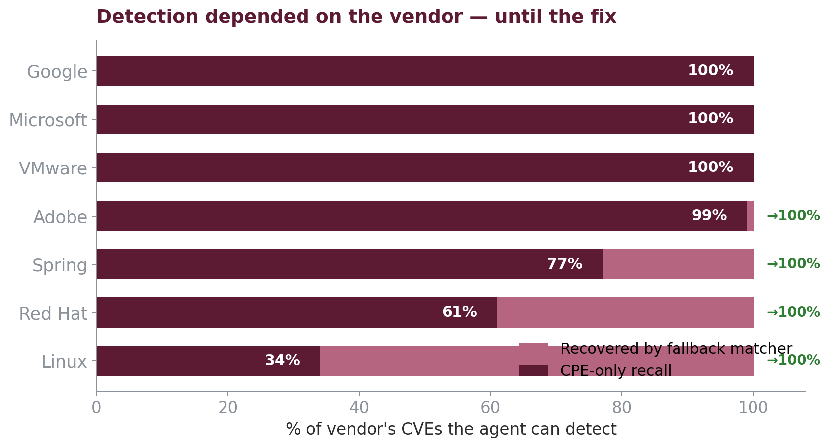
GOAL 3 · FAIRNESS
Does Detection Depend on Who Made the Software?
For a security tool, unfairness has a specific shape: a systematic blind spot for certain vendors.
A missed CVE is a real exposure. If misses cluster on particular vendors, the tool protects some users better than others — that is the harm we measured.
Metric
per-vendor recall
share of a vendor's CVEs the agent can detect
Linux
34%
CPE-only recall vs ~100% for Google & Microsoft
IT Security Agent · Week 2
5
Notes:
Set up the harm first, THEN show the chart. 'A missed vulnerability is a real exposure. So the fairness question isn't abstract — does our tool protect a Linux shop as well as it protects a Microsoft shop?' Point at Linux: 34%. Let that land before the next slide delivers the fix.

Slide 6

GOAL 3 · FAIRNESS RESULT
The Fallback Matcher Is an Equity Fix
THE BIAS
THE FIX
RESIDUAL: DATA SKEW
66.0 pp
0.0 pp
0.753
recall spread across
named vendors
spread after the
fallback matcher
vendor CVE-count Gini
(391 vendors)
The insight: Week 1 framed the fallback as a coverage patch. Measured as fairness, it collapses the per-vendor gap from 66 points to zero — an equity fix, not just more coverage.
Honest caveat: coverage is now fair, but data representation is not (Gini stays high), and the fallback's false-positive rate per vendor is not yet measured. The fix may not be free.
IT Security Agent · Week 2
6
Notes:
Deliver the three numbers like a drumbeat: '66 points of bias... zero after the fix... and here's what's still open.' The equity-fix reframe is the headline insight. Then the honest caveat — naming the residual weakness is what makes the result credible. Do not skip it.

Slide 7
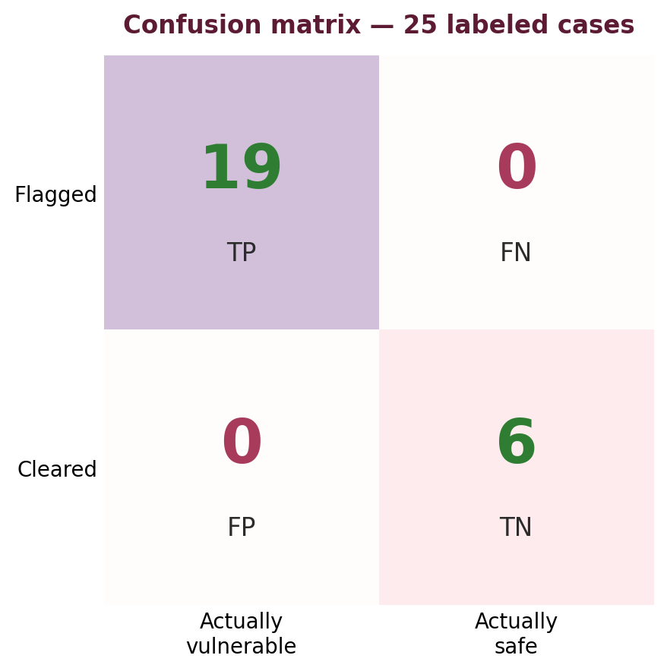
GOING DEEPER · EVALUATION
We Didn't Assert the Model Works — We Measured It
Rather than assert the model works, we built a labeled evaluation set — 25 cases probing real failure modes — and measured precision, recall, and false-positive rate against known ground truth.
PRECISION
RECALL
FALSE-POSITIVE RATE
1.00
1.00
0.00
when it flags, it's right
no real vuln missed
no false alarms
The honesty that makes it credible
Labels come from NVD itself
— we test whether our matcher rediscovers ground truth, not whether we can guess it.
25 cases = a targeted probe
— of specific failure modes (messy names, wrong vendors, out-of-range versions), not a representative sample.
IT Security Agent · Week 2
9
Notes:
Open with: 'Rather than just describe the model, we measured it.' Then the three numbers. Crucial: immediately give the scope — labels from NVD, 25 targeted cases. Stating the limitation yourself, before anyone asks, is what makes a perfect score believable rather than suspicious. Leading with the caveat reads as rigour.

Slide 8
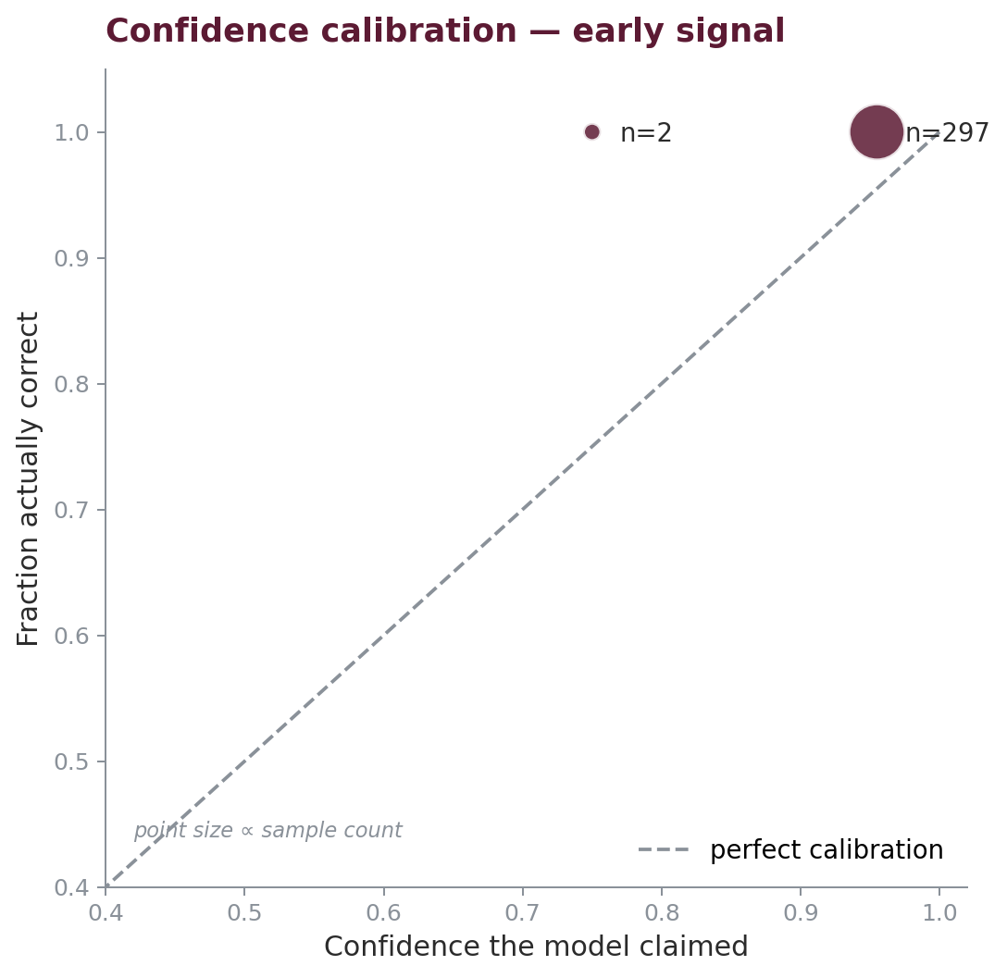
EVALUATION · TWO DEEPER CHECKS
Closing Our Own Open Questions
1 · Did the fairness fix add noise?
2 · Does the confidence mean anything?
The fallback matcher uses looser matching. We measured false positives per vendor — before assuming the fix was free.
0.00
false-positive rate across every vendor
Recall gained without a precision cost.
→ This closes the caveat we raised on the fairness slide. The equity fix is measurably clean on this set.
When it says 0.9, it's right ~100% of the time — so the AUTO band is safe. Reported as an early signal: small per-bin counts, tighter curve is a Week-3 task.
IT Security Agent · Week 2
10
Notes:
Two checks, both closing your own open questions — that's the story. Left: 'we said the fallback might add noise; we measured it; it didn't — zero false positives per vendor.' Right: the calibration curve, and IMMEDIATELY say 'early signal, small samples' — point at the n= labels. Never claim the calibration is precise. Owning that limit is the sophisticated move.

Slide 9

GOAL 2 · RISK ANALYSIS
Every Risk Grounded in a Real Number
False negative — vendor blind spot
fallback closes the recall gap to ~0 pp
Mitigated
Severity-only prioritization
KEV/EPSS promotes actively-exploited CVEs
Mitigated
Over-trust — 'no match = safe'
low confidence routes to human FLAG
By design
False positive from loose fallback
per-vendor FP rate not yet measured
Partial
OCR / screenshot extraction error
confidence already down-weights OCR source
Open
Stale threat intel
nightly feed refresh; timestamp in audit log
Process
IT Security Agent · Week 2
9
Notes:
Don't read all six rows. Say: 'Every risk here has a status tied to a measured number, not a guess.' Then highlight the contrast: the green 'mitigated' rows are done; the amber and grey are honestly open — especially the fallback false-positive rate, which is our top Week 3 task. Owning the open risks reads as maturity.

Slide 10
WHERE WEEK 2 LANDS
A model with judgment — and the honesty to show its limits
Delivered
Honestly open
Week 3 next
Confidence-scored baseline model
KEV/EPSS risk prioritization
Fairness audit: 66pp → 0pp
Risk register + audit trail
Fallback false-positive rate
Confidence weights uncalibrated
Data representation still skewed
XAI: per-signal attribution
Calibrate on labeled matches
Tests to ≥80% coverage
Next: analyze the model with XAI, calibrate confidence, and push test coverage to 80%.
Notes:
Close with command. Three columns: what we built, what is honestly still open, what is next. The middle column is the credibility — showing the gaps openly. End on: 'Week 2 gave the agent judgment. Week 3 makes that judgment explainable and tested.' Then stop and take questions.

