Slide 1
NVIDIA AI CEO Strategic Intelligence Agent
Project Progress Report
NLP Examination — June 2026
Individual Project · 1 Week Duration
244
3,395
9
7
Articles
Collected
DB Chunks
Data Sources
Dashboard
Sections
Exam date: 23 June 2026 · Student: Anish · SRH University Heidelberg

Slide 2
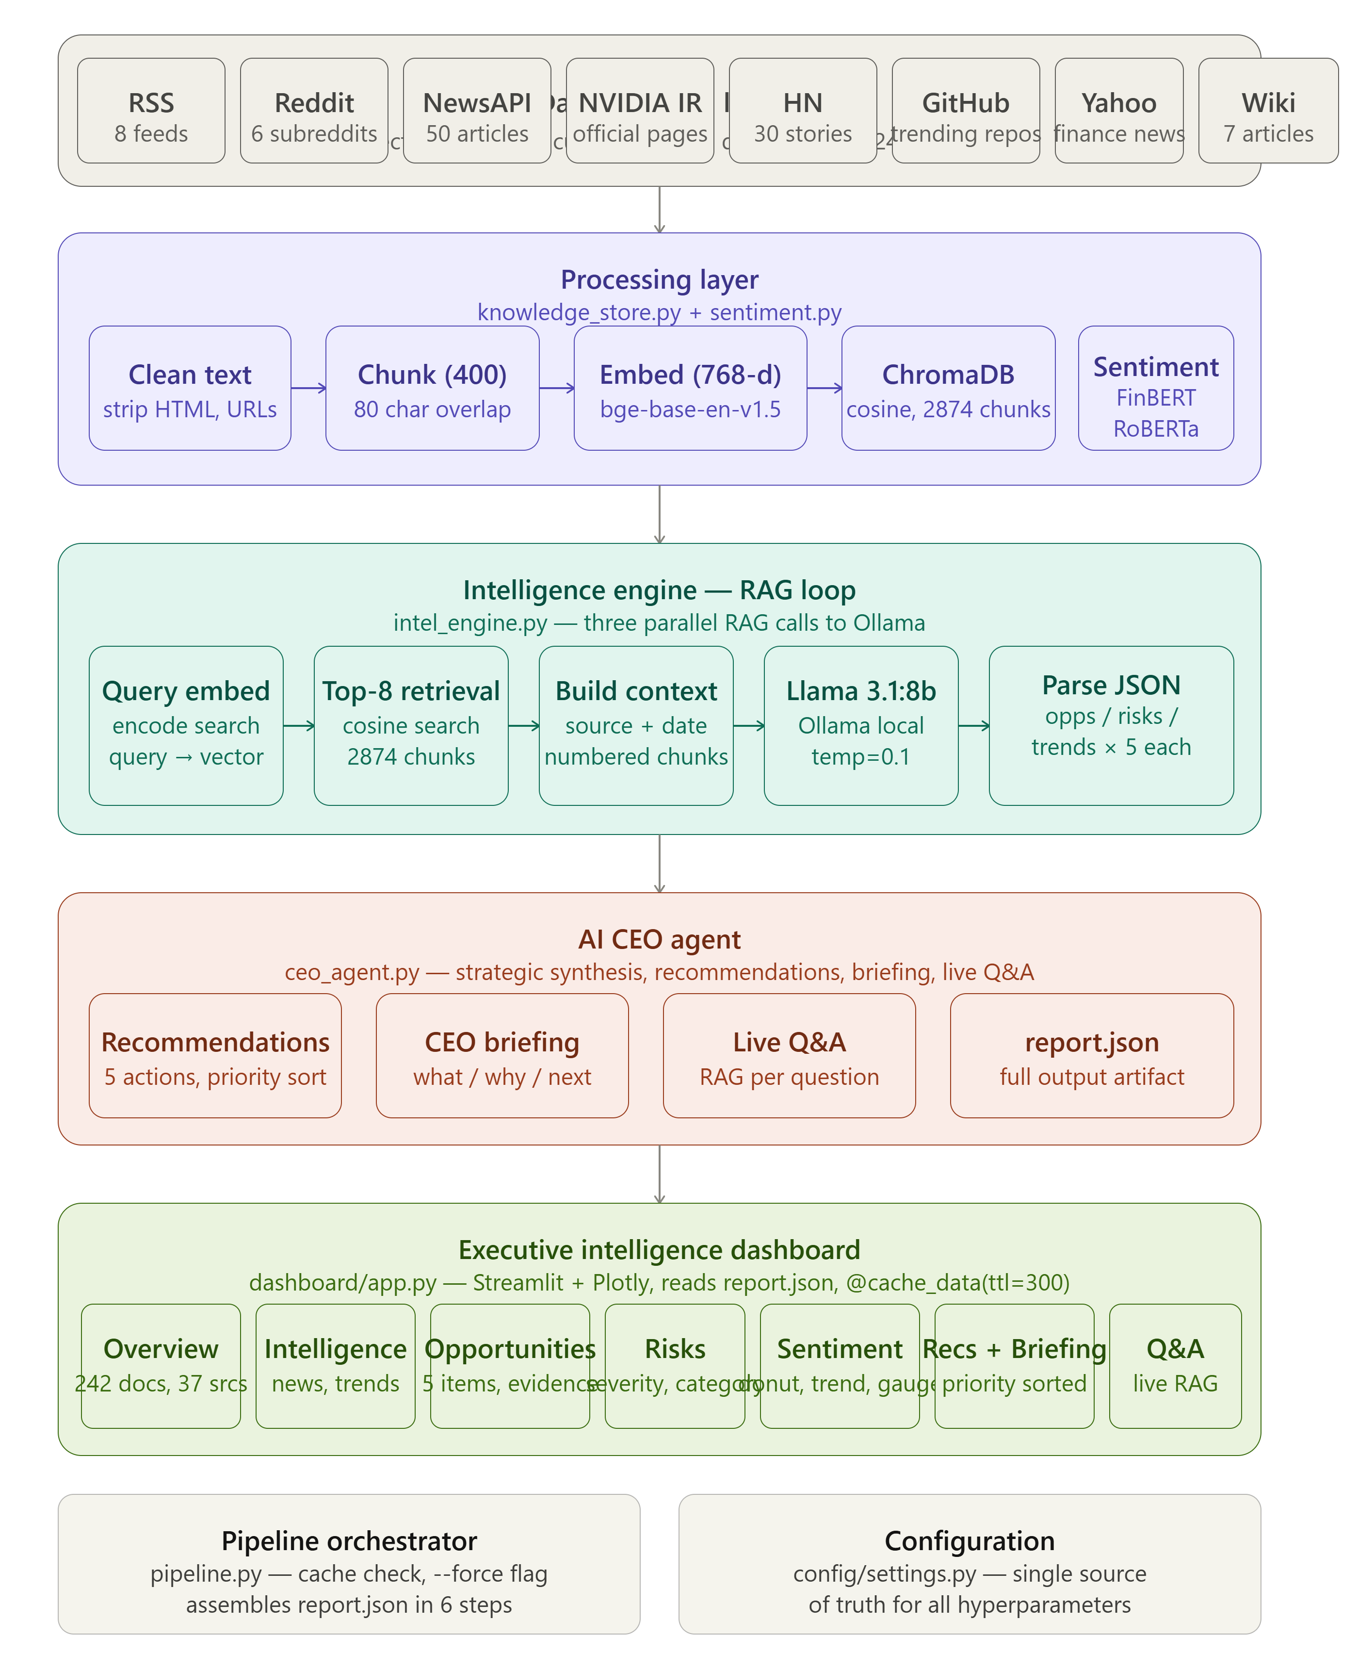
System Architecture
RAG Architecture
Retrieval-Augmented Generation grounds LLM answers in freshly collected articles — solves knowledge cutoff problem
Dual Sentiment
FinBERT for financial text (Reuters-trained) + Twitter-RoBERTa for social (124M tweets) — domain-appropriate routing
ChromaDB Vectors
768-dim BAAI/bge-base-en-v1.5 embeddings stored with cosine similarity — semantic search beyond keywords
Local LLM
Ollama llama3.1:8b runs entirely local — no API costs, no data privacy concerns, 8192-token context
Relevance Filter
35 NVIDIA-specific keywords filter out irrelevant articles before storage — improves RAG quality
Pipeline Cache
--force flag rebuilds from scratch; default reuses ChromaDB — fast iteration on intelligence layer

Slide 3
Deliverables Progress Tracker
DONE
PARTIAL
NOT DONE
Deliverable
Requirement
Status
Evidence / Notes
D1: Working Prototype (30%)
Collect live information from ≥3 sources
DONE
9 sources: RSS, Reddit, NewsAPI, HN, GitHub, Yahoo, NVIDIA IR, StockTwits, Wiki
Store and retrieve information (vector DB)
DONE
ChromaDB with BAAI/bge-base-en-v1.5 embeddings, cosine similarity, 3395 chunks
Analyze information (RAG pipeline)
DONE
3 RAG calls per pipeline run — opportunities, risks, trends — each with top-8 retrieval
Generate recommendations
DONE
5 priority-sorted recommendations with evidence, impact, risk assessment
≥100 collected documents
DONE
244 documents from 39 sources — exceeds minimum
D2: Executive Dashboard (10%)
Section 1: Company Overview
DONE
244 docs, 3395 chunks, 39 sources, chunk ratio explanation
Section 2: Market Intelligence + semantic search
DONE
ChromaDB semantic search, sentiment filter, source filter, clickable article links
Section 3: Opportunity Monitor
DONE
5 items with impact level, confidence score, evidence with source links
Section 4: Risk Monitor
DONE
5 risks with severity, category, evidence links, summary dataframe
Section 5: Sentiment Analysis (News/Public/Trends)
DONE
5.1 FinBERT news, 5.2 RoBERTa social (Reddit+StockTwits+HN), 5.3 30-day trend chart
Section 6: Strategic Recommendations
DONE
Priority, rationale, evidence, expected impact, risk assessment per recommendation
Section 7: CEO Briefing + Q&A
DONE
LLM-generated What/Why/Next + live RAG Q&A with source citations
D3: Architecture Docs (10%)
README with architecture diagram
DONE
master_architecture_overview.png embedded in README.md
Data flow diagram
DONE
ASCII flow diagram in README.md showing all 5 layers
Technology stack documentation
DONE
Table in README with each layer, technology, and justification
Design decisions
DONE
Documented in README: why RAG, why dual sentiment, why chunking strategy
AI pipeline documentation
DONE
Step-by-step RAG flow in README with embedding → retrieval → generation → parse
Summary: 17/17 DONE (100%) · 0 PARTIAL · 0 NOT DONE

Slide 4
Technical Stack & Key Concepts
LLM
Sentiment 2
Ollama llama3.1:8b
Cardiff Twitter-RoBERTa
Local, open-source, 8192 ctx
Social domain (124M tweets)
Embeddings
Sentiment 3
BAAI/bge-base-en-v1.5
VADER
768-dim, MTEB 63.6
Rule-based fallback, offline
Vector DB
Dashboard
ChromaDB
Streamlit + Plotly
Cosine similarity, persistent
7 sections, interactive charts
Sentiment 1
Pipeline
ProsusAI/FinBERT
Python 3.11
Financial domain (Reuters)
9 collectors, RAG, JSON LLM
All models are open-source and run locally — no commercial API required (compliant with exam requirements)

