Slide 1
GrowFlow
Anish Gajera, Brendan Go, Israa Hanoun, Nevin Gilday, Sarem Hussein

Slide 2
Objective
GrowFlow is a software system that streamlines farm operations by providing a centralized platform for local farmers to manage all aspects of their farm, including crop management, inventory control, crop rotation scheduling, customer engagement, and more. The software features advanced analytics tools for real-time insights, integrates with other tools like weather forecasting systems, and includes supply chain management features. Its objective is to help farmers make informed decisions about their operations.

Slide 3
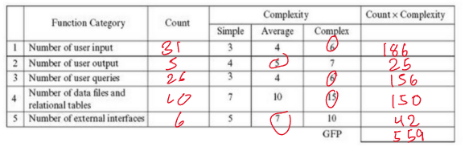
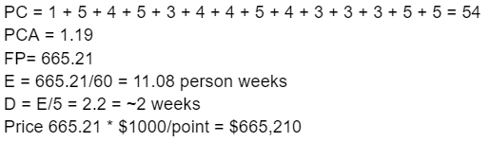
Cost Estimation
As our group does not have any prior experience to go off of, to find the cost per function point, research was performed to find that the average cost per function point is anywhere from $500 - $1,500 per function. For this model we will use the mean of $1,000 per function point, putting our cost at just around $665,500.
~3

Slide 4
Project Timeline
Project start date: October 1, 2023
Justification: Starting in October would provide enough time to complete the project, including any potential adjustments or iterations that may be needed, before farmers begin their preparations for the upcoming farming season.
Project end date: March 1, 2024
Justification: The project being completed by March will allow farmers to extensively test the software and provide feedback to the developers for improvement. The feedback cycle is essential to ensure that any problems or improvements found during testing may be dealt with before the start of the farming season in April.

Slide 5
Functional Requirements
Farmland management: The software should enable farmers to manage their farmland by offering the feature for crop rotation, soil mapping, and land-use analysis.
Crop Management: The software should alert users when it is the right time to plant each crop. It should also provide farmers the history of each crop, including ideal planting periods.
Water/Sprinkler: GrowFlow should allow users to monitor water usage and evaluate the effectiveness of the sprinkler system.
Weather monitoring: GrowFlow should monitor weather patterns and predict severe weather conditions.Additionally, the software should be able to alert farmers about potential hazardous weather.

Slide 6
Functional Requirements
Equipment management: GrowFlow should incorporate a wide range of functions related to equipment management. Firstly, the software should be able to track and record the history of each piece of equipment. Secondly, the software should have a means of scheduling maintenance. Lastly, the software should alert farmers through notifications when maintenance is due.
Livestock management: Farmers should be able to monitor and document information about all the animals in the farmland.General information such as height, weight, and age should be documented in the software.
Budget Management: Farmers should be able to input bills into the system and the software should provide reports based on a specified criteria.

Slide 7
Non-Functional Requirements
Safety/Security requirements: Employee information should be kept confidential. Security measures such as encryption should take place to protect against security threats.
Space requirements: Storage space should be maximized for the various data generated from farm operations, such as livestock information, financial data and customer data.
Performance requirements: Users should be able to receive fast response for the entirety of the function the software provides.
Usability requirements: Farmers should easily learn and navigate all of the functionality the software provides.
Dependability requirements: It is essential to keep the software running even in circumstances where power outages and hazardous weather might occur.

Slide 8
Non-Functional Requirements
Regulatory requirements: The software should adhere to relevant industry standards, essentially those set up by farmland organizations.
Ethical requirements: The software should be designed to ensure information or data acquired from the farm is not accessible to unauthorized parties.
Environmental requirements: Farmers should be able to access the software from various operating systems, web browsers, and mobile devices.
Operational requirements: The software should allow users to enter data, monitor farm operations, and collaborate with other farmers.
Development requirements: Development of the software should take place in a reliable platform such as Visual Studio Code.The programming language should also be chosen based on the reliability for the purpose of managing farmlands.
Accounting requirements: Financial transactions for the farm should be documented precisely so that there is an accurate financial report in the system.

Slide 9
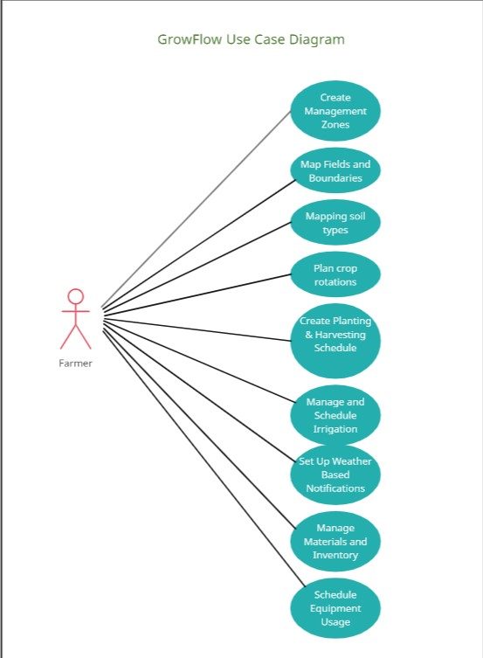
Use Case Diagram

Slide 10
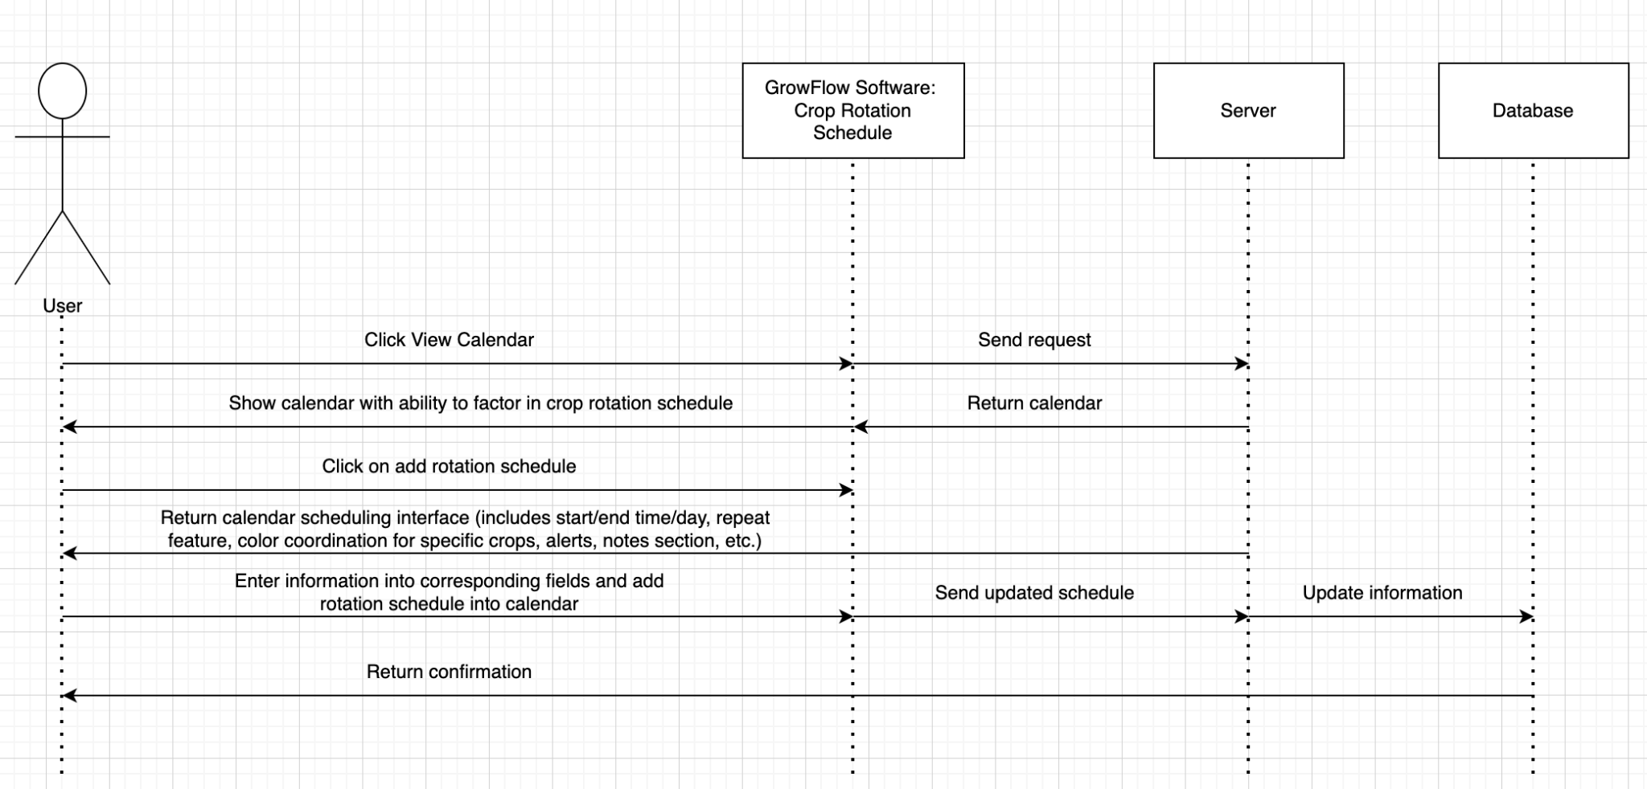
Sequence Diagram - Plan Crop Rotation

Slide 11
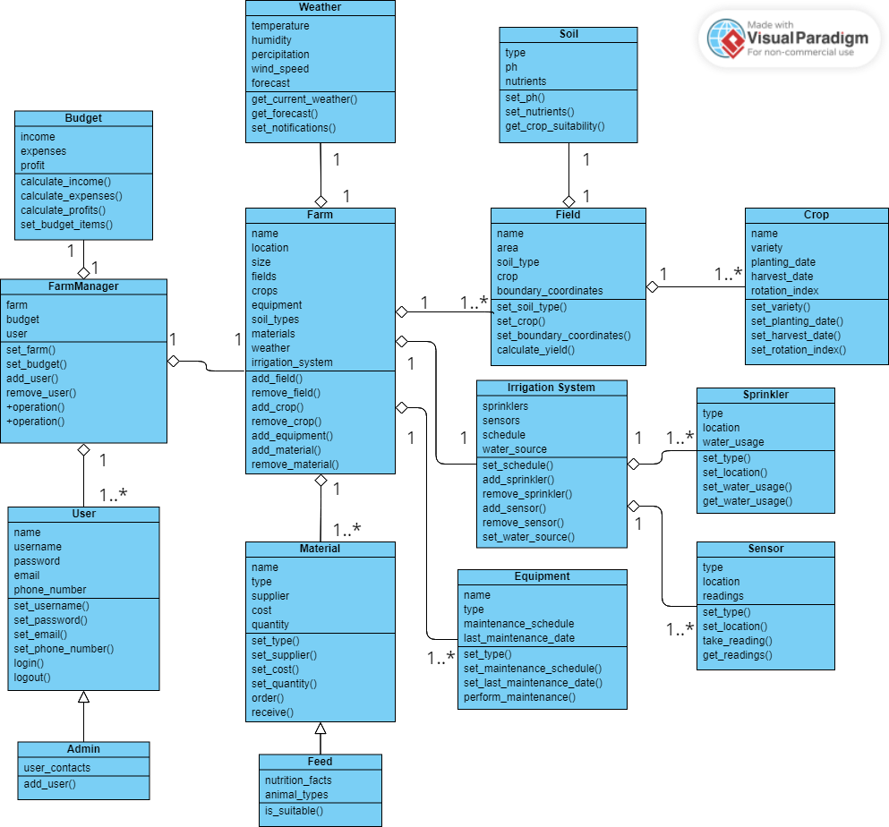
Class Diagram

Slide 12
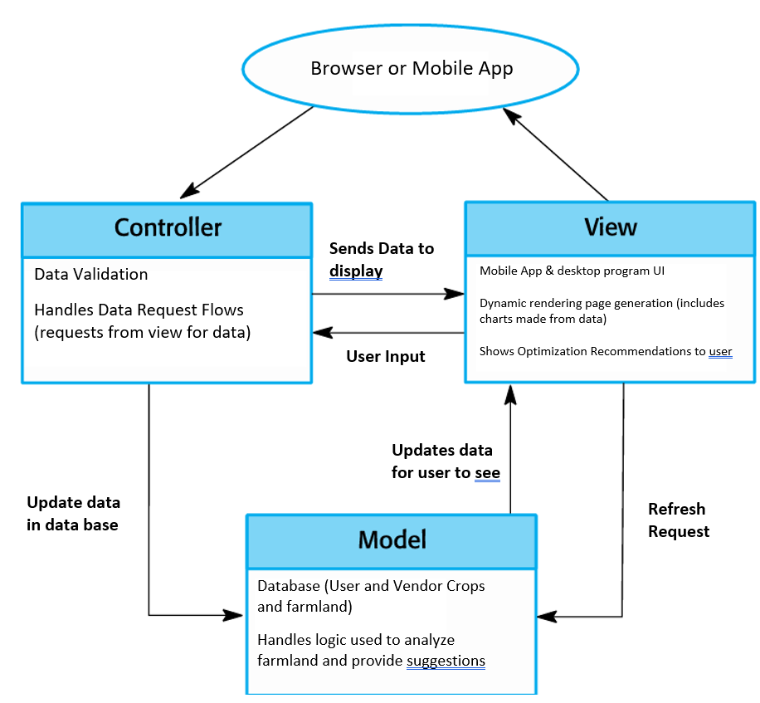
Architectural Design

