Slide 1
Gradient Descent

Slide 2
Agenda
Introduction
Moving along the gradient
Gradient descent and learning rate
Application to linear regression

Slide 3
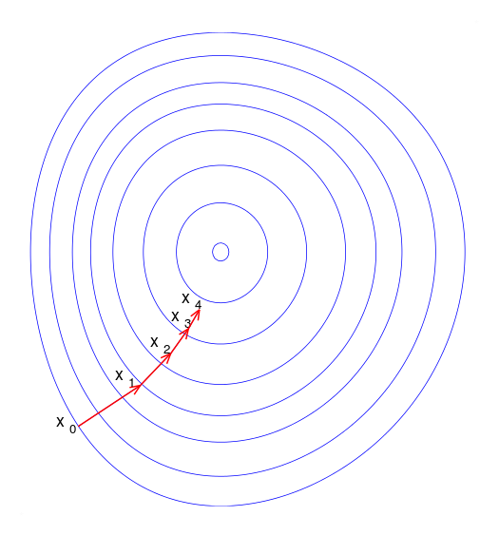
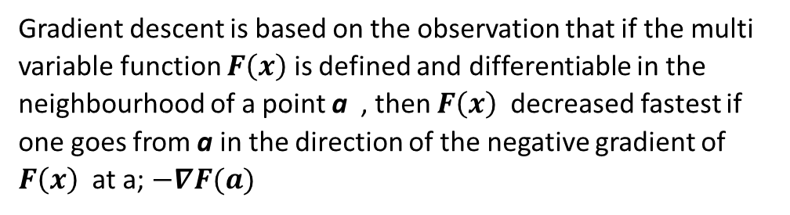
Introduction
What is gradient descent ?
Gradient descent is an optimization algorithm used to find the values of parameters (coefficients)
of a function (f) that minimizes a cost function (cost).
When do we use it?
Gradient descent is best used when the parameters cannot be calculated analytically (e.g. using linear algebra) and must be searched for by an optimization algorithm.
Fundamental calculus behind gradient descent
Gradient descent is based on the observation that if the multi variable function $F\left(x\right)$ is defined and differentiable in the neighbourhood of a point a , then $F\left(x\right)$ decreased fastest if one goes from a in the direction of the negative gradient of $F\left(x\right)$ at a; $−∇F(a)$
Illustration of gradient descent on a series of level sets.

Slide 4
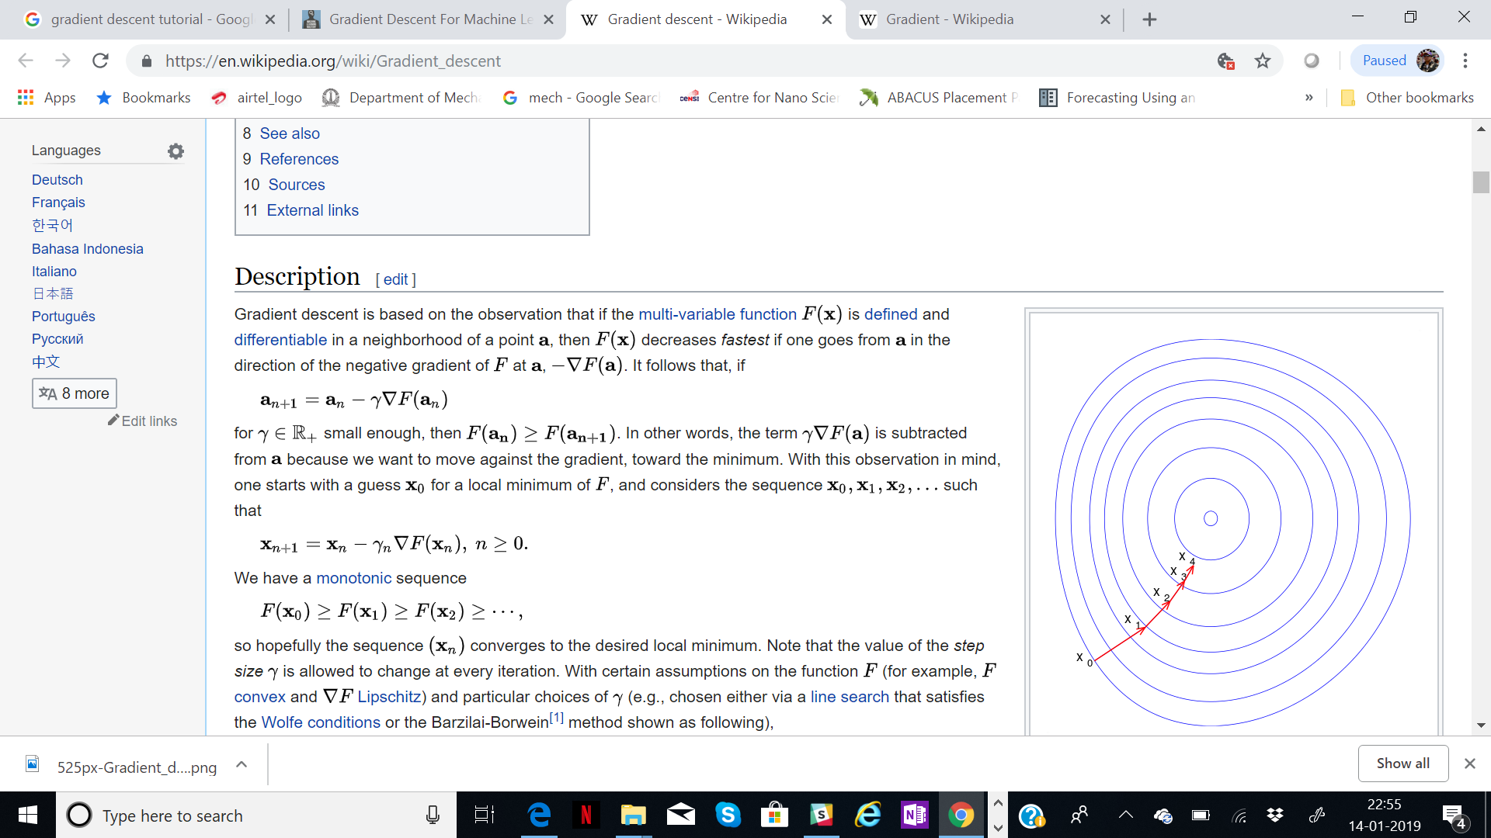


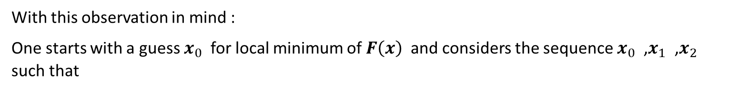
Moving along the gradient
Thus if we were to move according to
Then
Learning rate
With this observation in mind :
One starts with a guess $x_{0}$ for local minimum of $F\left(x\right)$ and considers the sequence $x_{0}$ ,$x_{1}$ ,$x_{2}$ such that
We have a monotonic sequence

Slide 5
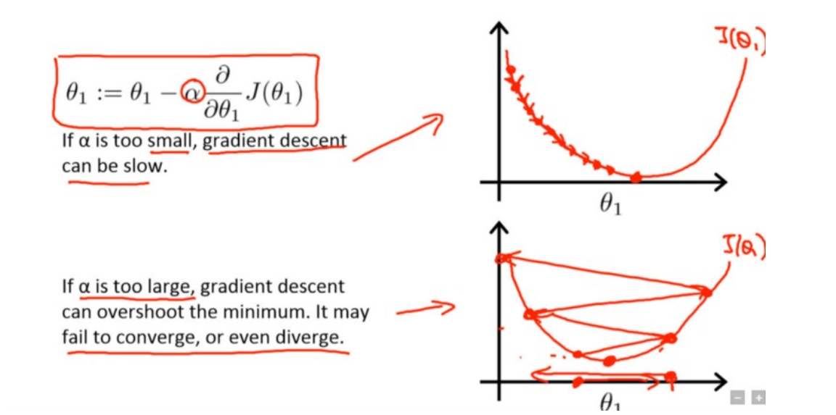
Gradient descent and learning rate

Slide 6
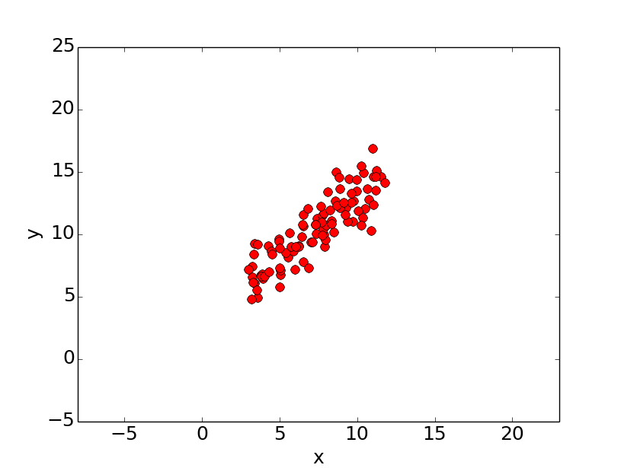
Application to Linear Regression
How do we compute the slope and intercept for best fit line ?
Define cost function
Set initial guess for slope and intercept
Compute cost based on initial value and store
Compute gradients at current point
Update slope and intercept
Iterate steps 3 to 5 till optimal error is reached
Let’s suppose we want to model the above set of points with a line. To do this we’ll use the standard y = mx + b line equation
Where m is the line’s slope and b is the line’s y-intercept.

Slide 7
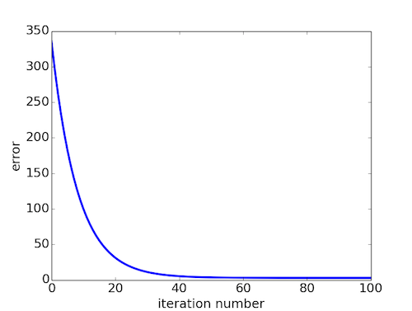
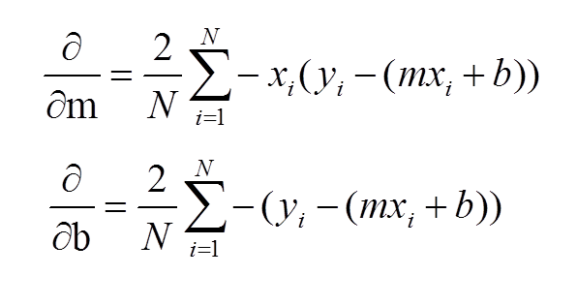



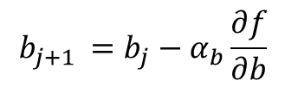
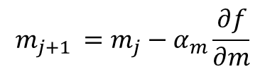
Application to Linear Regression
Line equation
4
Update rule
$$y=mx+b$$
$$m_{j+1 }=m_{j}−α_{m}\frac{∂f}{∂m}$$
1
Initialization
$$m=m_{0}$$
$$b= b_{0}$$
$$b_{j+1 }=b_{j}−α_{b}\frac{∂f}{∂b}$$
Cost compute
2
5
Iterate 2- 4 till error optimized or converged
3
Gradients

