Slide 1

AI101 MINI-PROJECT
GLOBAL RENEWABLE ENERGY OUTPUT & WEATHER CORRELATION
Analysing the relationship between weather conditions and renewable energy generation.
REPO LINK:-
https://github.com/anishiitrpr/ai101_project82.git
Team Number: 82
Sehajpreet Singh Reen :- PPT Lead
Anish Kumar :- Video Lead
Dharmesh Meena :- Documentation
Parmeet :- Execution
GLOBAL RENEWABLE ENERGY OUTPUT & WEATHER CORRELATION | AI101 MINI-PROJECT | IIT ROPAR
Notes:
Introduce the project: AI101 Mini-Project under the School of AI and Data Engineering, IIT Ropar. State the primary focus on uncovering real relationships between atmospheric variables and renewable power output.

Slide 2




PROBLEM & DATASET CONTEXT
WHAT ARE WE STUDYING?
Analysing the relationship between weather conditions and renewable energy generation, focusing on solar radiation, temperature, humidity, wind speed and cloud coverage.
196,776
17
Total Records (15-min intervals, with some gaps)
Columns Recorded
WHY DOES IT MATTER?
With growing energy demands and environmental concerns, understanding these relationships can help improve energy planning and support the promotion of clean energy.
DATASET SOURCE
14.91 MB
2017–2022
Renewable Power Generation and Weather Conditions via Kaggle.
1 Jan 2017 – 31 Aug 2022
CSV File Size
Kaggle dataset link:
https://www.kaggle.com/datasets/pythonafroz/renewable-power-generation-and-weather-conditions/data
GLOBAL RENEWABLE ENERGY OUTPUT & WEATHER CORRELATION | AI101 MINI-PROJECT | IIT ROPAR
Notes:
Walk through the core research problem and data foundations. Highlight the five primary weather factors examined against renewable output, noting the granular 15-minute interval coverage across the five-year recording span.

Slide 3




PROJECT APPROACH & WORKFLOW
From raw Kaggle multi-variable records to structured correlation findings across 4 stages.
Data Input
Data Inspection
Linear Regression
Data Visualization,
Output & Evaluation
Load the Kaggle CSV dataset and examine its 17 columns.
Understand dataset structure, date coverage, missing intervals and data quality.
Using the dataset from Kaggle.com
We simply trained our model using linear regression .
This model can now give output to new test data.
Present observed relationships through charts, graphs and meaningful visual comparisons. This helped us to train our model. Now this well-trained model can give output to new test-data.
For better performance we evaluated the accuracy of the model.
LIBRARIES USED:-
Core objective:-
Pandas, NumPy, Matplotlib, Seaborn.
To analyze how weather conditions influence global renewable energy output by identifying correlations, patterns, and trends in energy production.
GLOBAL RENEWABLE ENERGY OUTPUT & WEATHER CORRELATION | AI101 MINI-PROJECT | IIT ROPAR
Notes:
Present the systematic methodology: ingestion, rigorous interval inspection for missing timestamps, statistical correlation testing, and reporting visuals. Emphasize the core objective box below.

Slide 4
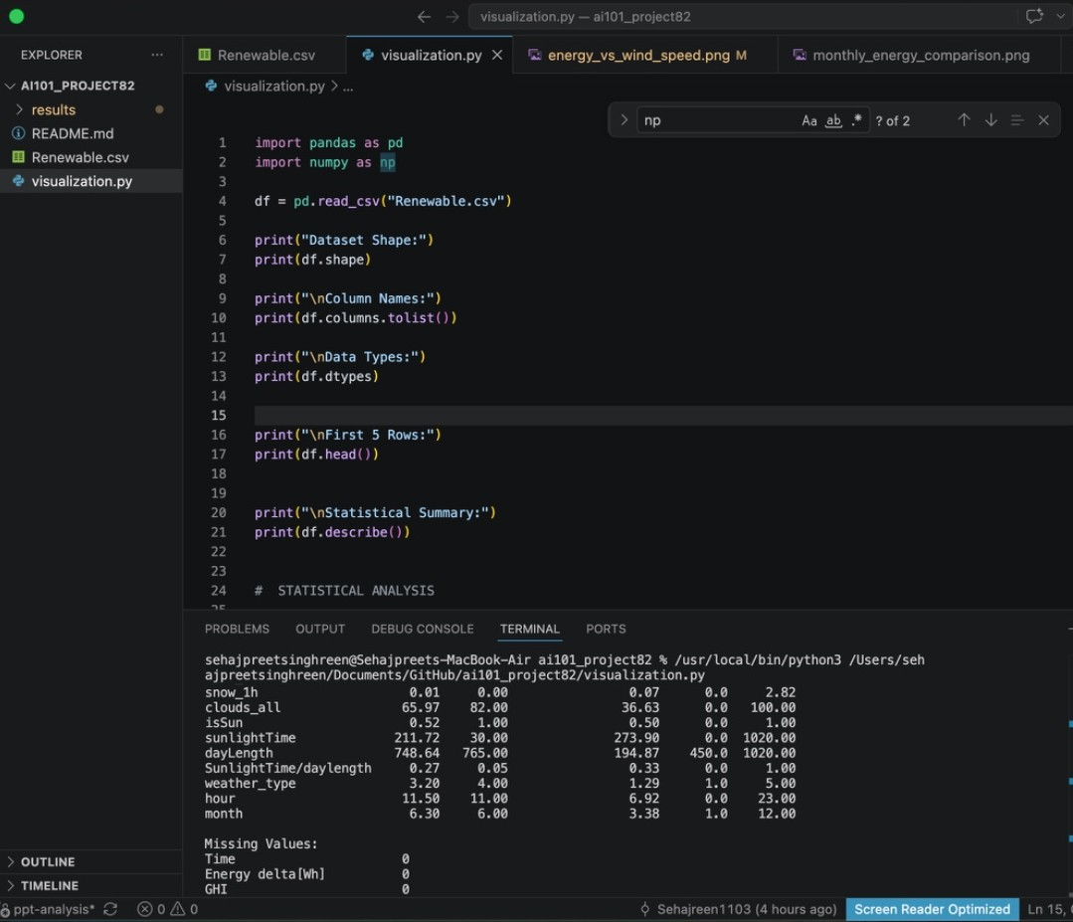
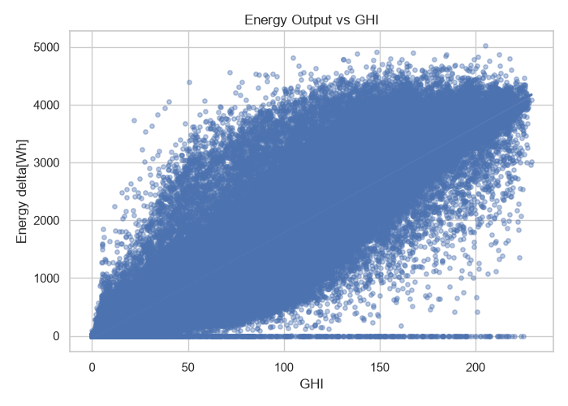
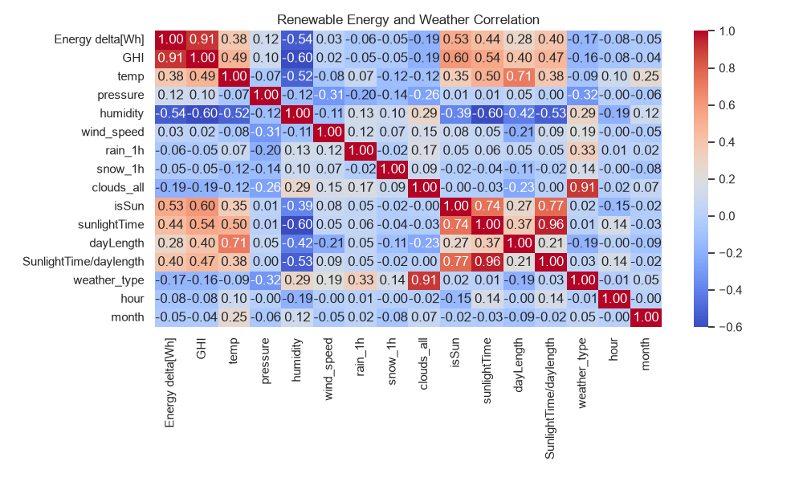
RESULTS & DATASET INSIGHTS:
Key Numbers:-
+0.91
-0.54
GHI
Strong positive
correlation
HUMIDITY
Moderate negative correlation
+0.38
-0.19
TEMPERATURE
Positive correlation
CLOUD COVER
Weak negative correlation
GLOBAL RENEWABLE ENERGY OUTPUT & WEATHER CORRELATION | AI101 MINI-PROJECT | IIT ROPAR
Notes:
Summarize the quantitative profile of the Kaggle dataset. Explicitly clarify that formal correlation matrices and predictive accuracy numbers will be populated during final model execution, keeping placeholders faithful to student scope.

Slide 5
KEY LEARNINGS & CONCLUSION
WHAT WORKED:
DATASET CHALLENGES
(what didn’t work):
TEAM CONTRIBUTIONS & AI DISCLOSURE:
Clear correlation patterns
Between weather and
energy output.
Effective data visualization
and comparisons.
Identification of key
influencing factors.
Member 1: Sehaj Reen:- PPT Lead
Member 2: Anish Kumar:- Video Lead
Member 3: Parmeet:- Execution
Member 4:- Dharmesh:- Documentation
AI Tool Usage:
ChatGPT, Claude & Gemini for references, understanding concepts, Python coding assistance, troubleshooting and GitHub guidance.
Inconsistent data.
Weak correlations for some weather parameters.
Limited ability to establish causation.
Conclusion: Understanding the relationship between weather conditions and renewable energy generation can contribute to better-informed clean energy planning.
GLOBAL RENEWABLE ENERGY OUTPUT & WEATHER CORRELATION | AI101 MINI-PROJECT | IIT ROPAR
Notes:
Conclude with project takeaways, dataset engineering obstacles faced during 15-minute timeline alignment, and team acknowledgments alongside academic AI transparency disclosures.

