Slide 1
MARKET INTELLIGENCE BRIEF
The Air Fryer Market
Who's winning, who's overpaying, and what customers actually want
By: Anish Jagota
DS3001 · Demand Estimation Lab

Slide 2
The Market at a Glance
A concentrated, dynamic, mid-priced category — but the leaderboard has shifted dramatically since 2019.
10
5
29 → 5%
3 → 23%
name brands
years of data
GoWise USA share
Instant Pot share
in cleaned market
2019 – 2023
collapsed over the window
took its place
The takeaway
The cleaned air-fryer market is a concentrated, mid-priced category dominated by a handful of recognizable kitchen brands. Average prices have been remarkably stable across the five-year window, and consumer ratings sit in a tight 4.4–4.75 range with very little year-to-year movement. What has changed dramatically is who actually wins customers. GoWise USA, the share leader in 2019 with roughly 29%, has lost more than four-fifths of its share. Instant Pot and Cosori effectively didn't exist in this category in 2019; together they now hold over a third of it. The lesson for any incumbent or new entrant: in air fryers, share is fluid, prices and ratings are sticky, and brand position is decided by something other than the headline numbers.

Slide 3
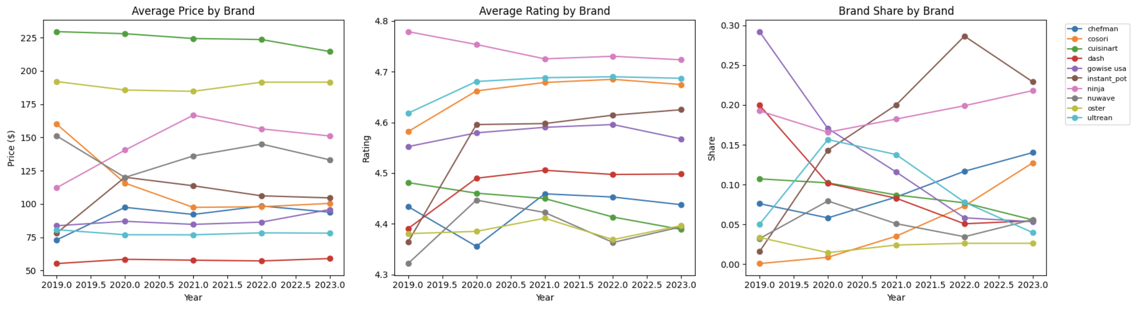
Five Years of Price, Rating, and Share
Prices and ratings are flat. Share is where the action is.
Average price ($)
Average rating
Brand share
Reading across the three panels:
Cuisinart and Oster anchor the premium tier (~$190–230) and barely move; Dash, Ultrean, and Chefman hold the value end (~$55–95). Every brand's average rating lives in the narrow 4.35–4.75 band, with Ninja consistently on top and Cuisinart and Oster trailing — a sign that high price does not buy customer satisfaction in this market. The right-hand panel is where the action is: GoWise USA collapses from 29% to 5%, while Instant Pot, Ninja, Cosori, and Chefman all gain share. Prices and ratings are flat, but the leaderboard has been rewritten — meaning the share shifts are being driven by something the headline numbers don't capture (likely product-line refreshes, marketing, distribution, or the value of the brand name itself).

Slide 4
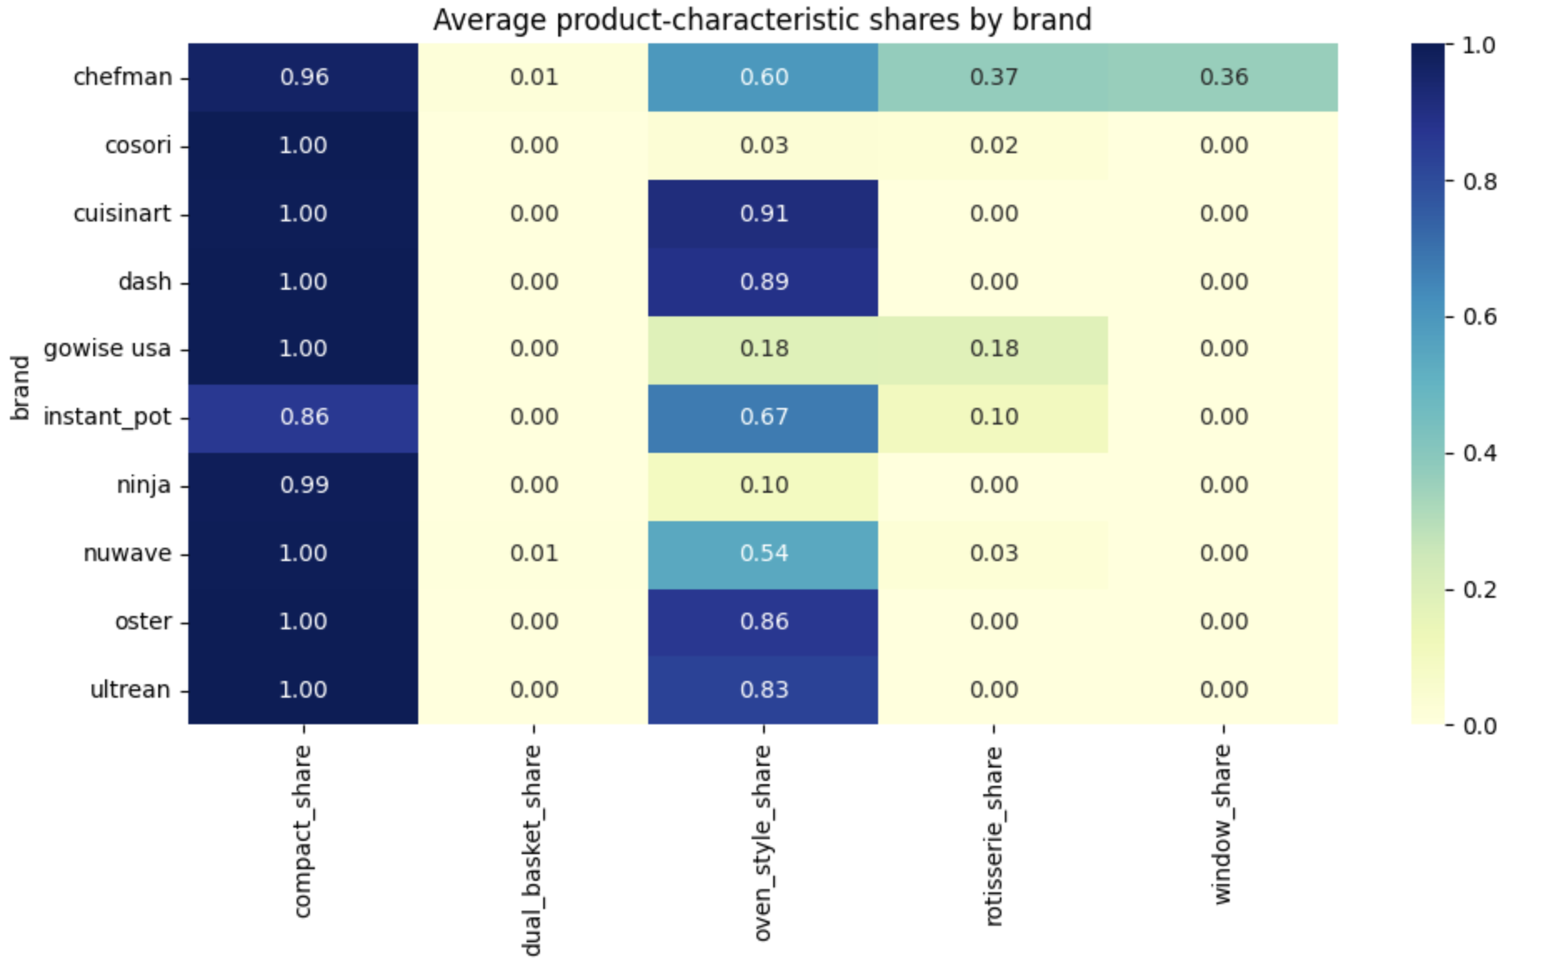
Brands Specialize on Different Form Factors
Average product-characteristic shares by brand. Darker = more of that feature.
What this shows
Compact shares is essentially saturated across the cleaned market — every brand carries products that are >85% compact. Specialization shows up in the rare features. Chefman is the clearest outlier: it is essentially the only brand carrying real window and rotisserie share. GoWise USA and Instant Pot also lean into rotisserie. Cuisinart, Dash, Oster, and Ultrean position as simple oven-style brands with no rotisserie or window features at all. Cosori and Ninja take the opposite position, carrying compact basket-style fryers with low oven-style share. Dual-basket products are essentially absent from the entire market — a notable gap given how popular dual-basket has become in the broader category.

Slide 5
How We Modeled Demand
A multinomial logit demand model, estimated by linear regression on log market share.
What the model does
We regress log brand share on price, average rating, and five product-feature shares, with separate brand and year fixed effects. This is the linear-regression analog of a multinomial logit demand model — the year dummies absorb the multinomial-logit denominator, and the brand dummies capture every time-invariant brand attribute we can't measure directly (perceived quality, design language, marketing, distribution).
We deliberately impose a single price slope across all brands and all years. That is a real modeling restriction — but it's the restriction that makes the next stage of the analysis possible. With one price slope, the firm's first-order pricing condition under multinomial-logit demand inverts cleanly into an estimate of unit cost for every brand-year. Allowing brand-specific slopes would split the data 10 ways and leave us unable to compare costs.
What this won't tell us: causal effects of changing any single variable. Brand fixed effects mean we are reading variation across brand-years, not running an experiment. Treat the coefficients as descriptive correlations conditional on the controls.
PRICE COEFFICIENT
−0.038
Negative — exactly what theory predicts.
Higher price ⇒ smaller demand/ share, all else equal. The sign also lets the cost-inversion in the next slides work cleanly.
Model fit: R² = 0.76 across 50 brand-year cells — a reasonable fit for this specification.

Slide 6
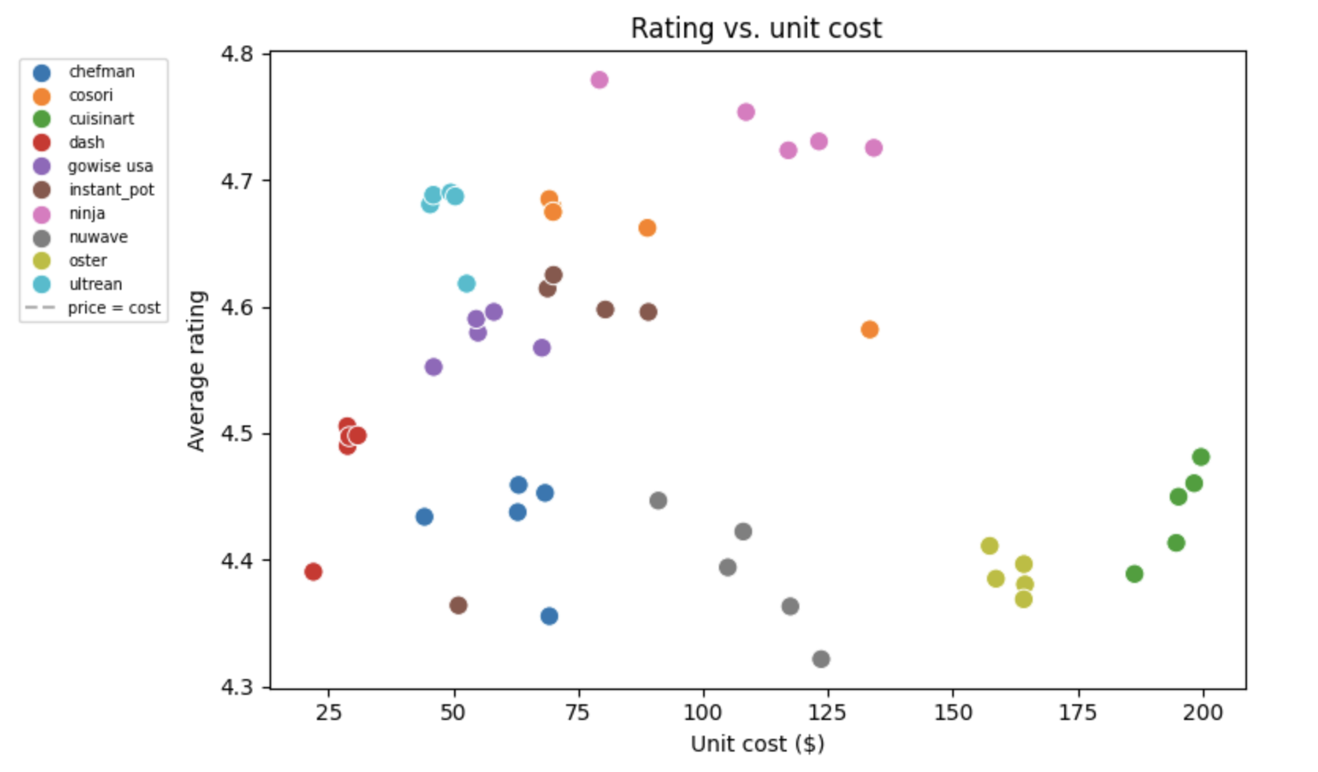
Price Tracks Cost, but Satisfaction Doesn't
Average customer rating against the inferred unit cost for every brand-year.
How to read it
Each dot is one brand-year. The scatter is essentially flat — paying more does not deliver a better-rated product in this market.
Ninja sits in the upper middle of the chart at moderate cost ($80–135) and the highest ratings in the market (4.72–4.78).
Cosori, Ultrean, and chefman cluster on the left side at low cost with above-average ratings — the value-and-quality combination.
Cuisinart and Oster anchor the right side at the highest unit costs ($160–200) but their ratings (4.37–4.48) are below the market median.
Dash sits at the bottom-left — the cheapest products in the market, with ratings near the median.
Strategic implication: customer satisfaction is uncorrelated with how much it costs to make the product. Brands competing on premium positioning are paying more to produce something customers don't reward.

Slide 7
Inferred Unit Costs & Markups
Backing out costs from the firm's first-order pricing condition, brand-year by brand-year.
Brand | Avg price | Avg share | Unit cost | Markup | Profit index
Ninja | $145.34 | 19.2% | $112.49 | $32.85 | 6.31
Instant pot | $104.46 | 17.5% | $71.90 | $32.56 | 6.01
Gowise Usa | $87.45 | 13.8% | $56.30 | $31.15 | 4.61
Dash | $57.48 | 9.8% | $27.94 | $29.54 | 2.99
Chefman | $90.94 | 9.5% | $61.57 | $29.37 | 2.82
Ultrean | $78.11 | 9.2% | $48.79 | $29.33 | 2.78
Cuisinart | $223.95 | 8.6% | $194.90 | $29.05 | 2.50
Cosori | $114.27 | 4.9% | $86.28 | $27.98 | 1.44
Nuwave | $137.02 | 5.1% | $109.05 | $27.97 | 1.42
Oster | $189.03 | 2.5% | $161.81 | $27.23 | 0.68
Reading the table
Markups are tightly compressed in the $27–$33 band by construction — with one price slope across the whole market, the implied markup depends only on each brand's share, so brands with similar shares get similar markups. This is why the profit ranking is driven almost entirely by share rather than by markup. Cuisinart and Oster carry by far the highest implied unit costs ($195 and $162) because their prices are so high; Dash, with the lowest unit cost ($28), sits at the value end. Profit index = share × markup, so Ninja and Instant Pot — both with strong shares and markups near $33 — pull away from the rest of the field. Cuisinart's combination of a $194 unit cost and only 8.6% share gives it a profit index of 2.50, well below several brands selling at less than half its price.

Slide 8
Who Captures the Most Value
Brands ranked by share-weighted profit. Ninja and Instant Pot are pulling away.
Leaders
Ninja 6.31
Instant Pot 6.01
GoWise USA 4.61
Lagging
Oster 0.68
Nuwave 1.42
Cosori 1.44
Where the value sits
Ninja (6.31) and Instant Pot (6.01) are pulling away from the field — together they capture more share-weighted profit than the bottom seven brands combined. GoWise USA's 4.61 is largely a 2019 artifact; by 2023 its profit index is much lower. Cuisinart's premium positioning leaves it generating less share-weighted profit than Dash, which sells at one-quarter of Cuisinart's price.

Slide 9
STRATEGIC TAKEAWAY
The middle of the market is winning.
Premium ≠ profit
Mid-price wins
Shares are not stable
Cuisinart and Oster carry the highest unit costs in the market ($195 and $162) and ask consumers to pay $190–$224 for an air fryer. Yet their share-weighted profit indices (2.50 and 0.68) sit at the bottom of the ranking. Premium pricing alone does not buy share or profit in this category; in fact, the brands with the lowest customer ratings tend to sit in the highest price tier.
Ninja's combination of a ~$145 average price, the highest customer rating in the market (4.74), and a 19% share dominates the profitability ranking. The category rewards brands that pair recognizable design and reliable performance with an accessible price point, not brands that chase the high end. Instant Pot follows the same playbook at a slightly lower price.
GoWise USA went from category leader at 29% share in 2019 to also-ran at 5% in 2023. Instant Pot did the reverse, going from 3% to 23% in the same window. Cosori went from essentially zero to 13%. No incumbent should treat its position as locked in, and the data suggest entry at the mid-price tier with strong product fundamentals can rapidly capture share.
Recommended next step: scenario analysis on Cuisinart re-pricing toward the $140-160 band, given its high brand-fixed-effect coefficient.

