Slide 1
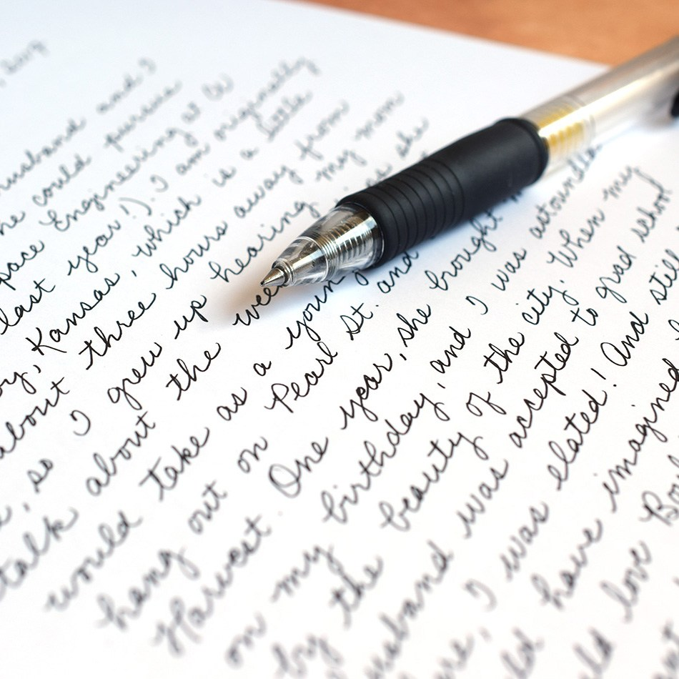
Tagline:
Write faster and effortlessly

Slide 2

Problem Statement
Our project is divided into 2 parts.
Handwriting to text:
Converting images of handwriting into text. Scanning images/words written to suggest predictions of the word.
Text to handwriting:
Providing the model with your handwriting as dataset and training it on it to generate handwritten images of inputted text in your own hand writing.

Slide 3
Implementation: Hand writing to Text
We trained our model using keras' CNN.
We inputted a dataset of handwritten characters and our model was able to predict the letter in the image accurately.
Further we our planning to use OCR to scan the handwritten text and output the text.
We also plan to add a feature that can scan a word and predict suggestions on what that word could be. For e.g. A lot of times we are unable to figure out what a person has written. This should be handled accurately by this model.

Slide 4
Implementation: Text to Handwriting
We are planning to implement this using LSTM
The model will take the user’s handwriting as a dataset and train on it.
The user will then provide it with the text they want to write and the model should generate image/pdf of the given text in the user’s handwriting.
This can be done by giving different letters(all from a-z) as the dataset and then generating text.
We basically want to solve the problem of wasting time and effort in writing long pieces of text by hand.

