Slide 1
AI In Stock Market
By Anish Katoch

Slide 2
Problem Statement
The project addresses the challenge In the stock market
most people struggle to understand price and volume signals.
prices going up and down but can’t tell if it’s a real trend or just noise.
Traders often fail to recognize if a stock is in accumulation, losing momentum, or about to reverse.
Too many technical indicators give mixed signals, some say “buy” while others say “sell.”
Sudden spikes in volume or price drops catch people by surprise.
This confusion leads to bad timing, emotional decisions, and financial losses

Slide 3
Importance of solving this problem
Helps traders clearly identify market trends and signals.
Reduces guesswork and avoids confusion from mixed indicators.
Builds confidence in making trading decisions.
Minimizes emotional trading by relying on data.
Combines trend prediction, technical indicators, anomaly detection, and forecasting into one system.
Provides a clear, data-driven view of the market.
Empowers traders to make smarter, consistent, and profitable decisions.

Slide 4
Methodology – Approach, dataset, tools/technologies
Approach:
Data Preparation – Collected 2 years of Tata Motors stock price data from NSE India (Open, High, Low, Close, Volume).
Feature Engineering – Created technical indicators: SMA20, SMA50, RSI(14), MACD, returns, volatility, lag features.
Target Variable – Defined tomorrow’s trend: 1 = Up, 0 = Down, using shifted close prices.
Model Training – Applied RandomForestClassifier for up/down prediction, ensuring time-series split (no random shuffling).
Forecasting – Used Prophet to project future stock trends.
Visualization – Built interactive charts to display trends, anomalies, volume patterns, and predictions.

Slide 5
Dataset:
Source: Historical stock market data from NSE India (Tata Motors, last 2 years).
Data Type: OHLCV (Open, High, Low, Close, Volume) daily data.
Derived Features: Moving Averages (SMA20, SMA50), RSI(14), MACD & MACD Histogram, volatility, ROC, lag features, accumulation signals.
Tools & Technologies:
PYTHON (PANDAS, NUMPY, SCIKIT-LEARN, PROPHET, TA LIBRARY).
RANDOMFORESTCLASSIFIER FOR CLASSIFICATION.
PROPHET FOR FORECASTING.
MATPLOTLIB / PLOTLY FOR VISUALIZATION.
STREAMLIT FOR BUILDING AN INTERACTIVE DEMO/DASHBOARD

Slide 6
Objectives – Key goals of the project
TO PREDICT NEXT-DAY STOCK MOVEMENT (UP/DOWN) USING MACHINE LEARNING.
TO PROVIDE TRADERS WITH TREND SIGNALS USING SMA20 AND SMA50.
TO IDENTIFY MOMENTUM AND STRENGTH USING RSI AND MACD.
TO DETECT ACCUMULATION PHASES AND VOLUME ANOMALIES FOR BREAKOUT SIGNALS.
TO FORECAST FUTURE STOCK MOVEMENT FOR BETTER PLANNING.
TO COMBINE ALL INSIGHTS INTO ONE PLATFORM SO TRADERS AVOID CONFUSION FROM MULTIPLE SCATTERED TOOLS.

Slide 7
Solution
Go to website : https://aistockmarketanalysis.streamlit.app/
a stock prediction system that uses Random Forest classification Model to predict whether a stock will move up or down the next day.
Random Forest achieved ~75% accuracy for Up/Down trend classification.
SMA20 & SMA50 & SMA200 → for short-term and medium-term trend identification.
RSI (14) → to detect overbought/oversold zones.
MACD & MACD histogram → to capture momentum shifts.
Forecast values (PropheT) → to project possible future trends and FORECAST.
evaluation metrics:
- RMSE: 30.12
- MAE: 23.22
Volume analysis & anomalies → to detect unusual activity.
Accumulation zone detection → to highlight consolidation before breakouts.
The outcome is a combined dashboard where traders can see next-day predictions, indicator charts, anomalies, and forecasts, making trading decisions clearer and more structured.

Slide 8
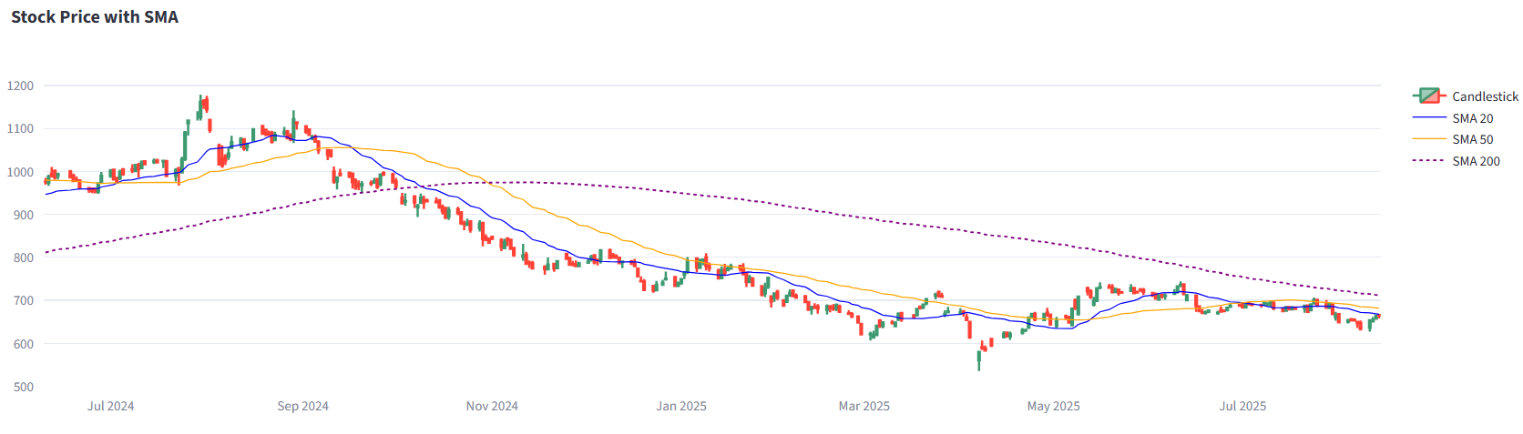
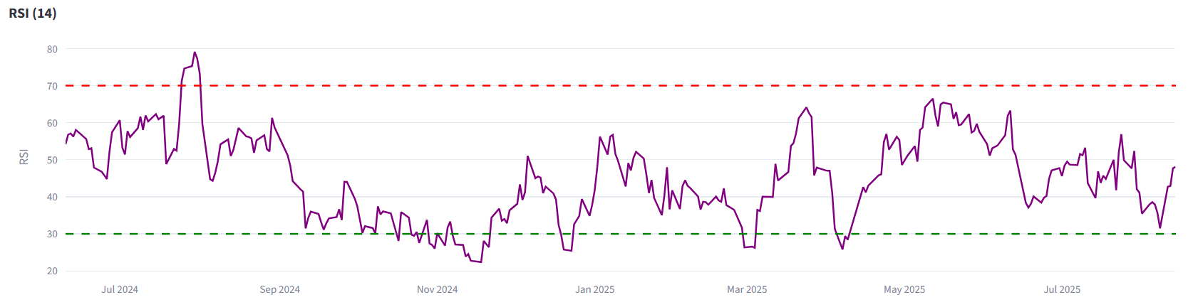
Visuals
📉 Below SMA-200 → clear long-term downtrend.
🔻 SMA-20 < SMA-50 → weakness sustained.
❌ Rallies capped below SMA-200.
⚠️ Distribution mode → sellers dominating.
👉 Long-term view: still bearish until price closes above SMA-200 with strength.
📉 Mostly below 50 → momentum has stayed weak
⚠️ Frequent dips near/below 30 → repeated oversold conditions show selling pressure dominates.
❌ Few sustained moves above 70 → no strong bullish momentum in this period.
👉 RSI confirms a bearish long-term bias. Unless RSI can stay above 50–60 with price strength, rallies are likely short-lived.

Slide 9
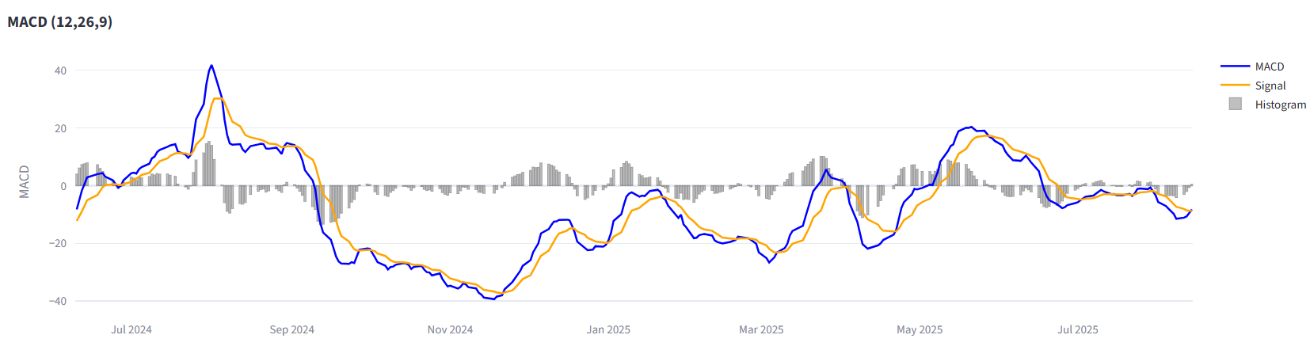
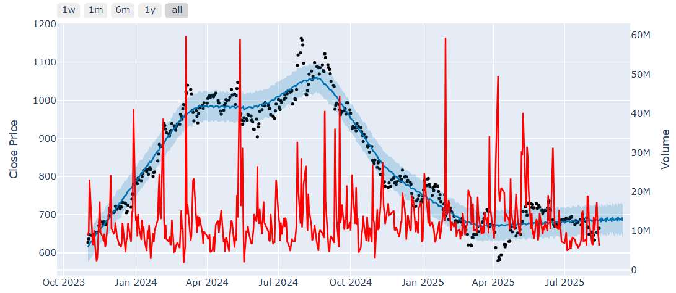
📉 Mostly below zero → bearish momentum.
🔻 Frequent sell crossovers (MACD < Signal).
❌ Bullish moves fade quickly.
🔄 Now flat near zero → weak/neutral.
👉 Bias: Still bearish unless MACD crosses up and stays positive.
📈 Early 2024: strong uptrend with volume support (accumulation).
📉 Late 2024: sharp downtrend, heavy selling (distribution).
🔄 2025: price flattening 650–700 → sideways consolidation.
⚠️ Volume still spiky → no clear breakout yet.
👉 Trend: Bearish overall, now shifting into sideways consolidation — wait for breakout above ~750 with volume for reversal.

Slide 10
Conclusion
Random Forest captures daily price movement signals.
Prophet forecasts long-term trends with confidence intervals.
Combined approach improves decision-making for investors.
Helps identify accumulation/distribution phases using volume overlays.
Future scope:
system will be designed in such a way that, for a particular day and time, it can suggest specific trading goals, for example targeting an 8% return, which will be especially valuable for futures and options trading.
to capture more complex market patterns and improve prediction accuracy.
system will be enhanced to automatically detect patterns such as trend reversals, breakouts reducing manual effort and giving traders a smarter, more reliable tool for decision-making.
Note:- It won’t “guarantee profits,” but it helps people avoid random guessing, spot better opportunities, and manage risk with data-driven signals.

