Slide 1
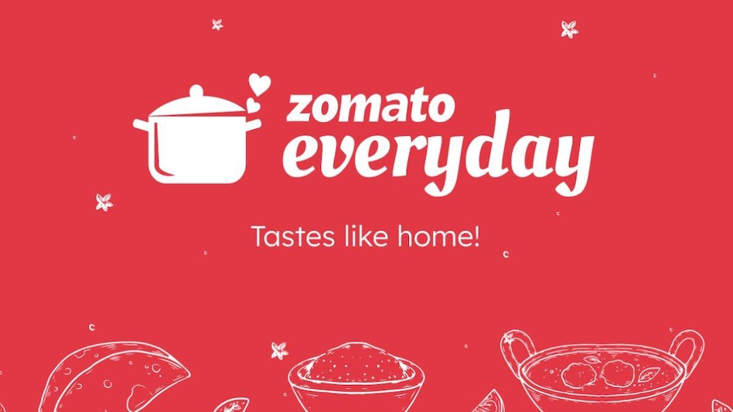
ZOMATO RECOMMENDATION MODEL
zcsfsdg

Slide 2
TEAMMATES
ANISH KATOCH
YASH UPADHYAY
SWATI LATTA
MANSI JAIN

Slide 3
INTRODUCTION
Zomato is an Indian multinational restaurant aggregator and food delivery company. It was founded in 2008 and headquarters in Gurugram, Haryana, India.
Initially launched as a restaurant review and discovery platform, Zomato has evolved into a comprehensive food tech company.
Zomato's continuous innovation, technology-driven approach, and focus on customer experience have positioned it as a leading player in the food delivery and restaurant industry.

Slide 4
OBJECTIVE
Developing a recommendation model based on scraped data from Zomato and make a webpage of it.
Design algorithms analyzing user data to generate personalized recommendations based on past ratings, cuisine preferences, and location.
Enabling users to access information about cuisine availability at different restaurants and preferred price ranges.
Develop user-friendly interface for feedback, enabling users to explore menus, reviews, and ratings of recommended restaurants
Assisting potential restaurant owners in determining optimal cuisine offerings and average pricing for new restaurant ventures.

Slide 5
PURPOSE
Provides personalized restaurant recommendations to users based on their preferences and needs.
Encourage users to explore and try new restaurants, leading to increased business for restaurant partners.
Reduce the time and effort required for users to discover new dining options.
Simplify the process of finding and selecting restaurants for users.
Empowers restaurateurs with data-driven recommendations.
To increase user satisfaction and engagement with the platform.
Aligns offerings with customer preferences and market trends.
Access to insights for success in a competitive industry.

Slide 6
DATA PREPROCESSING TECHNIQUES
Handling missing values
Datatype
Excel formula(Right, mid, left , concatenate)
Removing or correcting any errors
Scaling
Encoding categorical variables

Slide 7
MACHINE LEARNING
Logistic Regression - To predict Recommended Price for 1.
Decision Tree - To predict Recommended Location.
Accuracy Score for Logistic Regression Model has been found around 84 %, whereas that of Decision Tree Model has been found around 72%.
To avoid Biasness of the Output, Scaling with Min Max Scaler has been performed on features.
In order to convert Categorical values in the data to Continuous, Label Encoder has been used for encoding purpose.

Slide 8
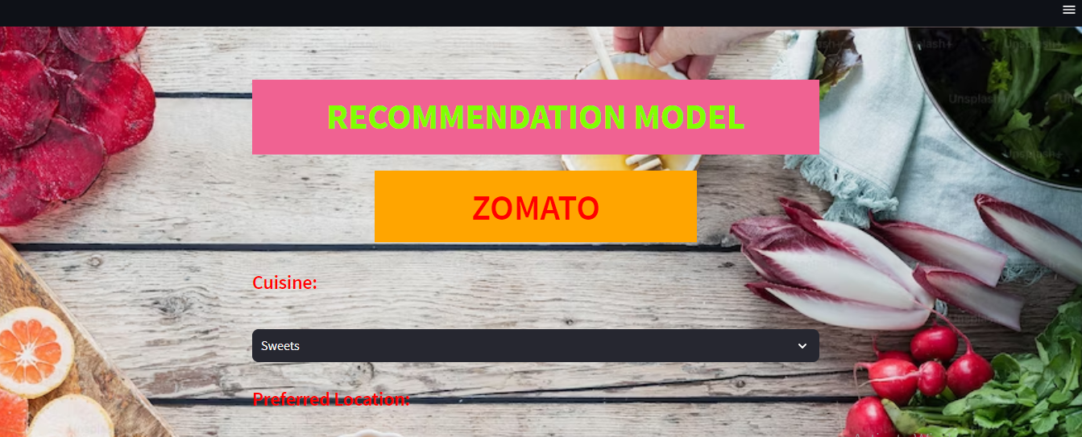
INPUT

Slide 9
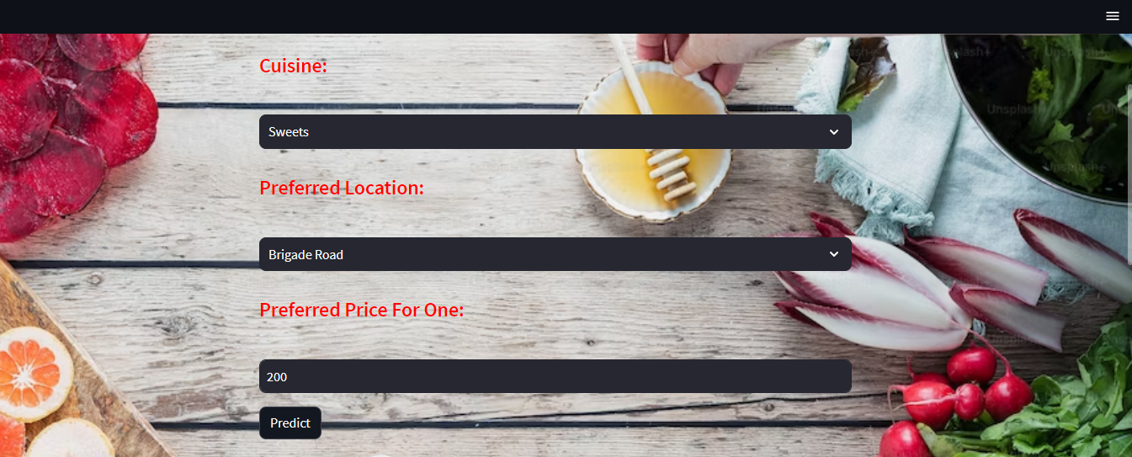

Slide 10
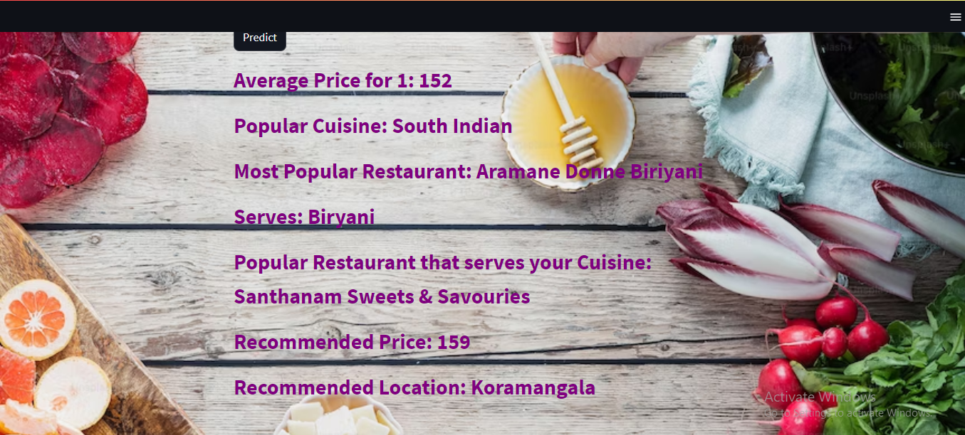
FINDINGS

Slide 11
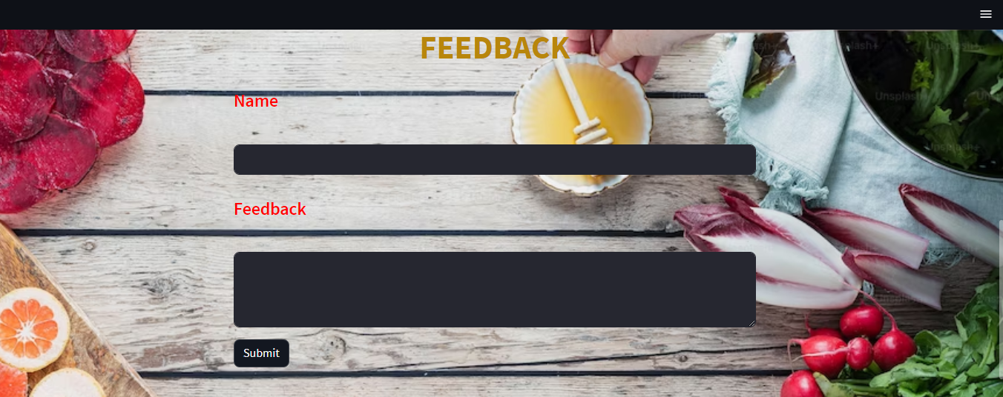
FEEDBACK

Slide 12
LIMITATIONS & FUTURE WORK
Not enough data about users or items, making it difficult to give accurate recommendations.
Alternative data sources
Struggle with updates in real-time, like new user preferences or changing item availability.
Adapt and update recommendations in real time.
Handle sensitive user data, so we need to prioritize privacy.
Privacy-preserving techniques

Slide 13
Not enough information about certain items, especially those that are not popular or niche.
Fill missing values by analyzing patterns in user-item interactions to estimate the unknown values.
Make recommendations more understandable and transparent.
Build trust and understanding and take user feedback into account.
Better ways to measure recommendation system performance.
Explore new evaluation metrics that consider user satisfaction, diversity, or long-term engagement

Slide 14
CHALLENGES | LEARNING
Converting numerical values to categorical outputs in the machine learning.
Styling web page elements include applying background color and text color.
Build interactive web page directly from Python scripts.
Stream lit python library
Deploy Machine Learning Model in Webpage
Basic Knowledge of CSS
Basic Knowledge of HTML tag
Scraping data from Websites
Time Management
Team Work and Coordination

Slide 15
THANK YOU

