Slide 1
Predicting IVY League Chances
Anish Krishnan Ganesh
Intern, GeakMinds

Slide 2
Agenda
DataSet
Correlation in Data
Models
Packages
Algorithms
Code Dive In
Linear Regression
References

Slide 3
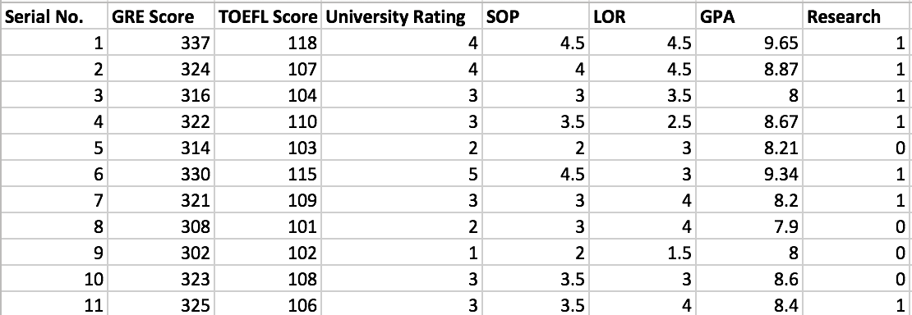
Dataset
Admission_Predict.csv from Kaggle
Sample extract from dataset

Slide 4
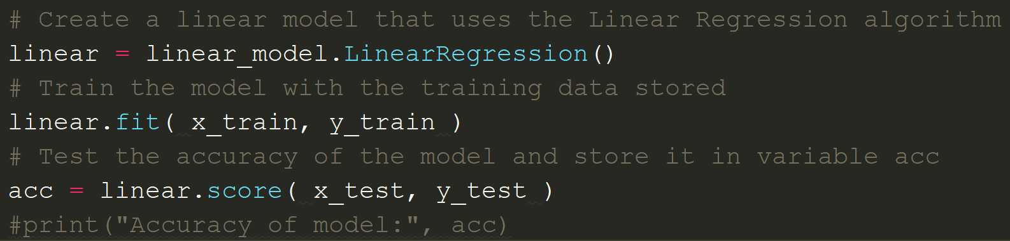
Models and Algorithms
Linear Model and Linear Regression Algorithm used for this program.
Correlation between input attributes and output label.
Other algorithms not as effective for this dataset.

Slide 5
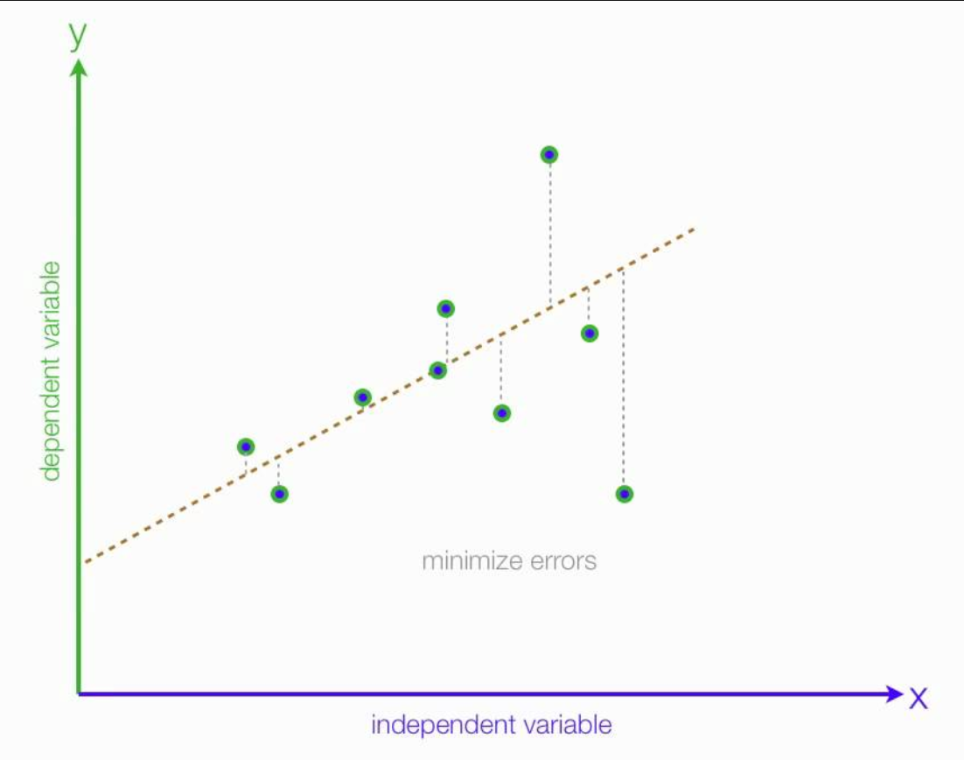
Linear Regression
Model trains by drawing and adjusting its line of best fit
Model adjusts line by using the least squares method
More training data provides a more accurate model
Model can then be implemented to predict output for real world data

Slide 6
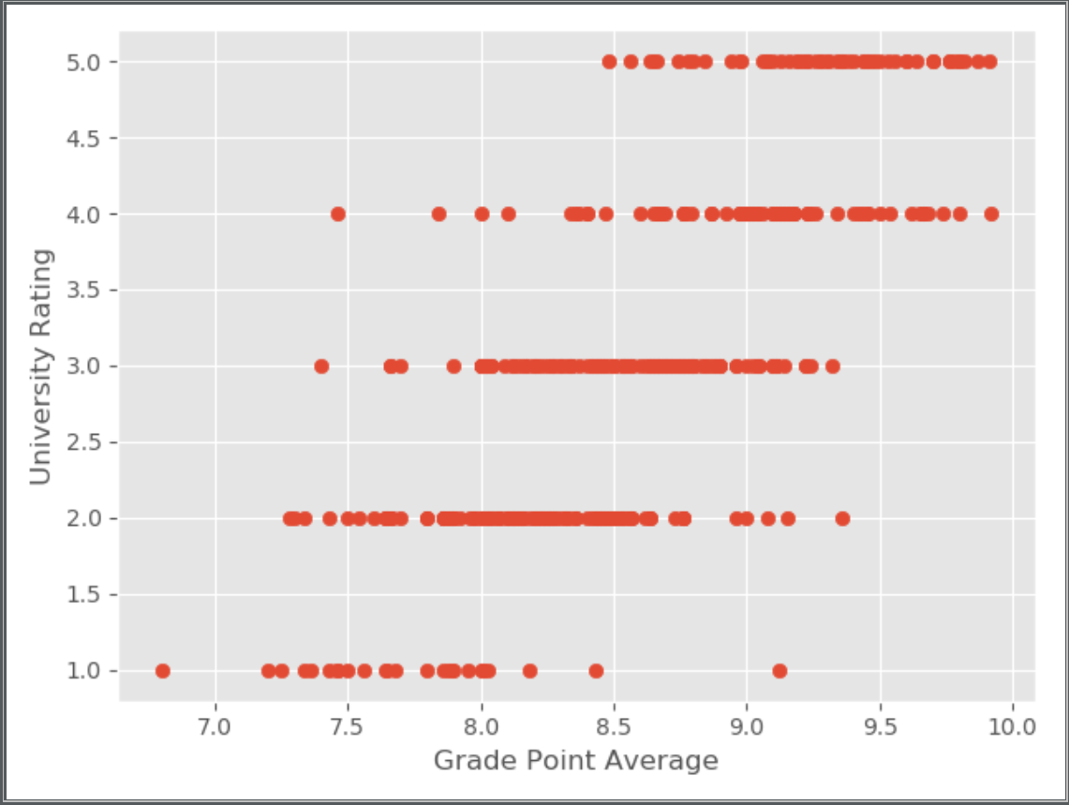
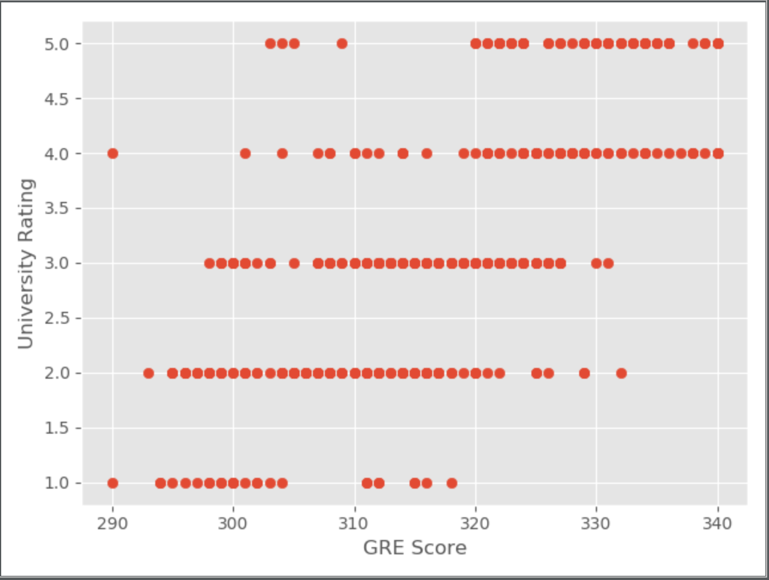
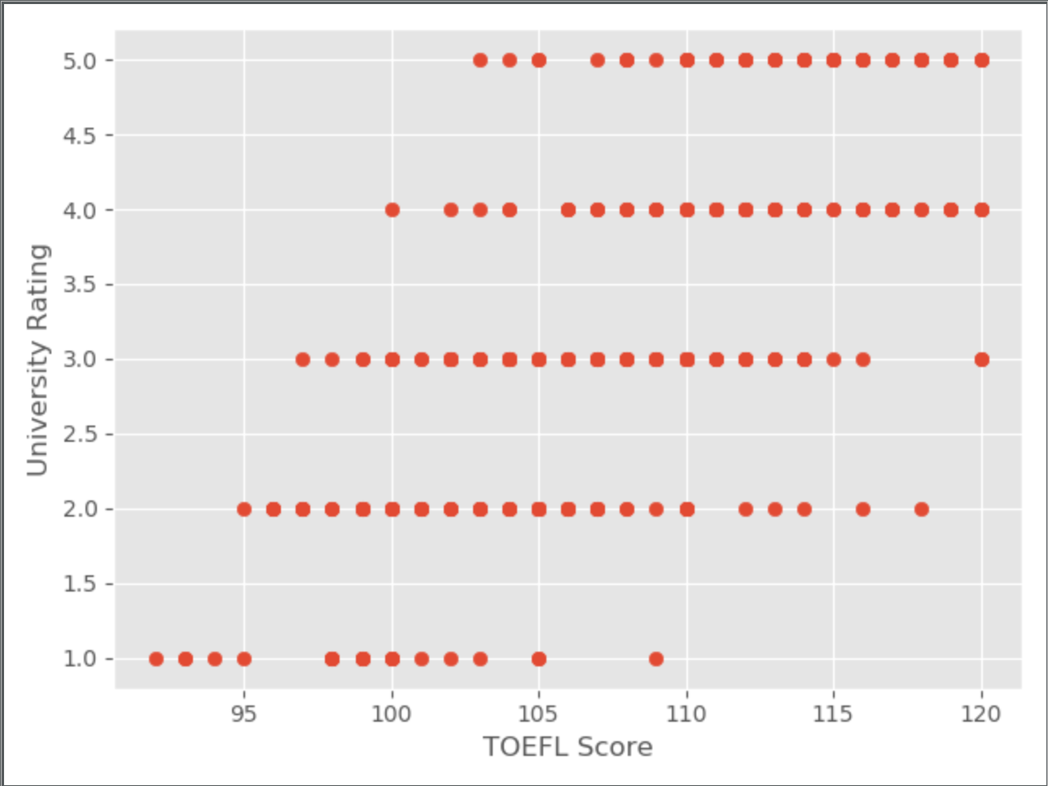

Correlations in Data

Slide 7
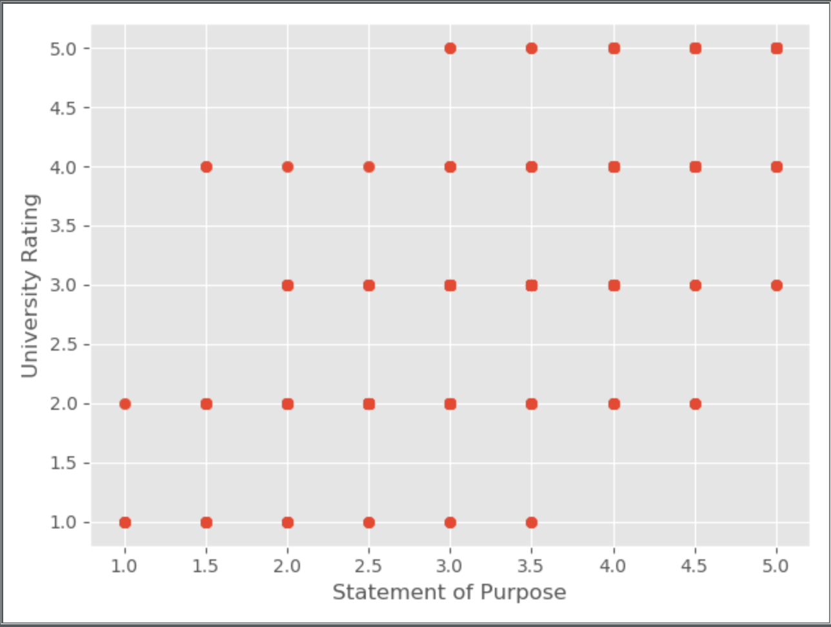
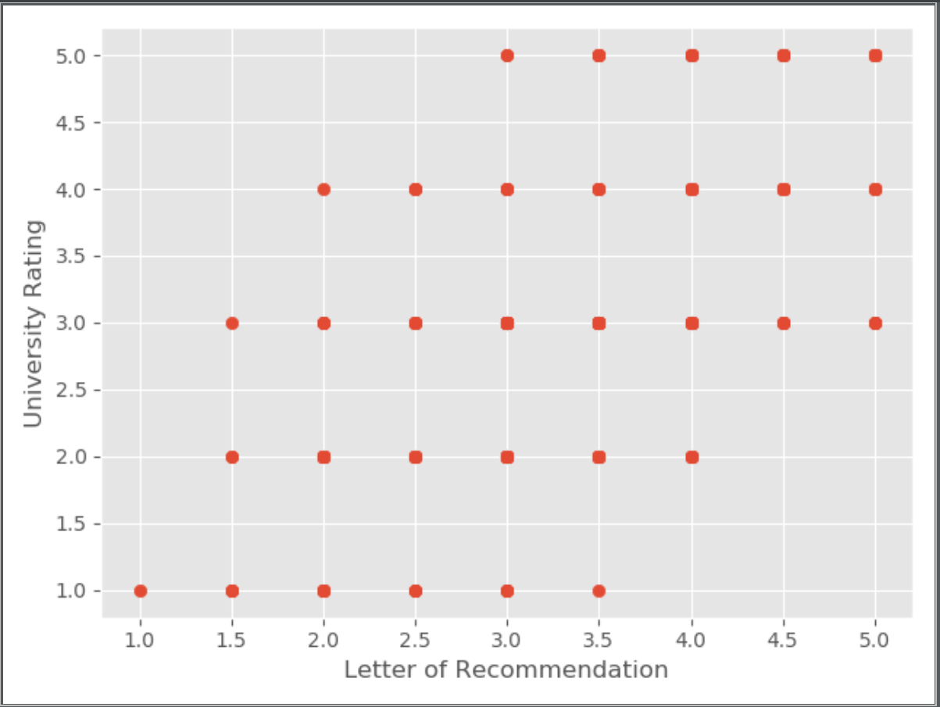
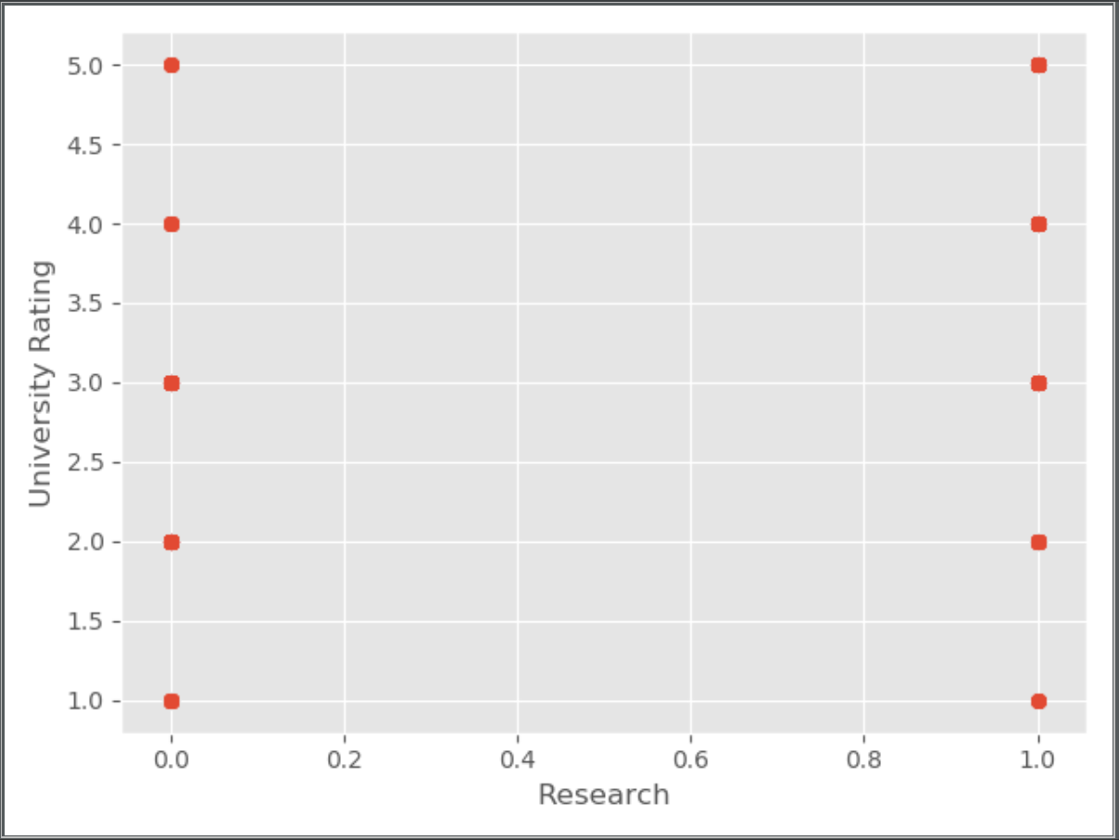

Correlations in Data

Slide 8
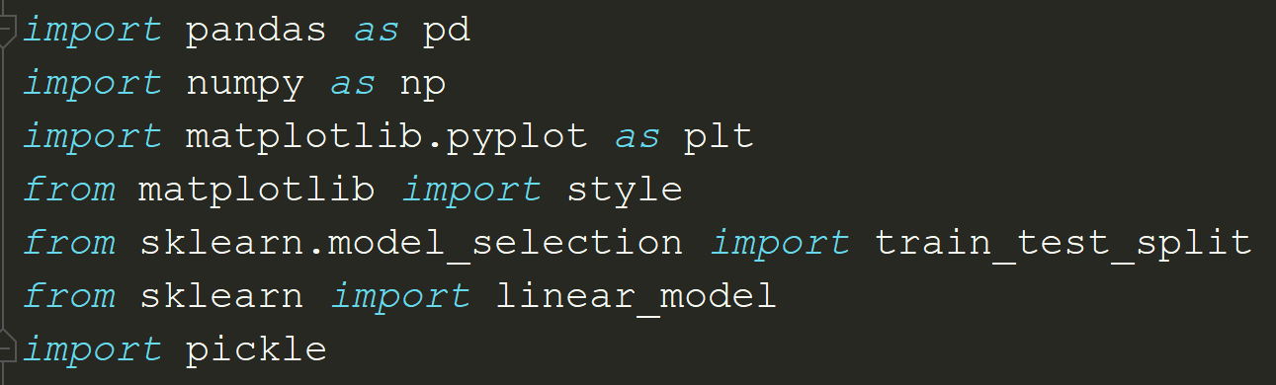
Packages
Provide inbuilt functions and methods for ease while programming.
Over 1,30,000 packages exist solely in the Python language.

Slide 9

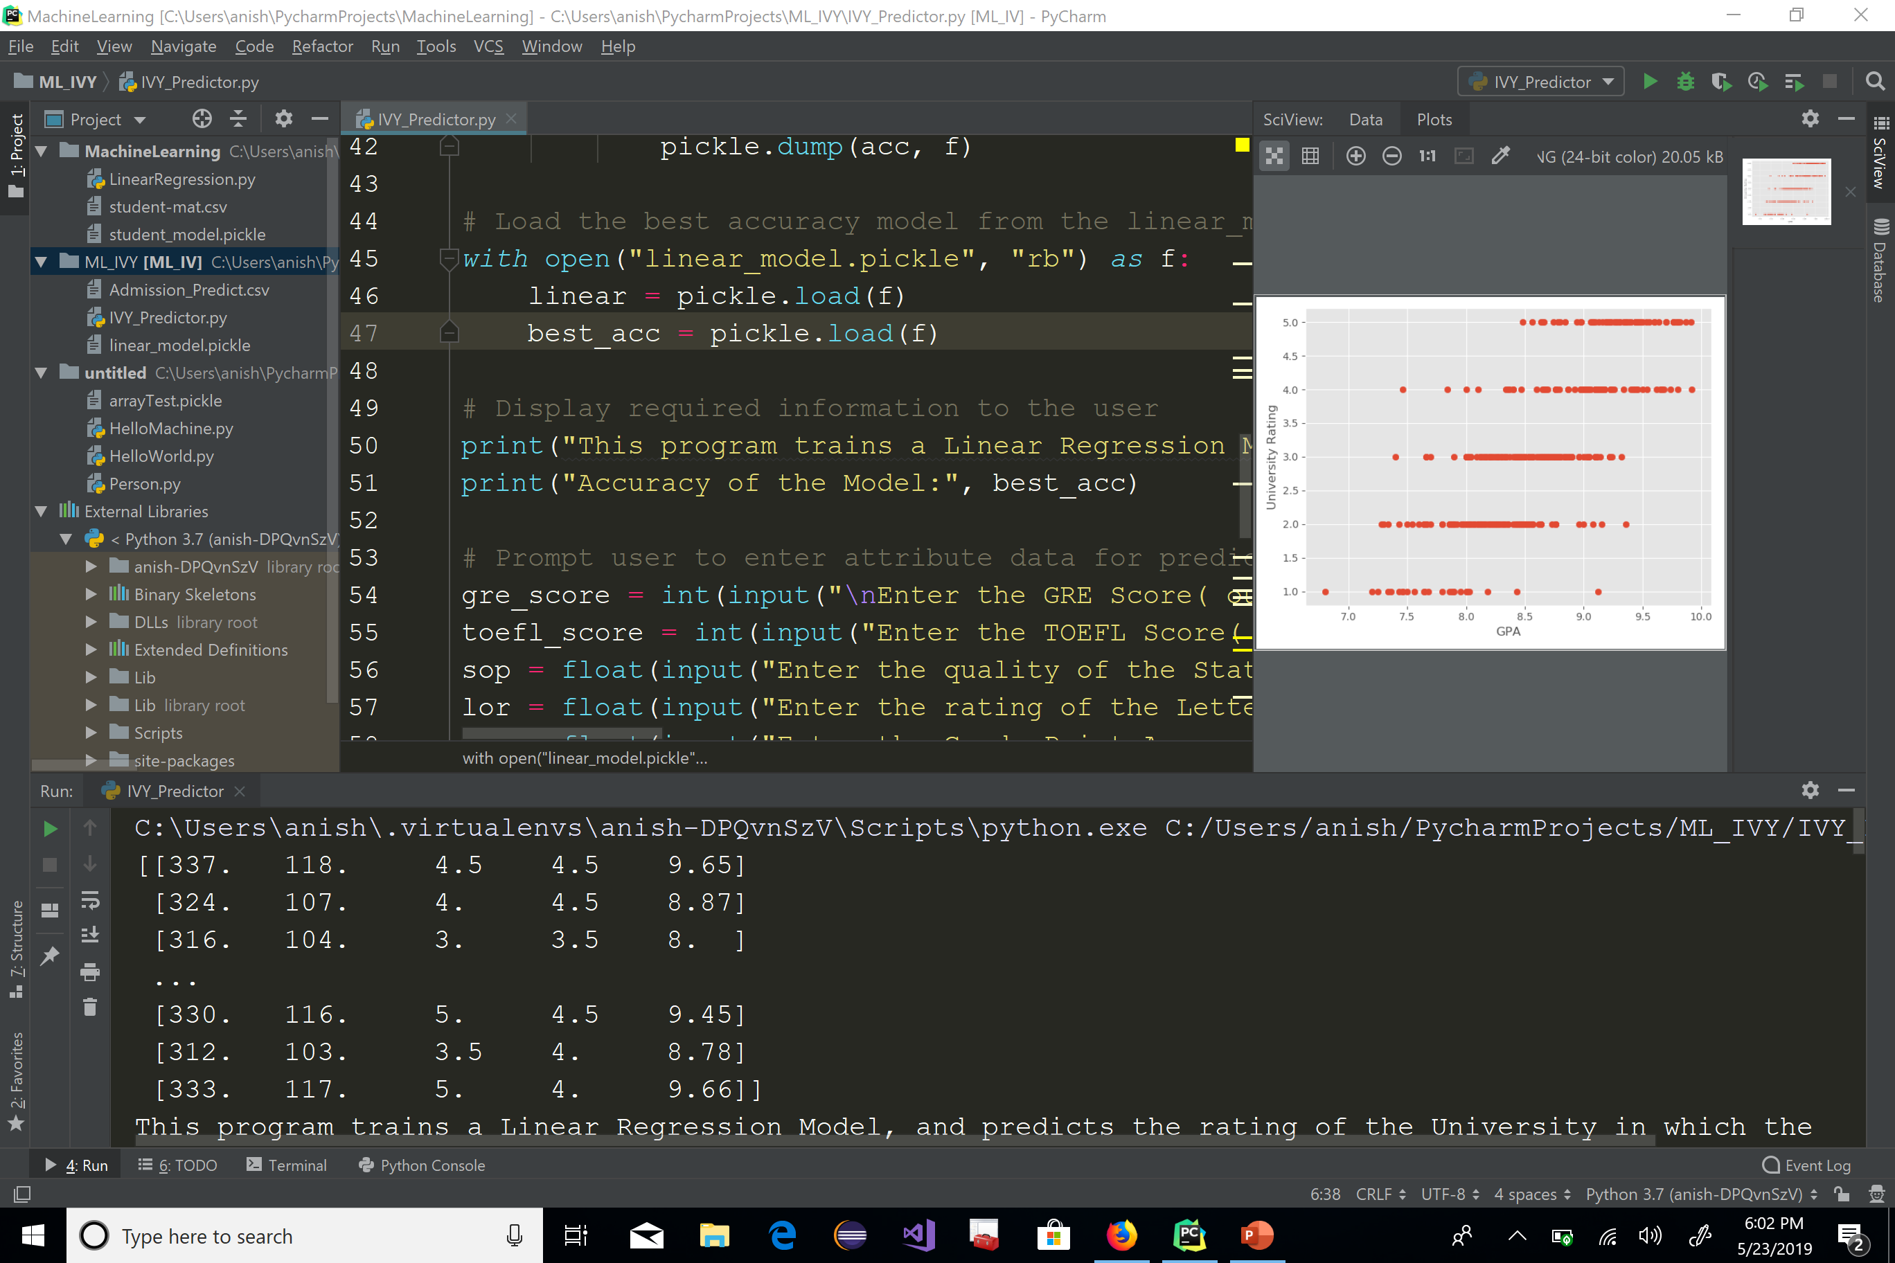
Code Dive In

Slide 10
References
[1] Andreas C. Muller, Sarah Guido: Introduction to Machine Learning with Python
[2] DataCamp: Introduction to Python course
[3] Coursera: Andrew Ng, Machine Learning course offered by Stanford
[4] Udemy: Kirill Eremenko, Hadelin de Ponteves, Machine Learning A-Z
[5] https://www.kaggle.com/annavictoria/ml-friendly-public-datasets/data

Slide 11
Acknowledgements
Thank You!

