Slide 1

Forecasting Home Prices: Data Visualization and Predictive Analysis
Data Visualization Project

Slide 2
Problem statement
Insufficient data availability for accurate market trend prediction.
Existing datasets often lack granular detail on property features and location.
Traditional statistical models may not capture complex market dynamics.
Limited use of advanced analytical techniques for predictive modeling.
Difficulty in incorporating qualitative factors influencing property value.
Need for a robust model to forecast future price changes and market shifts.
Lack of interactive tools for exploring and understanding data patterns.

Slide 3
Introduction
This presentation offers a comprehensive analysis of the local real estate market.
We will examine key factors influencing property values, including location, size, and features.
Interactive visualizations will allow for dynamic exploration of the data.
The analysis will uncover valuable insights for buyers, sellers, and investors alike.
Our goal is to provide a clearer understanding of market dynamics and future trends.

Slide 4
Research questions
What are the key factors influencing home prices in the local market?
How do property features (square footage, bedrooms, bathrooms) relate to price?
What is the relationship between neighborhood and property value?
How has the average home price changed over time?
Are there significant price variations across different neighborhoods?
What is the predictive power of a model incorporating these factors?
How accurate is a predictive model in forecasting future home prices?
How can these insights be used to inform real estate investment strategies?
What are the key features driving price differences between these neighborhoods?

Slide 5
Dataset
Feature Name | Description | Data Type | Input/Output
SquareFeet | Size of the property in square feet | Number | Input
Bedrooms | Number of bedrooms in the property | Number | Input
Bathrooms | Number of bathrooms in the property | Number | Input
Neighborhood | Location of the property (Rural, Suburb, Urban) | Categorical | Input
YearBuilt | Year the property was built | Number | Input
Price | Sale price of the property | Number | Output

Slide 6
Solution with Power BI
Research Question | Potential Outcomes | Visualizations
What are the key factors influencing home prices? | Identification of the most significant factors (e.g., square footage, location) | Scatter plots, bar charts, tree maps (feature importance)
How do property features relate to price? | Correlation coefficients, regression model coefficients showing feature impact on price | Scatter plots (Price vs. SquareFeet, Price vs. Bedrooms, etc.), correlation matrix
Relationship between neighborhood and property value? | Significant price differences between neighborhoods; visualization of price distribution | Box plots (Price by Neighborhood), bar charts (Average Price by Neighborhood), map
How has the average home price changed over time? | Visualization of price trends over time; identification of periods of growth/decline | Line chart (Average Price over YearBuilt)
Significant price variations across neighborhoods? | Identification of neighborhoods with significantly different average prices | Box plots, map with color-coding by average price
Predictive power of a model incorporating these factors? | R-squared value indicating model fit; RMSE showing prediction error | Tables showing model metrics (R-squared, RMSE, etc.)
Accuracy of a predictive model in forecasting future prices? | MAE, MAPE values indicating prediction accuracy; forecast visualizations | Line charts (Actual vs. Predicted Prices), error plots
How can insights inform real estate investment strategies? | Identification of high-value areas, optimal investment strategies based on risk tolerance | Interactive dashboards with filters and slicers
Key features driving price differences between neighborhoods? | Identification of specific features that disproportionately impact prices in certain areas | Segmented bar charts

Slide 7
Suitable Plot Types
Variable | Data Type | Suitable Plot Types | Insights Gained
Square Footage | Numerical | Scatter Plot (vs. Price), Histogram, Box Plot | Relationship between size and price; distribution of house sizes; outliers
Bedrooms | Numerical | Bar Chart, Scatter Plot (vs. Price), Box Plot | Number of bedrooms and their impact on price; distribution of bedrooms per house
Bathrooms | Numerical | Bar Chart, Scatter Plot (vs. Price), Box Plot | Number of bathrooms and their impact on price; distribution of bathrooms per house
Neighborhood | Categorical | Bar Chart (Average Price), Map, Pie Chart, Box Plot | Price variation by neighborhood; geographical distribution of prices
Year Built | Numerical | Histogram, Line Chart (Average Price over time), Box Plot | Distribution of house ages; price trends over time; price changes across decades
Price | Numerical | Histogram, Box Plot, Scatter Plot (vs. other variables) | Price distribution; outliers; relationship with other variables

Slide 8
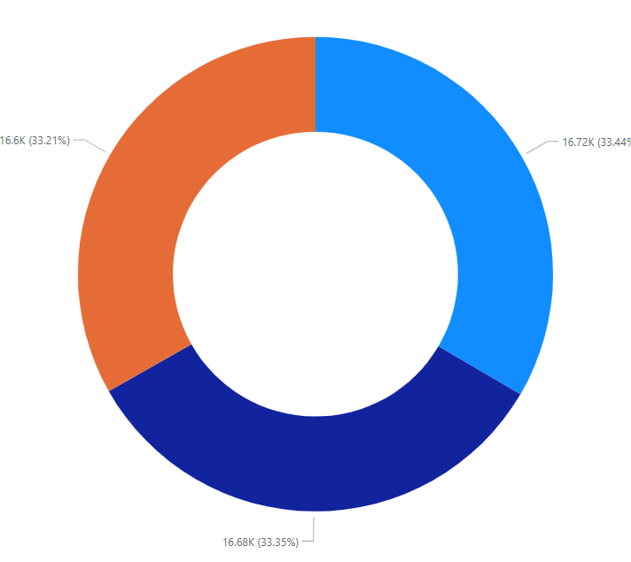
Neighborhood Breakdown
Neighborhood Breakdown:
Suburb (light blue): 16.72K (33.44%)
Rural (dark blue): 16.68K (33.35%)
Urban (orange): 16.6K (33.21%)
Insights:
The distribution among the three neighborhoods is almost evenly split, with each group representing approximately one-third of the total.
The suburban area has a slightly higher count (16.72K) than rural (16.68K) and urban (16.6K).

Slide 9
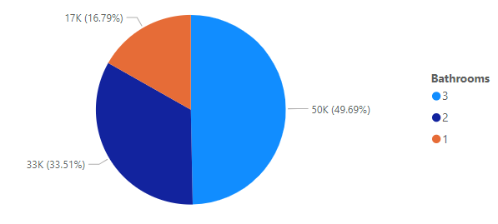
Bathroom Breakdown
Bathroom Breakdown:
3 Bathrooms (light blue): 50K (49.69%)
2 Bathrooms (dark blue): 33K (33.51%)
1 Bathroom (orange): 17K (16.79%)
Insights:
Houses with 3 bathrooms dominate, making up almost half of the total (49.69%).
Houses with 2 bathrooms account for about one-third (33.51%).
Houses with 1 bathroom represent the smallest portion at 16.79%.

Slide 10
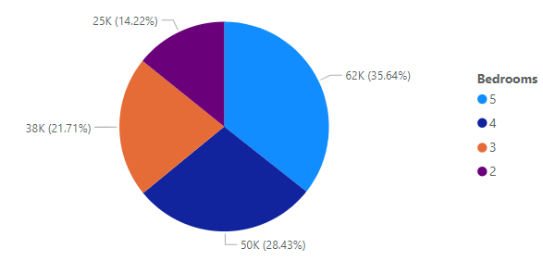
Bedroom Breakdown
Bedroom Breakdown:
5 Bedrooms (light blue): 62K (35.64%)
4 Bedrooms (dark blue): 50K (28.43%)
3 Bedrooms (orange): 38K (21.71%)
2 Bedrooms (purple): 25K (14.22%)
Insights:
Houses with 5 bedrooms are the most common, representing over a third (35.64%) of the total.
Houses with 4 bedrooms follow, accounting for nearly 28.43%.
Houses with 3 bedrooms represent 21.71%.
Houses with 2 bedrooms are the least common, at just 14.22%.

Slide 11
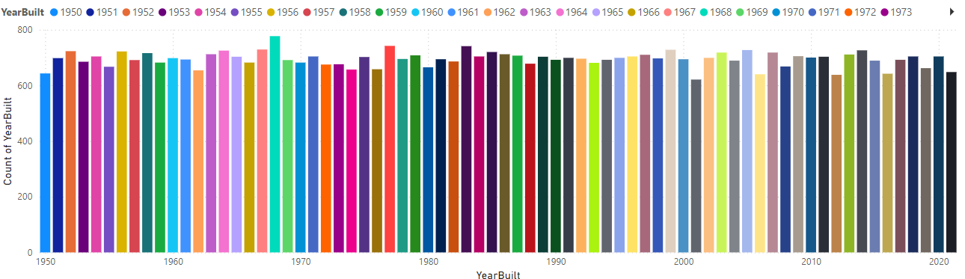
Trend in constructions
1960s: A significant peak in construction occurred during this decade, possibly due to post-war economic boom and suburban development.
Early 1970s: A slight dip is observed, which might be related to economic downturns or shifts in housing policies.
Late 1970s to 1980s: Another peak is evident, suggesting renewed growth in the housing market.
Early 1990s: A minor dip, potentially linked to economic recessions or changes in interest rates.
Late 1990s to 2000s: A strong surge in construction, possibly fueled by economic expansion and increased demand for housing.
2010s: A slight decline, which could be attributed to the global financial crisis and its impact on the housing market.
2020s: The trend appears to be continuing upwards, indicating sustained growth in house construction.

Slide 12
Descriptive statistics

Slide 13
Descriptive statistics
Typical Property Profile:
The average home in this dataset is approximately 2006 square feet, with 3.5 bedrooms and 2 bathrooms, built around 1985. This provides a clear picture of the typical property.
Price Range is Wide:
Home prices vary significantly, ranging from a minimum of -$36,588.17 (note the negative value – investigate this outlier!) to a maximum of $492,195.26. This wide range suggests a diverse market with properties catering to different price points. The presence of a negative price warrants further investigation; it's likely an error in the data.
Neighborhood Impact (Possible):
While the average neighborhood score is 2.33, the standard deviation is relatively high (0.94). This suggests that neighborhood has a substantial impact on pricing, though more analysis would be needed to confirm this.
Data Quality Considerations:
The presence of a negative price and the significant standard deviations in several variables highlight the need to investigate potential data entry errors or outliers. Cleaning the data before further analysis is crucial.
No Strong Skewness or Kurtosis:
The skewness and kurtosis values for most variables are close to zero, indicating that the data distributions are relatively symmetrical and not heavily skewed (except for possibly the 'Neighborhood' variable). This is good for many statistical methods.
Square Footage is Relatively Normal:
The relatively low standard deviation of square footage (575.51) compared to the mean (2006.37) suggests that most homes are of a similar size.

Slide 14
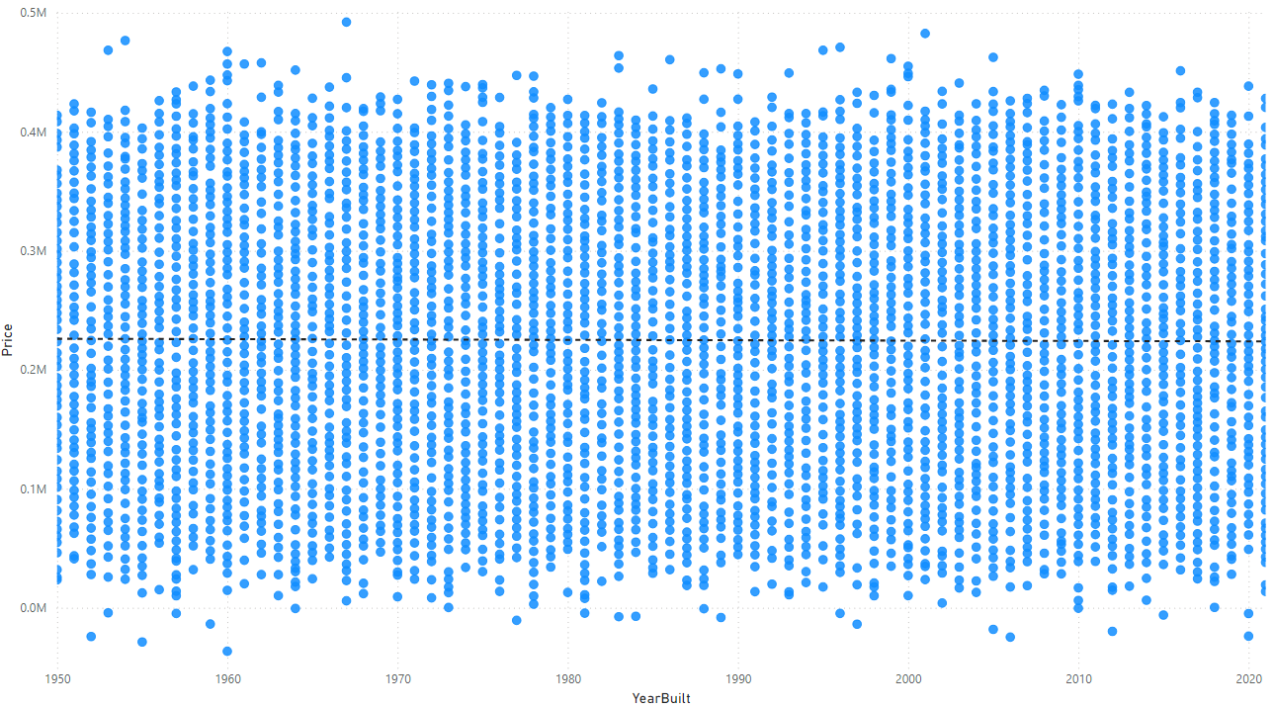
Relationship Between Year Built and House Price
Observations:
No Clear Trend: There's no clear upward or downward trend in the data. The points are scattered randomly across the plot.
Price Range: Prices vary significantly, with some houses built in older years commanding higher prices than newer ones.
Outliers: There are a few outliers, especially in the higher price range, which might be due to unique features, location, or other factors not captured in the data.
Interpretation:
Year Built is Not a Strong Predictor: The year a house was built is not a strong predictor of its price. Other factors like location, size, condition, and amenities likely play a more significant role in determining a house's value.
Potential for Other Factors: To better understand price variations, it would be helpful to include additional variables like square footage, number of bedrooms and bathrooms, neighborhood, and property type.

Slide 15
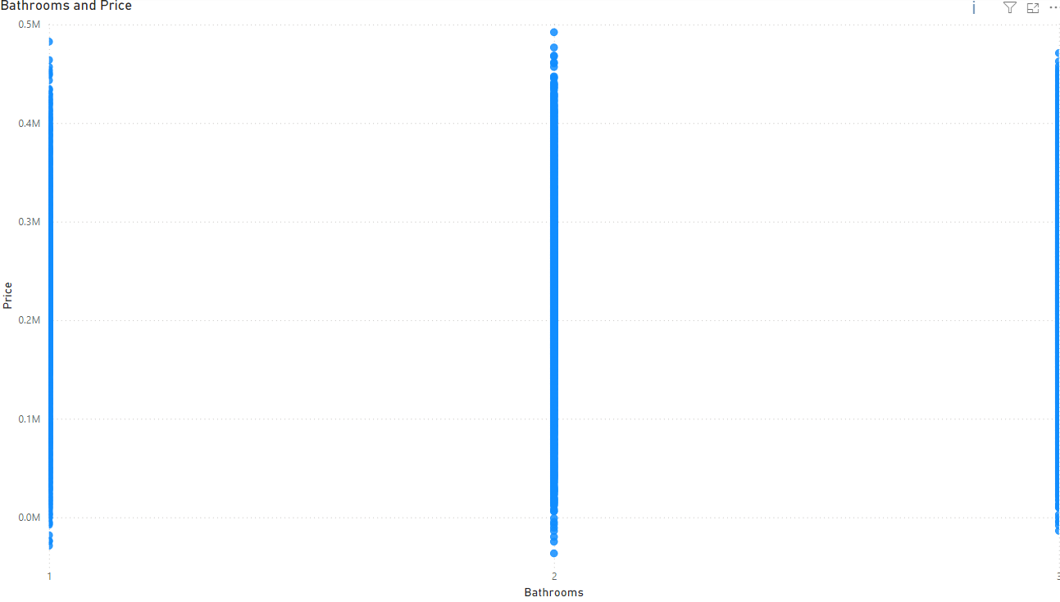
Relationship Between Bathrooms and House Price
Observations:
Vertical Lines: The data points form distinct vertical lines at 1, 2, and 3 bathrooms. This indicates that for each bathroom count, there's a wide range of house prices.
No Clear Trend: There's no clear upward or downward trend in the data. The price range for each bathroom count overlaps significantly.
Price Variation: Within each bathroom category, there's a substantial variation in prices. Some houses with fewer bathrooms have higher prices than houses with more bathrooms.
Interpretation:
Bathrooms as a Factor: While the number of bathrooms is a factor influencing house prices, it's not the sole determinant. Other factors like location, size, condition, and amenities play a significant role.
Overlapping Price Ranges: The overlapping price ranges for different bathroom counts suggest that the number of bathrooms alone cannot accurately predict a house's price.

Slide 16
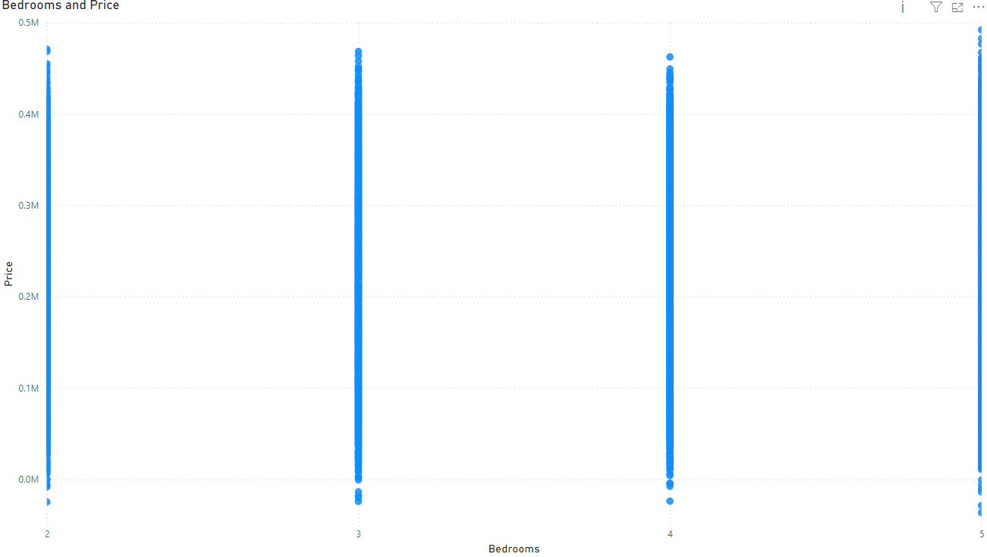
Relationship Between Bedrooms and House Price
Observations:
Vertical Lines: The data points form distinct vertical lines at 2,3,4 and 5 bedrooms. This indicates that for each bathroom count, there's a wide range of house prices.
No Clear Trend: There's no clear upward or downward trend in the data. The price range for each bedroom count overlaps significantly.
Price Variation: Within each bedroom category, there's a substantial variation in prices. Some houses with fewer bedrooms have higher prices than houses with more bedrooms.
Interpretation:
Bathrooms as a Factor: While the number of bedrooms is a factor influencing house prices, it's not the sole determinant. Other factors like location, size, condition, and amenities play a significant role.
Overlapping Price Ranges: The overlapping price ranges for different bedrooms counts suggest that the number of bedrooms alone cannot accurately predict a house's price.

Slide 17
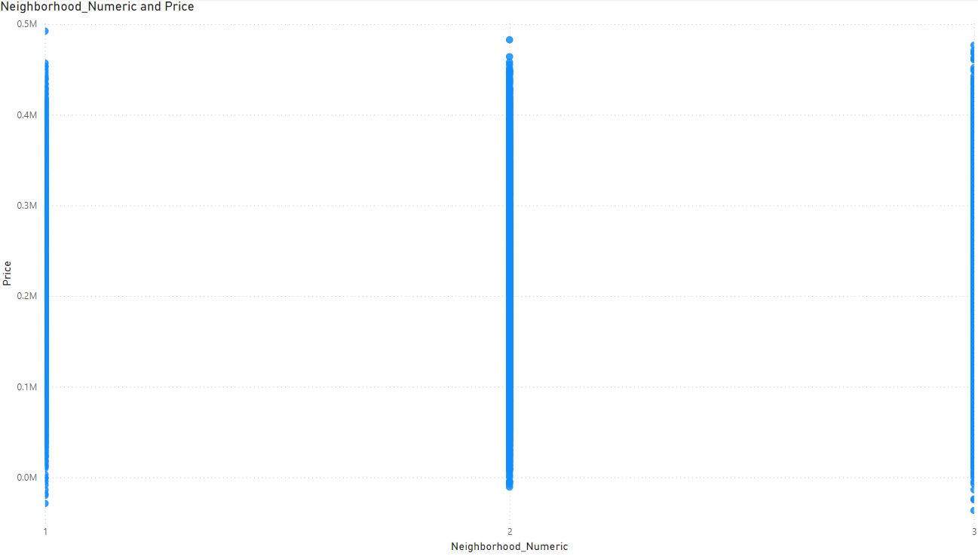
Relationship Between neighborhood and House Price
Observations:
Vertical Lines: The data points form distinct vertical lines at 1, 2, and 3 on the x-axis, which represents the neighborhood. This indicates that each neighborhood has a range of house prices.
Price Variation: Within each neighborhood, there's a substantial variation in prices. Some houses in a specific neighborhood are more expensive than others.
Overlapping Price Ranges: The price ranges for different neighborhoods overlap significantly. This suggests that neighborhood alone is not a strong predictor of house price.
Interpretation:
Neighborhood as a Factor: While neighborhood is a factor influencing house prices, it's not the sole determinant. Other factors like house size, condition, and amenities play a significant role.

Slide 18
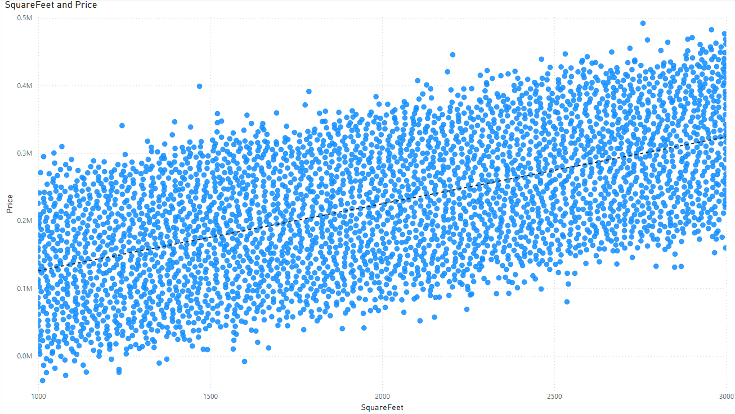
Relationship Between Square feet and House Price
Observations from the Scatter Plot:
Positive Correlation: There's a clear positive correlation between square footage and price. As the square footage of a house increases, its price tends to increase as well. This is indicated by the upward trend of the data points.
Scatter: While there's a positive trend, the data points are scattered around the trend line. This suggests that while square footage is a significant factor in determining price, it's not the only factor. Other variables like location, age, number of bedrooms, and bathrooms also influence the price.
Interpretation:
Square Footage as a Strong Predictor: Square footage is a strong predictor of house price. Larger houses tend to be more expensive.
Other Factors Matter: Other factors like location, age, number of bedrooms, bathrooms, and amenities also play a significant role in determining a house's price.

Slide 19
Correlation
Square Feet and Price: The strongest correlation is between square feet and price (0.7507). This indicates a strong positive linear relationship, meaning that as the square footage of a house increases, its price tends to increase as well.
Other Variables: The correlations between other variables and price are much weaker. For example, the correlation between bedrooms and price is 0.0726, indicating a very weak positive relationship. Similarly, the correlation between bathrooms and price is 0.0284, also indicating a very weak positive relationship.

Slide 20
Regression
Model Performance:
R-squared: The model explains approximately 57% of the variance in house prices. This indicates a moderately strong fit.
Adjusted R-squared: Similar to R-squared but accounts for the number of predictors, suggesting a robust model.
Standard Error: The standard error of the estimate is 49927.28914, indicating the average deviation of predicted values from actual values.
Variable Significance:
Square Feet: Has a highly significant positive impact on price. A one-unit increase in square feet is associated with a $99.35 increase in price, holding other factors constant.
Bedrooms: Has a significant positive impact on price. A one-unit increase in bedrooms is associated with a $5074.91 increase in price, holding other factors constant.
Bathrooms: Has a significant positive impact on price. A one-unit increase in bathrooms is associated with a $2830.40 increase in price, holding other factors constant.
Neighborhood: Has a non-significant impact on price.
Year Built: Has a non-significant negative impact on price.

Slide 21
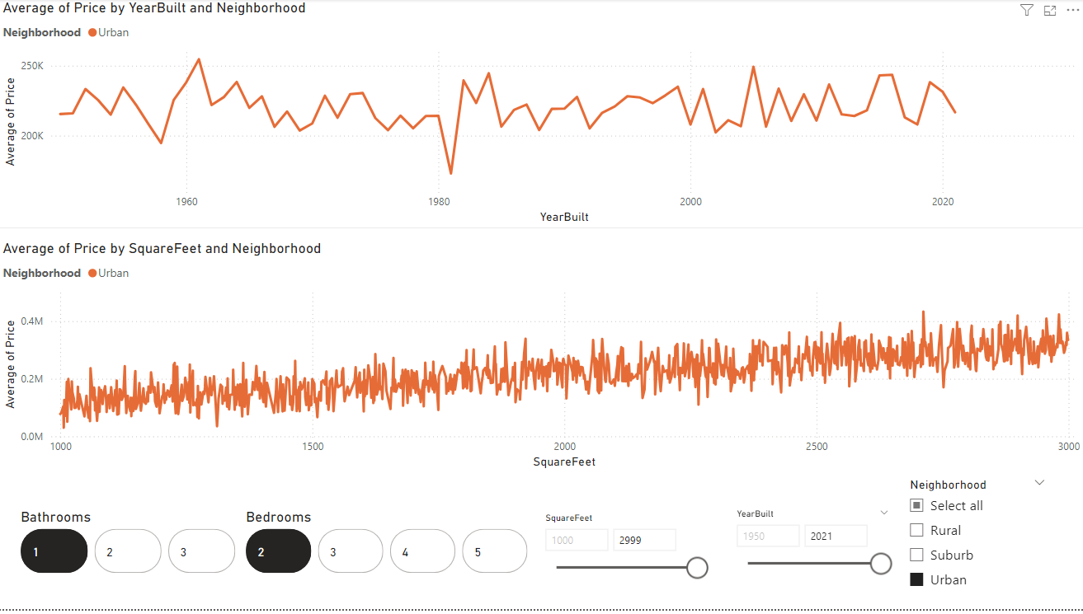
Interactive Dashboard
The dashboard allows you to explore the relationship between house price, year built, square footage, number of bathrooms, number of bedrooms, and neighborhood. By adjusting the filters, you can gain insights into how these factors influence house prices in different neighborhoods and time periods.
Bathrooms: You can select specific numbers of bathrooms to filter the data.
Bedrooms: You can select specific numbers of bedrooms to filter the data.
Square Feet: You can adjust the minimum and maximum square footage to filter the data.
Year Built: You can adjust the minimum and maximum year built to filter the data.

Slide 22
Conclusion
1. Identifying Key Drivers of Price:
Visualizing the correlation matrix clearly highlighted the strong positive relationship between square footage and price. This helped us understand that larger houses tend to command higher prices.
Scatter plots further reinforced this relationship, allowing us to see the trend visually.
2. Uncovering Neighborhood Influences:
Interactive dashboards enabled us to explore how average prices vary across different neighborhoods over time and by square footage.
Visual comparisons helped us identify neighborhoods with higher or lower average prices and understand the factors contributing to these differences.
3. Evaluating Model Performance:
Visualizing model residuals allowed us to assess the model's accuracy and identify potential areas for improvement.
Comparing predicted and actual values graphically helped us understand how well the model performs in different scenarios.
4. Communicating Insights Effectively:
Clear and concise visualizations made it easier to communicate complex findings to a diverse audience.
Interactive dashboards empowered stakeholders to explore the data themselves and gain deeper insights.

