Slide 1
4699 SysML Team 102
Europa Submarine Model
Dhriti Naik, Anish Kulkarni, Ryland Marley, Aaditya Patel, Toby Reitman, William Mulder
July 22, 2026

Slide 2
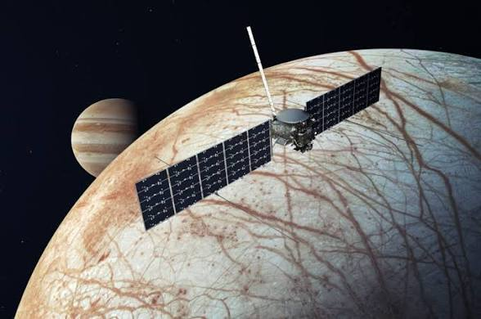
Background of Europa Exploration: Europa Clipper
Europa is believed to have a saltwater ocean under its icy crust
The chemical compounds and temperatures for liquid water to exist is thought to allow life to exist on Europa
The Europa Clipper launched in 2024 and is intended to study the moon Europa that orbits Jupiter; a trip over 1.8 billion miles and five years
It utilizes many systems to search for the necessary elements of life, such as water as it orbits the moon

Slide 3
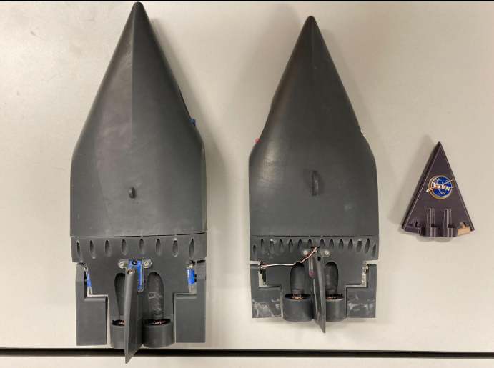
Europa and Our Mission
Until a few years ago, NASA was working on the Sensing With Independent Micro-swimmers (SWIM) mission
Objective: use miniature submarines to explore under Europa’s icy surface to search for signs of life
Our project is modeling the subsystems of a SWIM submarine and the spacecraft transporting it, specifically Thermal Control, Power, Radiation Shielding and Structural, Communications, and Propulsion
NASA Prototypes >>

Slide 4



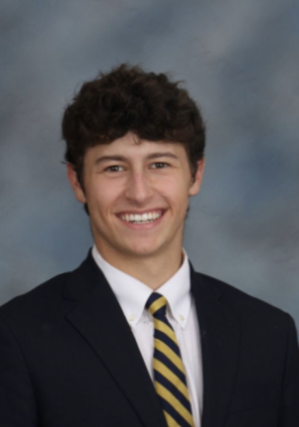

The Team
Dhriti Naik
dnaik39@gatech.edu
William Mulder
wmulder3@gatech.edu
Ryland Marley
wmarley6@gatech.edu
Anish Kulkarni
akulkarni367@gatech.edu
Toby Reitman
treitman3@gatech.edu

Slide 5
Power Subsystem
William Mulder
wmulder3@gatech.edu
William Mulder

Slide 6
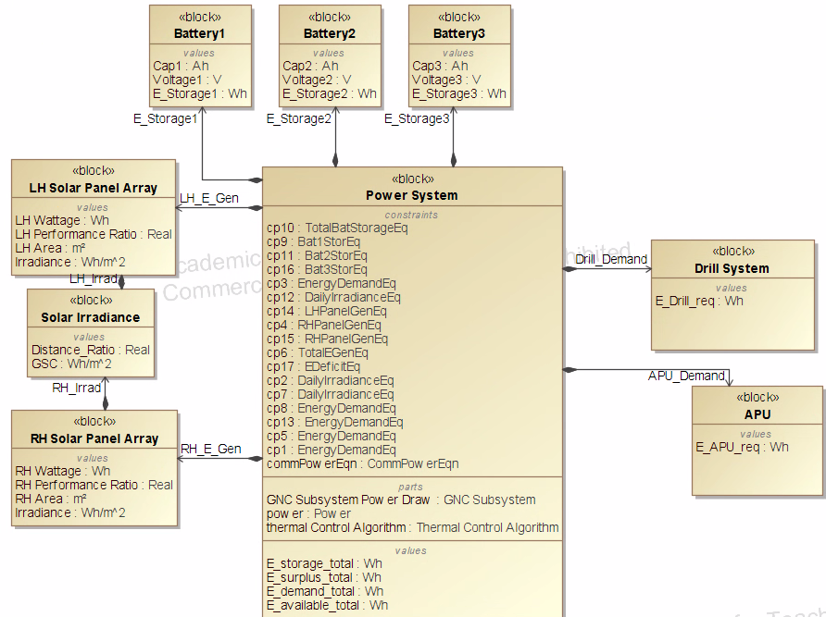
Power Subsystem
OBJECTIVES:
  Calculate power generated by solar panels based on size and irradiance
  Determine power storage for three batteries
  Find power surplus/deficit from generation compared to demand from other systems.

Slide 7
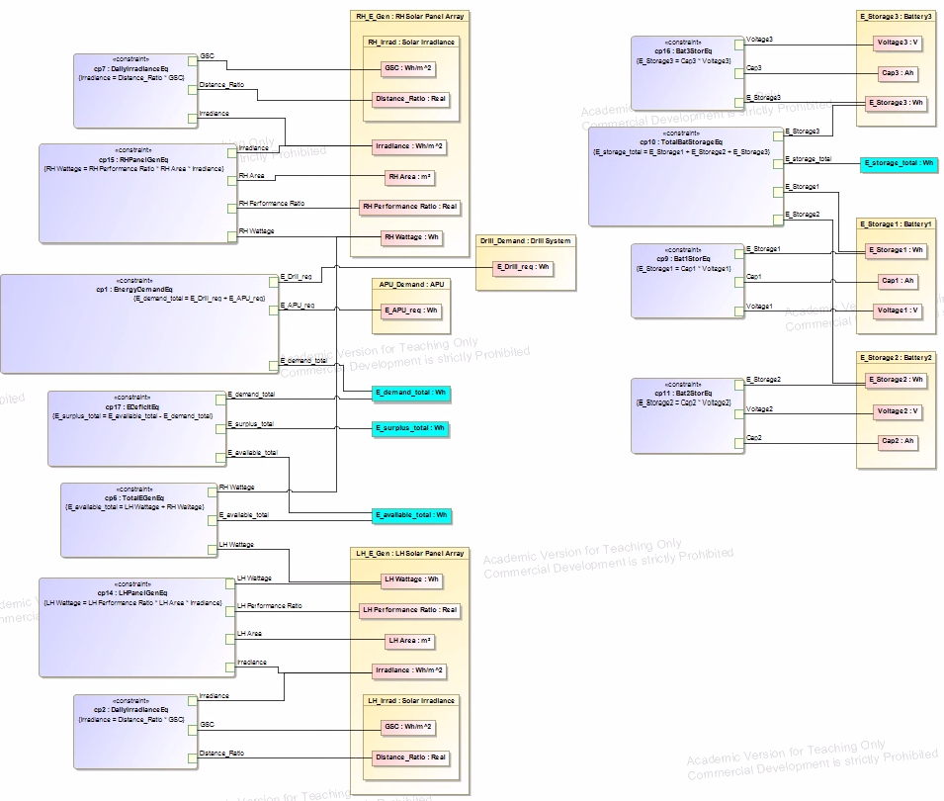
Power Subsystem Block Parametrics
Assumptions
  100% efficiency from all systems except solar panels
  Constant irradiance (GSC and distance ratio)
Inputs
  Solar panel wattage, performance ratio, area
  Daily GSC and distance for irradiance
  Battery capacity and voltage
  Power consumption of other subsystems
Equations: See footer for sources

Slide 8
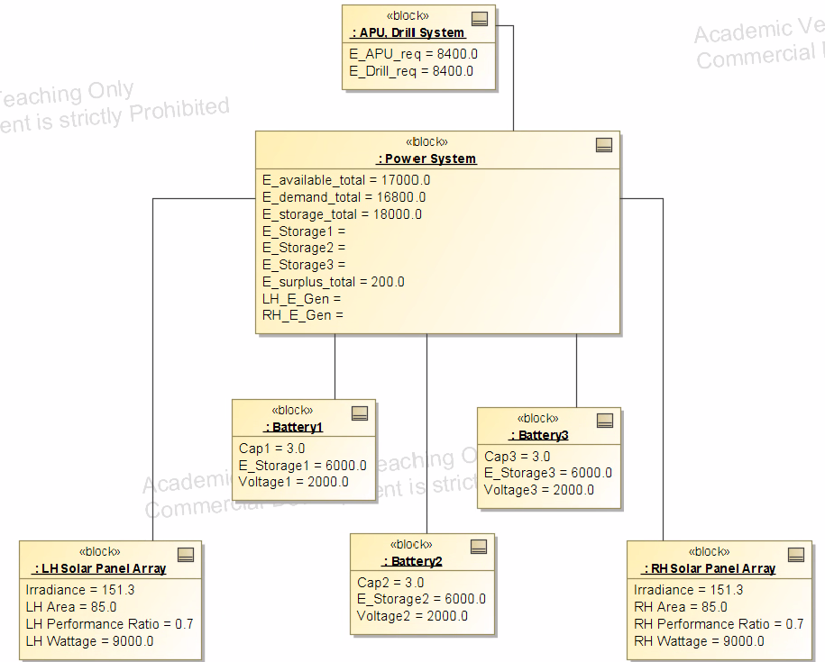
Power Example Instance
Simple, but clearly highlights important connections and considerations for power system design
Room for improvement in future semesters with development in simulation and test instances
Further improvement in equation complexity

Slide 9
Thermal Control Subsystem
Ryland Marley
wmarley6@gatech.edu
Ryland Marley

Slide 10
Equations
Q_{solar} = S*A_{p}*⍺_{s}*cos(θ)
S - solar constant (distance dependent) (W/m²)
  A_{p} - projected area facing sun (m²)
  ⍺_{s} - outer surface solar absorptivity
  θ - incidence angle between rays and surface normal (simplified to 90)
Q_{albedo} = S*A_{s}*⍺_{s}*a*F_{sat-planet}
A_{s} - surface area receiving reflection (m²)
  a - planetary albedo coefficient
  F_{sat-planet} - view factor between satellite facet and planet
Q_{planet-IR} = q_{IR}*A_{s}*ε_{IR}*F_{sat-planet}
  q_{IR} - outgoing longwave radiation flux from planet (W/m²)
  ε_{IR} - infrared emissivity of satellites outer surface
Q_{internal} = P_{electrical}*(1-𝜂)
  P_{electrical} - total power consumed by internal electronics (W)
  𝜂 - power efficiency of components
Qradiated = ε_{IR}*𝜎*A_{r}*T⁴
  𝜎 - Stefan-Boltzmann constant (5.6704 × 10⁻⁸ W/m²⋅K⁴)
  A_{r} - radiating surface area of satellite panels (m²)
  T - absolute temp of satellite surface (K)
G
Governing Equation:
Q_{solar} + Q_{albedo} + Q_{planet-IR} + Q_{internal} - Q_{radiated} + Q_{heat} = 0
g

Slide 11
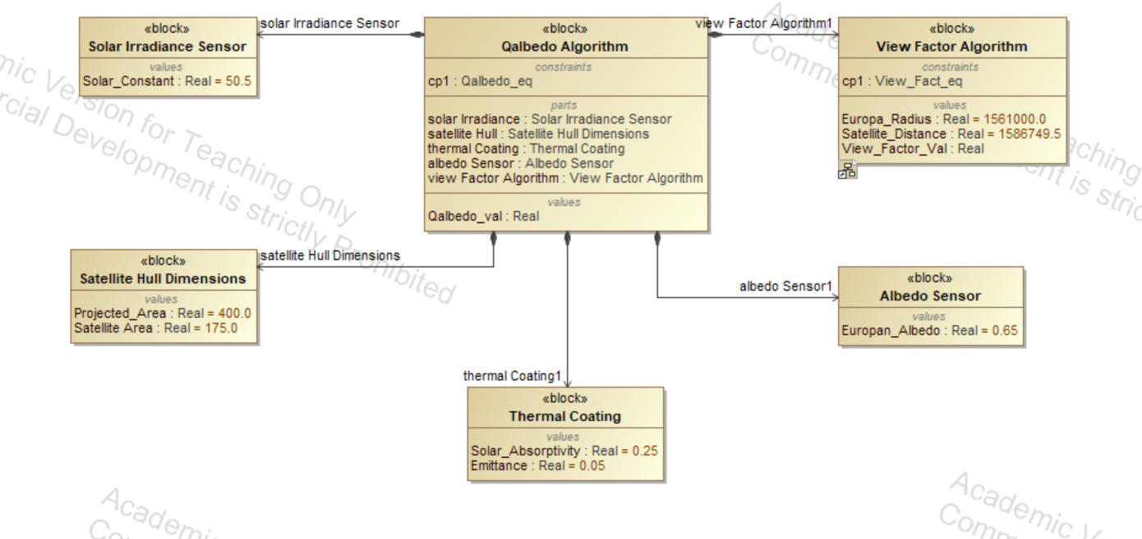
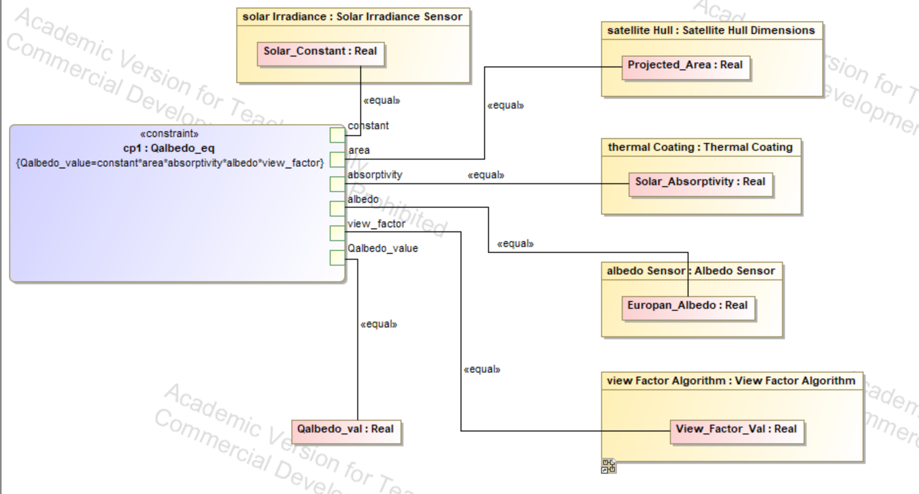
Albedo Parametrics
Assumptions:
Near Europa
Treating Satellite shape simply for area
Orbiting at ~25,000m
Gold plating (emittance, absorptivity)

Slide 12
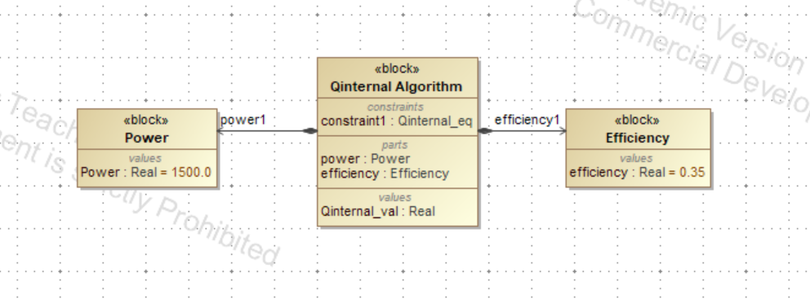
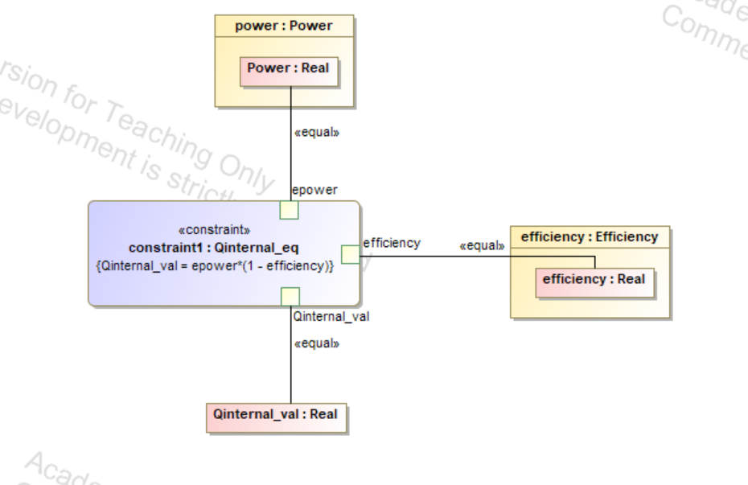
Internal Parametrics
Assumptions:
Power (W)
Efficiency similar to that of advanced NASA missions

Slide 13
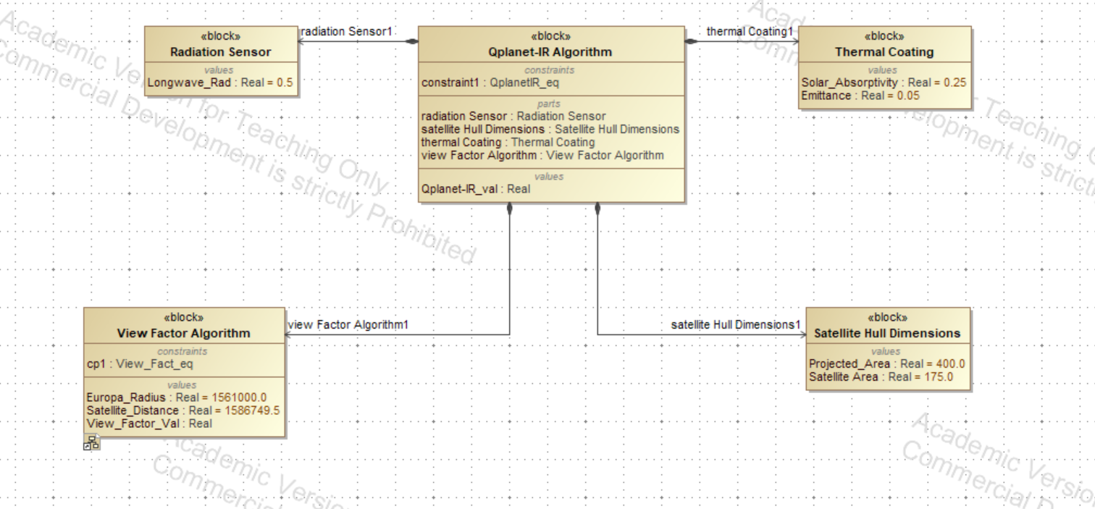
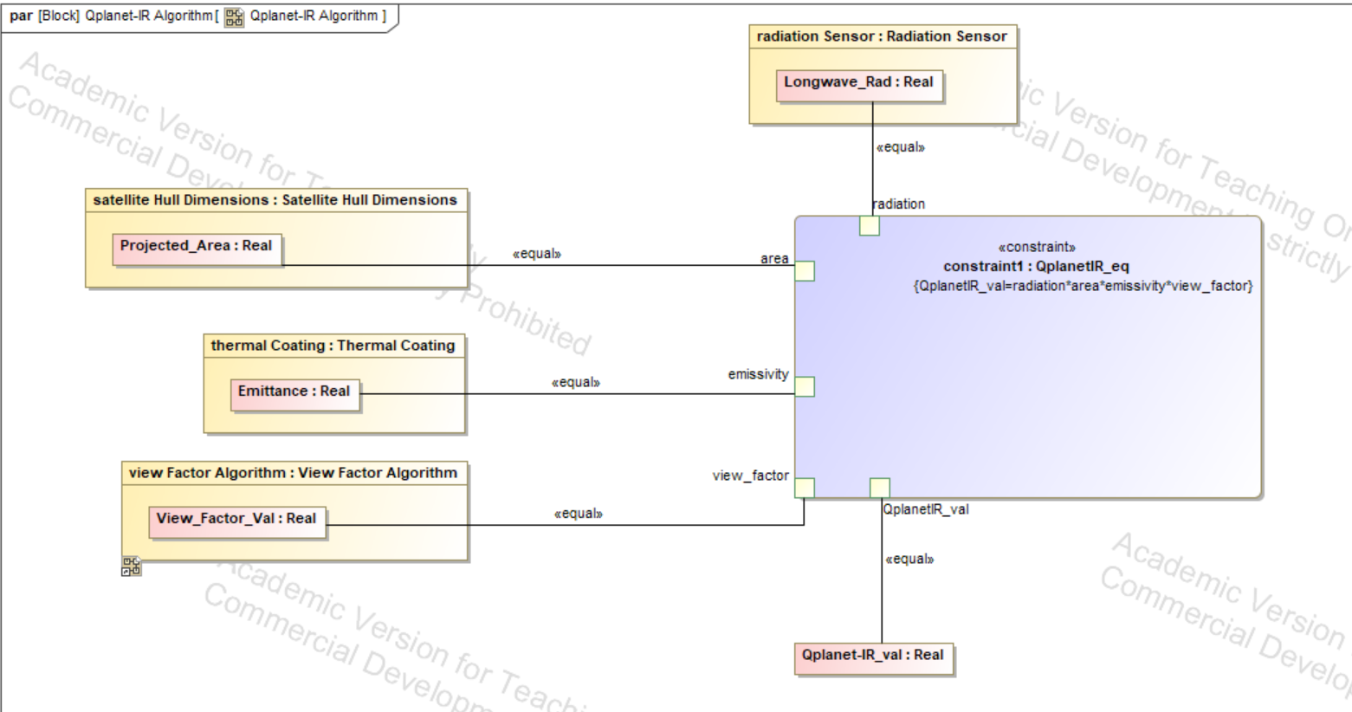
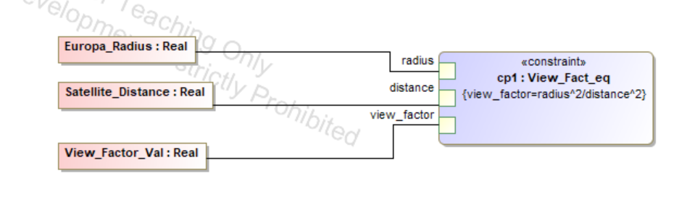
Planet-IR Parametrics
Assumptions:
Longwave Radiation from values around Europan equator

Slide 14
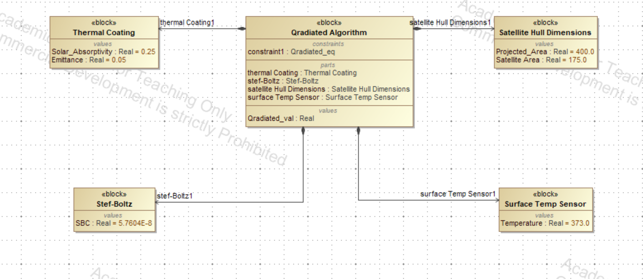
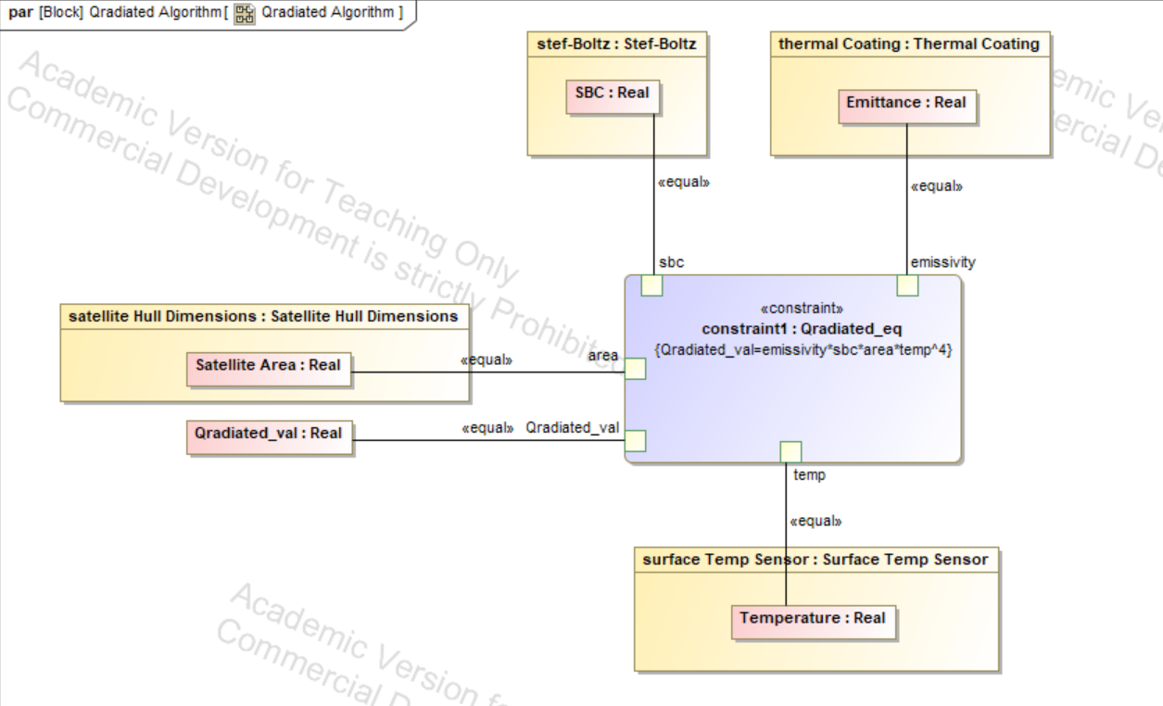
Radiated Parametrics
Assumptions:
Surface is facing sun

Slide 15
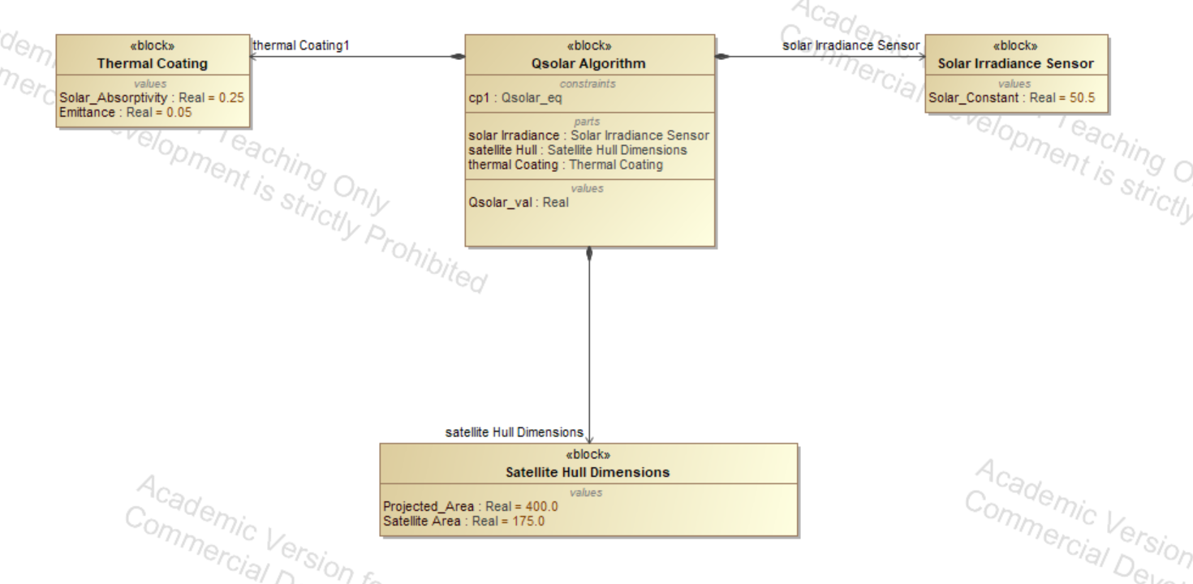
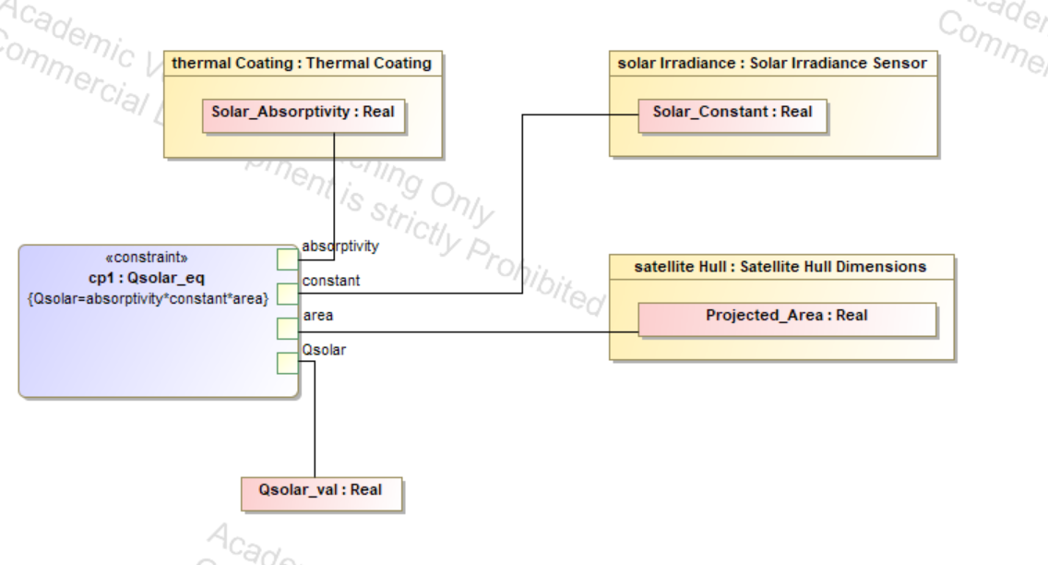
Solar Parametrics
Assumptions:
Solar constant value near Europa (W/m²)

Slide 16
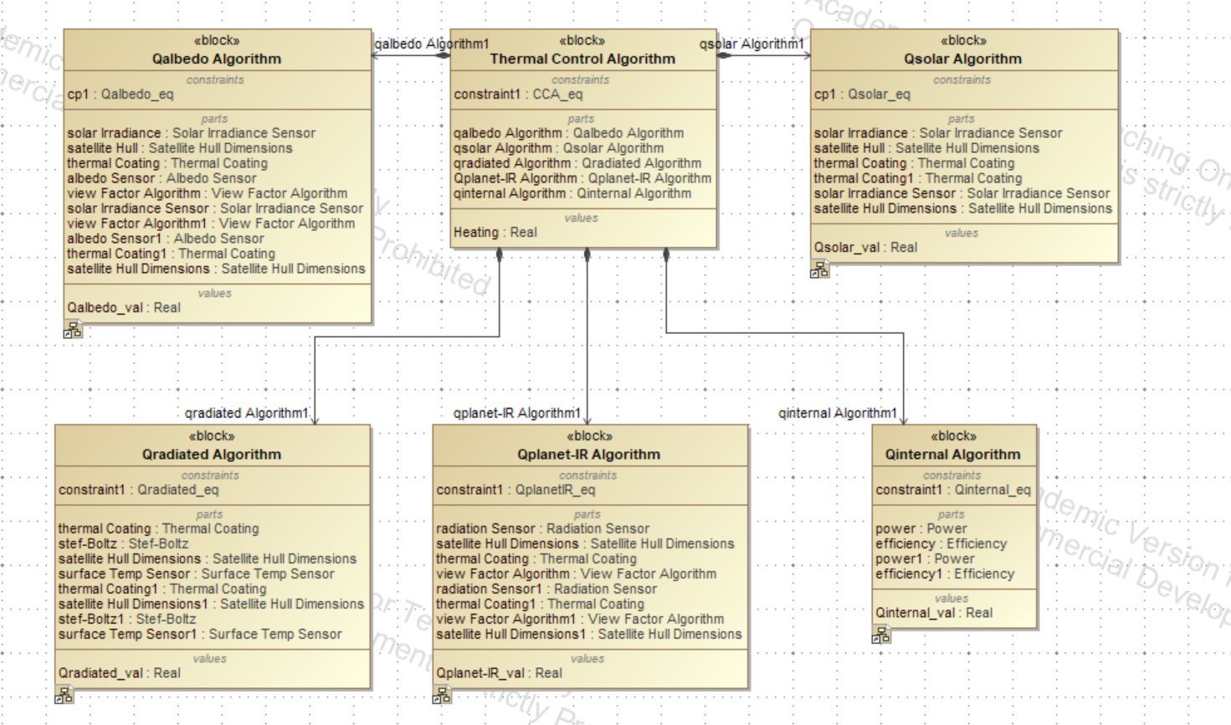
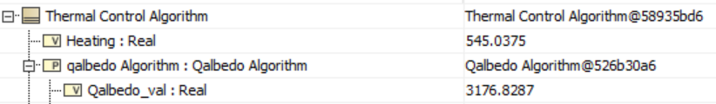
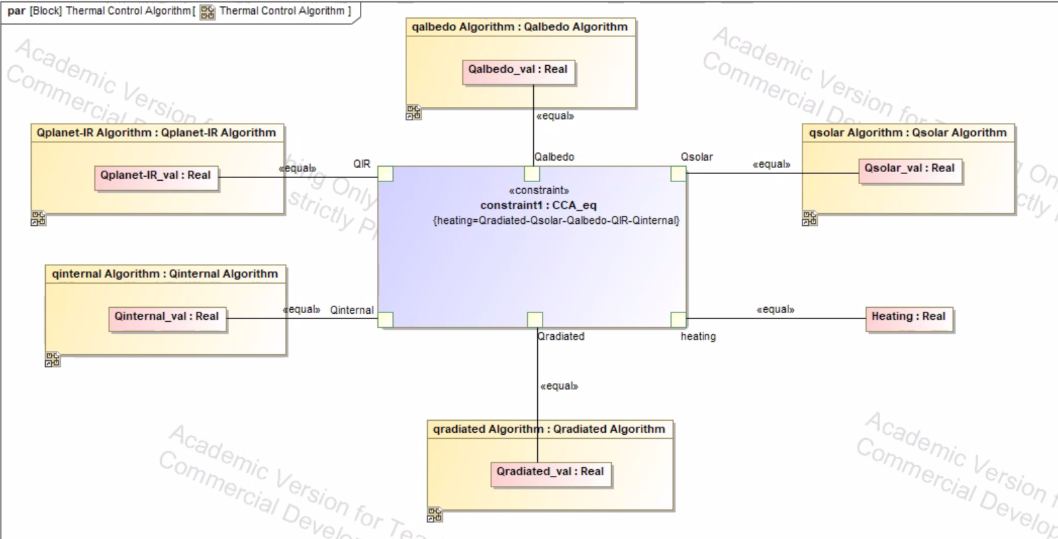
Heating Parametrics
Calculations put together to determine how much power needed to maintain current temperature (W)

Slide 17
Radiation Shielding & Structural Subsystem
Aaditya Patel

Slide 18
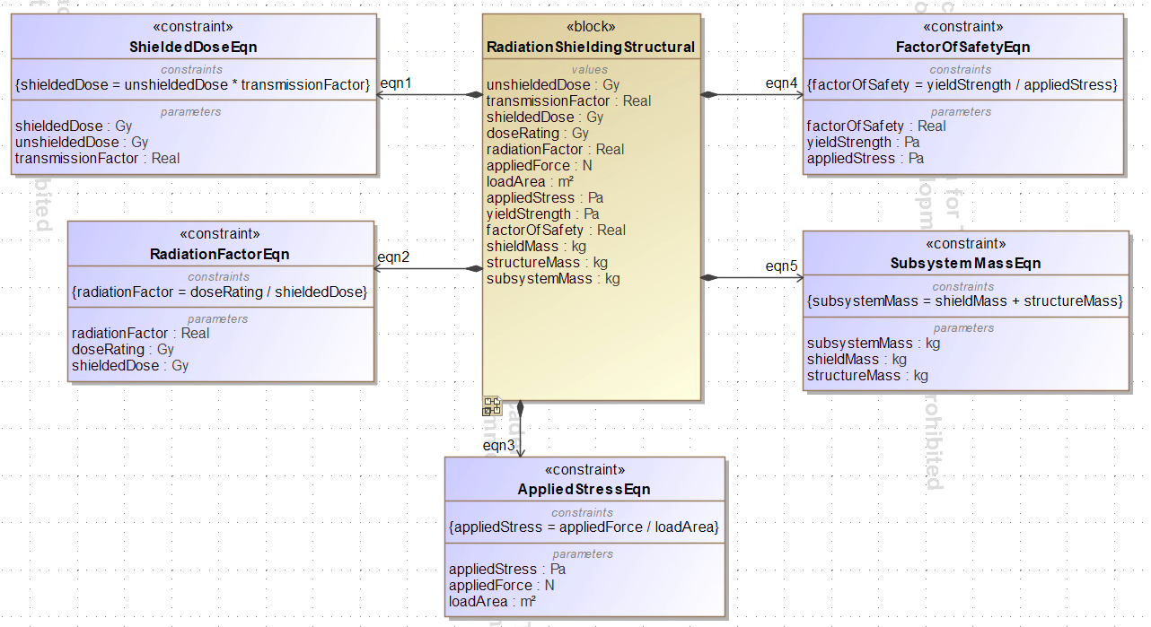
Radiation Shielding & Structural Architecture
Objectives
Reduce radiation exposure to electronics
Evaluate structural stress and safety
Calculate subsystem mass
Key outputs
Shielded dose
Radiation factor
Applied stress
Factor of safety
Total subsystem mass
Assumptions
Uniform structural loading
Constant radiation transmission factor
Preliminary conceptual analysis

Slide 19
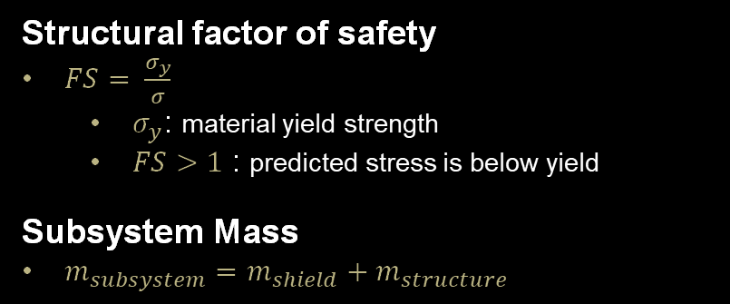
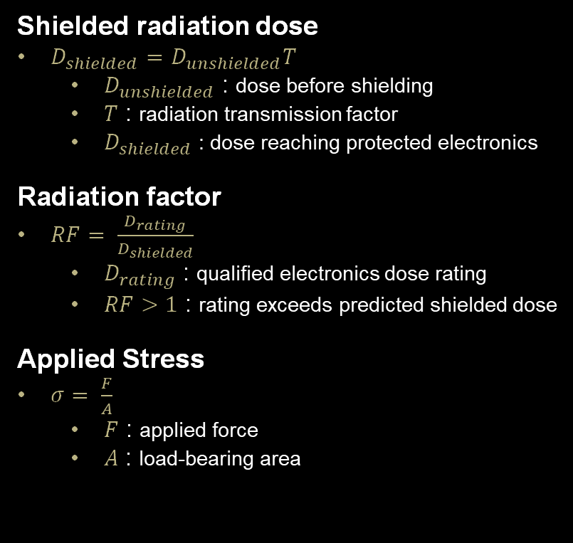
Radiation and Structural Equations
Shielded radiation dose
$D_{shielded}=D_{unshielded}T$
  $D_{unshielded}$ : dose before shielding
  $T$ : radiation transmission factor
  $D_{shielded}$ : dose reaching protected electronics
Radiation factor
$RF= \frac{D_{rating}}{D_{shielded}}$
  $D_{rating}$ : qualified electronics dose rating
  $RF>1$ : rating exceeds predicted shielded dose
Applied Stress
$σ= \frac{F}{A}$
  $F$ : applied force
  $A$ : load-bearing area
Structural factor of safety
$FS= \frac{σ_{y}}{σ}$
  $σ_{y}$: material yield strength
  $FS>1$ : predicted stress is below yield
Subsystem Mass
$m_{subsystem}=m_{shield}+m_{structure}$

Slide 20
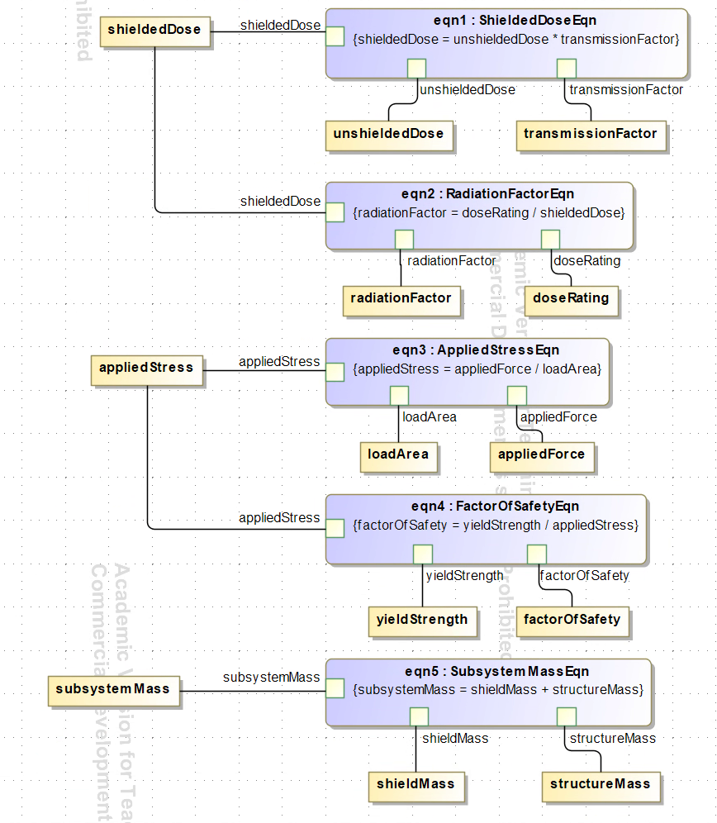
Radiation Shielding & Structural Parametrics
Calculation flow
Shielded dose is calculated from unshielded dose and transmission factor.
Structural stress is calculated from applied force and load area.
Radiation factor, factor of safety, and subsystem mass are then determined.
Scope
The model assumes constant radiation transmission and uniform loading.

Slide 21
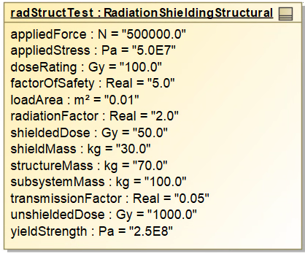
Radiation & Structural Example Instance
Key results
Shielding reduced the modeled dose from 1,000 Gy to 50 Gy, a 95% reduction.
The electronics rating was twice the calculated shielded dose.
The structural case produced stress of 50 MPa and a factor of safety of 5.
Shielding and structure contributed 100 kg to the total vehicle mass.
Values shown are for model verification and are not final Europa design inputs.

Slide 22
Communication Subsystem
Anish Kulkarni
akulkarni367@gatech.edu
By Anish Kulkarni

Slide 23
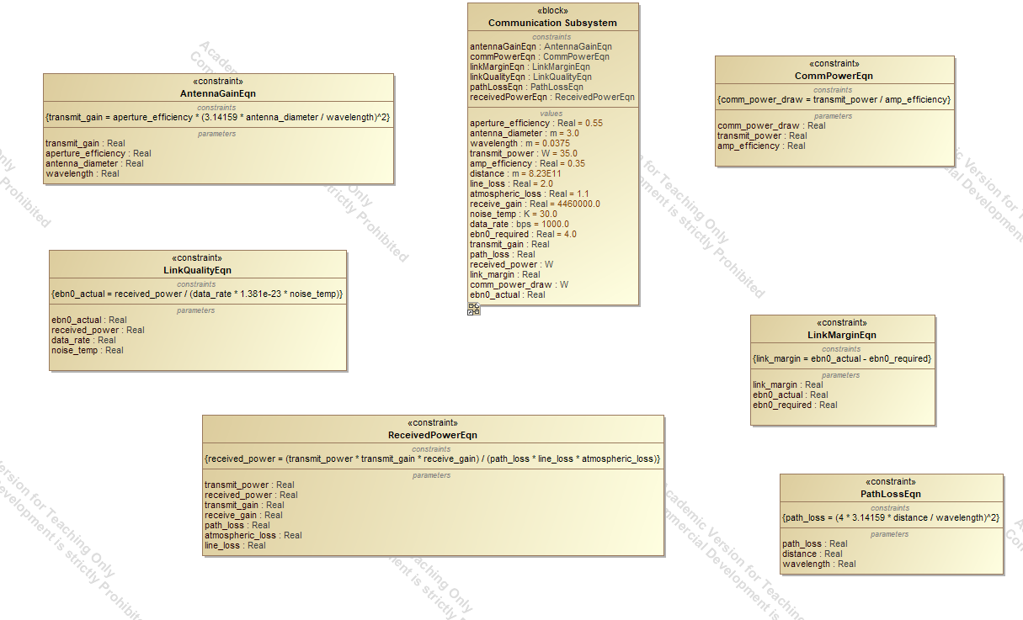
Communication System Architecture
OBJECTIVES:
  Close the RF link from the Europa lander to Earth across 5 AU
  Verify enough signal arrives to decode science data reliably
  Report the radio's power draw to the power subsystem
Key Outputs
  Transmit antenna gain
  Free space path loss
  Received power at the DSN
  Energy per bit to noise density (Eb/N0)
  Link margin
  Comm power draw and daily energy demand

Slide 24
Communication Equations Used
Antenna Gain: G = η(πD/λ)²
  η = aperture efficiency
  D = antenna diameter
  λ = wavelength (λ = c/f)
Free-Space Path Loss: Lfs = (4πd/λ)²
  d = range, Europa to Earth
  λ = wavelength
Received Power: Pr = (Pt·Gt·Gr)/(Lfs·Ll·La)
  Pt = transmit power
  Gt, Gr = spacecraft and DSN antenna gain
  Ll = line and pointing loss
  La = atmospheric loss at receiver
Link Quality: Eb/N0 = Pr/(R·k·Ts)
  R = data rate
  k = Boltzmann constant
  Ts = system noise temperature
Link Margin: M = (Eb/N0)actual − (Eb/N0)required
  M > 0 : link closes with margin to spare
Comm Power Draw: Pcomm = Pt/ηpa
  ηpa = power amplifier efficiency

Slide 25
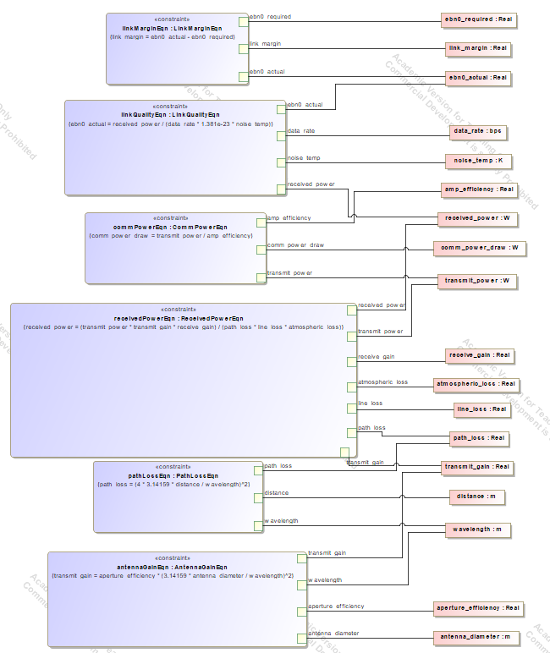
Communication System Architecture
Assumptions:
  Free space propagation with fixed pointing and atmospheric loss factors
  Constant data rate during a downlink pass
  Range from GNC is closest approach so margin is optimistic
Inputs:
  Antenna diameter, apperture efficiency, wavelength
  Transmit power and amplifier efficiency
  DSN receive gain and system noise temperature
  Data rate and required Eb/N0
  Range from GNC
Calculation flow:
  Antenna gain and path loss set received power
  Received power and data rate set Eb/N0
  Eb/N0 against the requirement gives link margin, the pass/fail metric

Slide 26
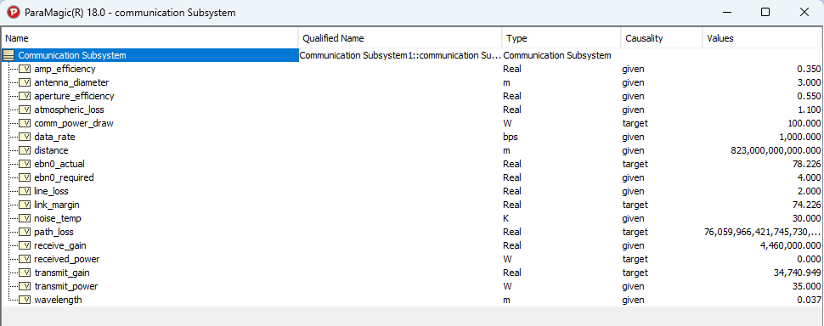
Communication Sample values used for calculation
Solved from antenna geometry to margin
Margin is positive so the link closes with the given hardware

Slide 27
Propulsion Subsystem
Dhriti Naik
dnaik39@gatech.edu
Dhriti Naik

Slide 28
Equations
Drag: F_{D} = 0.5ρC_{D}Av²
  F_{D} = Drag force
  ρ = Fluid density (constant ≈1050)
  C_{D} = Drag coefficient (constant ≈ 0.12)
  A = Reference area (constant ≈ 0.010)
  v = Velocity (input)
Thrust: T = C_{T}ρn²D⁴
  T = Thrust force
  C_{T}​ = Thrust coefficient (constant ≈ 0.18)
  ρ = Fluid density (constant ≈1050)
  n = Propeller RPM (input)
  D = Propeller diameter (constant ≈ 0.05)
Motor Power: P = τω
  τ = Torque (input)
  ω = Angular velocity (input)
Propellor Power: P = Tv
  P = Power
  T = Thrust
  v = Velocity (input)
Battery Power Needed: P = Pprop/(ηmotor·ηprop)
  P = Battery power
  Pprop = Mechanical power
  ηmotor = Motor efficiency (constant ≈ 0.95)
  ηprop = Propellor efficiency (constant ≈ 0.80)
Battery Current: I = P/V
  I = Battery current
  P = Battery power
  v = Battery voltage (constant ≈ Power subsystem)
Net force: Fnet​ = T−F_{D}
  Fnet​ = Net force
  T = Thrust
  F_{D} = Drag force
Acceleration: a = F/m
  a = Acceleration
  F = Net force
  m = Mass (constant ≈ 2.3)

Slide 29
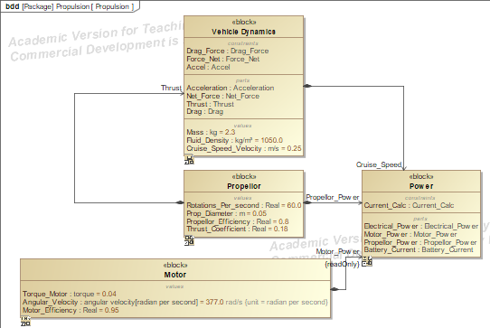
Propulsion BDD Diagram
Objective: Using cruise speed (or a set velocity), determine how much power needed given submarine structure and surrounding forces
Velocity>>Drag>>Thrust>>(Net force, acceleration)
Motor>>Propellor Power>>Power Equations

Slide 30
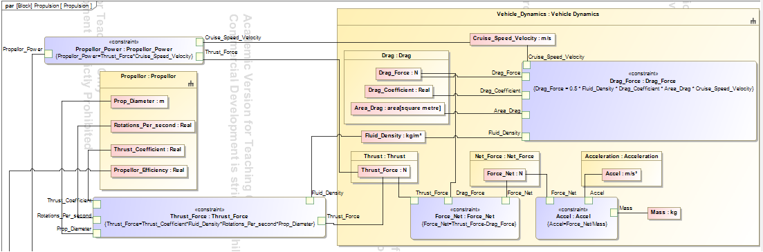
Propulsion Parametric Diagram
Assumptions:
  Input: velocity (or cruise speed)
  No pressure effects from deeper water
  Comparable to Earth’s submarines

Slide 31
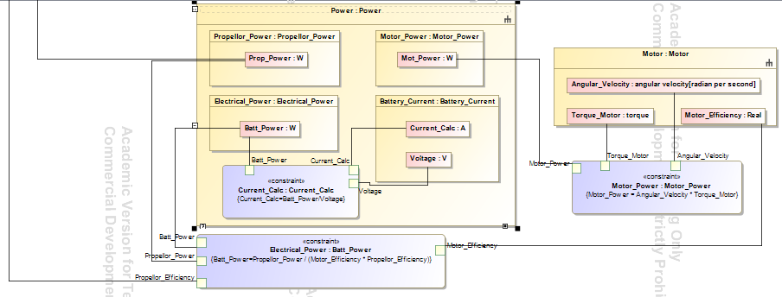
Propulsion Parametric Diagram
Assumptions:
  Sensors taking angular velocity input
  No buoyancy effects in this model

Slide 32
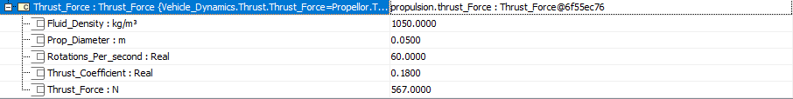
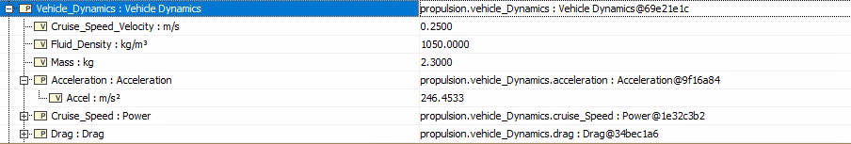
Propulsion Simulation Example Results

Slide 33
GNC Subsystem
Toby Reitman

Slide 34
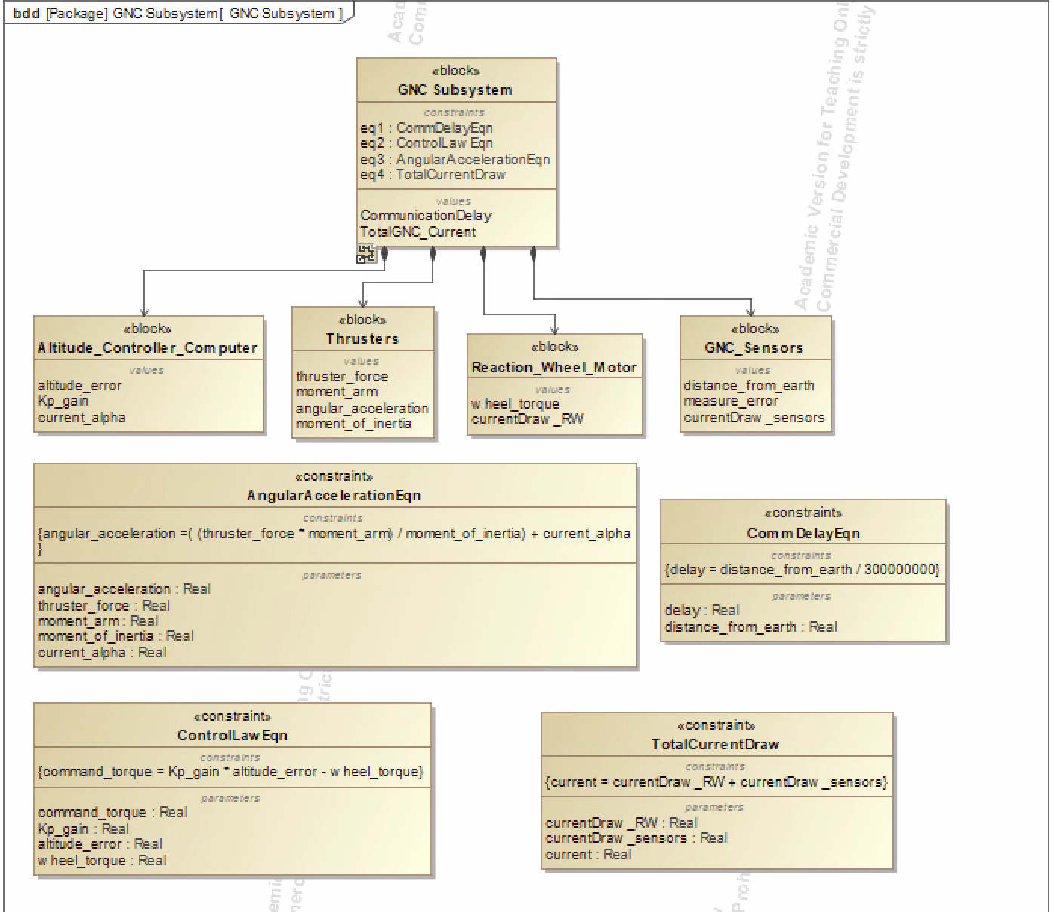
GNC System Architecture
Exploring often used components of control systems:
Controller computers (Coding)
Thrusters (TVC)
Reaction Wheel Motor (internal control)
GNC Sensors (Relay current state of the system)
Overall BDD contains some of the values that can be obtained using GNC values

Slide 35
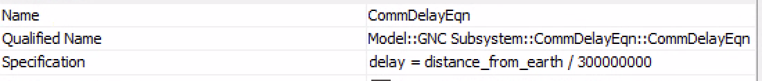
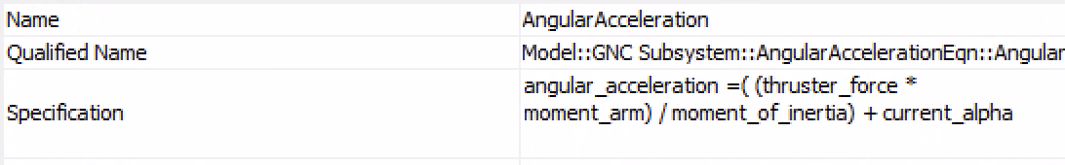
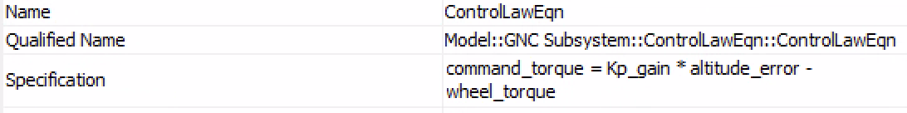
Equations Used
With the given variables from the GNC component , these are some of the equations that could be used to define the system/ could be useful pieces of information
Assume all values used are in SI units

Slide 36
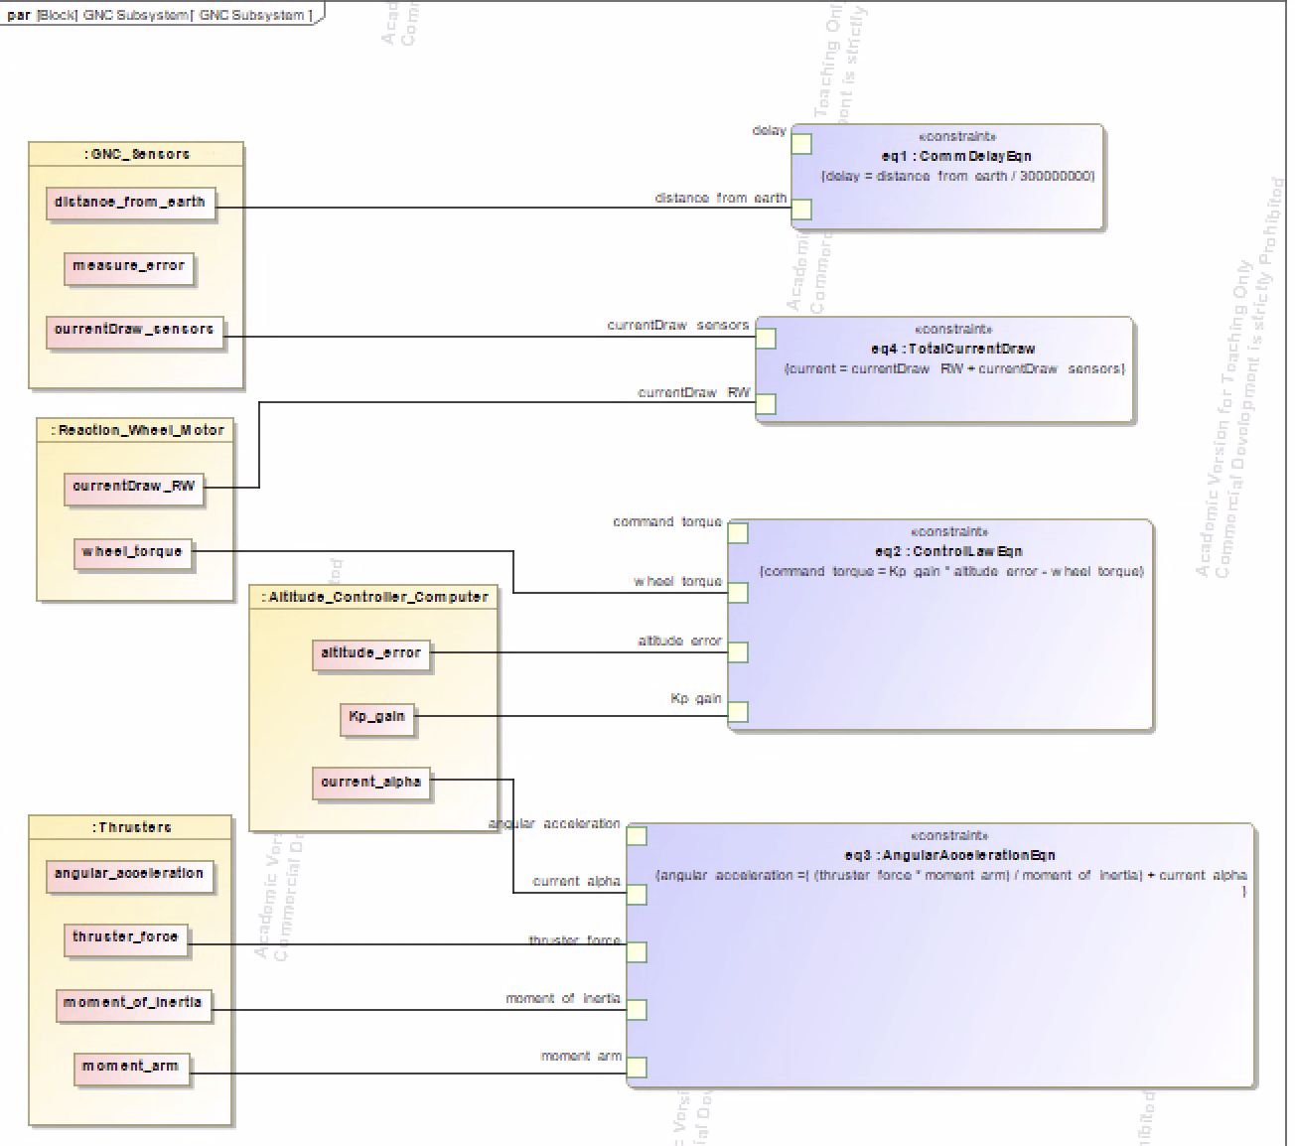
Parametric Diagram
Parametric diagram of sample equations used along with variables
All GNC sub systems depend on one another to solve equations

Slide 37
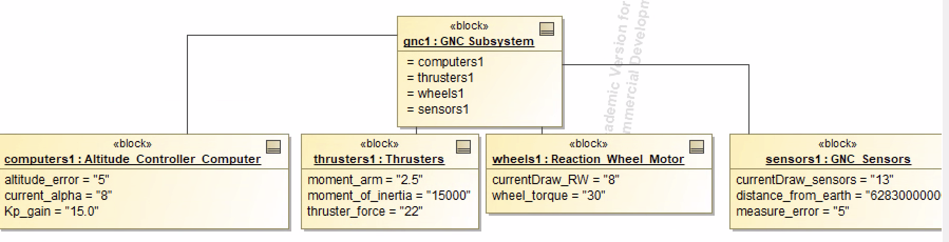
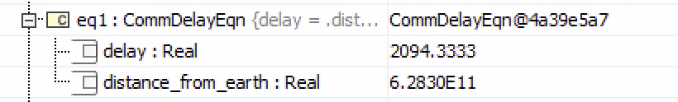
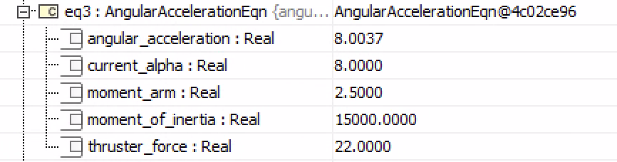
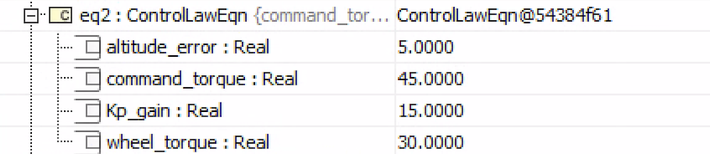
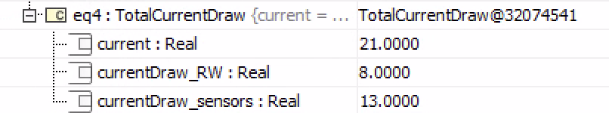
Sample values used for calculation
Upon running calculations, the model correctly calculated desired values. In reality, the given values would be known quantities or measured quantities by the systems being used

Slide 38
Integrated Subsystems
Anish Kulkarni
akulkarni367@gatech.edu
By Anish Kulkarni

Slide 39
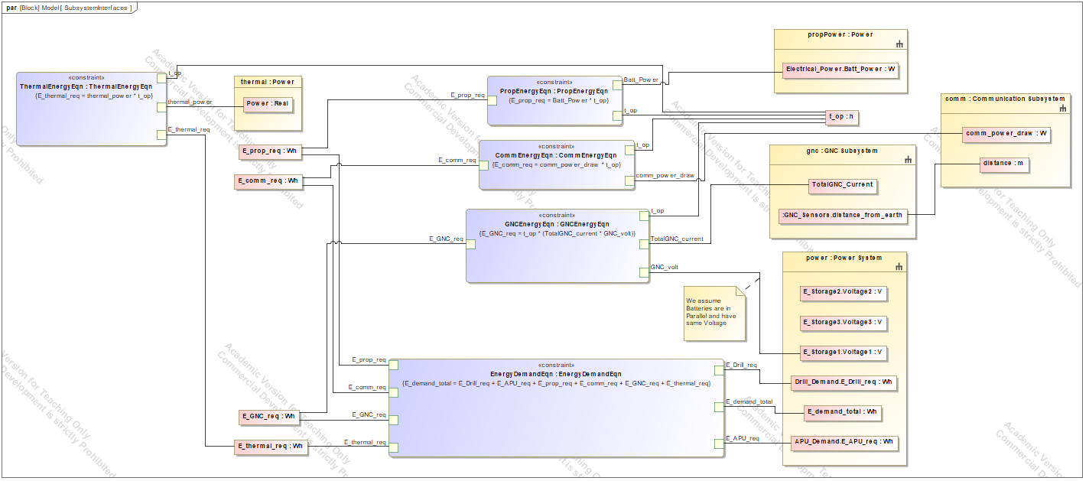
Integration Architecture
Approach:
Each Subsystem was modeled independently, then added as a part property of the system level module <block>
A parametric diagram at system level can only reach values in the part properties, hence cross system is possible
Electrical power was chosen as Integrating quantity between almost all subsystems
Additional distance from earth was also connected between systems
OBJECTIVES:
Connect six independently developed subsystems into one executable model
Establish a common unit so subsystem outputs can be combined
Verify the vehicle's power supply meets total demand

Slide 40
Integration Architecture
Integration Strategy:
Each subsystem's power/amp is converted into energy (Wh) with a given time and battery voltage
Uses assumption that batteries are in parallel and have same Voltage
Total Energy is calculated and sent back into power subsystem
Earth to craft distance was connected between GNC and Communications

Slide 41
Equations Used
Comm Energy Demand: E_comm_req = comm_power_draw · t_op
  E_comm_req = daily energy required by the communication subsystem (Wh)
  comm_power_draw = electrical power drawn by the radio (W)
  t_op = shared operating period (h)
Propulsion Energy Demand: E_prop_req = Batt_Power · t_op
  E_prop_req = daily energy required by propulsion (Wh)
  Batt_Power = electrical power drawn from the battery (W)
GNC Energy Demand: E_GNC_req = t_op · (TotalGNC_current · GNC_volt)
  E_GNC_req = daily energy required by GNC (Wh)
  TotalGNC_current = summed current draw of reaction wheel and sensors (A)
  GNC_volt = bus voltage supplied by the batteries (V)
Thermal Energy Demand: E_thermal_req = thermal_power · t_op
  E_thermal_req = daily energy required by thermal control (Wh)
  thermal_power = heater power needed to hold operating temperature (W)
Total Energy Demand:
E_demand_total = E_Drill_req + E_APU_req + E_prop_req + E_comm_req + E_GNC_req + E_thermal_req
  E_demand_total = total daily energy demand of the vehicle (Wh)
  E_Drill_req = energy required by the ice drill (Wh)
  E_APU_req = energy required by the auxiliary power unit (Wh)

Slide 42
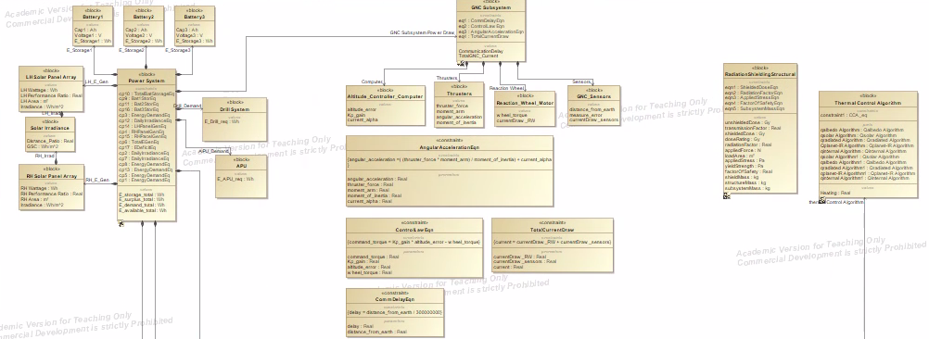
Integration BDD

Slide 43
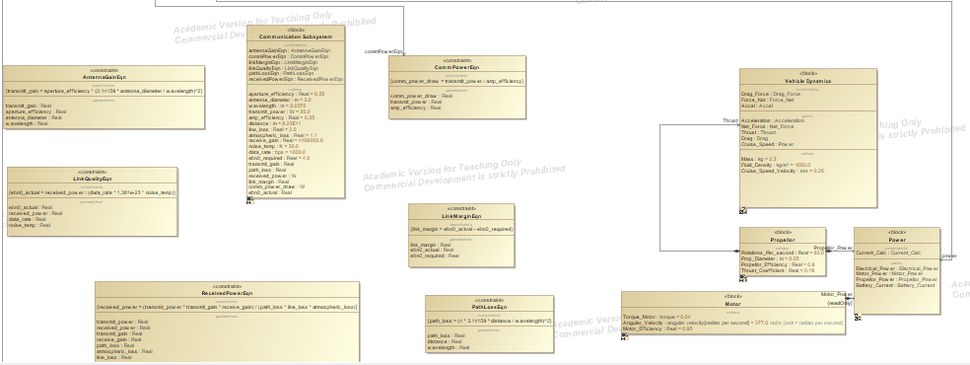
Integration BDD

Slide 44
Integration Parametric
Voltage Assumption
Energy calculations to Wh instead of W or A
Distance Relation
Energy Total Calc and sent to Power

