Slide 1
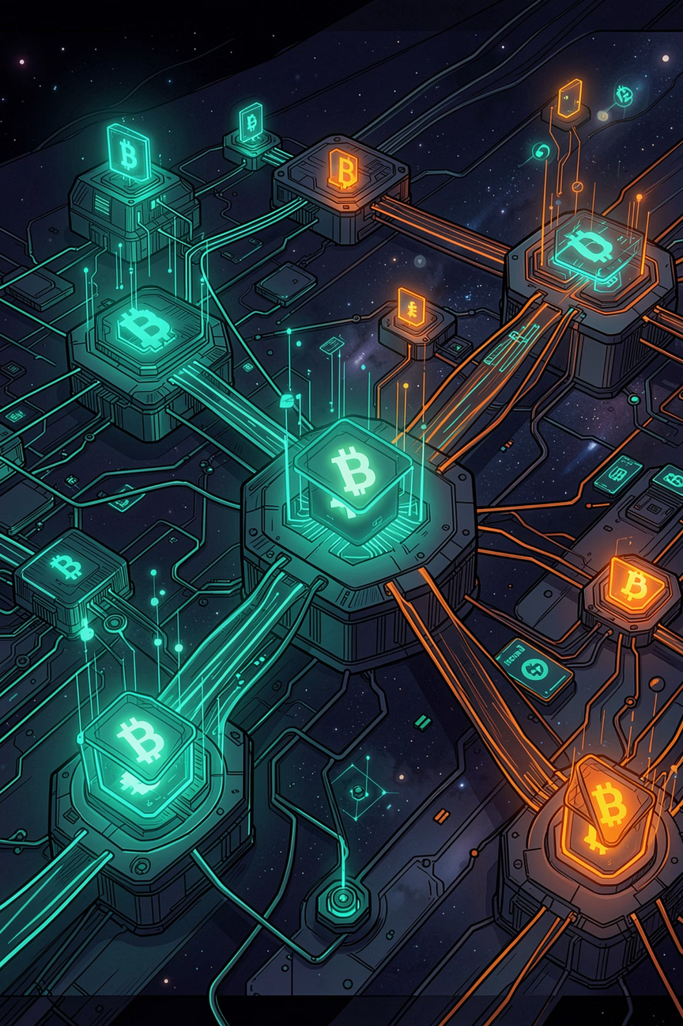


EscrowX – Decentralized Freelance Payments
Secure, Low-Cost, and Instant Payment Protection on the Stellar Blockchain
FOUNDER & LEAD DEVELOPER
STELLAR ECOSYSTEM
Notes:
1

Slide 2

THE PROBLEM
The Freelance Trust & Fee Crisis
Extortionate Platform Fees
Slow & Costly Payouts
Upwork and Fiverr charge 10–20% commission per transaction, squeezing freelancer margins to the bone.
Cross-border wire fees and payout holds can delay payments by up to 14 days, crippling cash flow.
The Trust Deficit
Freelancers risk non-payment; clients risk paying upfront for subpar work. No neutral ground exists.
Notes:
2

Slide 3

THE SOLUTION
EscrowX: Secured Freelance Payment Protection
By using smart contracts, we eliminate the centralized middleman. Clients secure funds directly in an immutable escrow contract. Funds cannot be retrieved by either party until milestones are completed and approved, or a refund is issued — ironclad security at virtually zero cost.
Soroban Contract
Milestones Completed
Immutable Rust contract holds funds securely.
Client reviews and approves work deliverables.
Client Deposits
Payout or Refund
Funds locked on-chain into escrow.
Instant settlement: release or refund processed.
Funds are secured on-chain in an immutable Rust-based smart contract on Stellar — released instantly upon milestone approval, or refunded if terms expire.
Notes:
3

Slide 4
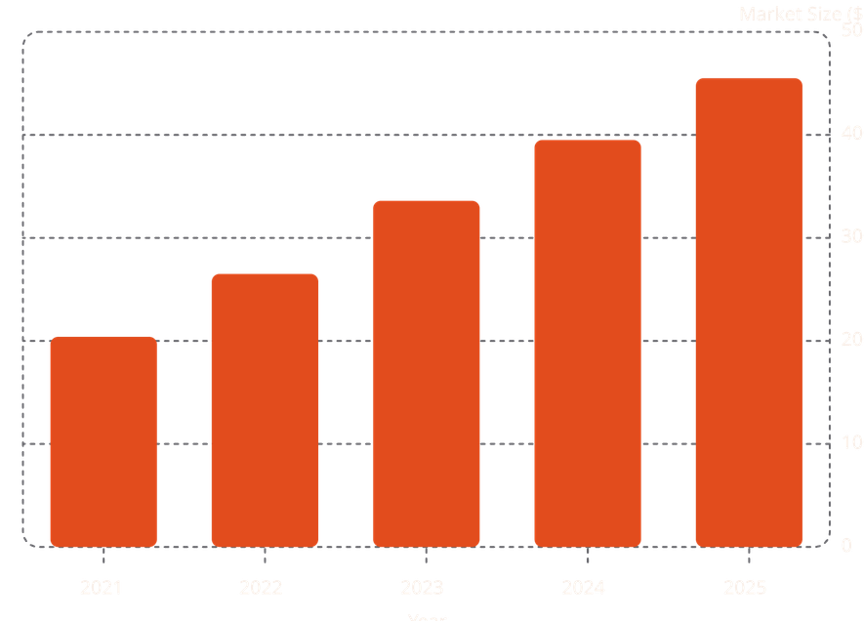

MARKET OPPORTUNITY
Capturing the Global Gig Economy
A $455 Billion Opportunity
The global gig economy is expanding rapidly, yet freelancers are held back by outdated payment rails. Stellar's ultra-fast finality and microscopic fees position EscrowX to capture this massive cross-border market.
$455B by 2026
50%+ Workforce
Under 5 Seconds
Projected gig economy transaction volume
Expected to freelance by 2027
Stellar transaction finality — ideal for micro-payments
Notes:
4

Slide 5
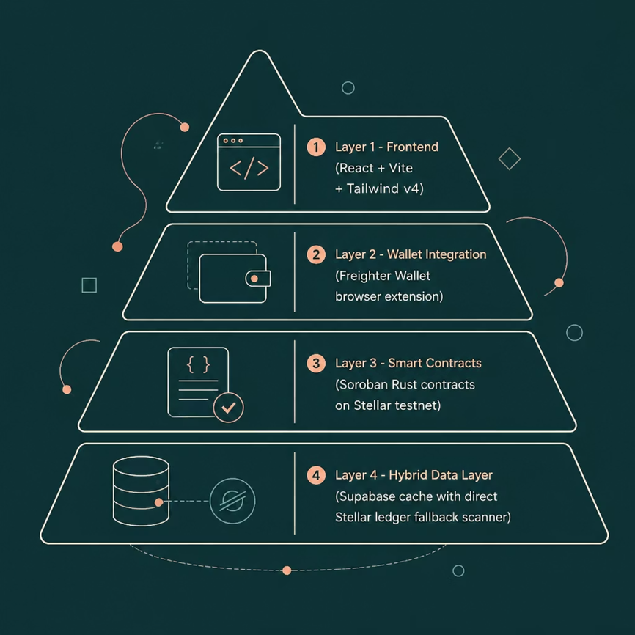
ARCHITECTURE
Robust, Decentralized & Resilient
Institutional-Grade Uptime
EscrowX features a highly resilient hybrid architecture. While Supabase caches metadata, the core application never depends on a single server.
Soroban Rust Contracts manage state and native XLM tokens on-chain
Freighter Wallet enables seamless browser-based signing
Direct Ledger Fallback — if cache is cleared, the app queries Stellar directly to reconstruct the full dashboard
Notes:
5

Slide 6


VALIDATION
On-Chain Validation & Active Growth
We didn't just build a prototype — we validated it with real users on the Stellar testnet.
50
On-Chain Users
Unique testnet wallets funded via Stellar Friendbot
55
Contracts Executed
Real transactions ranging from 50 to 1,000 XLM
Full transaction hashes and user feedback are logged in the public repository — verified, on-chain proof of product-market fit.
Notes:
6

Slide 7
ROADMAP
Future Evolution & Scaling Strategy
Phase 1 — Stablecoin Settlements
Phase 3 — Reputation Ledger
Integrate USDC & EURC via Stellar Asset Contracts to protect freelancers from XLM price volatility during project milestones.
Build an on-chain history of successfully completed escrows, giving freelancers verifiable proof of work and a portable trust score.
1
2
3
Phase 2 — Dispute Resolution
Introduce a 2-of-3 multi-signature consensus mechanism with trusted third-party arbitrators to resolve disputes and authorize releases or refunds.
Notes:
7

Slide 8


EscrowX – Freelance Secured
Global freelance transacting made safe, immediate, and extremely affordable.
🌐 Live Demo
💻 GitHub
escrow-x-secure-freelance-payments-sepia.vercel.app
github.com/anishkumar79/level5
🔗 Smart Contract
CBGL7N5GANUBPAV2UHXC5UBW3JSXGNLAKOMVJD54YNIZF6WN6PHSMQAL
Built on Stellar · Powered by Soroban · Open for partnership and investment conversations.
Notes:
8

