Slide 1
Finance & Risk Analysis Capstone Project
By Anishma Kathpal

Slide 2
Problem Statement
In the recent past, the industry of wealth management has seen a lot of growth. Every individual or business actively searches for opportunities to get the maximum returns. However, in most cases, they either lack the skills to identify the right investment opportunity, or there is a shortage of time for finding these opportunities. Hence, this gave rise to the dedicated individuals who perform this task on behalf of the investors for a commission - Portfolio managers.
A portfolio manager makes investment decisions and carries out other related activities on behalf of vested investors. They work with a team of analysts and researchers, and their main objective is to realize the needs of the investor and suggest a suitable portfolio that meets all the expectations. They are responsible for establishing the best investment strategy and selecting appropriate investments along with the right allocation. However, in doing so, they face a lot of competition in the form of other portfolio managers and rival firms. Therefore, the portfolio manager has to use the available resources to provide the best solution to the investor.
Consider ourselves working for an associate at an investment firm that manages accounts for private clients. Our role requires you to analyze a portfolio of stocks and provide consultation on investment management based on the client’s requirements.

Slide 3
Business Goal
As a portfolio manager, our task is to provide consultation to two different investors, Mr. Patrick Jyengar and Mr. Peter Jyengar based on their requirements and financial objectives.
The goal of the case study is :
To Suggest a Portfolio of stocks to Mr. Patrick Jyengar based on his risk profile to meet his goal of doubling the amount of 500K Dollars in five years of a timespan to buy a minority stake in Naturo.
To Suggest a High-risk stock to Mr. Peter Jyengar based on his risk profile to meet his goal of gaining higher returns for the invested amount of 1 Million Dollars over five years of a timespan to use it for the expansion of JWW.

Slide 4
Data Description
Information for 24 stocks of leading companies listed in the New York Stock Exchange(NYSE):
Date
Open price: Price of stock at the start of the day
Close price: Price of stock at the end of the day
High price: Highest price reached by the stock on that day
Low price: Lowest price reached by the stock on that day
Adjusted close price: Stock price adjusted to include the annual returns (dividends) that the company offers to the shareholders
Volume traded: Number of stocks traded on the day
The information for every stock ranges from 1st October 2010 to 30th September 2020.
The stocks belong to different domains:
Technology/IT
Travel/Aviation/Hospitality
Banking/Financial Services and Insurance
Pharmaceuticals/Healthcare/Life Sciences
To help you with the market benchmark, you are given the S&P 500 index prices for the same period.

Slide 5

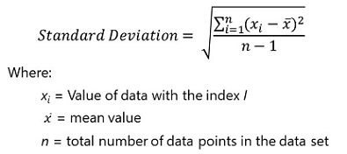
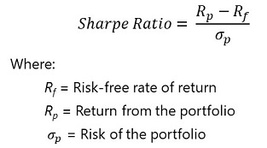
Formula used to find the Sharpe Ratio

Slide 6
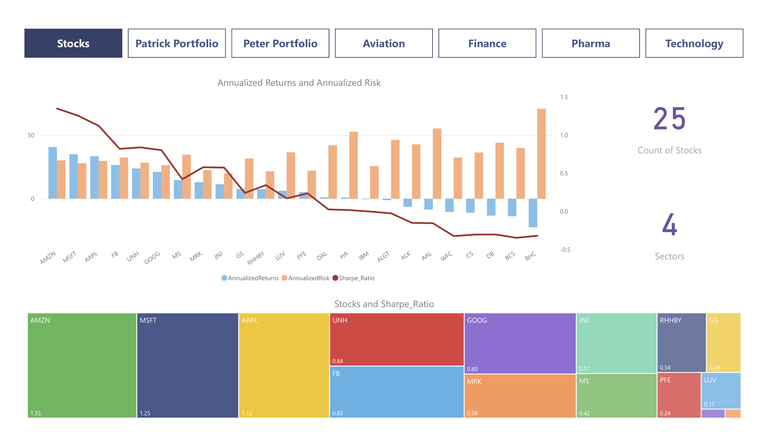
Notes:
Aviation Sector faced a major crisis in March 2020 due to Corona Pandemic and the aviation sector has not recovered thereafter even though the market index has gone up.
Finance Sector also faced a crisis in March 2020 due to Corona Pandemic and the Finance sector has recovered a bit although the majority of stocks have been hit.
Morgan Stanley & Goldman Sachs have performed well when compared to other stocks
Pharma & Health care Sector has also faced a crisis in March 2020 due to Corona Pandemic but the recovery rate shown by this sector is commendable.
United Health and Johnson & Johnson have performed well when compared to S&P Index.
Bausch Health is consistently performed very badly over the years when compared to other stocks in the same sector.
Technology Sector has also faced a crisis in March 2020 due to Covid Pandemic but the recovery rate shown by this sector is commendable.
Microsoft, Amazon, Apple, Facebook & Google have performed well along with the Market index.
IBM is consistently performed very badly over the years when compared to other stocks in the same sector.

Slide 7
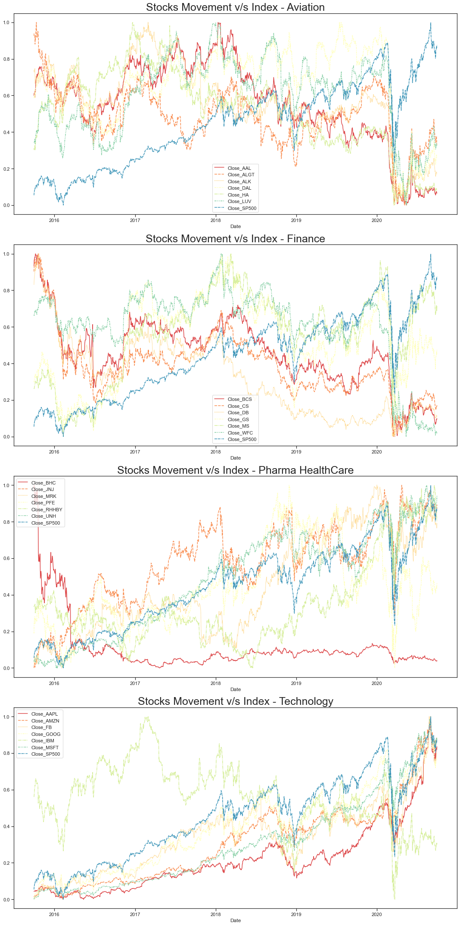

Slide 8
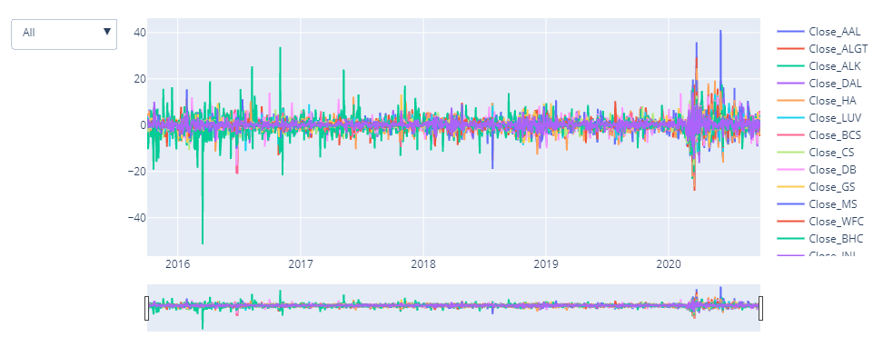
Daily Returns

Slide 9
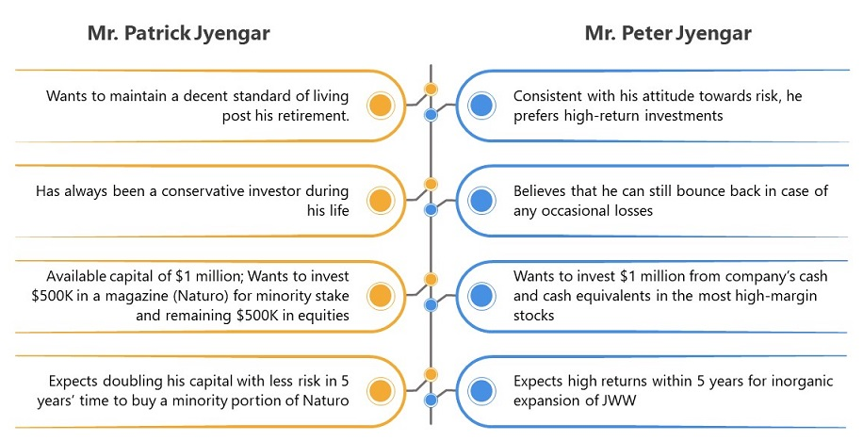
Investors Profile

Slide 10
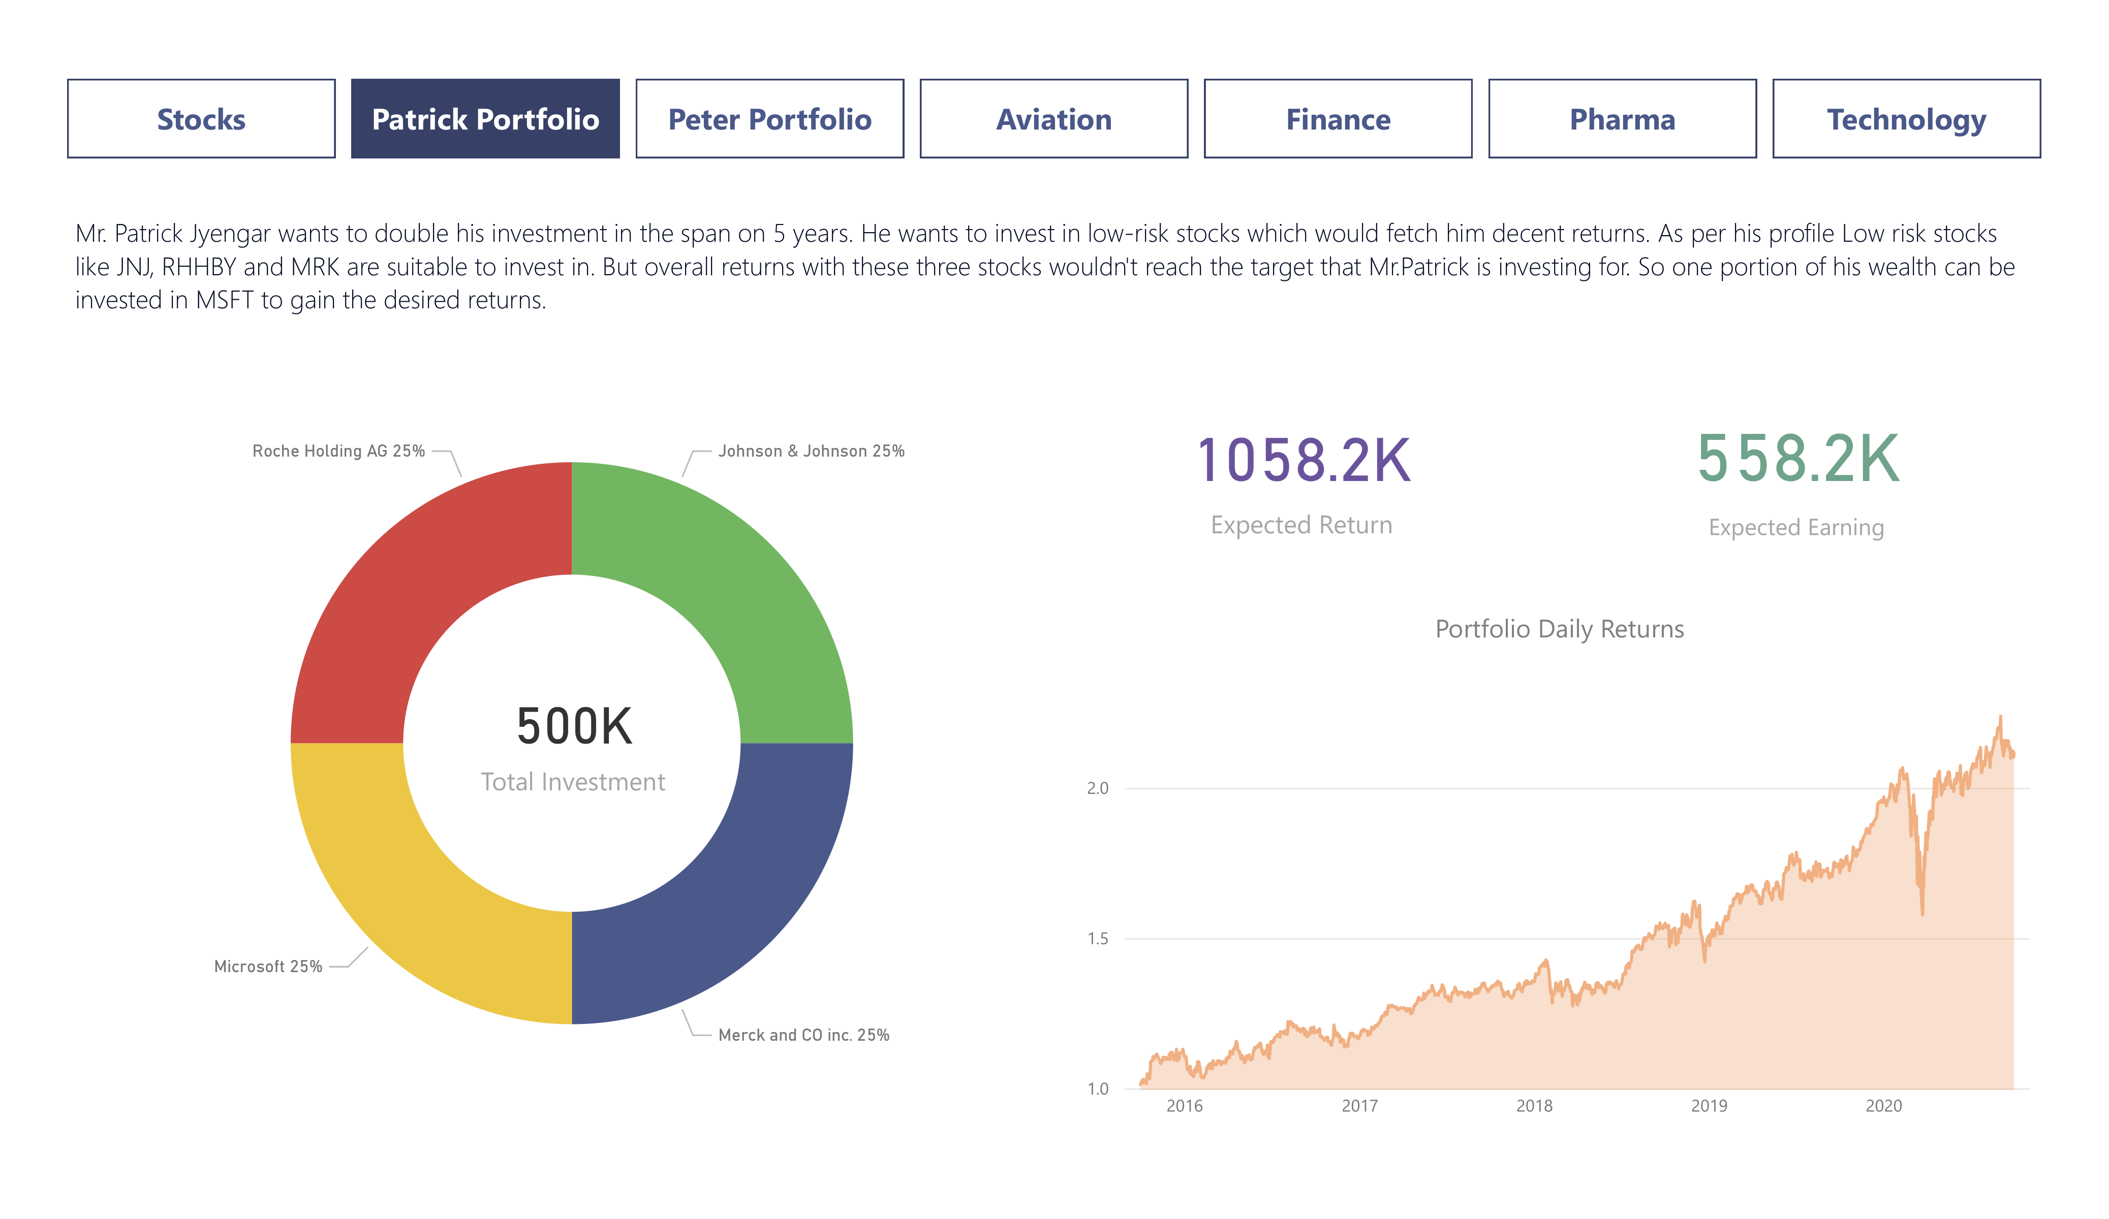
Notes:
Aviation Sector faced a major crisis in March 2020 due to Corona Pandemic and the aviation sector has not recovered thereafter even though the market index has gone up.
Finance Sector also faced a crisis in March 2020 due to Corona Pandemic and the Finance sector has recovered a bit although the majority of stocks have been hit.
Morgan Stanley & Goldman Sachs have performed well when compared to other stocks
Pharma & Health care Sector has also faced a crisis in March 2020 due to Corona Pandemic but the recovery rate shown by this sector is commendable.
United Health and Johnson & Johnson have performed well when compared to S&P Index.
Bausch Health is consistently performed very badly over the years when compared to other stocks in the same sector.
Technology Sector has also faced a crisis in March 2020 due to Covid Pandemic but the recovery rate shown by this sector is commendable.
Microsoft, Amazon, Apple, Facebook & Google have performed well along with the Market index.
IBM is consistently performed very badly over the years when compared to other stocks in the same sector.

Slide 11
Patrick Jyengar Portfolio Insight
Mr.Patrick Jyengar invests 500 Thousand Dollars on equities i.e. the above Portfolio. Returns that he would fetch after 5 years is 1.58 Million Dollars with 558.23 Thousand dollars of gain

Slide 12
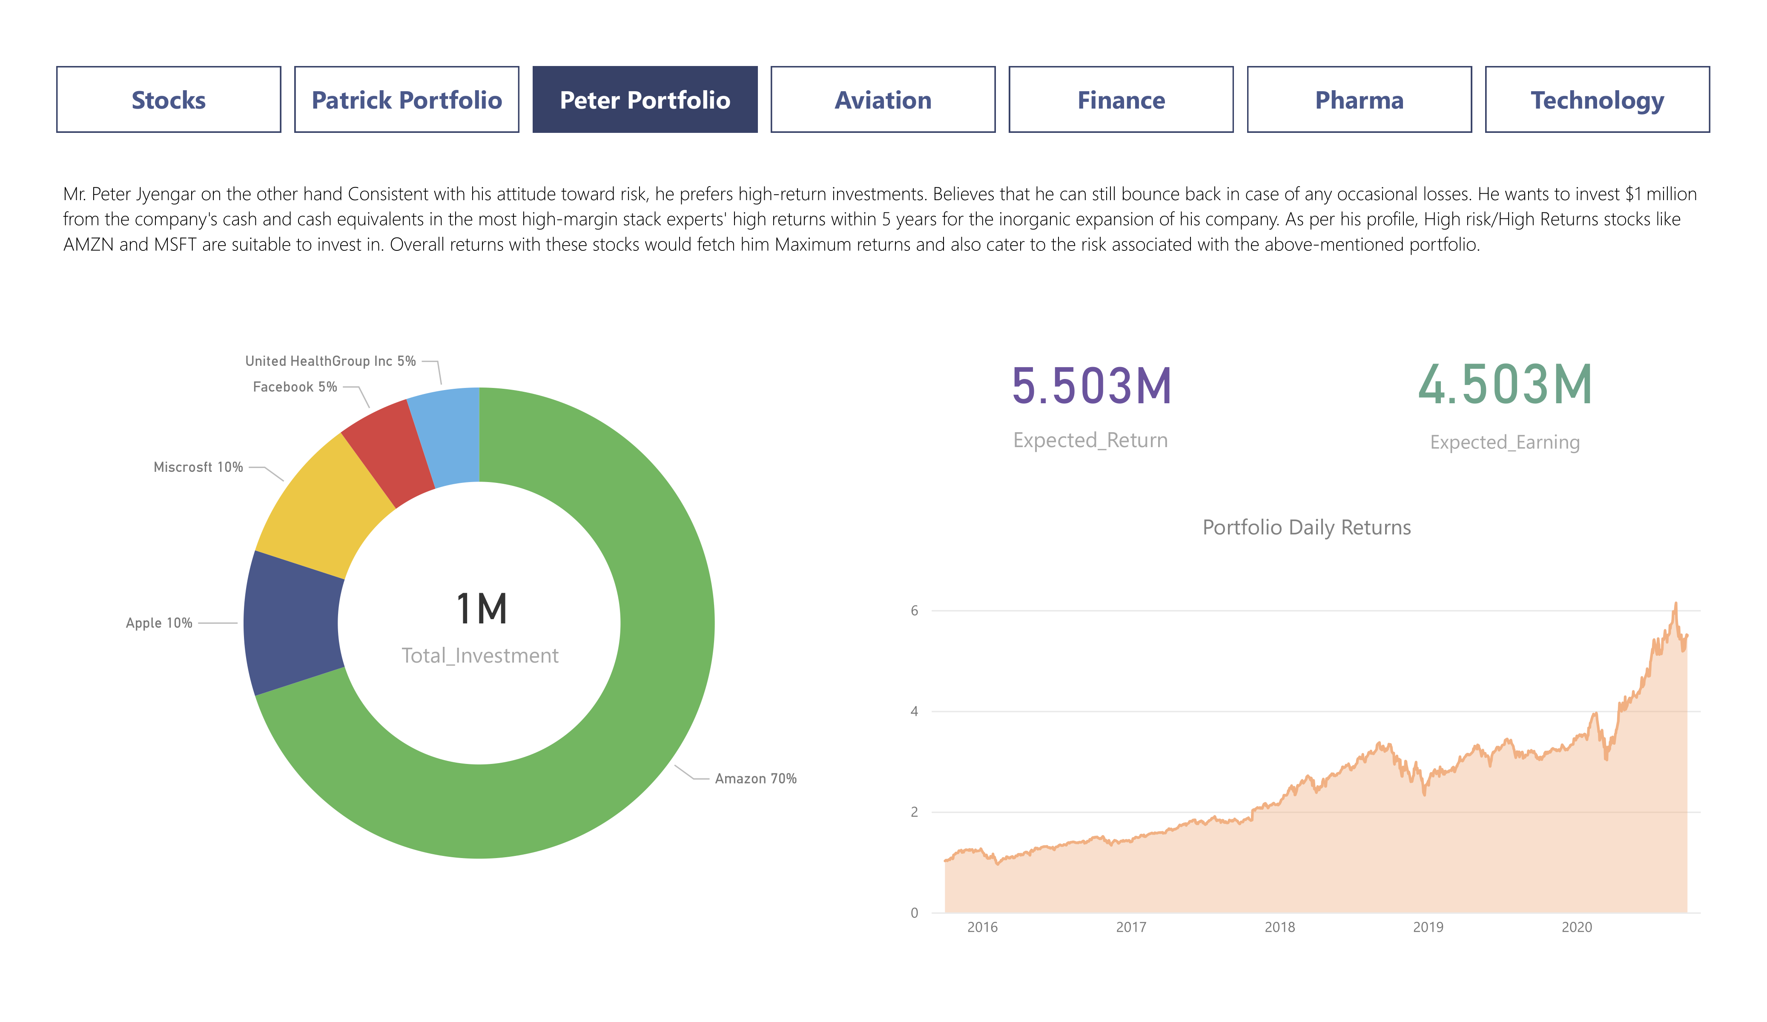
Notes:
Aviation Sector faced a major crisis in March 2020 due to Corona Pandemic and the aviation sector has not recovered thereafter even though the market index has gone up.
Finance Sector also faced a crisis in March 2020 due to Corona Pandemic and the Finance sector has recovered a bit although the majority of stocks have been hit.
Morgan Stanley & Goldman Sachs have performed well when compared to other stocks
Pharma & Health care Sector has also faced a crisis in March 2020 due to Corona Pandemic but the recovery rate shown by this sector is commendable.
United Health and Johnson & Johnson have performed well when compared to S&P Index.
Bausch Health is consistently performed very badly over the years when compared to other stocks in the same sector.
Technology Sector has also faced a crisis in March 2020 due to Covid Pandemic but the recovery rate shown by this sector is commendable.
Microsoft, Amazon, Apple, Facebook & Google have performed well along with the Market index.
IBM is consistently performed very badly over the years when compared to other stocks in the same sector.

Slide 13
Peter Jyengar Portfolio Insight
Mr.Peter Jyengar invests 1 Million Dollars in equities i.e. the above Portfolio. Returns that he would fetch after 5 years is more than 5 Million Dollars with 4.5+ Million dollars of gain

Slide 14
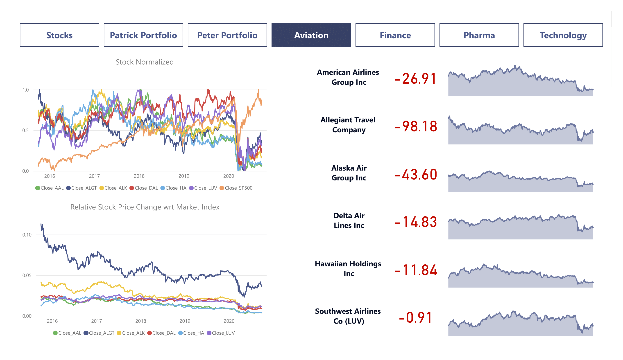
Notes:
Aviation Sector faced a major crisis in March 2020 due to Corona Pandemic and the aviation sector has not recovered thereafter even though the market index has gone up.
Finance Sector also faced a crisis in March 2020 due to Corona Pandemic and the Finance sector has recovered a bit although the majority of stocks have been hit.
Morgan Stanley & Goldman Sachs have performed well when compared to other stocks
Pharma & Health care Sector has also faced a crisis in March 2020 due to Corona Pandemic but the recovery rate shown by this sector is commendable.
United Health and Johnson & Johnson have performed well when compared to S&P Index.
Bausch Health is consistently performed very badly over the years when compared to other stocks in the same sector.
Technology Sector has also faced a crisis in March 2020 due to Covid Pandemic but the recovery rate shown by this sector is commendable.
Microsoft, Amazon, Apple, Facebook & Google have performed well along with the Market index.
IBM is consistently performed very badly over the years when compared to other stocks in the same sector.

Slide 15
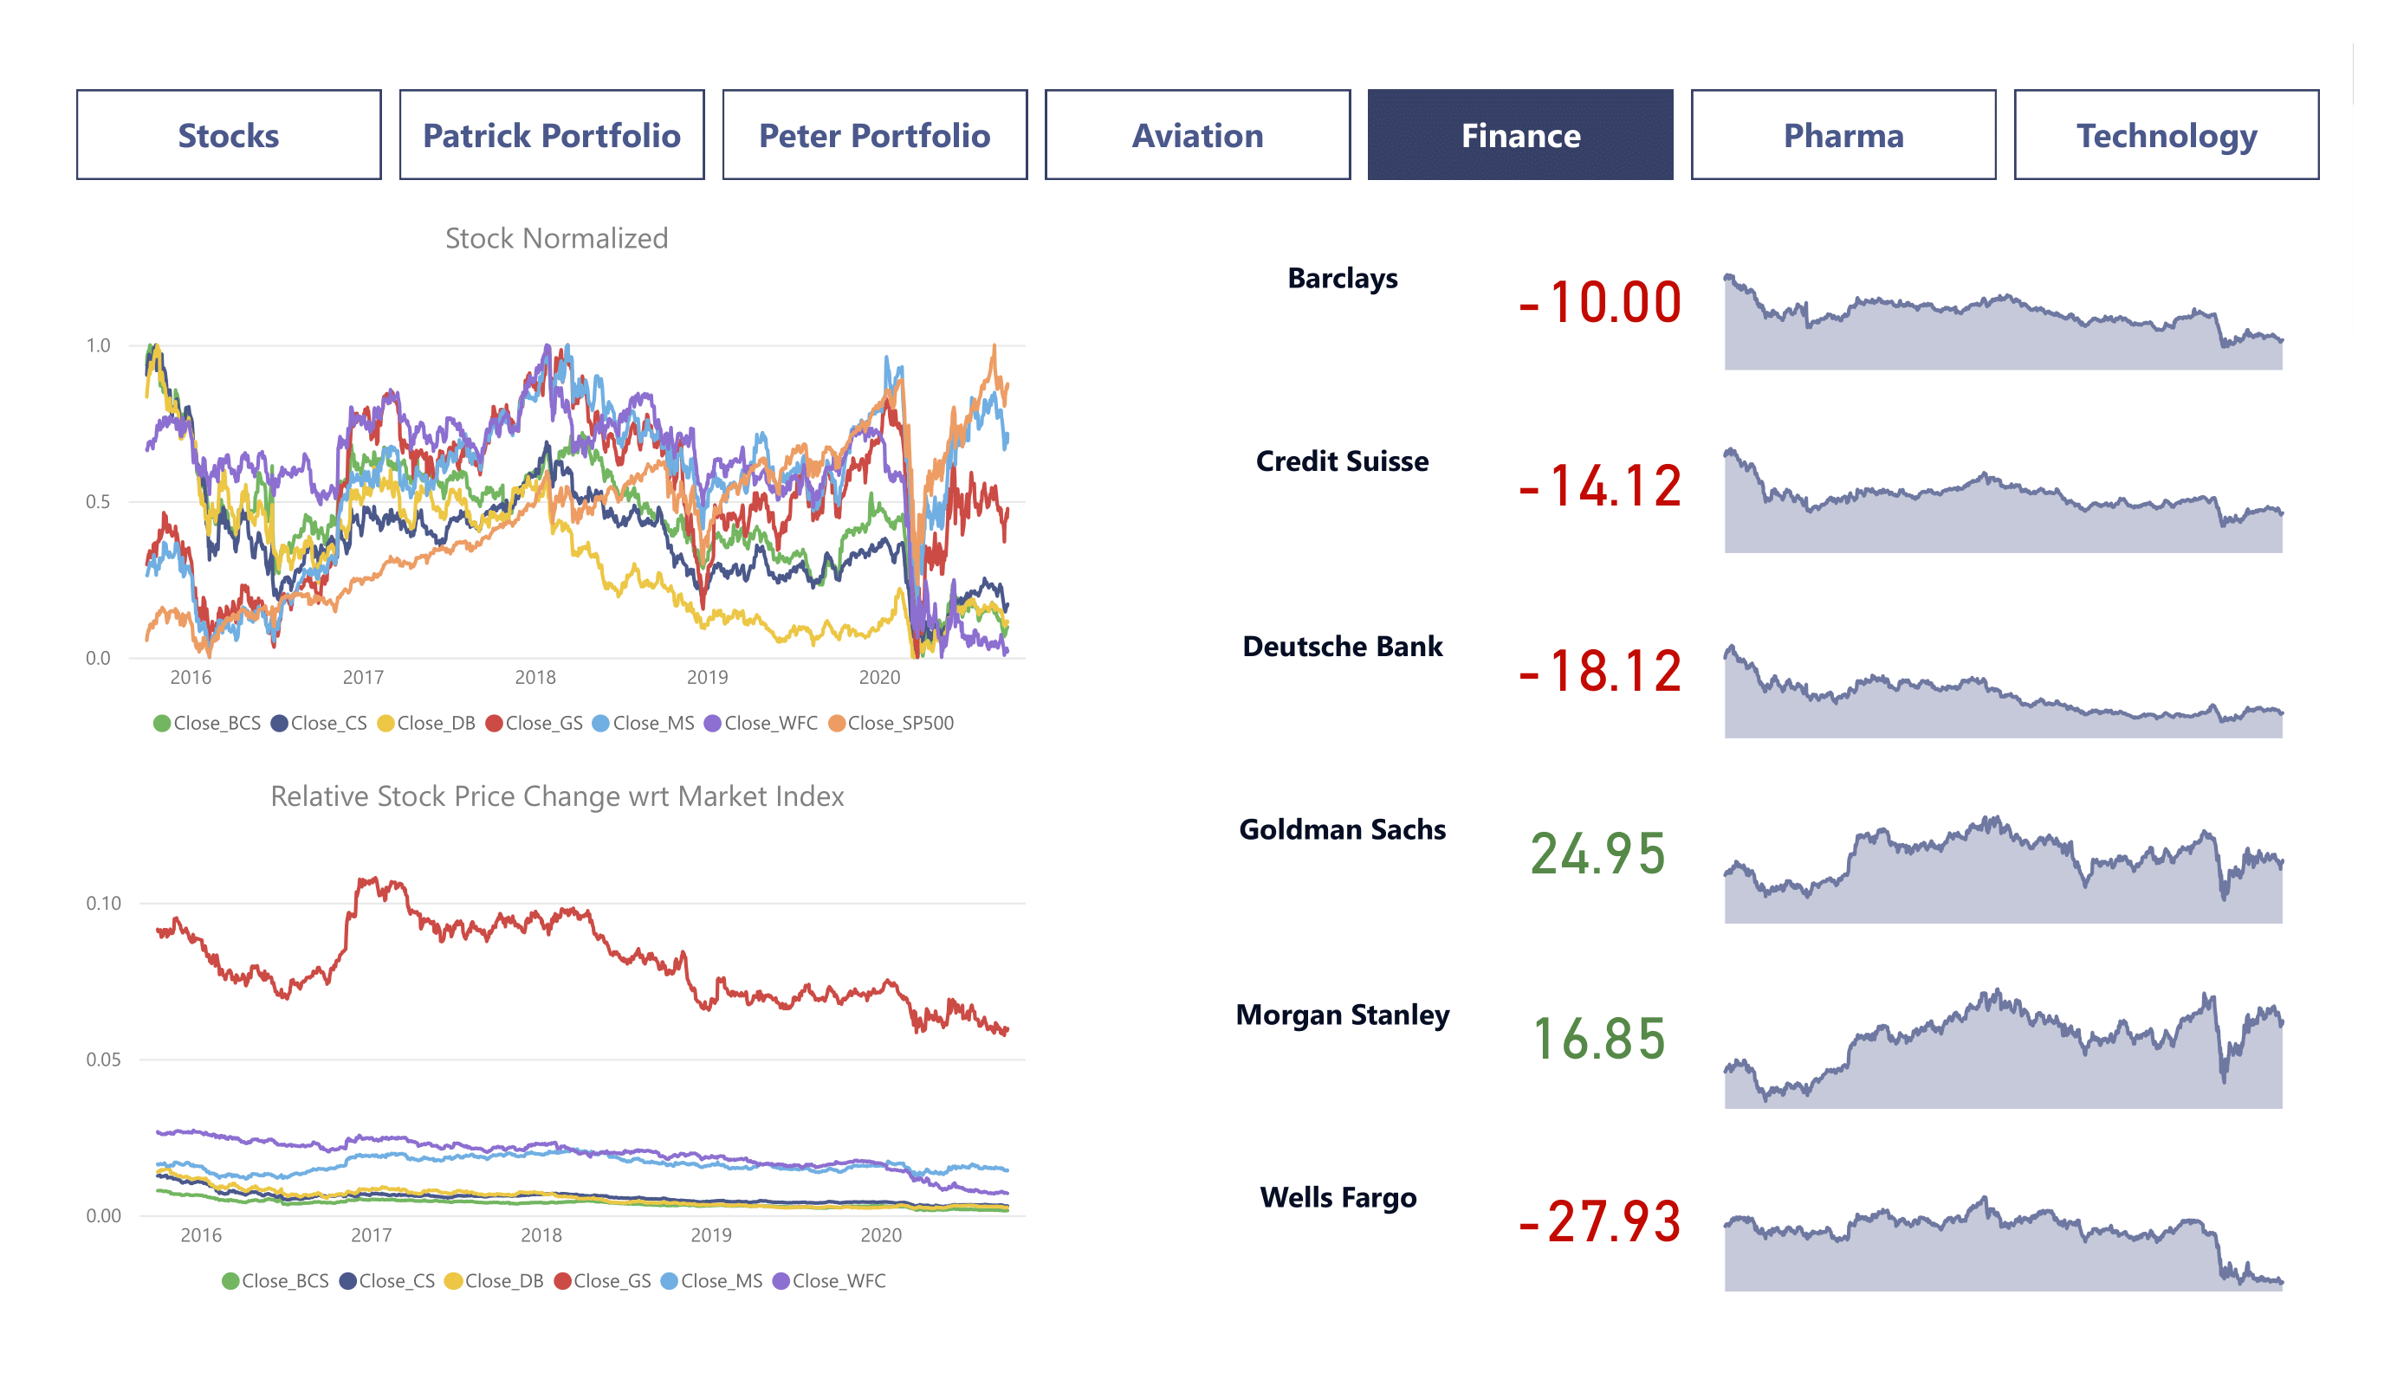
Notes:
Aviation Sector faced a major crisis in March 2020 due to Corona Pandemic and the aviation sector has not recovered thereafter even though the market index has gone up.
Finance Sector also faced a crisis in March 2020 due to Corona Pandemic and the Finance sector has recovered a bit although the majority of stocks have been hit.
Morgan Stanley & Goldman Sachs have performed well when compared to other stocks
Pharma & Health care Sector has also faced a crisis in March 2020 due to Corona Pandemic but the recovery rate shown by this sector is commendable.
United Health and Johnson & Johnson have performed well when compared to S&P Index.
Bausch Health is consistently performed very badly over the years when compared to other stocks in the same sector.
Technology Sector has also faced a crisis in March 2020 due to Covid Pandemic but the recovery rate shown by this sector is commendable.
Microsoft, Amazon, Apple, Facebook & Google have performed well along with the Market index.
IBM is consistently performed very badly over the years when compared to other stocks in the same sector.

Slide 16
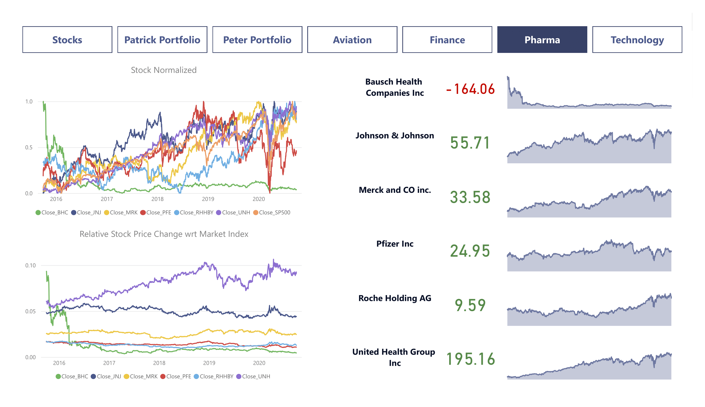
Notes:
Aviation Sector faced a major crisis in March 2020 due to Corona Pandemic and the aviation sector has not recovered thereafter even though the market index has gone up.
Finance Sector also faced a crisis in March 2020 due to Corona Pandemic and the Finance sector has recovered a bit although the majority of stocks have been hit.
Morgan Stanley & Goldman Sachs have performed well when compared to other stocks
Pharma & Health care Sector has also faced a crisis in March 2020 due to Corona Pandemic but the recovery rate shown by this sector is commendable.
United Health and Johnson & Johnson have performed well when compared to S&P Index.
Bausch Health is consistently performed very badly over the years when compared to other stocks in the same sector.
Technology Sector has also faced a crisis in March 2020 due to Covid Pandemic but the recovery rate shown by this sector is commendable.
Microsoft, Amazon, Apple, Facebook & Google have performed well along with the Market index.
IBM is consistently performed very badly over the years when compared to other stocks in the same sector.

Slide 17
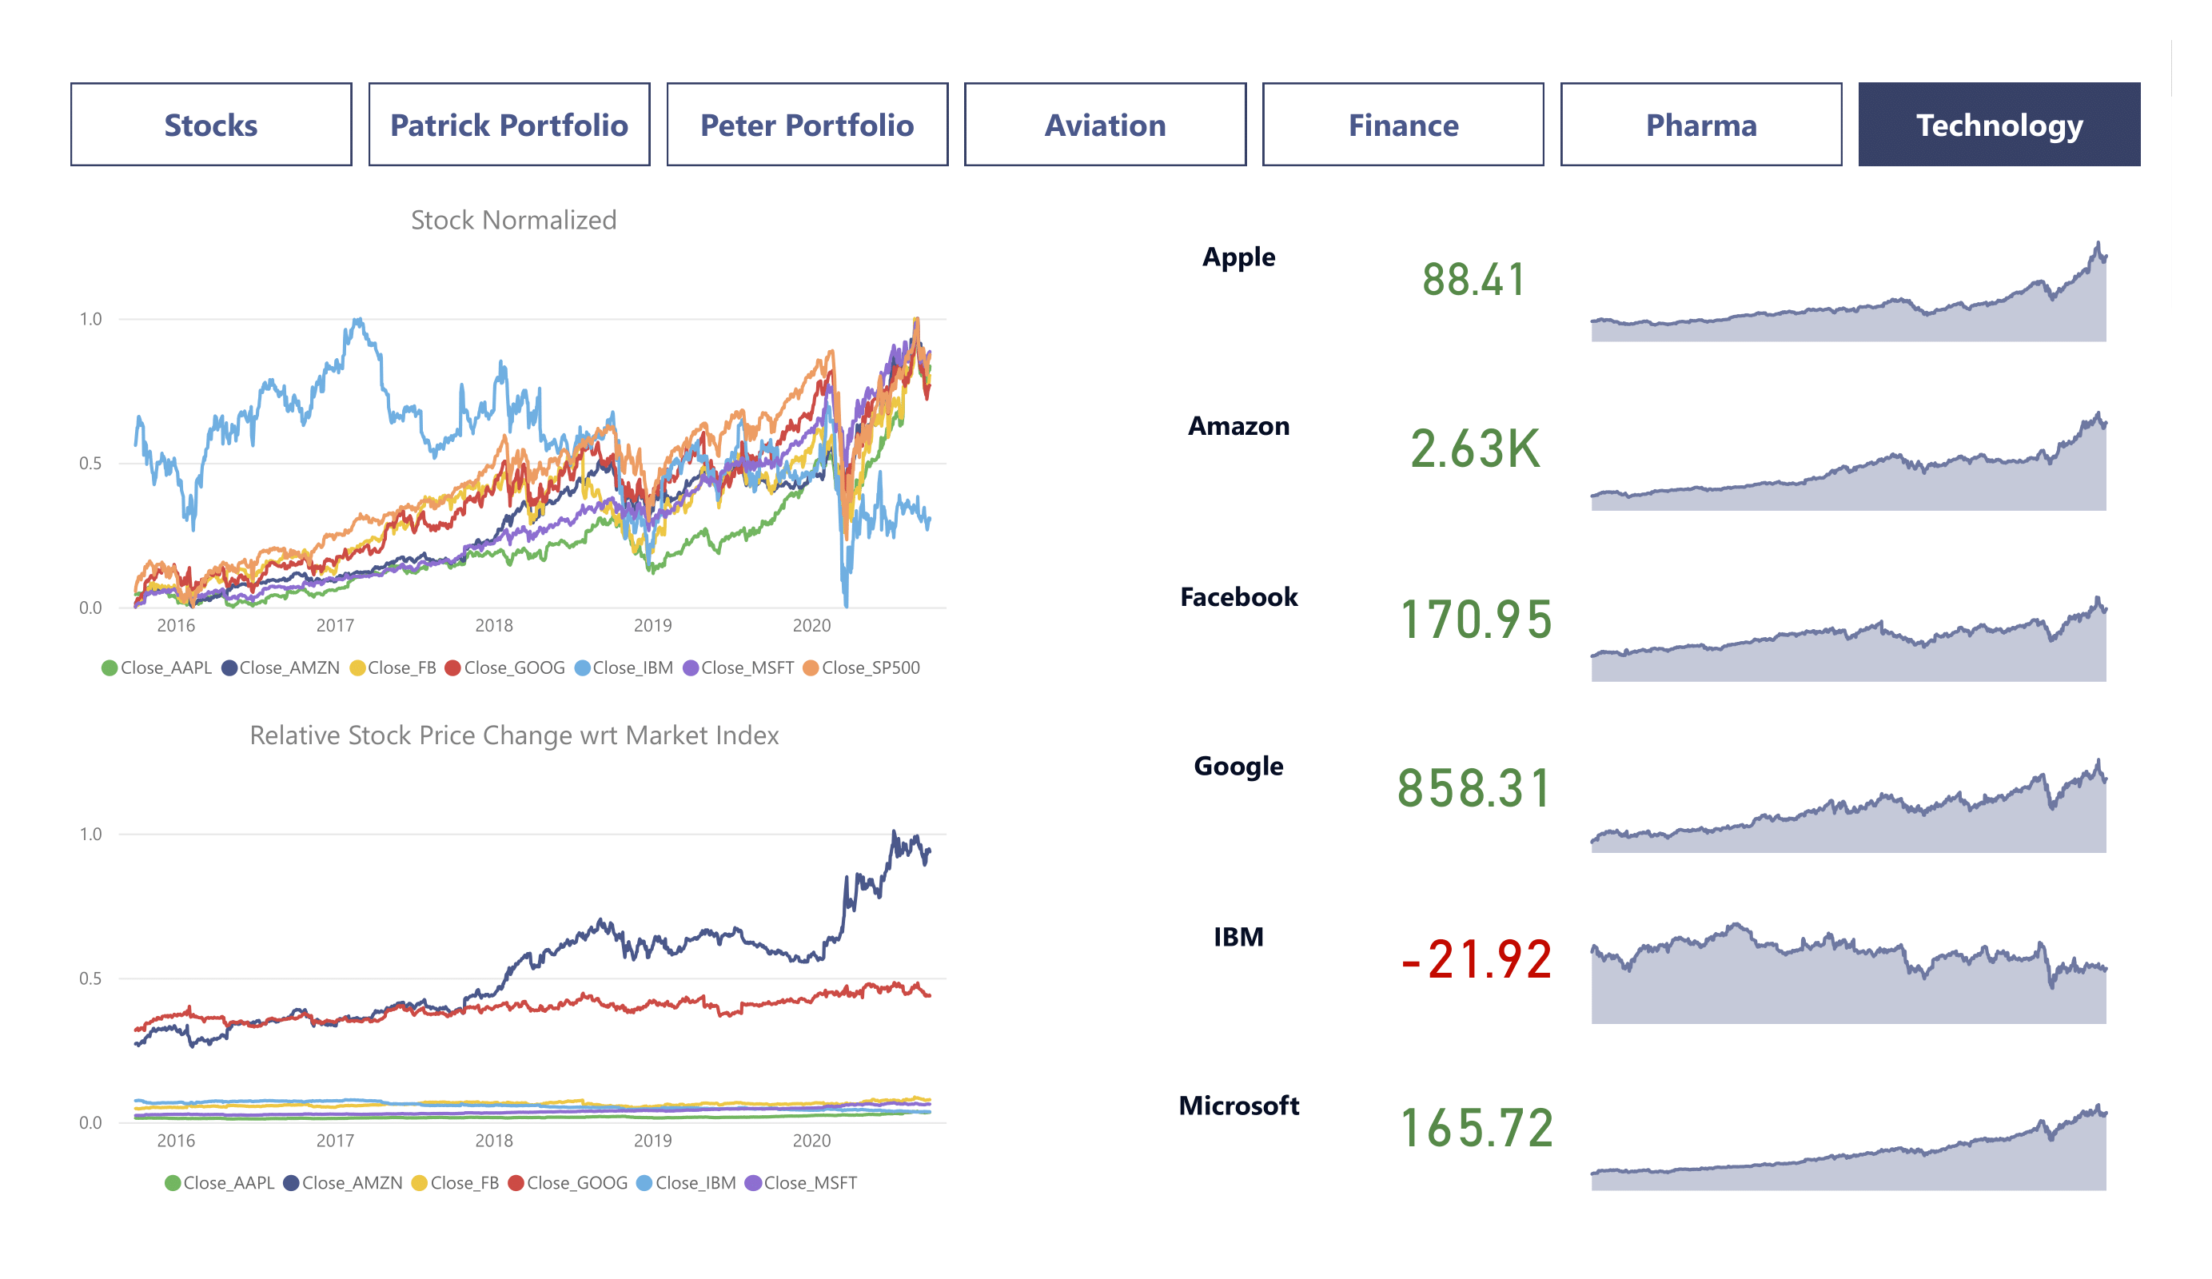
Notes:
Aviation Sector faced a major crisis in March 2020 due to Corona Pandemic and the aviation sector has not recovered thereafter even though the market index has gone up.
Finance Sector also faced a crisis in March 2020 due to Corona Pandemic and the Finance sector has recovered a bit although the majority of stocks have been hit.
Morgan Stanley & Goldman Sachs have performed well when compared to other stocks
Pharma & Health care Sector has also faced a crisis in March 2020 due to Corona Pandemic but the recovery rate shown by this sector is commendable.
United Health and Johnson & Johnson have performed well when compared to S&P Index.
Bausch Health is consistently performed very badly over the years when compared to other stocks in the same sector.
Technology Sector has also faced a crisis in March 2020 due to Covid Pandemic but the recovery rate shown by this sector is commendable.
Microsoft, Amazon, Apple, Facebook & Google have performed well along with the Market index.
IBM is consistently performed very badly over the years when compared to other stocks in the same sector.

Slide 18
Thank You

