Slide 1

Designing, Running and Evaluating Quantum Circuits on the Quokka Device
MSE802 Quantum Computing – Assessment 2: Quantum Project (group presentation)
Presenter: Anish Shrestha (270889991), team lead
Group partner: Sandhya Tiwari (270918511)
Lecturer: Dr Helena Bahrami | Yoobee College of Creative Innovation | 4 November 2026
Notes:
[0:00 – 0:50]
Kia ora and good evening. My name is Anish Shrestha, and I was the team lead for our MSE802 Assessment 2 group project. My partner is Sandhya Tiwari.
Our project had one goal from the brief: build different quantum circuits, run them on a practical quantum computer, and judge how effective that computer really is.
In the next fifteen minutes I will show you our four tasks, the results we measured on the Quokka device, a comparison between our own computer and Quokka, and finally what I learned as team lead.

Slide 2
Four tasks, one device, 1000 shots per circuit
1
Task 1 – Bell state in Cirq
Weight 25%
4 / 4
1000
Task 2 – Qiskit circuit + own QASM circuit
Weight 35%
tasks run on the Quokka device (quokka2)
shots for every circuit
2
4 of 11
~24
3
Task 3 – Quantum tic-tac-toe
Weight 25%
cloud Quokkas online on 4 Nov 2026
qubits where Quokka catches up with our computer
4
Task 4 – Quantum machine learning
Weight 15%
Objective: implement diverse circuits → test them on a practical quantum computer → assess its effectiveness
Notes:
[0:50 – 2:00]
Here is the whole project on one slide. Task 1 is a Bell state in Cirq. Task 2 is the biggest, at thirty-five percent: a given circuit in Qiskit plus our own circuit written in QASM. Task 3 is a quantum tic-tac-toe game, and Task 4 is a small quantum machine-learning classifier.
Every circuit used one thousand shots, so every result is a real statistical sample.
The numbers on the right are the headline. All four tasks ran on the Quokka device called quokka2. On the day we tested, four of the eleven cloud Quokkas were online. And our comparison showed that Quokka only catches up with an ordinary computer at about twenty-four qubits. I will come back to that number later, because it answers the "effectiveness" part of the objective.

Slide 3
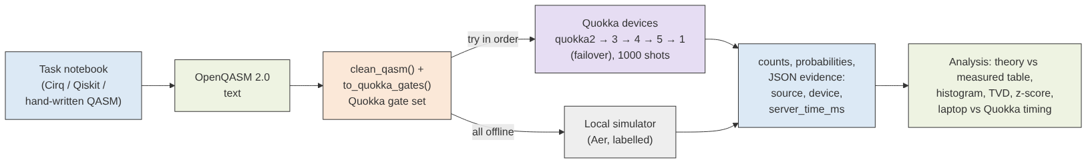
One shared pipeline sends every circuit to Quokka
1
Shared helper
2
Device failover
3
Honest fallback
quokka_helper.py cleans the QASM, rewrites gates Quokka does not support (S, Toffoli), and saves every result as JSON with its source and device.
quokka1 was offline, so the helper now tries quokka2 → 3 → 4 → 5 → 1 and records which device answered.
If every device is down, the same QASM runs on a local simulator and is labelled LOCAL SIMULATOR – never passed off as device data.
Notes:
[2:00 – 3:00]
As team lead, my first job was to make sure we never wrote the same Quokka code twice. So I built one shared helper that every task uses.
It takes a circuit from Cirq, Qiskit or hand-written QASM, cleans it, and rewrites any gate that Quokka does not support – for example the S gate and the three-qubit Toffoli. Then it posts the script to Quokka with one thousand shots.
When quokka1 – the address in our course notebook – was offline, I added a device list with automatic failover. And if no device answers at all, the same script runs on a local simulator, clearly labelled. This honesty rule mattered: no simulator number was ever presented as device data.

Slide 4
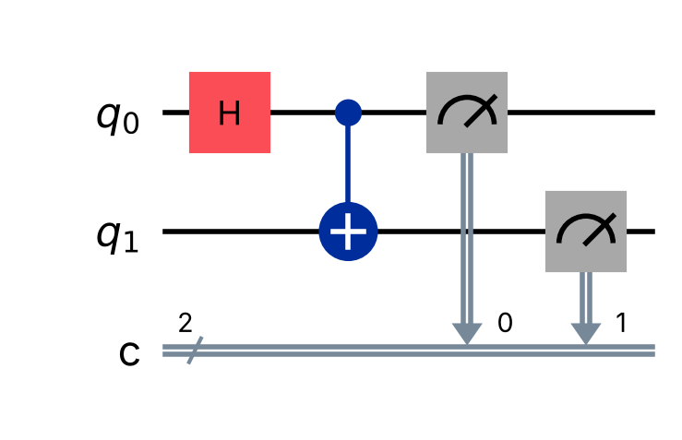
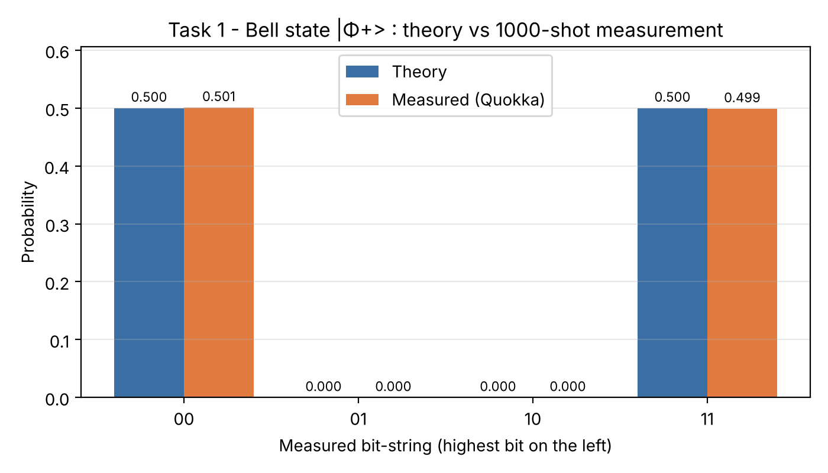
Task 1 – A Bell state: two coins that always agree
H on q0, then CNOT q0 → q1, then measure (Cirq)
Target state: |Φ⁺⟩ = (|00⟩ + |11⟩)/√2
Quokka (quokka2): 501 × 00, 499 × 11, never 01 or 10
z = +0.06, distance from theory (TVD) = 0.001
Each qubit alone is random; the pair is perfectly correlated
Theory vs 1000 measured shots on Quokka
Notes:
[3:00 – 4:00]
Task 1 was built by my partner Sandhya, and I reviewed it. A Hadamard gate puts the first qubit into superposition, and a CNOT copies it onto the second qubit in every branch at once. That creates the Bell state.
On Quokka we measured 501 times zero-zero and 499 times one-one, and not a single zero-one or one-zero. That absence is the real proof of entanglement, because theory says those outcomes are impossible.
The split is not exactly 500 to 500, and it should not be: with one thousand shots the normal spread is about sixteen. Our z-score is only 0.06.
We also ran the same circuit through the alternative Qiskit version and on three other Quokka devices, and every run showed the same pattern: half zero-zero, half one-one, and nothing else. That consistency across tools and devices is what makes the result convincing.

Slide 5
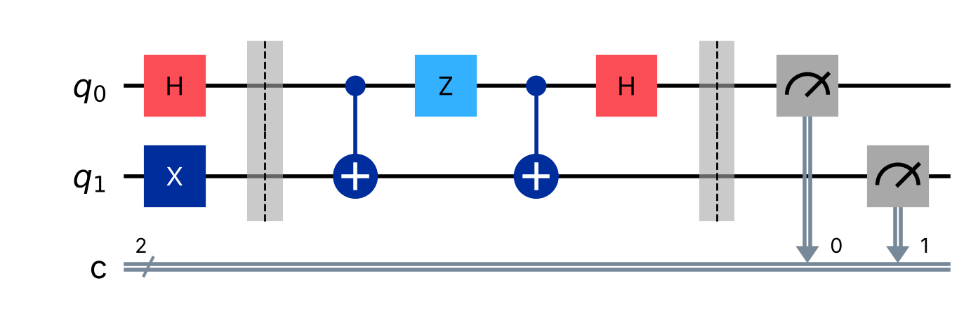
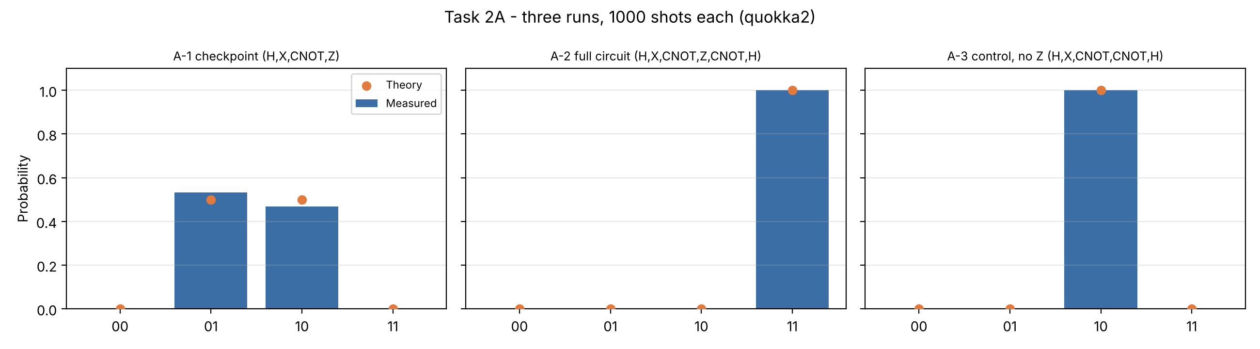
Task 2A – Block C: create, change, then read entanglement
Lecturer's brief: start with H (q0) and X (q1), add 2–3+ gates including a CNOT
CNOT creates |Ψ⁺⟩; Z flips its phase to |Ψ⁻⟩; CNOT + H = Bell measurement
Entanglement entropy: 0 → 1 → 1 → 0 bits
Idea from superdense coding (Bennett & Wiesner, 1992)
Given H and X, then our block C: CNOT → Z → CNOT → H
Quokka: checkpoint only 01/10 (532/468) · full circuit 11 × 1000 · without Z 10 × 1000
Notes:
[4:00 – 5:40]
Task 2 is where I spent most of my design time. Our first version was just H, X and one CNOT. When I asked the lecturer, she explained that block C should hold at least two or three gates, including a controlled gate, and that we must show whether entanglement is created.
So I redesigned block C as a story with three acts. The first CNOT creates an entangled Bell pair. The Z gate flips its phase – a change that no direct measurement can see. Then a second CNOT and an H gate form a Bell measurement, which reads that hidden phase.
We ran three versions on Quokka. The checkpoint run, stopped after Z, gave only opposite bits – that is the entanglement. The full circuit gave one-one in all one thousand shots. And the control run without Z gave one-zero in all one thousand shots. One phase gate changed the answer with certainty.

Slide 6
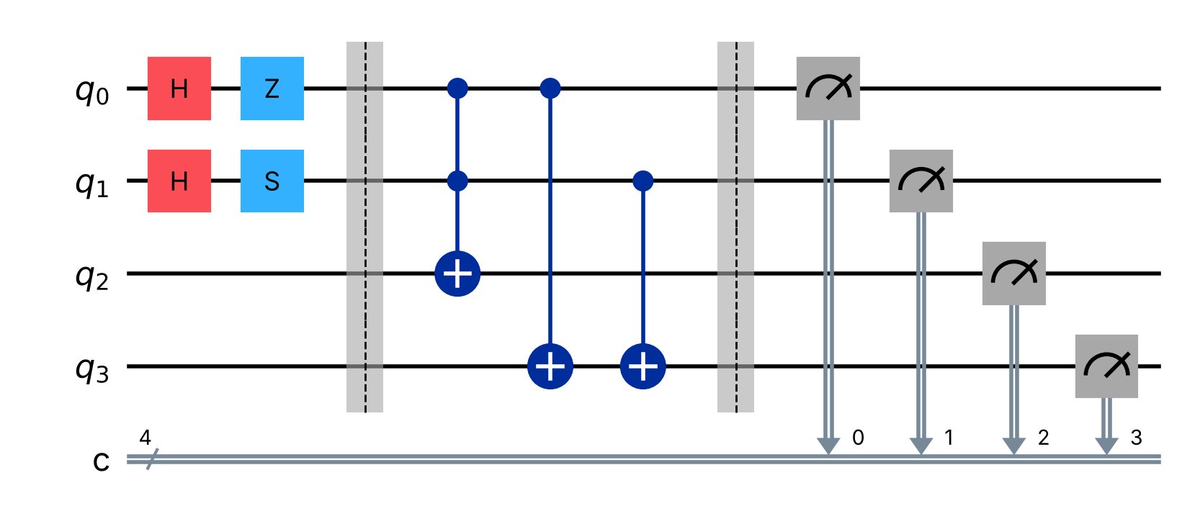
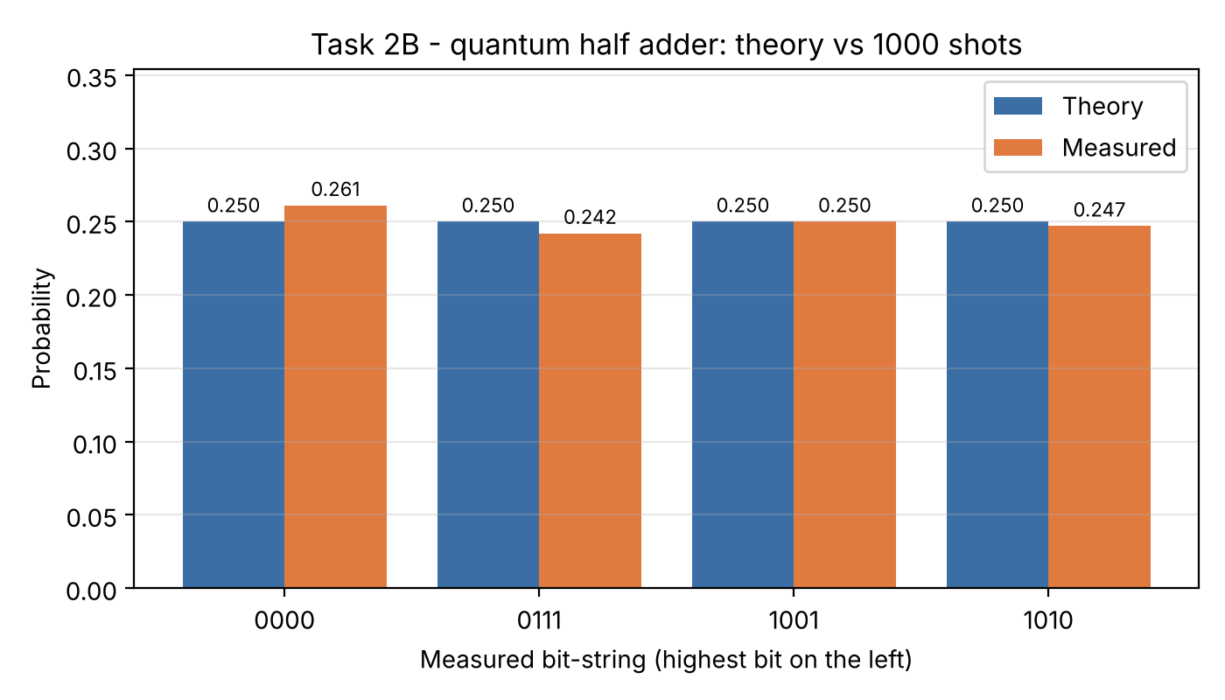
Task 2B – Our own QASM circuit: a quantum half adder
4 qubits · H, Z, S, Toffoli, CNOT (custom_half_adder.qasm)
Inputs A and B in superposition: all four additions in one circuit
SUM = A XOR B (two CNOTs), CARRY = A AND B (Toffoli)
Quokka: 1000 of 1000 shots were correct additions (242–261 per row)
Quokka has no S or Toffoli → helper rewrote 7 gates into 21
Each bar is one row of the truth table
Notes:
[5:40 – 6:50]
For the second part, the brief asked for a completely different circuit with different gates and qubits. I chose a half adder – the basic building block of computer arithmetic – but with a quantum twist.
Both inputs start in superposition, so one circuit holds all four additions at once. Every shot then shows one complete, correct row of the truth table, and on Quokka all one thousand shots were correct.
Two lessons here. First, superposition is not free parallel output: you still see only one answer per shot. Second, real devices have a limited gate set. Quokka does not support S or Toffoli, so our helper rewrote seven gates into twenty-one – exactly what real hardware compilers do.
The notebook checks that the rewritten circuit has exactly the same probabilities as our original design, so the translation is proven, not assumed. The cost is that a one-line Toffoli became about fifteen gates, and on noisy hardware every extra gate would add error.

Slide 7
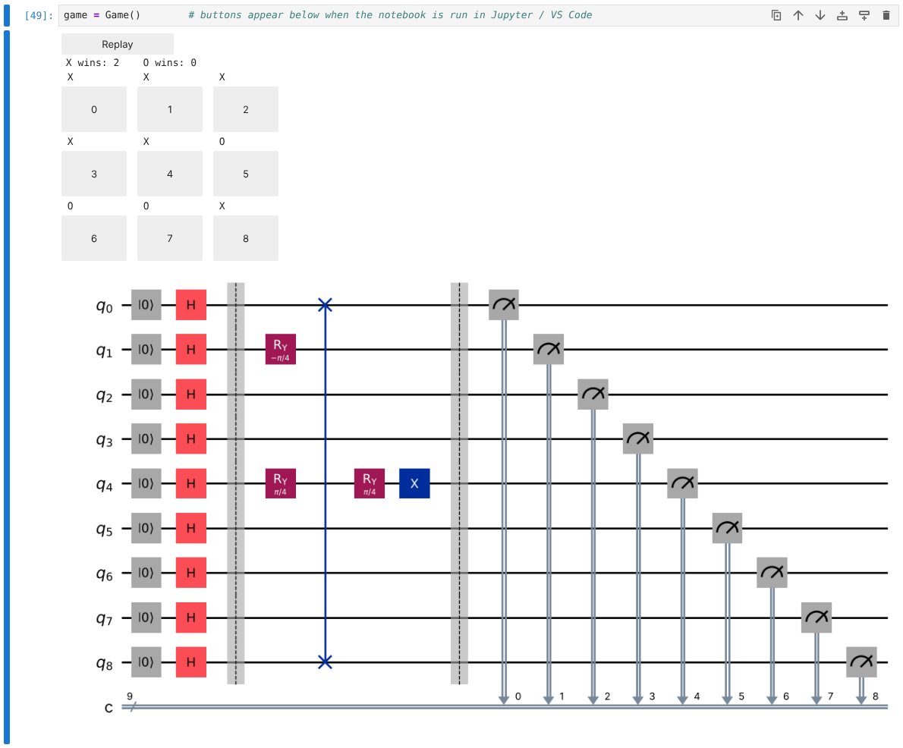
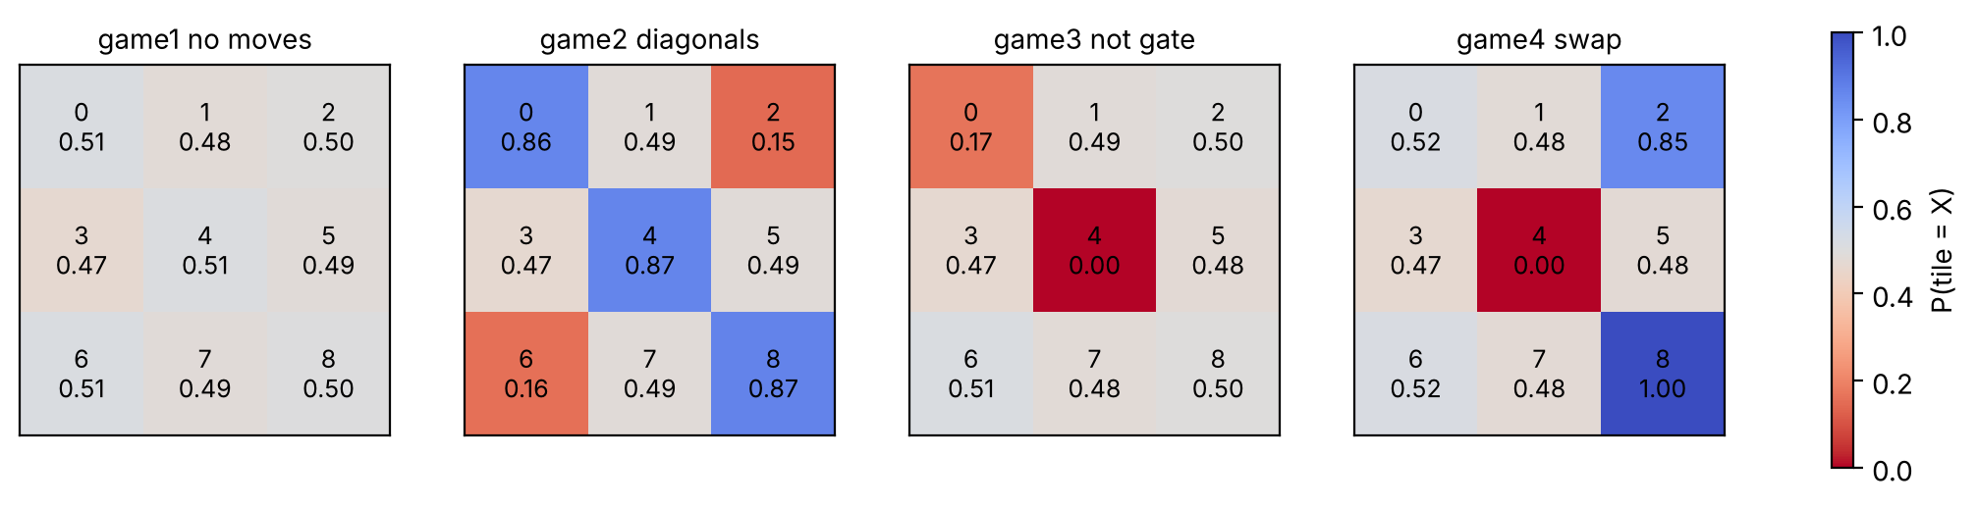
Task 3 – Quantum tic-tac-toe: every click adds a gate
Completed 4 missing gates: X → RY(−π/4), O → RY(+π/4), Not → X, SWAP
Added the 8 winning lines; fixed 5 bugs, incl. silent buttons in Jupyter
NOT on an undecided tile does nothing: X|+⟩ = |+⟩
A game circuit on Quokka matched theory (0.86 / 0.50 / 0.14)
Game C played by clicking in Jupyter: X wins 2 lines
Chance each tile becomes X after four recorded games (1000 shots)
Notes:
[6:50 – 8:10]
Task 3 was mine as well. We received a partly built quantum tic-tac-toe game. Each tile is one qubit, and each move adds one gate. An X move rotates the tile towards zero, an O move rotates it towards one, and nobody owns a tile until the board is measured.
I completed the four missing gates, added the eight winning lines – the original code could never produce a winner – and fixed five bugs. The most interesting one: the buttons worked in Colab but did nothing in Jupyter, because the output was silently dropped. I fixed it with an Output widget and then played games by clicking.
The games show real quantum behaviour. For example, a NOT gate on an undecided tile does nothing at all, because that state is an eigenstate of X. We also sent a game circuit to Quokka, and the tile probabilities matched theory.

Slide 8
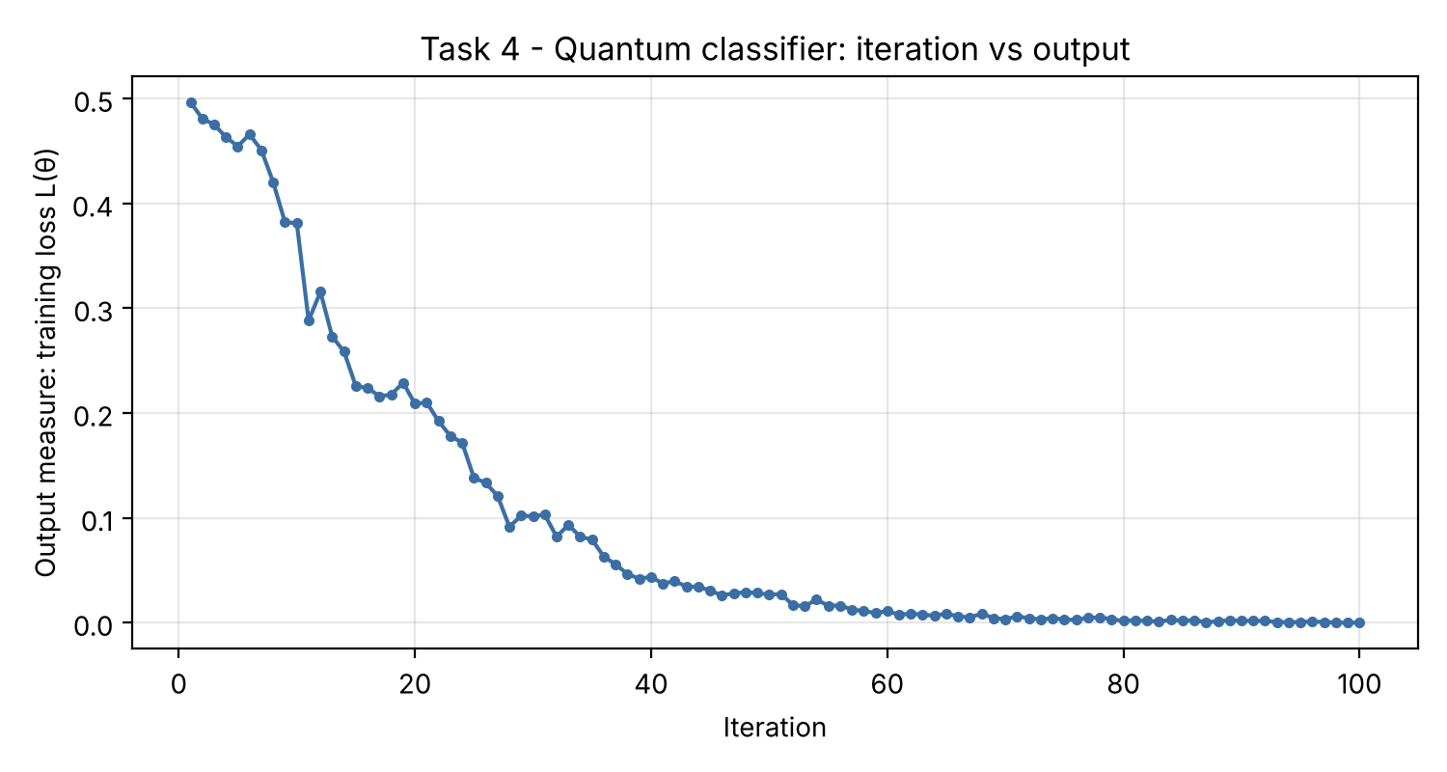
Task 4 – Quantum classifier: right structure, not more speed
Loss per iteration on Quokka: 0.50 → 0.00 in 100 iterations
Pixels → X gates (basis encoding); tree of RY–RY–CNOT blocks
100 iterations, 900 circuits on Quokka: all 4 images correct
Linear classical models: only 3 of 4 (the data is XOR-shaped)
Notes:
[8:10 – 9:30]
Task 4 was owned by Sandhya, and I integrated it into our runner. The notebook trains a small quantum circuit to sort tiny two-by-two images into bars and stripes. Each pixel becomes one qubit through an X gate, and a tree of rotation and CNOT blocks combines them into one output qubit.
We logged every one of the one hundred iterations. On Quokka the loss fell from 0.5 to zero, and all four images were classified correctly – while simple linear classical models only got three of four, because the data has an XOR shape.
But look at the chart: on Quokka each iteration took about four seconds; an exact local simulation took about one millisecond. So the circuit won because of its structure, not because of quantum speed.
There was also an honest failure: the original warm-up example, a single qubit trained with the Nelder–Mead method, did not converge in ten iterations, because shot noise hides the slope of a flat loss curve. That is a small version of a real problem in quantum machine learning, called barren plateaus.

Slide 9
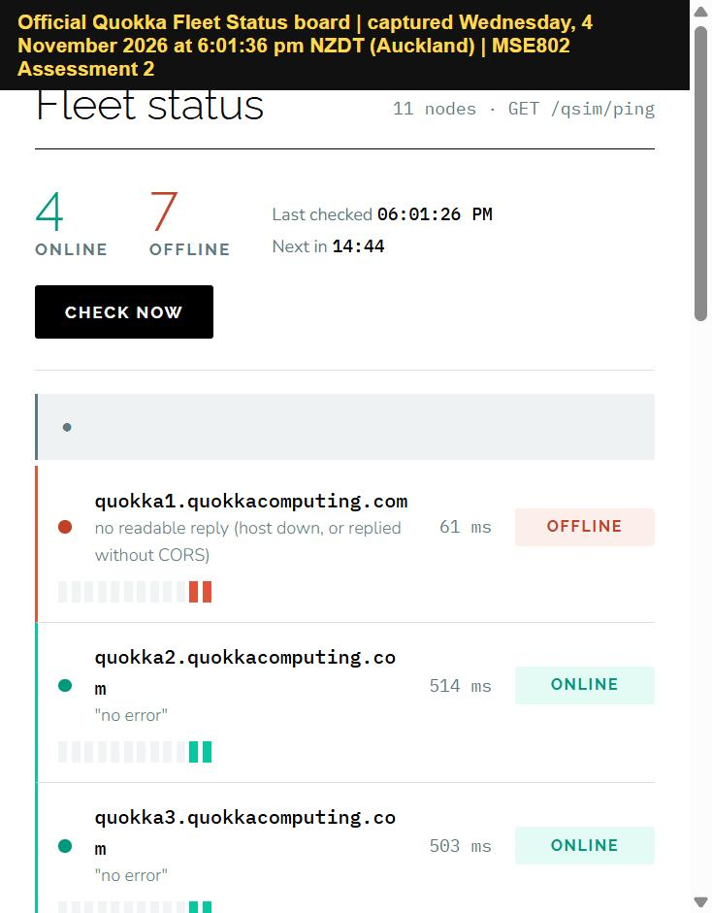
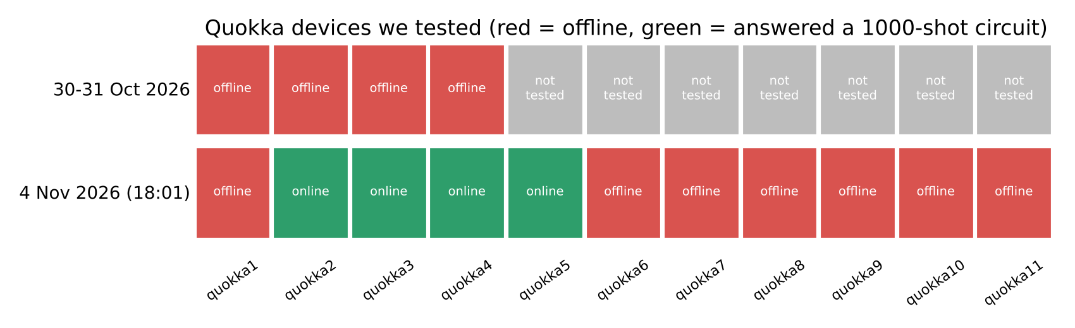
When the quantum computer was offline
1
30–31 Oct quokka1 returned ERR_NGROK_3200 – offline. We finished on a labelled simulator.
2
4 Nov, 17:57 Probed quokka1–20 with a real circuit: quokka2–5 answered.
3
4 Nov, 18:14 One command re-ran Tasks 1–4 on quokka2; labels changed to QUOKKA DEVICE.
Official Fleet Status board, 4 Nov 2026, 6:01 pm
Notes:
[9:30 – 10:40]
Now the part of the project that taught me the most. On the thirtieth of October every request to quokka1 came back with the error ERR_NGROK_3200 – the address existed, but no server was behind it. A login or API key would not have helped; the official notebooks use none.
Instead of stopping, we finished on the labelled simulator. On the fourth of November I signed in to the Quokka website, found the official Fleet Status board with eleven devices, and saw that quokka2 to quokka5 were online.
Because every task already went through the shared helper, one command re-ran everything on the real device. The outage cost us days, but the design made recovery take minutes.

Slide 10
Our computer vs Quokka: same answers, different costs
12–16×
faster on our computer for small circuits
> 99%
of Quokka's time is network delay (device: 2–4 ms)
< 0.015
TVD on every device – identical outcomes
Notes:
[10:40 – 12:10]
The lecturer asked us to compare our own computer with Quokka, so I built a comparison tool that sends the exact same QASM to both.
For outcome, there is no difference: every device stayed within normal shot noise of the theory, with a distance below 0.015. That makes sense, because Quokka emulates an ideal, error-free quantum computer.
For speed, small circuits are twelve to sixteen times faster on our computer. But Quokka itself only needs two to four milliseconds – more than ninety-nine percent of its time is the internet round trip.
The line chart is the most important result. Our computer's time stays flat until about sixteen qubits, then roughly quadruples every two qubits. Quokka stays flat. At twenty-four qubits they meet, and by thirty qubits a laptop would need about seventeen gigabytes just to store the state. That is where a quantum device starts to pay off.
There is also an engineering lesson. In Task 4, every one of the nine hundred circuits was a separate internet request, so the network dominated. A remote quantum device should receive batches of large circuits, not many tiny ones.

Slide 11
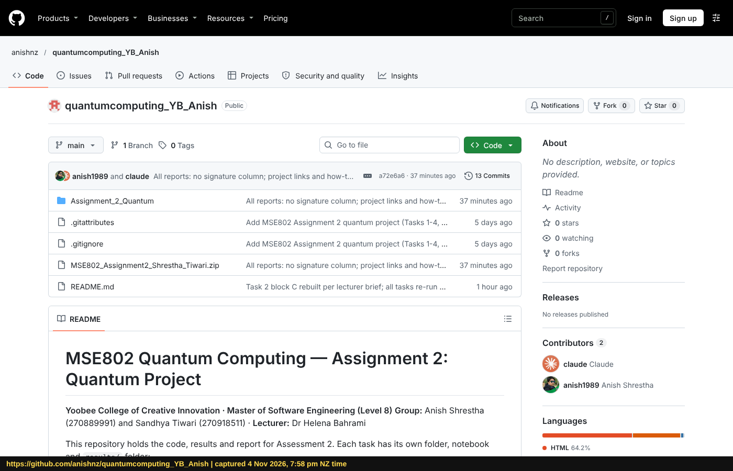
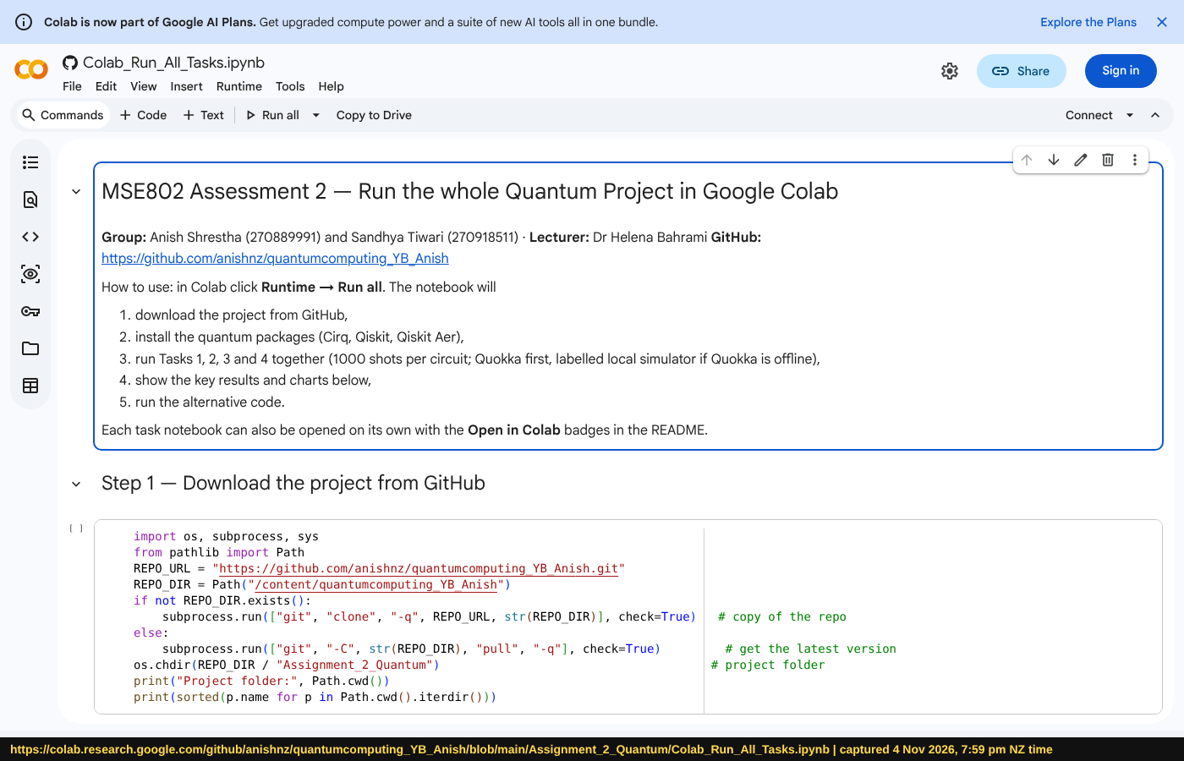
Reproducible by anyone: GitHub, Colab, launchers
github.com/anishnz/quantumcomputing_YB_Anish – public, 13+ commits
Colab_Run_All_Tasks.ipynb – Runtime → Run all, nothing to install
Windows: run_project.bat macOS: run_project.command Any: python run_project.py all | status | compare
Notes:
[12:10 – 13:00]
A result is only useful if someone else can repeat it. Everything is in a public GitHub repository – every change is a commit with a message explaining why, so the history doubles as documentation.
For the marker there are three ways to run it. In Google Colab, one link and Runtime, Run all – nothing to install. On Windows, double-click run_project.bat. On a Mac, double-click run_project.command. All three run the same notebooks with one thousand shots and save the same evidence files, including the device name and Quokka's own processing time.

Slide 12
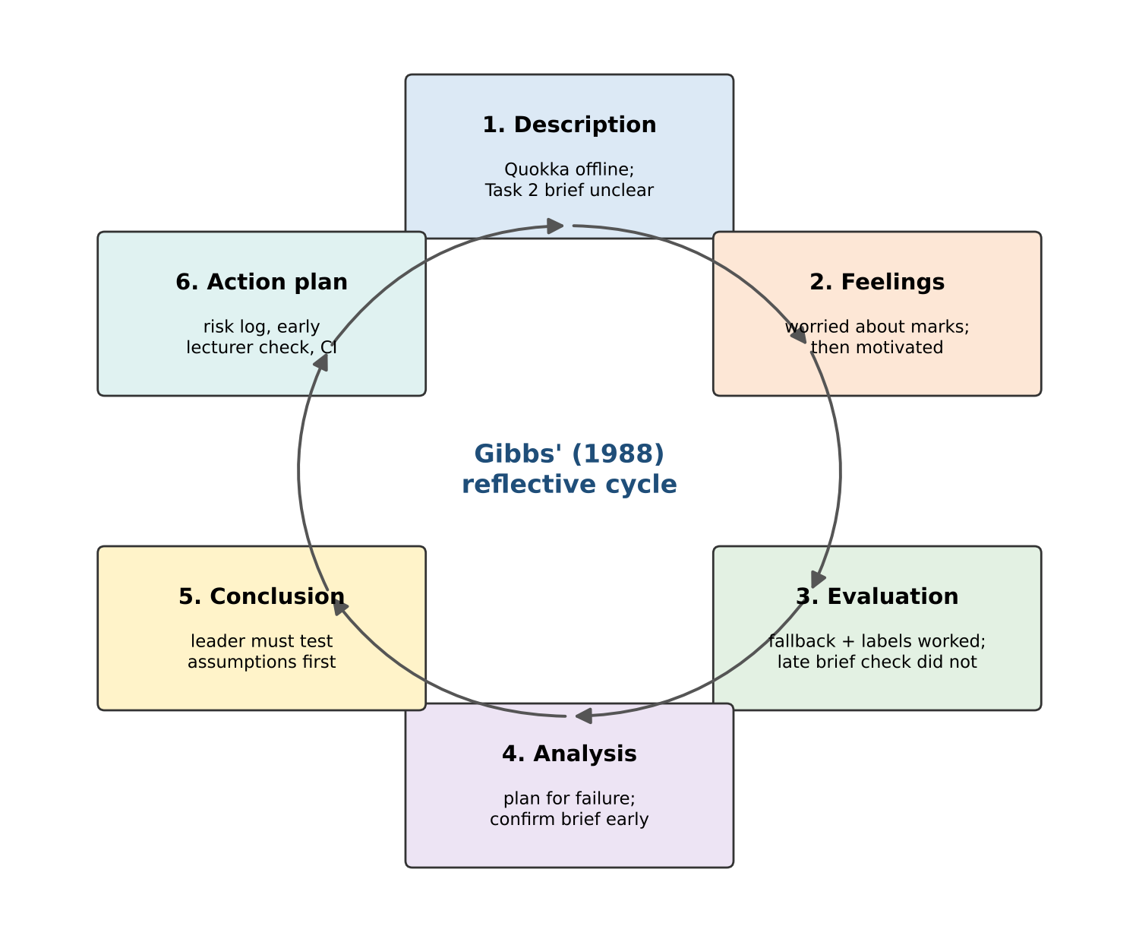
What I learned as team lead (Gibbs' reflective cycle)
1
Test assumptions early
I assumed Quokka would be online and that one CNOT was enough for block C. Both were wrong.
2
Plan for failure
The labelled fallback and device list turned a crisis into a one-command re-run.
3
Ask, then design
The lecturer's feedback turned a 1-gate block into a create–change–measure experiment.
4
Next time
Write a risk register on day one, confirm the brief in week one, and test in every environment.
Notes:
[13:00 – 14:10]
For my individual reflection I used Gibbs' reflective cycle.
My biggest lesson is that a leader must test the assumptions the whole plan depends on – and do it early. I assumed the device would be online, and I assumed one CNOT was enough for block C. Both assumptions failed and cost us time.
What went well was planning for failure: the labelled fallback and the device list meant the outage never stopped our work.
I also learned to ask before designing. The lecturer's feedback made our Task 2 much richer.
Next time I will write a risk register on the first day, confirm the brief in the first week, and test every notebook in every environment we promise to support.
On the team side, I learned that giving my partner full ownership of two tasks, while I built the shared code she depended on, worked well. In the future I will also ask her to review my integration work earlier, so that knowledge flows both ways.

Slide 13
Conclusion – predict, measure, explain
Circuits
Evidence
Effectiveness
Bell state, block C, half adder, game and classifier – all designed, explained and run on Quokka.
Every result agrees with theory within shot noise; every number is labelled with its source and device.
Quokka gives identical answers; it is slower for small circuits but wins beyond about 24 qubits.
GitHub: https://github.com/anishnz/quantumcomputing_YB_Anish
Colab: https://colab.research.google.com/github/anishnz/quantumcomputing_YB_Anish/blob/main/Assignment_2_Quantum/Colab_Run_All_Tasks.ipynb
Thank you – questions?
Notes:
[14:10 – 15:00]
To conclude. We designed and explained five kinds of quantum circuit and ran every one of them on the Quokka device. Every result agreed with theory within normal shot noise, and every number carries a label saying where it came from.
On effectiveness, our answer is clear: Quokka gives the same answers as theory, it is slower for small circuits because of the network, and it becomes the better choice above about twenty-four qubits.
The most important habit I take away is simple: predict with mathematics first, then measure, then explain the difference.
All code, results and reports are on GitHub and run in Colab with one click. Thank you – I am happy to take your questions.

