Slide 1


Application of Computer Vision
Anish Patel
Undergraduate, Sophomore Student, Computer Science
Dr. Daniel Vrinceanu
Associate Professor, Department of Physics

Slide 2
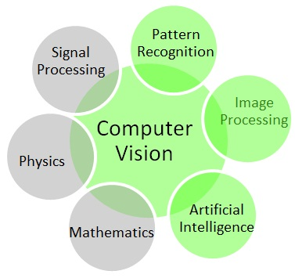

What is Computer Vision?
It is a method for acquiring, processing, analyzing, and understanding images from real world.
It concerned with the theory behind artificial system that extract information from images.
Sub-domain of Computer vision include scene recognition, event detection, video tracking, object recognition, motion estimation and image restoration.

Slide 3


Programming Language and Library
High Level programming languages, like C++ and C#.
OpenCV (C++, C, Python) and EmguCV (C# and VB) is a Computer Vision library with rich inbuilt functions that can process the images.

Slide 4
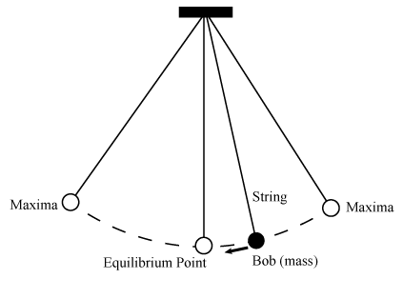
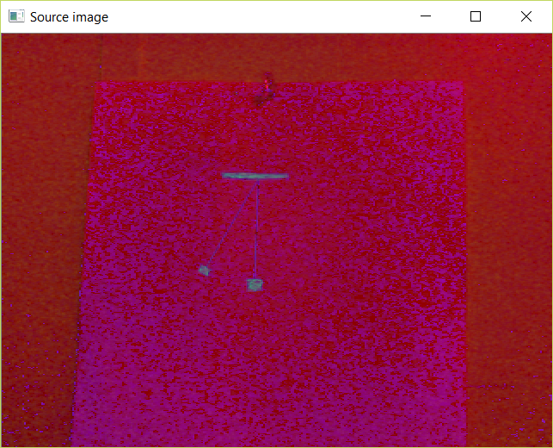
Simple Pendulum Experiment Using Camera
Transform original color image into HSV format.
Morphological Transformation is a simple operation based on the image shape. It normally performed on binary images and needs two input (for OpenCV), one HSV image, and second structuring element which decide the nature of operation.

Slide 5
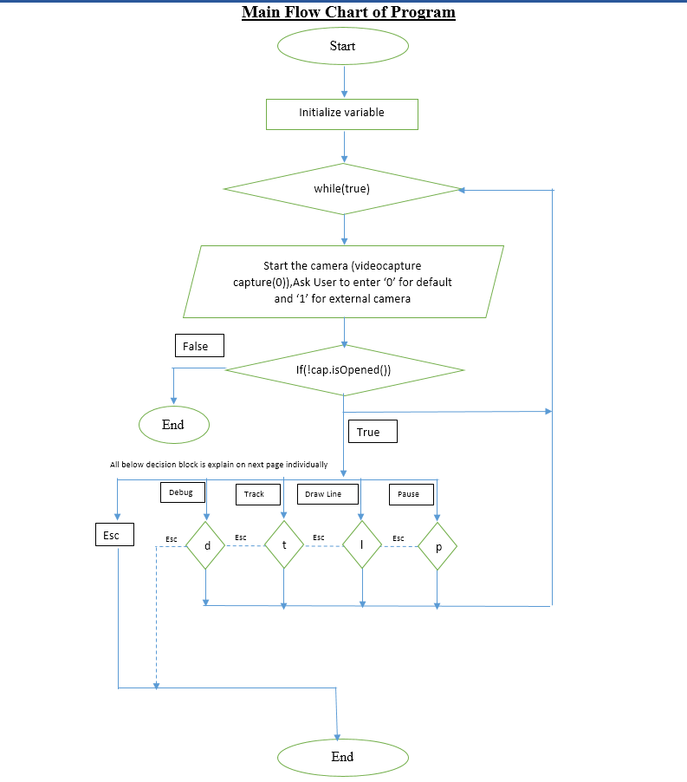
Algorithm/Programming Flowchart for Simple Pendulum

Slide 6
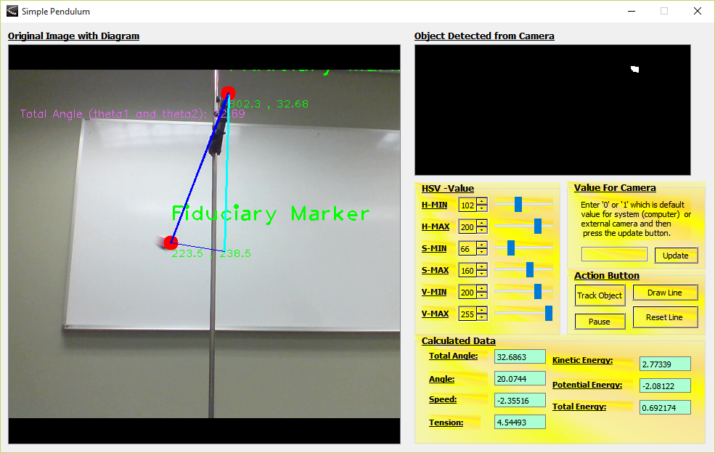
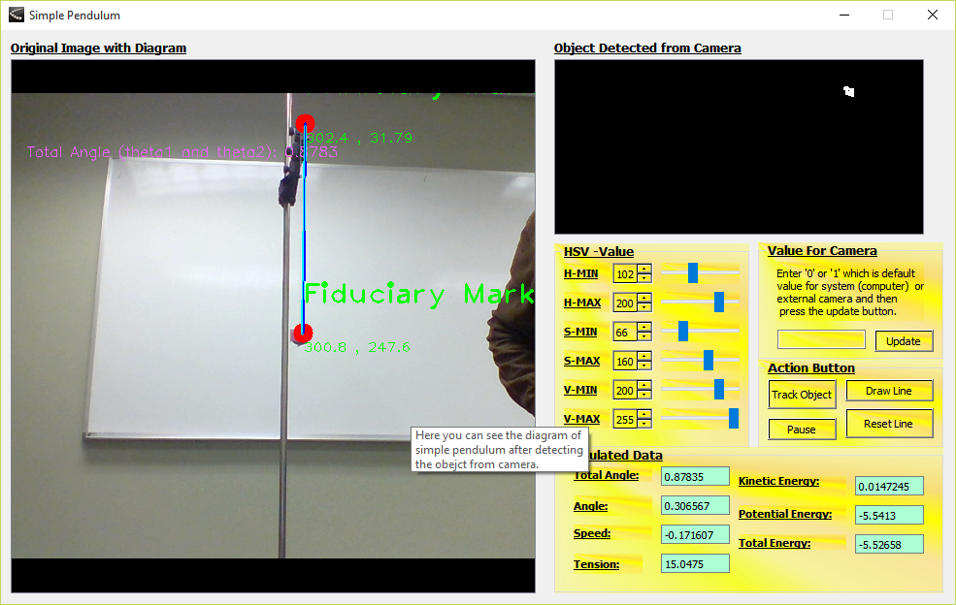
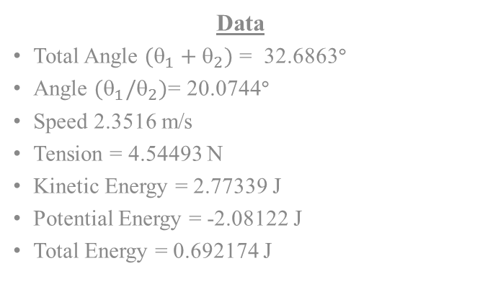
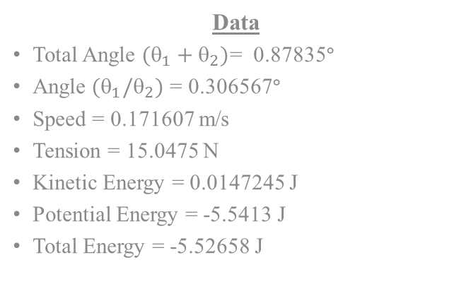
Program Generated Pendulum Diagram with Data
Data
Total Angle $(_{1}+_{2})$ = 32.6863º
Angle $(_{1}/_{2})$= 20.0744º
Speed 2.3516 m/s
Tension = 4.54493 N
Kinetic Energy = 2.77339 J
Potential Energy = -2.08122 J
Total Energy = 0.692174 J
Data
Total Angle $(_{1}+_{2})$= 0.87835º
Angle $(_{1}/_{2})$ = 0.306567º
Speed = 0.171607 m/s
Tension = 15.0475 N
Kinetic Energy = 0.0147245 J
Potential Energy = -5.5413 J
Total Energy = -5.52658 J

Slide 7
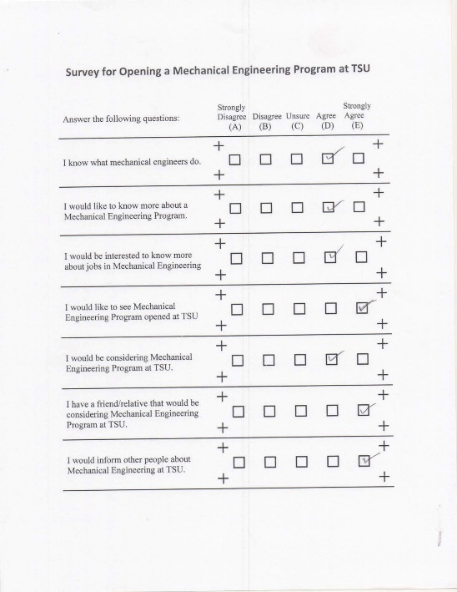
Automatic Survey Grading
Another application uses Optical Mark Recognition (OCR) technology which will provide institute / university to grade their survey automatically using software
The main ides of this application is to detect all crosses inside page, so we don’t worry about the text, QR code, and so forth.
According to the pixel value of each square we can assume that the square which has highest number of non-zero pixel is the answer

Slide 8
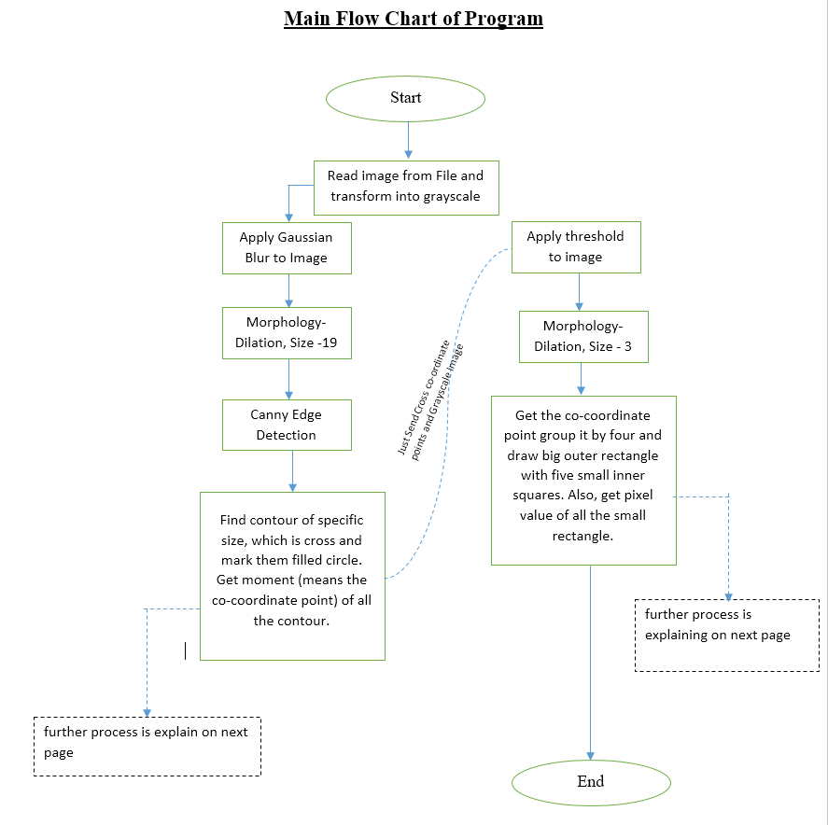
Algorithm/Programming Flowchart for Survey

Slide 9
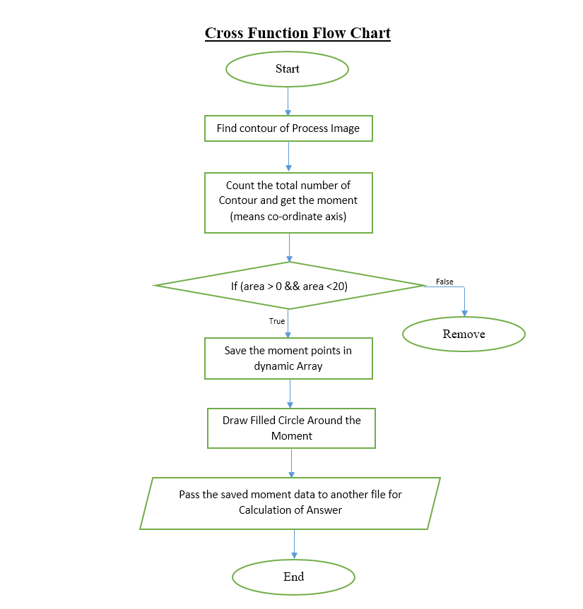
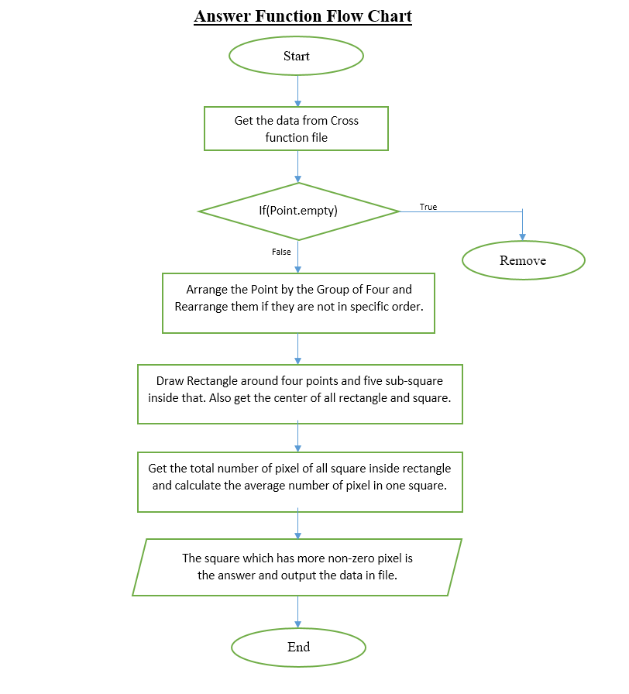
Algorithm/Programming Sub-Flowchart for Survey

Slide 10
Accuracy of Application by Increasing Noise Value on Image

Slide 11
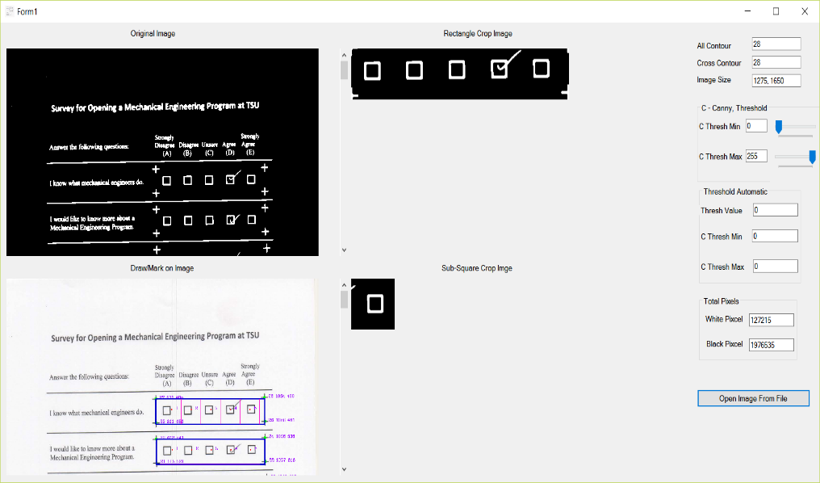
Survey Process Image with Data
No of Questions | Total Pixel Inside Rectangle | Pixel Inside sub-five Squares |  |  |  |  | Average Number of Pixel in Square + 70
 |  | Square 1 | Square 2 | Square 3 | Square 4 | Square 5
 |  | A | B | C | D | E
1. | 3580 | 595 | 602 | 606 | 859 | 628 | 728
2. | 3382 | 602 | 594 | 565 | 790 | 567 | 693
3. | 3424 | 582 | 591 | 599 | 758 | 567 | 689
4. | 3496 | 572 | 570 | 574 | 568 | 872 | 701
5. | 3795 | 632 | 627 | 651 | 875 | 646 | 756
6. | 3420 | 580 | 574 | 592 | 577 | 755 | 685
7. | 3808 | 636 | 631 | 648 | 645 | 855 | 753

Slide 12
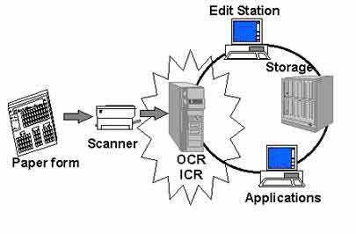
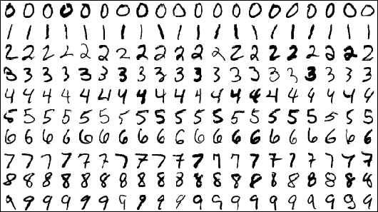
Conclusion
There are many more possible science experiments which can be program like collision of atom, find total number of protein inside microscopic cell.
In addition, grading handwritten letters and words by using camera, which will reduce lots of work in the field of education, automatic filled application processing rather than entering data manually.

Slide 13
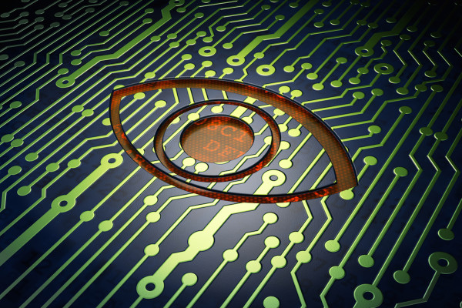
Thank you ! Do you have any questions?

