Slide 1

Optimizing Fraud Detection - Comparative Analysis of Machine Learning Algorithms for enhanced accuracy and efficiency
Anish Pitale – 20030877

Slide 2

Introduction:
Problem Statement – The research endeavours to fill these gaps through a comparison study between standard algorithms like Decision Trees, and Random Forests, and nonstandard algorithms such as Isolation Forests and K-means Clustering in an effort to enhance the performance of fraud detection and system dependability.
Solution – A comparative analysis of advanced machine learning algorithms, including Random Forests, Decision Trees, Isolation Forests, and K-Means, to optimize fraud detection systems for accuracy and efficiency.
Conclusion – By the end of this project, using advanced classification and anomaly detection techniques, especially Random Forest, make it much easier to spot fraud and provide flexible and scalable solutions for the financial industry.

Slide 3

Research Aim & Research Questions:
Aim: The main aim of the study is to enhance fraud detection in credit card transactions by conducting a comparative analysis of machine learning algorithms that include anomaly detection and classification.
Research Questions?
What are the strengths/weaknesses of the algorithms?
How can anomaly detection complement classification?
Which models balance accuracy and scalability?

Slide 4
Literature Review and Gaps:
Machine learning’s role in fraud detection.
1
Supervised methods: Random Forest, Decision Tree.
2
Unsupervised methods: Isolation Forest, K-Means.
3
Identified gaps: Interpretability and adaptability of models.
4

Slide 5
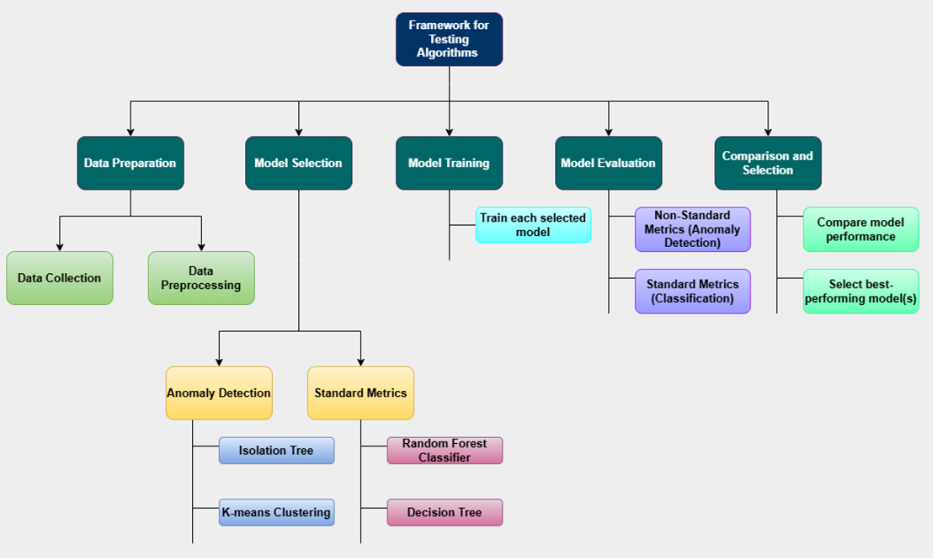
Research Methodology:
Data Collection: Publicly available Resources (Kaggle)
Data Pre-processing: Cleaning, feature creation, and scaling.
Model Development: Training standard and non standard ML models and evaluating performance. Like Random Forest, Decision tree, Anomaly detection such as Isolation Forest and K-Means Clustering.
Model Selection: Identifying the best-performing model.

Slide 6

Challenges:
The dataset used in this study focuses solely on credit card transactions, limiting its applicability to other sectors like insurance or e-commerce. The anonymized features restrict the ability to identify specific patterns influencing fraud, reducing the generalizability of the findings across industries.
Additionally, the algorithms evaluated have inherent limitations, such as struggles with imbalanced datasets and varying performance across fraud types. Metrics like accuracy, precision, and recall, while standard, may not fully capture the impact of false positives or negatives, which are critical in real-world fraud detection, potentially affecting the study’s credibility.

Slide 7

Conclusion:
1. Model Performance:
Random Forest: Best accuracy (92.39%) and balanced metrics.
Decision Tree: Accurate (88.83%) but prone to overfitting.
Isolation Forest: Poor accuracy (48.96%), high false positives.
K-Means: Moderate clustering (ARI 86%), struggles with noise.
2. Challenges:
Imbalanced Data: Fraud cases only 0.17%.
Anomaly Models: Limited effectiveness in detecting fraud.
3. Recommendations:
Random Forest: Most suitable for fraud detection.
Combine supervised and unsupervised models for better results.
4. Limitations:
Focused on credit card transactions, limiting generalizability.

Slide 8
References:
Alarfaj, F.K., Malik, I., Khan, H.U., Almusallam, N., Ramzan, M. and Ahmed, M., 2022. Credit card fraud detection using state-of-the-art machine learning and deep learning algorithms. IEEE Access, 10, pp.39700-39715.
Bahri, M., Salutari, F., Putina, A. and Sozio, M., 2022. AutoML: state of the art with a focus on anomaly detection, challenges, and research directions. International Journal of Data Science and Analytics, 14(2), pp.113-126.
Chang, V., Di Stefano, A., Sun, Z. and Fortino, G., 2022. Digital payment fraud detection methods in digital ages and Industry 4.0. Computers and Electrical Engineering, 100, p.107734.
Dang, T.K., Tran, T.C., Tuan, L.M. and Tiep, M.V., 2021. Machine learning based on resampling approaches and deep reinforcement learning for credit card fraud detection systems. Applied Sciences, 11(21), p.10004.
Elhassan, T., 2022. Financial fraud detection based on machine learning: a systematic literature review. Applied Sciences, 12(19), p.9637.
Fang, Y., Zhang, Y. and Huang, C., 2024. Credit card fraud detection based on machine learning. In Proceedings of the 2024 2nd International Conference on Image, Algorithms and Artificial Intelligence (p. 35). Springer Nature.
Gadal, S., Mokhtar, R., Abdelhaq, M., Alsaqour, R., Ali, E.S. and Saeed, R., 2022. Machine learning-based anomaly detection using K-mean array and sequential minimal optimization. Electronics, 11(14), p.2158.
Hasan, M.R., Gazi, M.S. and Gurung, N., 2024. Explainable AI in Credit Card Fraud Detection: Interpretable Models and Transparent Decision-making for Enhanced Trust and Compliance in the USA. Journal of Computer Science and Technology Studies, 6(2), pp.01-12.
Ileberi, E., Sun, Y. and Wang, Z., 2021. Performance evaluation of machine learning methods for credit card fraud detection using SMOTE and AdaBoost. IEEE Access, 9, pp.165286-165294.
Javaid, H.A., 2024. How Artificial Intelligence is Revolutionizing Fraud Detection in Financial Services. Innovative Engineering Sciences Journal, 4(1).Kasula, B.Y., 2020. Fraud Detection and Prevention in Blockchain Systems Using Machine Learning. International Meridian Journal, 2(2), pp.1-8.
Lin, T.H. and Jiang, J.R., 2021. Credit card fraud detection with autoencoder and probabilistic random forest. Mathematics, 9(21), p.2683.Mehbodniya, A., Alam, I., Pande, S., Neware, R., Rane, K.P., Shabaz, M. and Madhavan, M.V., 2021. [Retracted] Financial Fraud Detection in Healthcare Using Machine Learning and Deep Learning Techniques. Security and Communication Networks, 2021(1), p.9293877.

Slide 9
Thank you

