Slide 1
HTTP1.1 vs HTTP2

Slide 2
HTTP/1.1 – Connection Usage
HTTP/1.1 connections can request a single object at a time
But there are many objects in a webpage and some have dependencies
What happens if I want to parallelize downloads?
Need to open multiple TCP connections (usually max 6)
What happens if a less important object is downloaded first?
This is a problem
Head Of Line Blocking where a large unimportant file ‘clogs up’ the connection

Slide 3
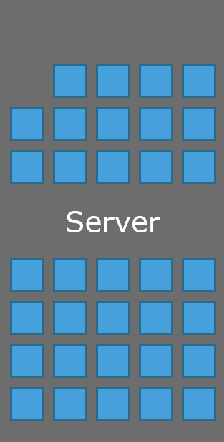
Domain Sharding
Maximum of 6 connections per domain
Client

Slide 4
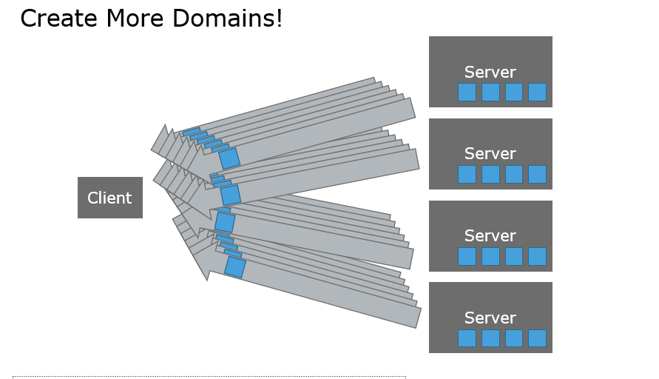
Domain Sharding

Slide 5
HTTP/2 Multiplexed Streaming
Can stream multiple resources over the same connections
Resources are prioritized by specifying a dependency graph, no Head Of Line Blocking

Slide 6
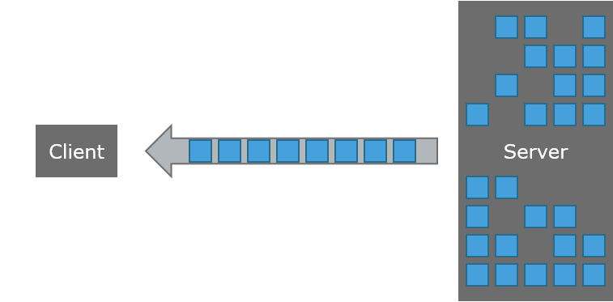
HTTP/2 Multiplexed Streaming
Single TCP connection per domain
Up to 100 ‘Streams’ per TCP connection

Slide 7
Other features of HTTP/2
Header Compression
Binary Protocol (HTTP/1.1 is text)
Encryption Required
Server Push (Server can push resources uninitiated)

Slide 8
Congestion Control
HTTP/1.1 uses many connections
When a packet is dropped, only one connection goes into congestion avoidance
Throughput of a single connection is halved
HTTP/2 has one connection, when a packet is dropped the throughput of the entire download is halved
HTTP/2 connections may reach higher speeds faster, since new connections do not need to be created
If websites do not load faster, people won’t use HTTP/2

Slide 9
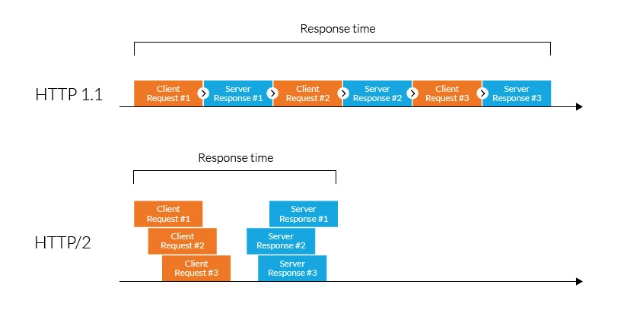

Slide 10
Conclusions
HTTP/2 has increased performance over HTTP/1 for non-congested links
Unclear if domain sharding will disappear with HTTP/2
Under high loss links, HTTP/2 performs significantly worse
HTTP/2 may not be ubiquitous, advantages for high bandwidth delay product links with no loss

