Slide 1
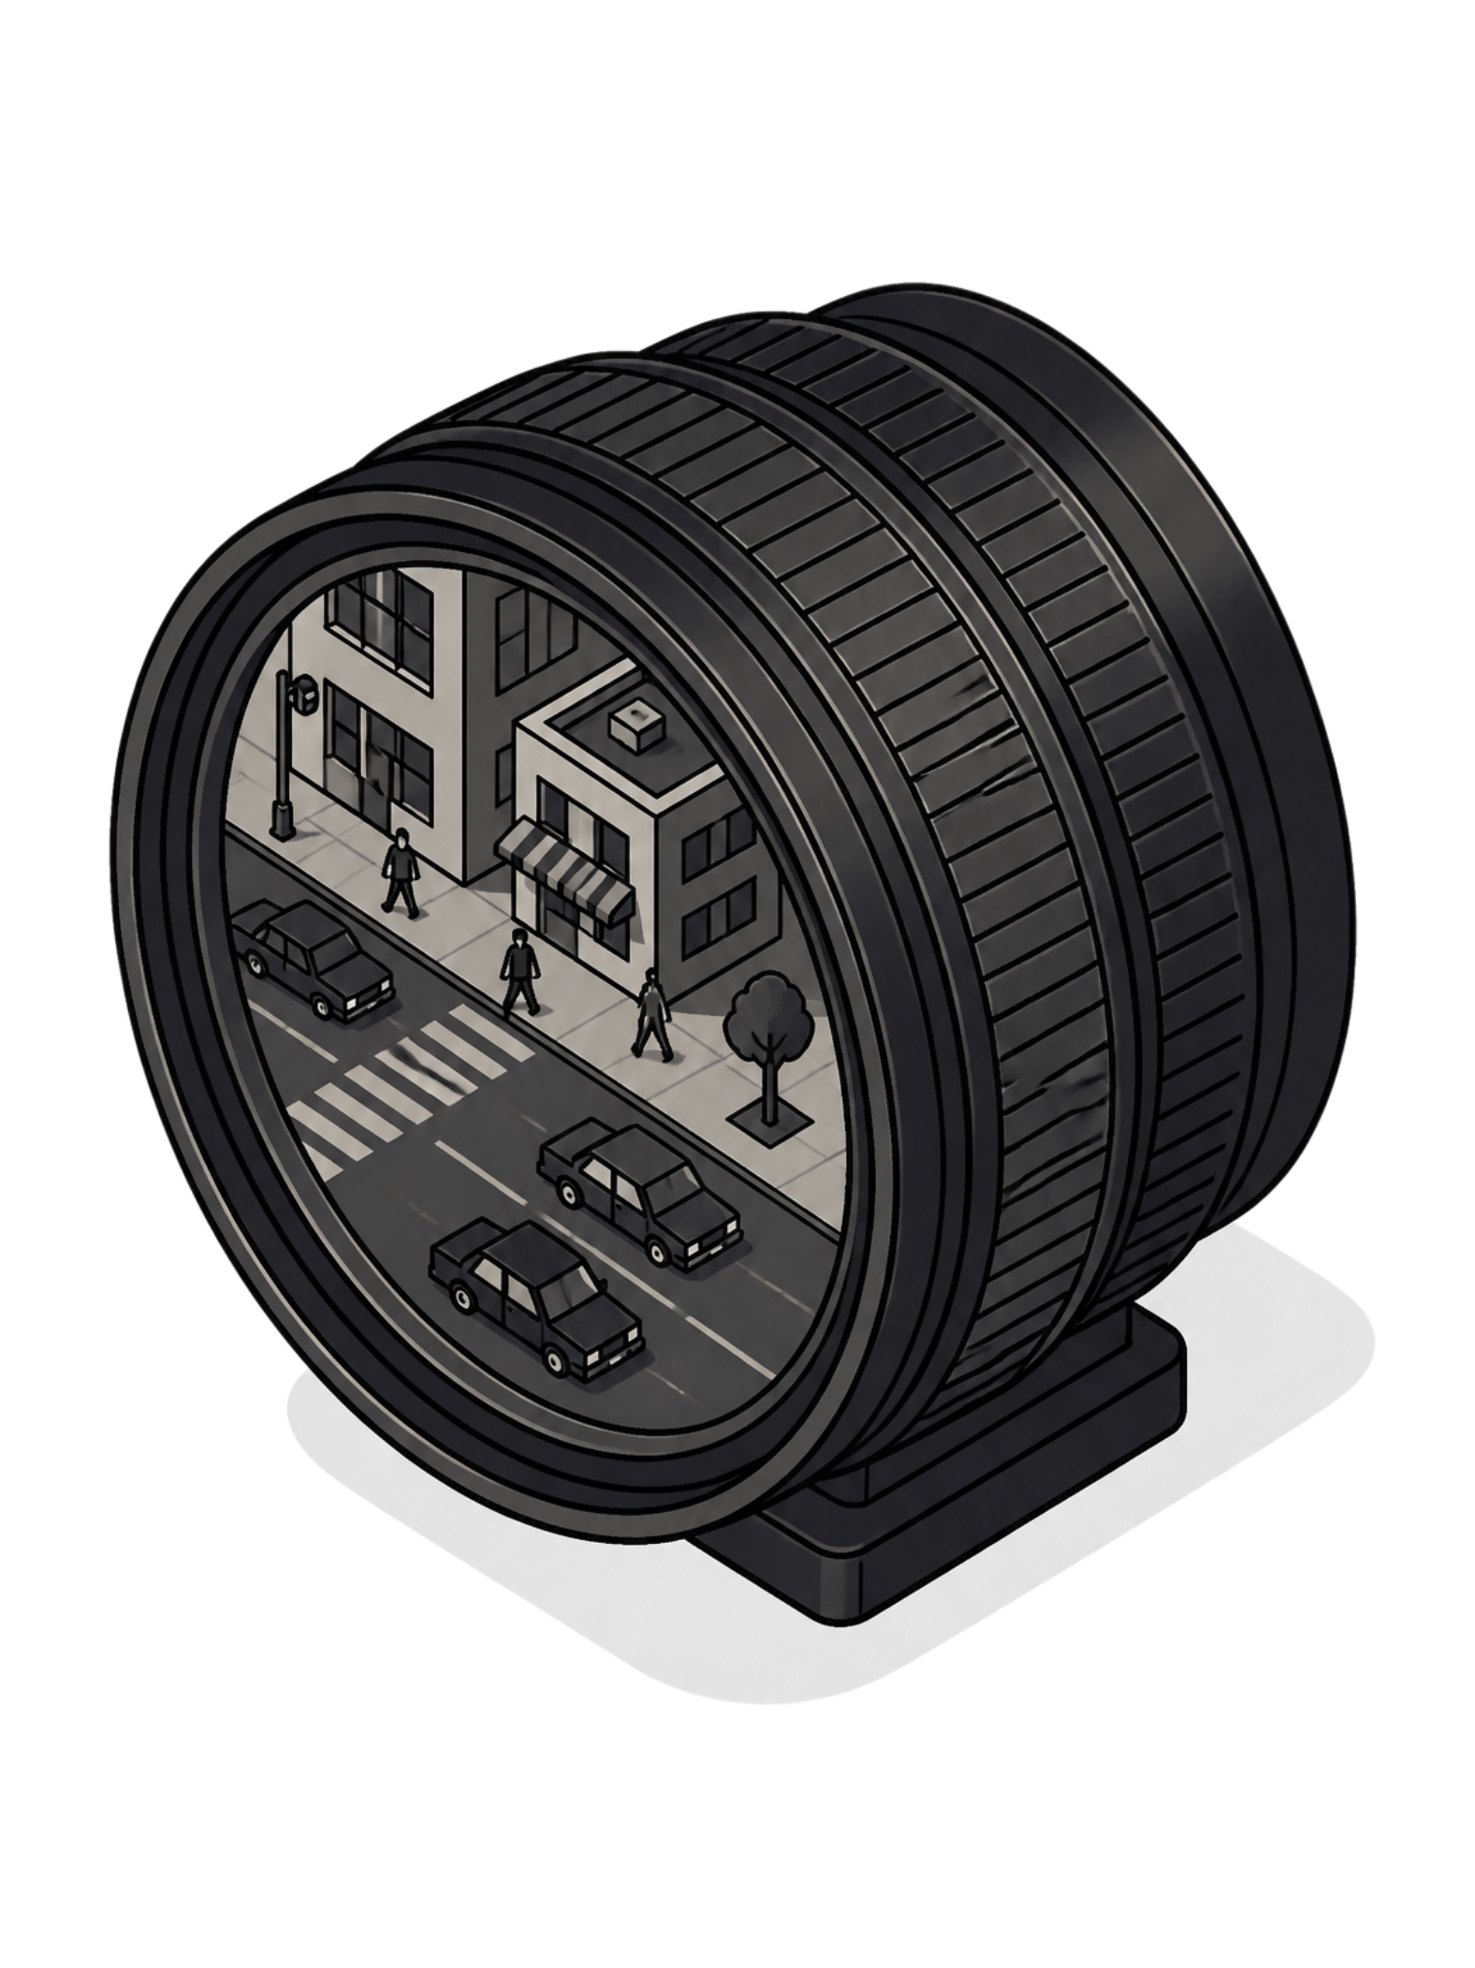
Computer Vision: From Pixels to Perception
A technical deep-dive for engineers and AI practitioners — from foundational theory to real-world autonomous systems.
P.V.N. ANISH BABU (192472329)

Slide 2
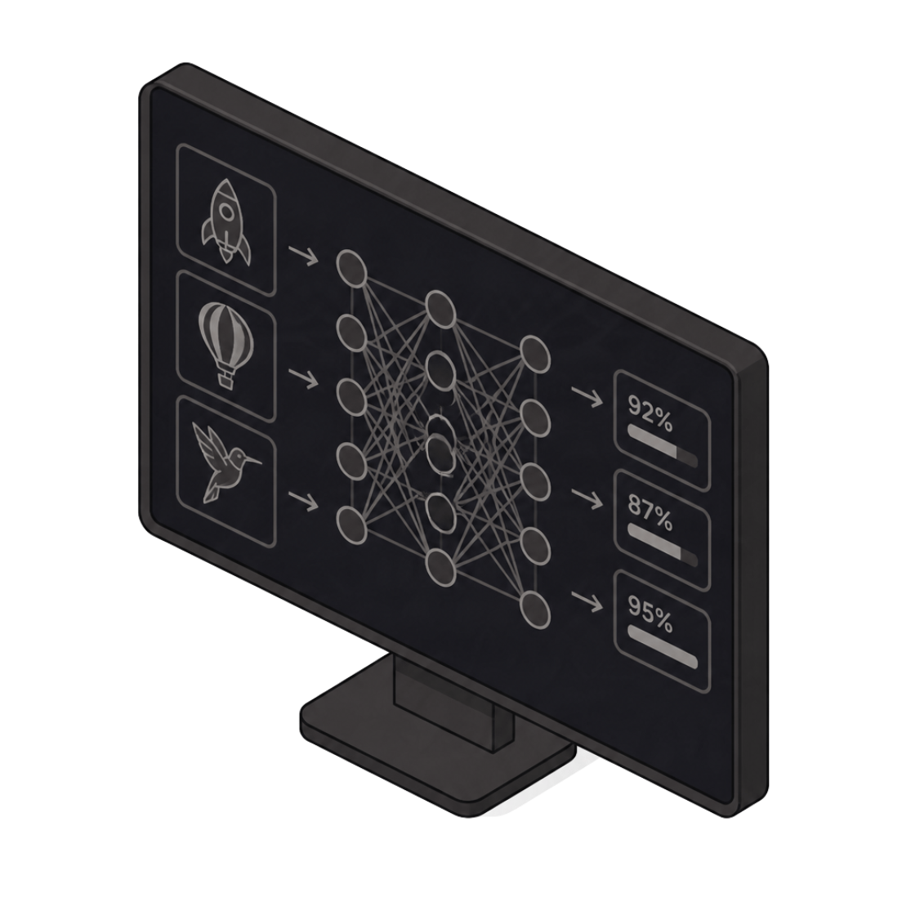
What is Computer Vision?
Machines That See
Computer Vision is an interdisciplinary field at the intersection of artificial intelligence and image processing, enabling machines to interpret and understand visual data from images, videos, and 3D scenes.
Combines image processing, machine learning, and deep learning to extract actionable information
Automates perception tasks that the human visual system performs naturally — but at machine speed and scale
Operates across static images, real-time video streams, and volumetric 3D data

Slide 3
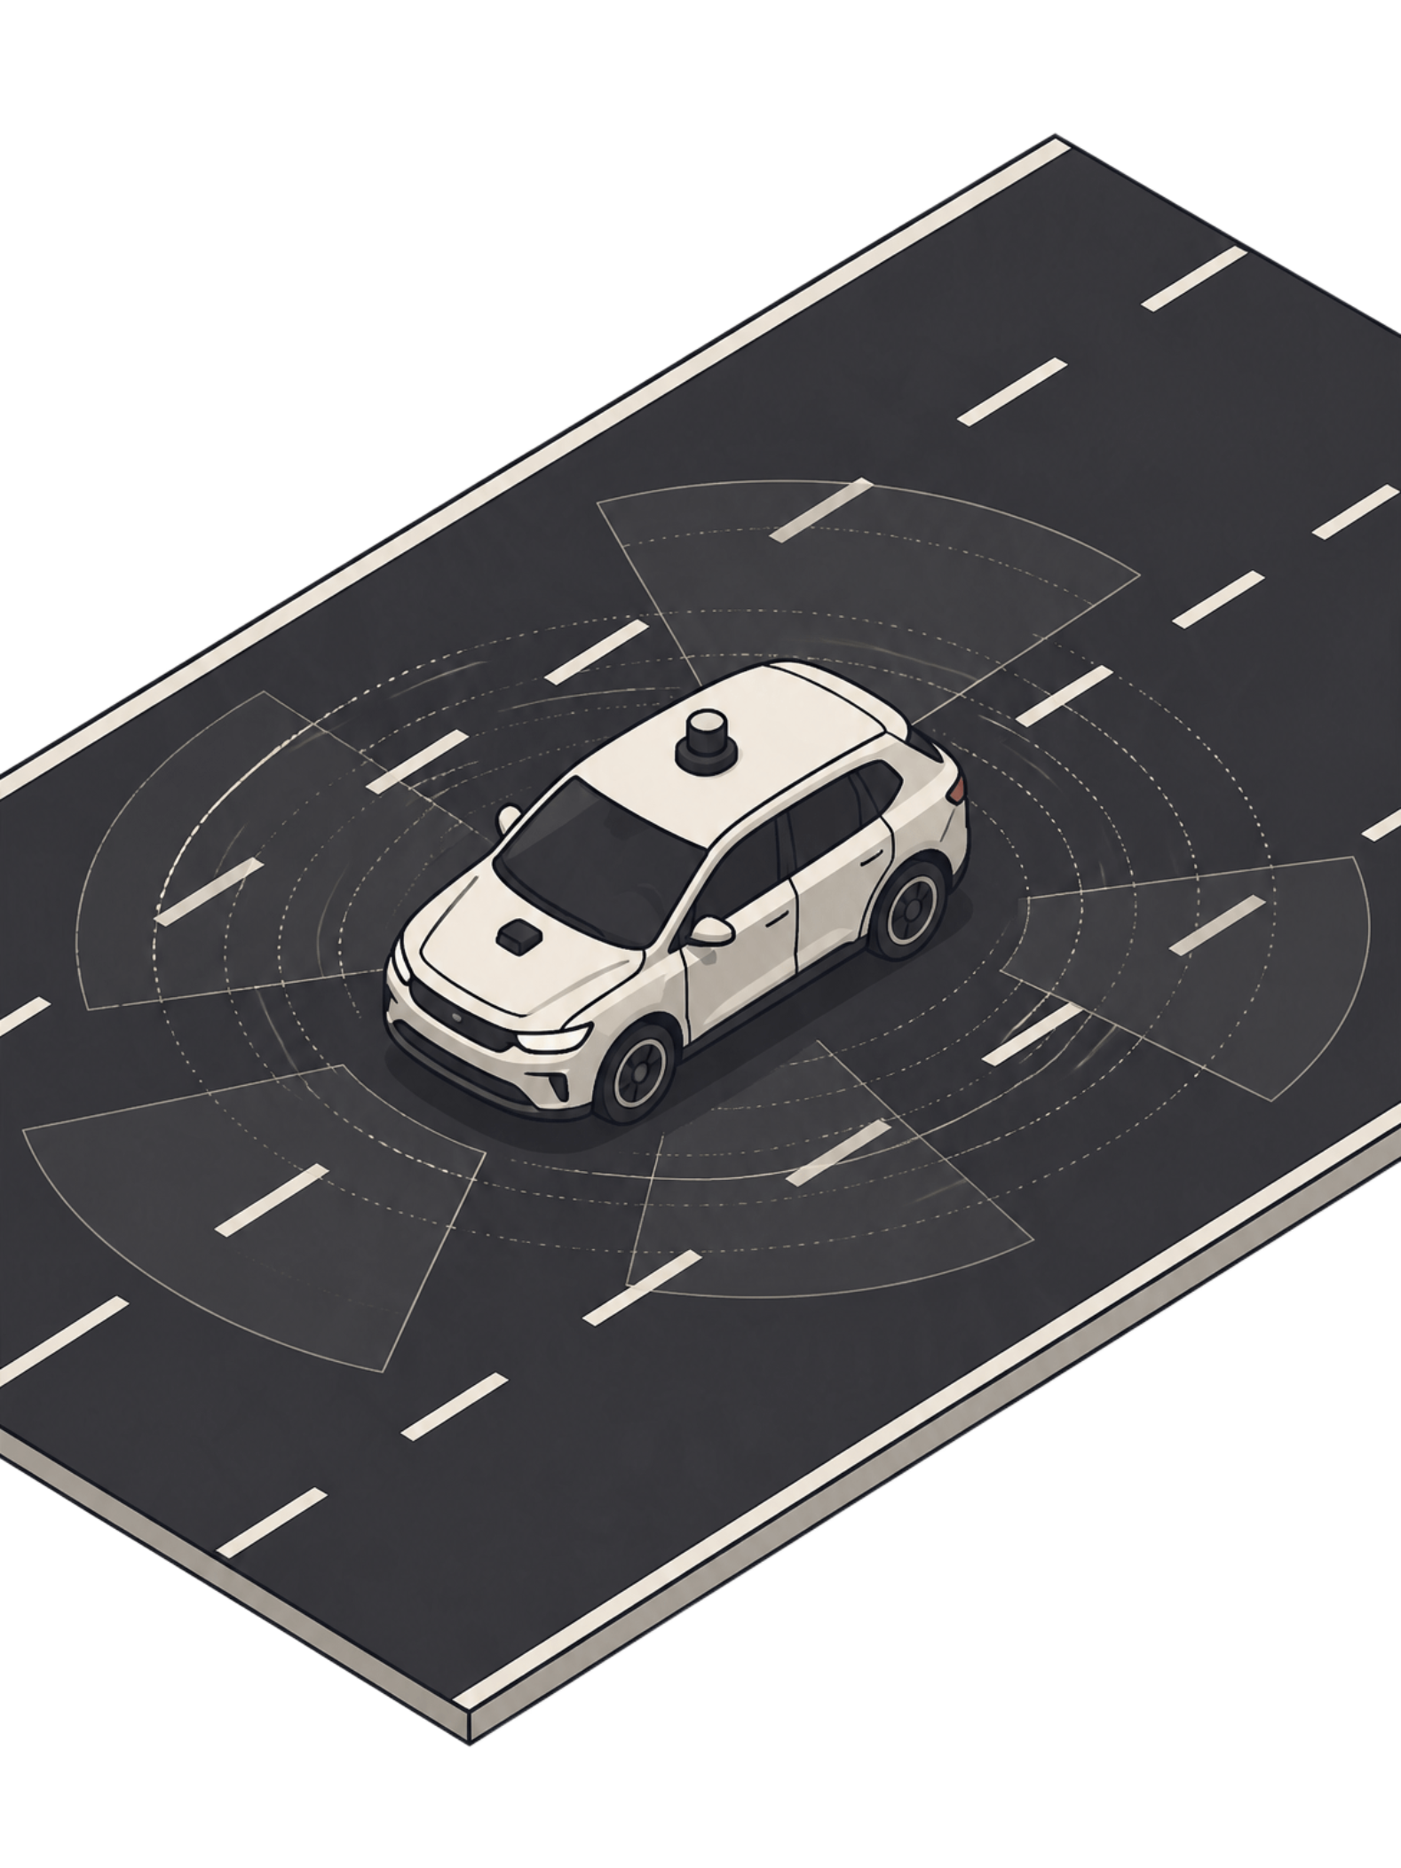
The Problem Context: Autonomous Vehicle Perception
🚗 The Challenge
📋 Requirements
Vehicles must perceive complex, dynamic environments in real-time to ensure safe navigation in transient, degraded, and dynamic conditions.
Detect pedestrians, vehicles, lane markings, traffic signs, and obstacles under varying lighting and weather conditions — simultaneously.
⚠️ The Stakes
A safety-critical system where perception failures translate directly into accidents. Zero margin for error at 30+ fps.

Slide 4
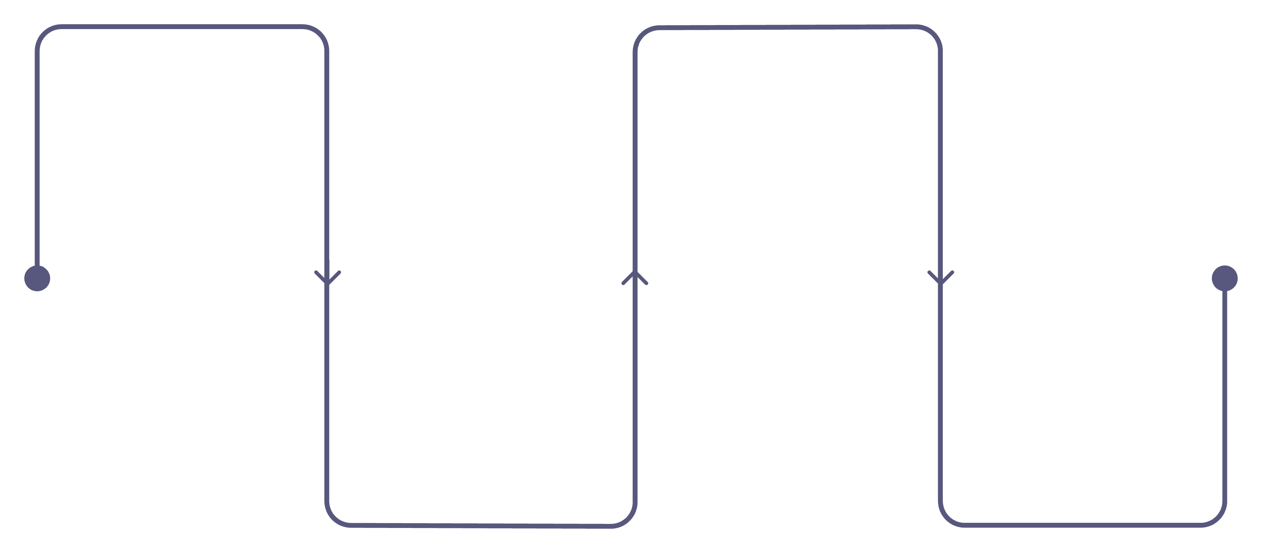
Computer Vision Pipeline
Sequential processing stages — from raw sensor input to actionable output:
Image Acquisition
Feature Extraction
Cameras, LiDAR, radar, thermal
Edges, shapes, textures, patterns
Image Processing
Output & Interpretation
Noise reduction, enhancement, normalization
Classifications, detections, decisions
Each stage refines the signal — hardware sensors feed pre-processing, which feeds learned feature representations, which ultimately drive real-time decisions in systems like lane-keeping and obstacle avoidance.

Slide 5
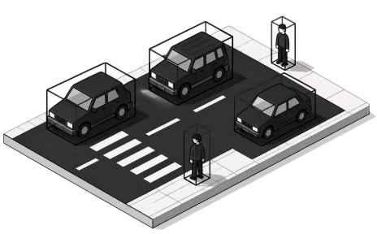
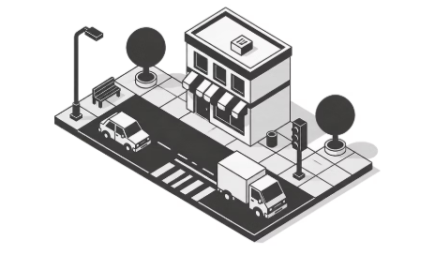
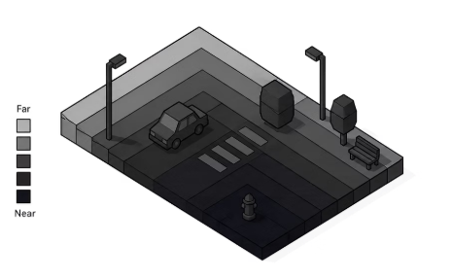
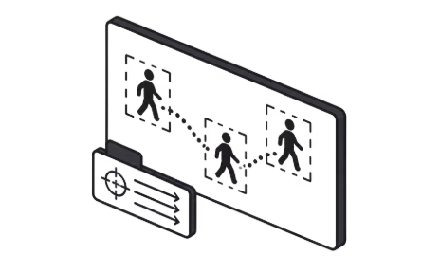
Key Features of Computer Vision Systems
Object Detection
Semantic Segmentation
Depth Estimation
Motion Tracking
Localize and classify objects — vehicles, pedestrians, signs — with precise bounding boxes in real time.
Calculate 3D distance and spatial relationships from 2D image data — critical for obstacle clearance.
Follow and predict the trajectories of moving objects across consecutive video frames.
Classify every pixel into semantic categories: road, sidewalk, vegetation, sky, building.

Slide 6
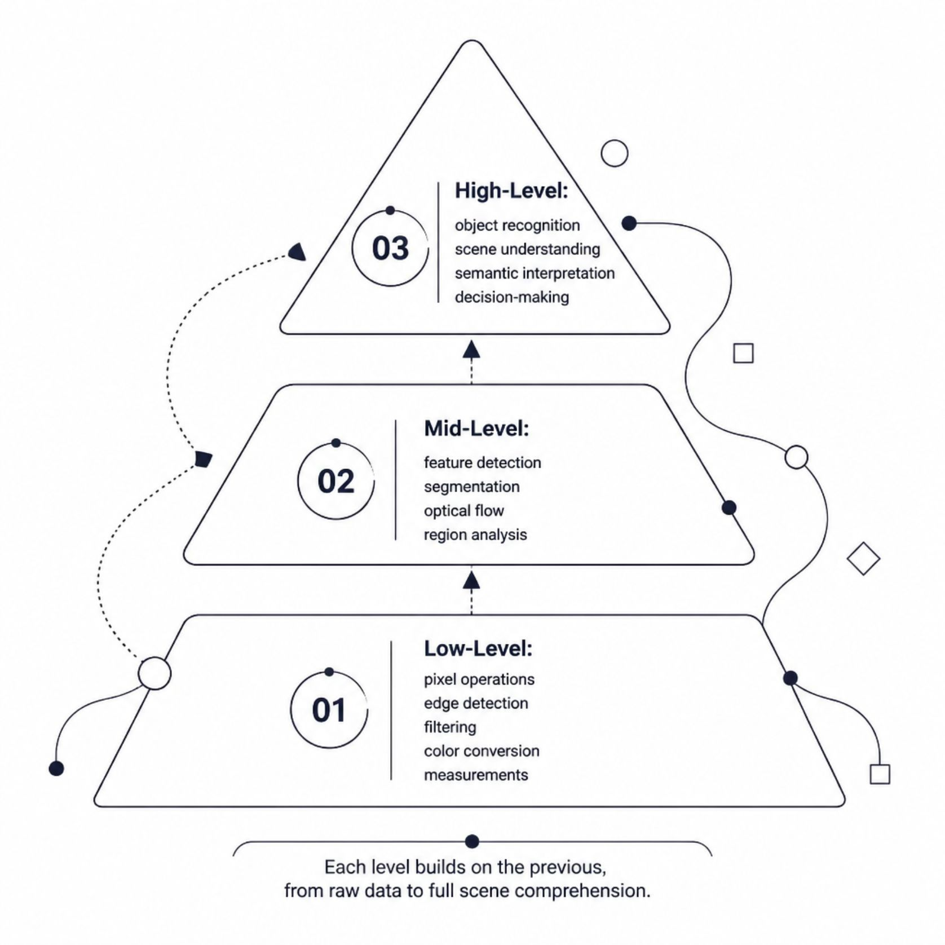
The Three Levels of Computer Vision
Low-Level Vision
Initial processing of raw image data — edge detection, filtering, color conversion, and basic measurements. No contextual understanding yet.
Mid-Level Vision
Feature detection, segmentation, optical flow analysis, and region grouping. Bridges raw pixels and semantic meaning.
High-Level Vision
Object recognition, full scene understanding, semantic interpretation, and decision-making. Requires learned world models and context.

Slide 7

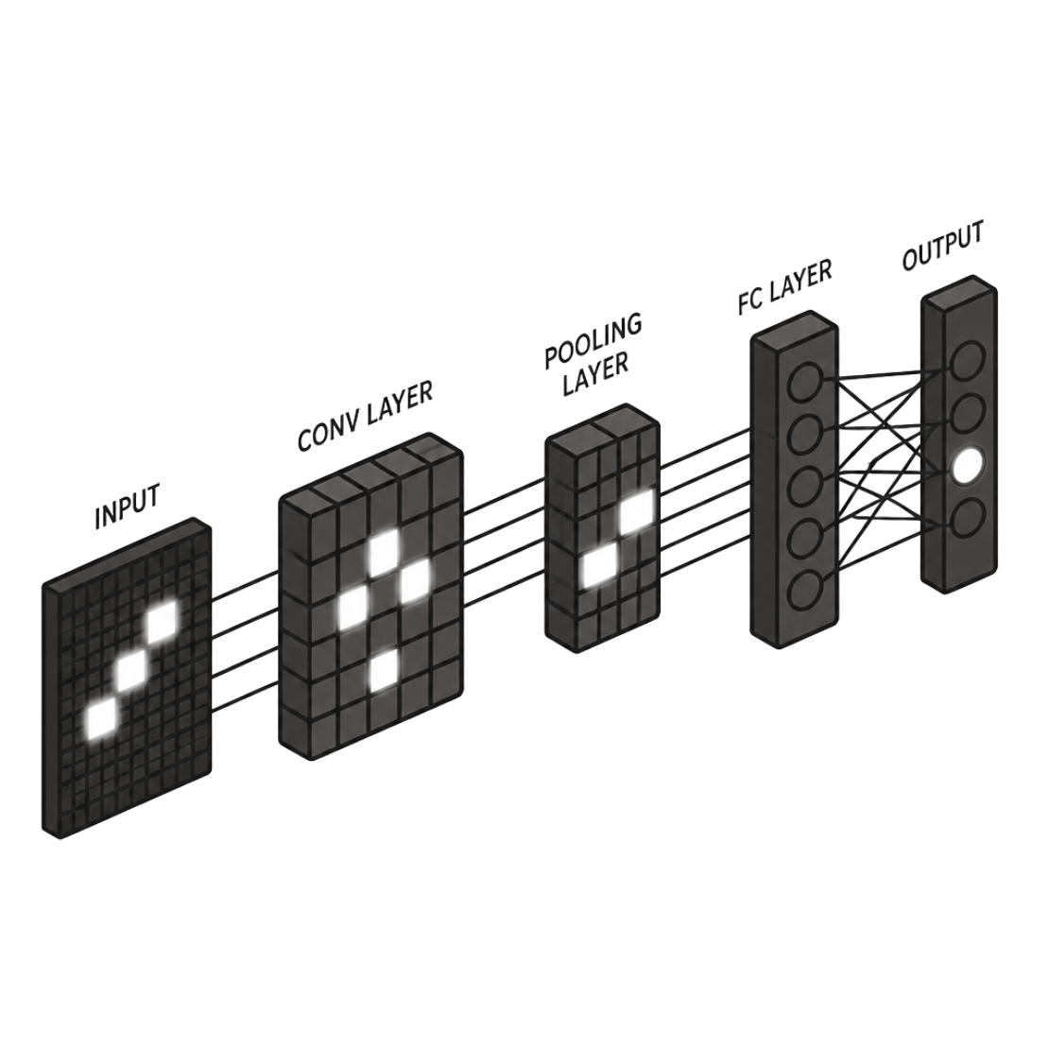
Deep Learning: The Modern Approach
Architecture Landscape
CNNs
YOLO
Break images into pixel grids; hierarchically learn edges → shapes → objects without explicit feature engineering.
Single-pass real-time object detection. Frames detection as a regression problem — ideal for <100ms latency constraints.
DeepLabv3+
Vision Transformers
State-of-the-art semantic segmentation using atrous convolutions for dense per-pixel classification.
Self-attention mechanisms for global context — excel at high-level scene understanding and cross-modal reasoning.

Slide 8
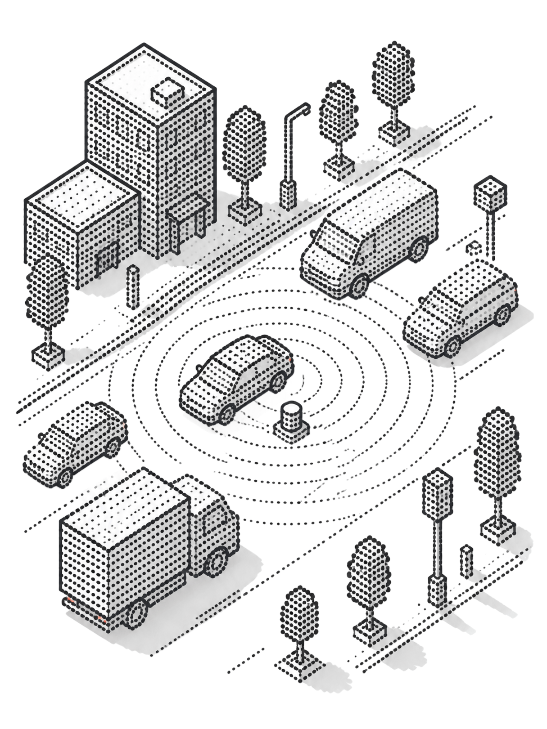

Autonomous Vehicles: Computer Vision in Action
Sensor Fusion
Critical Perception Tasks
Multimodal fusion of RGB cameras, LiDAR, radar, and thermal imaging. Each modality compensates for the others' weaknesses under adverse conditions.
Lane detection, traffic sign recognition, pedestrian detection, and obstacle avoidance — all running simultaneously on embedded hardware.
Real-Time Constraint
Systems must process 30+ frames per second with <100ms end-to-end latency — hard deadlines where any slip compromises safety.

Slide 9
Why Computer Vision Matters
$23.6B
$101.5B
30+
Market Value (2025)
Projected by 2033
FPS Required
Global Computer Vision market valuation in 2025, driven by autonomous systems and industrial AI.
Forecasted market size — a ~4.3× expansion reflecting adoption across every major industry vertical.
Minimum frame throughput for safe autonomous perception — the real-time engineering bar every production system must clear.
Industry Applications
Autonomous Systems
Manufacturing: Automated defect detection and quality control
Healthcare: Medical image analysis and diagnostic support
Retail: Inventory management and checkout automation
Vehicles: Full-stack perception for self-driving platforms
Drones: Navigation, obstacle avoidance, inspection
Robotics: Manipulation, pick-and-place, scene understanding

Slide 10


Current Challenges & Future Directions
Open Engineering Problems
Emerging Solutions & Next Frontier
1
2
Self-Supervised Learning
Cross-Modal Transformers
Environmental Variability
Dataset Limitations
Leverage unlabeled video at scale to learn robust representations without costly manual annotation.
Fuse camera, LiDAR, and radar streams within a unified attention architecture for holistic scene understanding.
Annotated training data is expensive, slow to produce, and rarely covers long-tail edge cases that matter most for safety.
Adverse weather (fog, rain, snow), lighting extremes, and occlusions systematically degrade model performance in deployment.
Multimodal AI
Combining vision with language models and reasoning engines — the next frontier for higher-level semantic scene comprehension.

Slide 11
Sources
Computer Vision 101 - GeeksforGeeks
Applications of Computer Vision in Autonomous Vehicles: Methods, Challenges and Future Directions
What Are The Three Levels Of Computer Vision? - Metaeye
What Is Computer Vision? A Beginner's Guide in 2024 | atomcamp
Multi-sensor fusion and deep learning for road scene understanding: a comprehensive survey | Artificial Intelligence Review | Springer Nature
Understanding Computer Vision and Enterprise Applications

