Slide 1

PlacementAI
Explainable placement risk for education loans
Shri Ramdeobaba College of Engineering & Management, Nagpur
TEAM MEMBERS
GUIDE
Aakash Singh Roll No. 01
Anish Pujari Roll No. 02
Sandali Katrojwar Roll No. 27
Afreen
Prof. Gunjan Keswani
DEPARTMENT
Major Project
Computer Science and Engineering
ACADEMIC YEAR
2026-27
COURSE CODE
Notes:
Introduce the team and guide. One line: PlacementAI predicts, before graduation, which education-loan borrowers are likely to struggle to find a job, and explains why.

Slide 2

PROBLEM STATEMENT
1
The problem
2
Who is affected
Education lenders cannot see which borrowers will struggle to find a job until EMIs are already being missed. By then, the options to help are limited.
Banks and NBFCs funding study abroad, students and families repaying large loans, and loan officers reviewing every account by hand.
3
Current challenges
4
Why it matters
Credit scores look at the co-applicant's income, not the student's job prospects. Visa routes, sector hiring and institute track record are ignored.
Repayment depends on employment. An early, explainable warning leaves time for counselling, skilling or an EMI holiday, as the RBI Fair Practices Code expects.
17 October 2026
Slide 2 of 11
Notes:
Lenders only learn about placement risk once EMIs are missed. Credit scores look at the co-applicant, not the student's job prospects. Repayment depends on employment, so an early, explainable warning matters.

Slide 3
EXISTING SOLUTION / LITERATURE REVIEW
APPROACH
WHAT IT DOES
LIMITATION
Credit bureau scoring
Scores repayment history of the borrower and co-applicant
Has no view of the student's future employability
Campus placement prediction (ML studies)
Predicts placed or not placed from CGPA and skills, using logistic regression, decision trees or random forests
Binary outcome, no time horizon, no loan context, rarely explained
Manual review by loan officers
Judgement based on university, course and documents
Subjective, slow, and does not scale to large portfolios
Research gap: no tool gives lenders an explainable, time-based placement risk for each borrower, tied to the loan it affects.
17 October 2026
Slide 3 of 11
Notes:
Three existing approaches and what each misses. The gap: nothing combines a time-based placement forecast, loan context and explanations for the lender.

Slide 4
PROPOSED SOLUTION
1
Predict risk before graduation
Rate each borrower High, Medium or Low risk, with the probability of a job within 3, 6 and 12 months.
INNOVATION
Cost-sensitive alerts. The high-risk threshold is tuned so 80% of risky borrowers are caught.
Honest evaluation. Trained on 2023-24 graduates, tested on an unseen 2025 cohort.
Accuracy ceiling. We measure the best any model can do on this data, and reach within 1 point of it.
Fraud checks. Rules flag suspicious loan, visa and course combinations.
2
Forecast salary
Give a low-to-high salary range and compare it with the EMI the student must pay.
3
Explain every score
SHAP shows which factors raise or lower each student's risk, in plain language.
4
Put it in a loan officer's hands
A dashboard, REST API and one-page PDF risk card for each borrower.
17 October 2026
Slide 4 of 11
Notes:
Four parts: risk tier with 3, 6 and 12 month probabilities, salary range, SHAP explanations, and lender tools. Innovations on the right; the key one is tuning the high-risk threshold for lenders.

Slide 5
OBJECTIVES
01
Build a 1,00,000-record synthetic dataset of Indian students studying abroad
MEASURABLE TARGETS
Metric | Target | Achieved
AUC-ROC | 0.91 or more | 0.923
High-risk recall | 79% or more | 80.3%
Salary forecast error (MAPE) | 11% or less | 7.6%
Accuracy | 84% or more | 78.0%
02
Predict each borrower's placement risk tier and job timeline before graduation
03
Forecast post-study salary to check EMI affordability
04
Explain every prediction and deliver it through a lender dashboard and API
Accuracy is capped at 79.7% by random noise in the data. No model can reach 84% here; ours is within 1 point of that ceiling.
17 October 2026
Slide 5 of 11
Notes:
Three of four targets met. Accuracy is the honest exception: the data has a 79.7% ceiling because of random noise, so 84% is not reachable by any model. We are within 1 point of it.

Slide 6
SYSTEM ARCHITECTURE / METHODOLOGY
Data
Features
Models
Explain
Deliver
1,00,000 synthetic students
52 correlated fields
Fraud cases injected
37 model features
6 derived signals
Label encoding
XGBoost + SMOTE
Tuned high-risk threshold
Quantile salary model
SHAP TreeExplainer
Per-student drivers
Fraud rule checks
FastAPI REST API
Streamlit dashboard
PDF risk cards
WORKFLOW
1 Generate data
2 Train on 2023-24 graduates
3 Tune threshold on validation slice
4 Test on unseen 2025 cohort
5 Serve with explanations
17 October 2026
Slide 6 of 11
Notes:
Walk left to right through the pipeline. Stress the time-based split: train on 2023-24 graduates, tune on a validation slice of those years, test once on the unseen 2025 cohort. No test data is used for tuning.

Slide 7
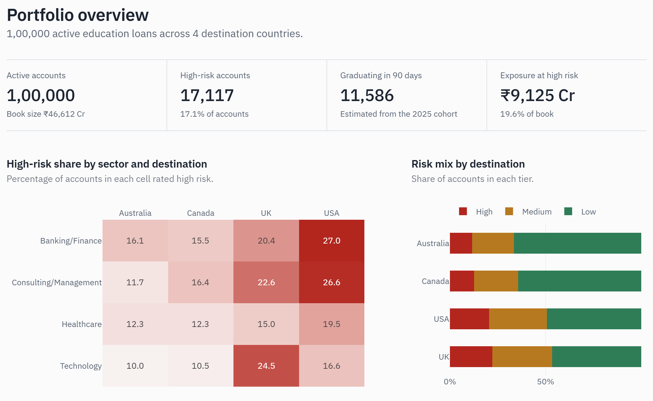
IMPLEMENTATION
Language and data
Python 3.12, NumPy, Pandas, Faker
Machine learning
XGBoost, scikit-learn, imbalanced-learn (SMOTE)
Explainability
SHAP TreeExplainer
API
FastAPI, Pydantic, Uvicorn
Dashboard and reports
Streamlit, Plotly, fpdf2
Portfolio overview: 1,00,000 accounts and where high risk is concentrated
Deployment
Docker, docker-compose. No special hardware: runs on a laptop CPU
17 October 2026
Slide 7 of 11
Notes:
All open-source Python. No special hardware. The screenshot is the live dashboard on 1,00,000 accounts.

Slide 8
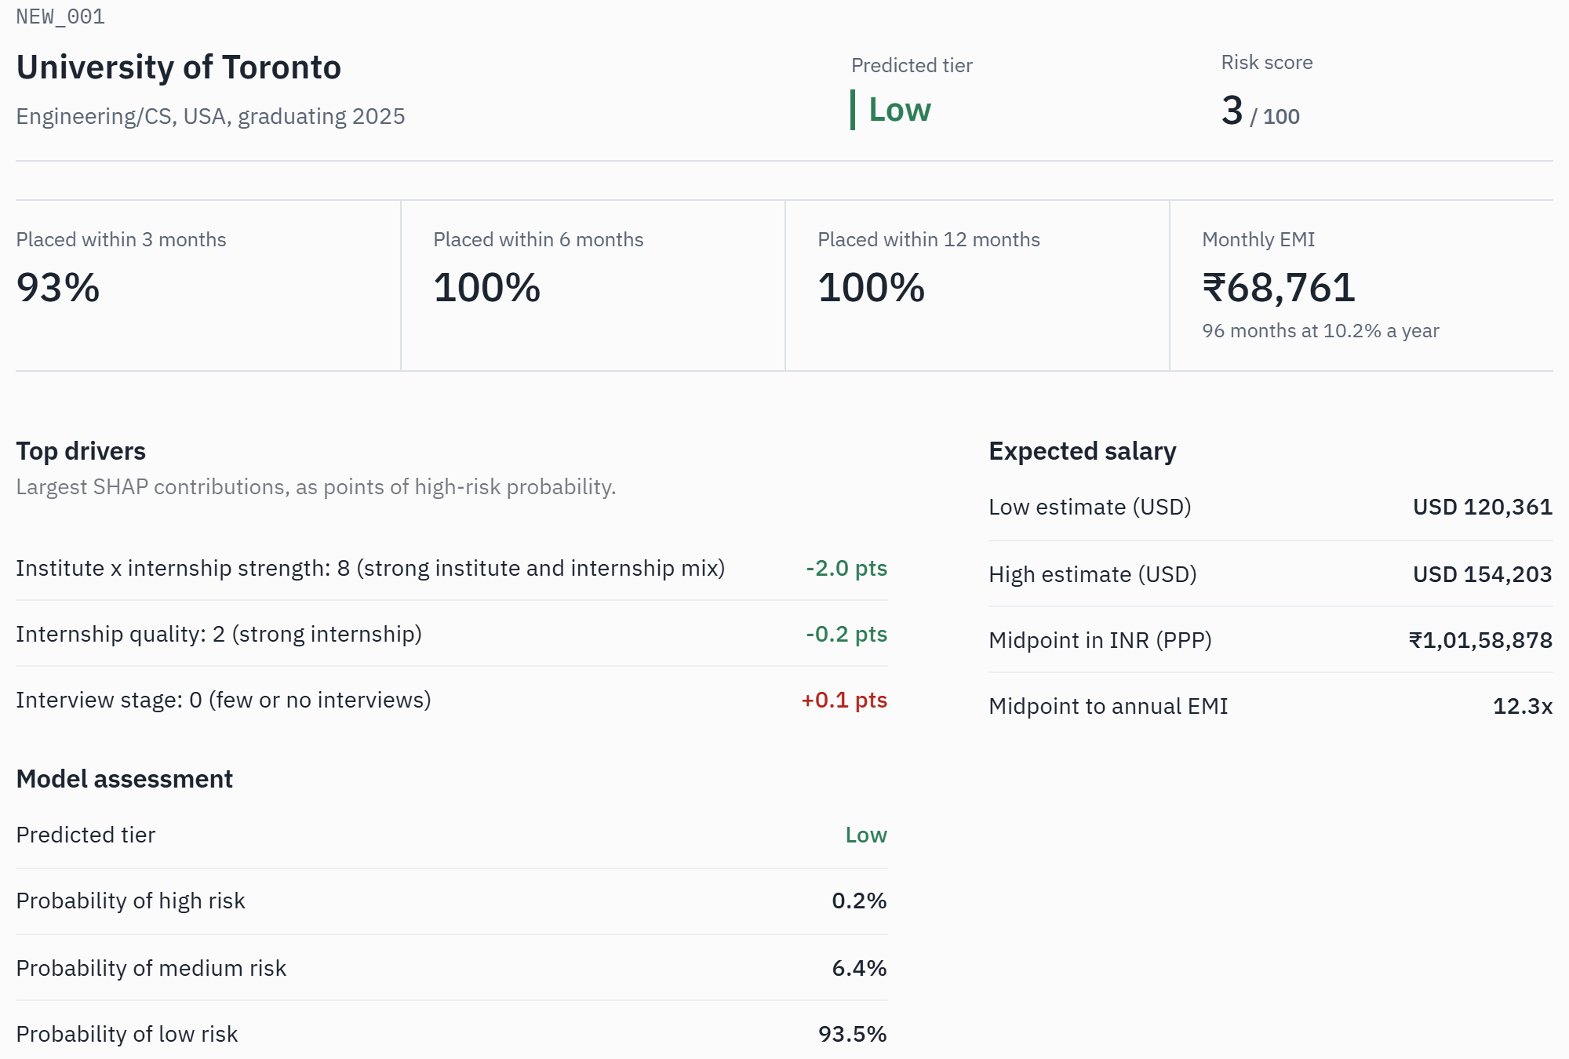
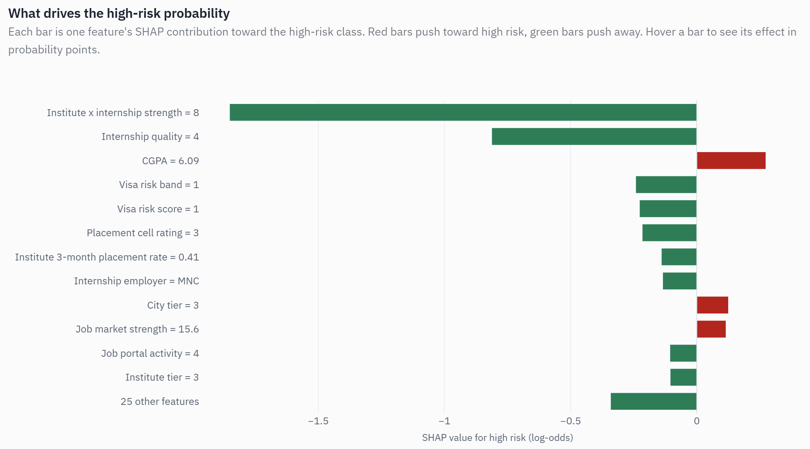
RESULTS / PROTOTYPE
Detailed SHAP. Every feature's push toward or away from high risk. Here a low CGPA is the only factor raising this student's risk.
New assessment. A new applicant is scored live, with job-timeline probabilities, salary range and top drivers.
17 October 2026
Slide 8 of 11
Notes:
Left: scoring a new applicant live. Right: SHAP for one student; green bars lower risk, red bars raise it. Demo the dashboard here if time allows.

Slide 9
RESULTS / MODEL PERFORMANCE
80.3%
high-risk borrowers caught target 79%
0.923
AUC-ROC target 0.91
78.0%
accuracy ceiling 79.7%
7.6%
salary forecast error target 11% or less
Axis starts at 50%. Accuracy ceiling for this data: 79.7%.
17 October 2026
Slide 9 of 11
Notes:
Headline numbers on the left. The chart compares XGBoost with simpler models on the same data. XGBoost wins on accuracy, F1 and AUC; only the tuned version reaches 80% high-risk recall. If asked why logistic regression is close: the labels come from a largely linear score.

Slide 10
INNOVATION, IMPACT, DELIVERABLES & FUTURE SCOPE
Innovation
Impact
Time-based placement risk, not a yes or no
Cost-sensitive threshold for lenders
Accuracy ceiling proves the model is near the limit
Early warning months before EMIs start
Every score explained, in line with RBI fair practices
Lenders see where their exposure is concentrated
Deliverables
Future scope
Trained models and 1,00,000-record dataset
FastAPI service with tests
5-page dashboard and PDF risk cards
Train on real, anonymised lender data
Live job-market and visa-policy feeds
Probability calibration and fairness audits
17 October 2026
Slide 10 of 11
Notes:
Innovation, impact, deliverables, and future work. Main future step: train on real, anonymised lender data.

Slide 11
CONCLUSION & REFERENCES
CONCLUSION
REFERENCES
PlacementAI flags education-loan borrowers likely to struggle with placement before they graduate.
It catches 80.3% of high-risk borrowers on an unseen cohort, with AUC 0.923.
Accuracy is within 1 point of the 79.7% ceiling set by the data, and XGBoost beats simpler models.
Every score comes with SHAP drivers a loan officer can act on and explain to the borrower.
[1] T. Chen and C. Guestrin, "XGBoost: A Scalable Tree Boosting System," Proc. ACM KDD, 2016.
[2] S. M. Lundberg and S.-I. Lee, "A Unified Approach to Interpreting Model Predictions," NeurIPS, 2017.
[3] N. V. Chawla et al., "SMOTE: Synthetic Minority Over-sampling Technique," JAIR, vol. 16, 2002.
[4] F. Pedregosa et al., "Scikit-learn: Machine Learning in Python," JMLR, vol. 12, 2011.
[5] Reserve Bank of India, Fair Practices Code for Lenders.
PROJECT REPOSITORY
github.com/anishpujari/Placement-Risk-Modelling-System
17 October 2026
Slide 11 of 11
Notes:
Summarise in three numbers: 80.3% of high-risk borrowers caught, AUC 0.923, within 1 point of the accuracy ceiling. Thank the guide and invite questions.

