Slide 1
APEXPLANET • DATA ANALYTICS
Exploratory Data Analysis & Business Intelligence
TRANSACTIONS
1,000
Source records
Sales Performance & Customer Analytics
REVENUE
₹13.94 Cr
₹139,399,439.65
Python • Pandas • SQL • SQLite • Excel
2025 full-year analysis + January 2026 partial period
CUSTOMERS
947
Unique Customer IDs
Prepared for internship / academic evaluation
13-slide final presentation

Slide 2
SECTION 01
02 / 13
Project Objective & Dataset
PROJECT OBJECTIVE
Analyze customer transactions to identify revenue drivers, category and product performance, seasonal patterns, and retention opportunities.
RECORDS
CUSTOMERS
1,000
947
transaction records
unique customers
COLUMNS
PERIOD
ANALYTICAL WORKFLOW
12
2025 + Jan 2026
01
02
03
source variables
Jan 2026 is partial
Dataset
Data Quality
EDA
TOOLS
Python • Pandas • Matplotlib • Seaborn SQLite • SQL • Excel • PowerPoint
04
05
06
SQL
Insights
Dashboard
ApexPlanet Data Analytics Project

Slide 3
SECTION 02
03 / 13
Data Quality Assessment
VALIDATION CHECKS
RECORDS
DUPLICATE ROWS
1,000
0
Total rows
1,000
PASS
full dataset
clean
Total columns
12
PASS
Duplicate rows
0
PASS
MISSING AGE
MISSING CITY
Invalid dates
0
PASS
20
13
Zero / negative quantity
0
PASS
2.0% of records
1.3% of records
Zero / negative unit price
0
PASS
SALES CALC ERRORS
PROBLEM ORDER ID
Incorrect total sales
0
PASS
0
1
ORDER_ID HANDLING
Transactions = 1,000 Distinct Order IDs = 992
verified
ORD100050
ORD100050 appears across multiple customers and dates.
ApexPlanet Data Analytics Project

Slide 4
SECTION 03
04 / 13
Executive KPI Dashboard
TOTAL REVENUE
TRANSACTIONS
DISTINCT ORDER IDS
₹13.94 Cr
1,000
992
₹139,399,439.65 total sales
source records analyzed
reported separately
CUSTOMERS
UNITS SOLD
AVG TRANSACTION VALUE
947
5,435
₹1.394 L
unique Customer IDs
total quantity
₹139,399.44 per transaction
HEADLINE INSIGHT
Electronics leads the portfolio with 36.43% of total revenue.
ApexPlanet Data Analytics Project

Slide 5
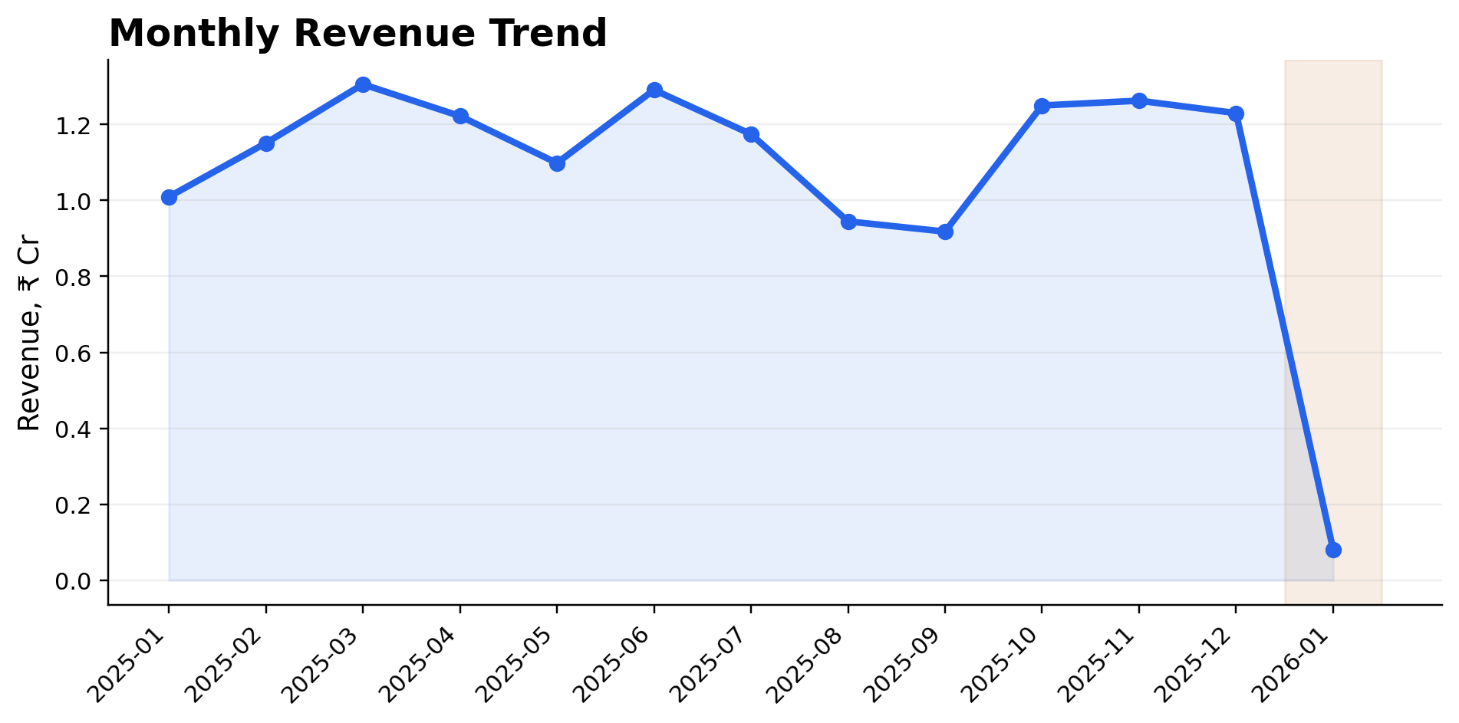
SECTION 04
05 / 13
Monthly Revenue Performance
January 2026 is shown separately because the period is partial.
PEAK COMPLETE MONTH
March 2025
₹13,059,899.94
WEAKEST COMPLETE MONTH
September 2025
₹9,179,896.29
JAN 2026
₹0.08 Cr
partial period
ApexPlanet Data Analytics Project

Slide 6
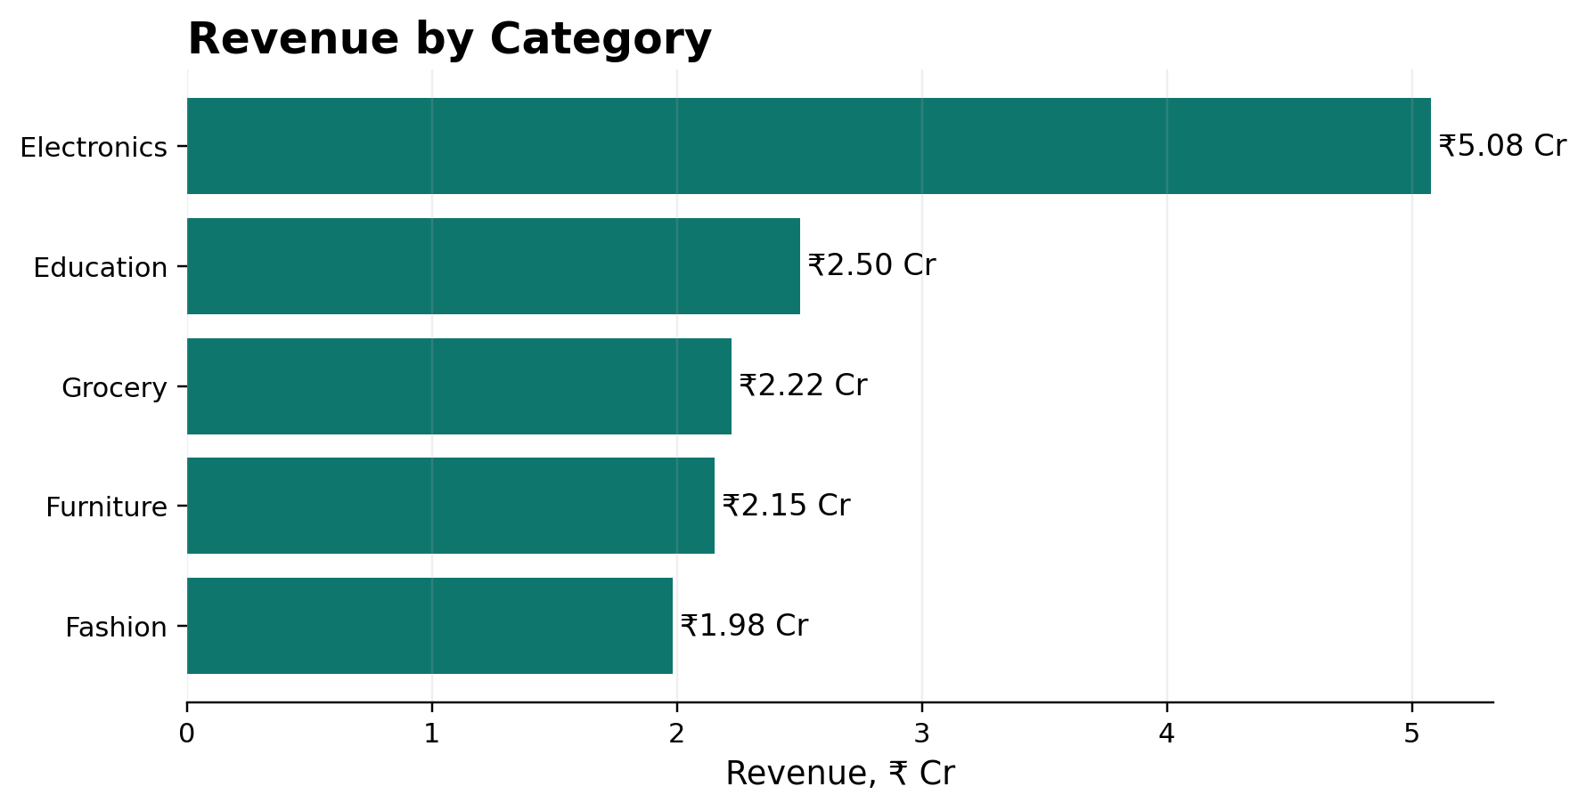
SECTION 05
06 / 13
Category Revenue Performance
LEADING CATEGORY
Electronics
₹5.08 Cr revenue
REVENUE SHARE
36.43%
of ₹13.94 Cr
INSIGHT
Electronics leads by a clear margin over the next category.
ApexPlanet Data Analytics Project

Slide 7
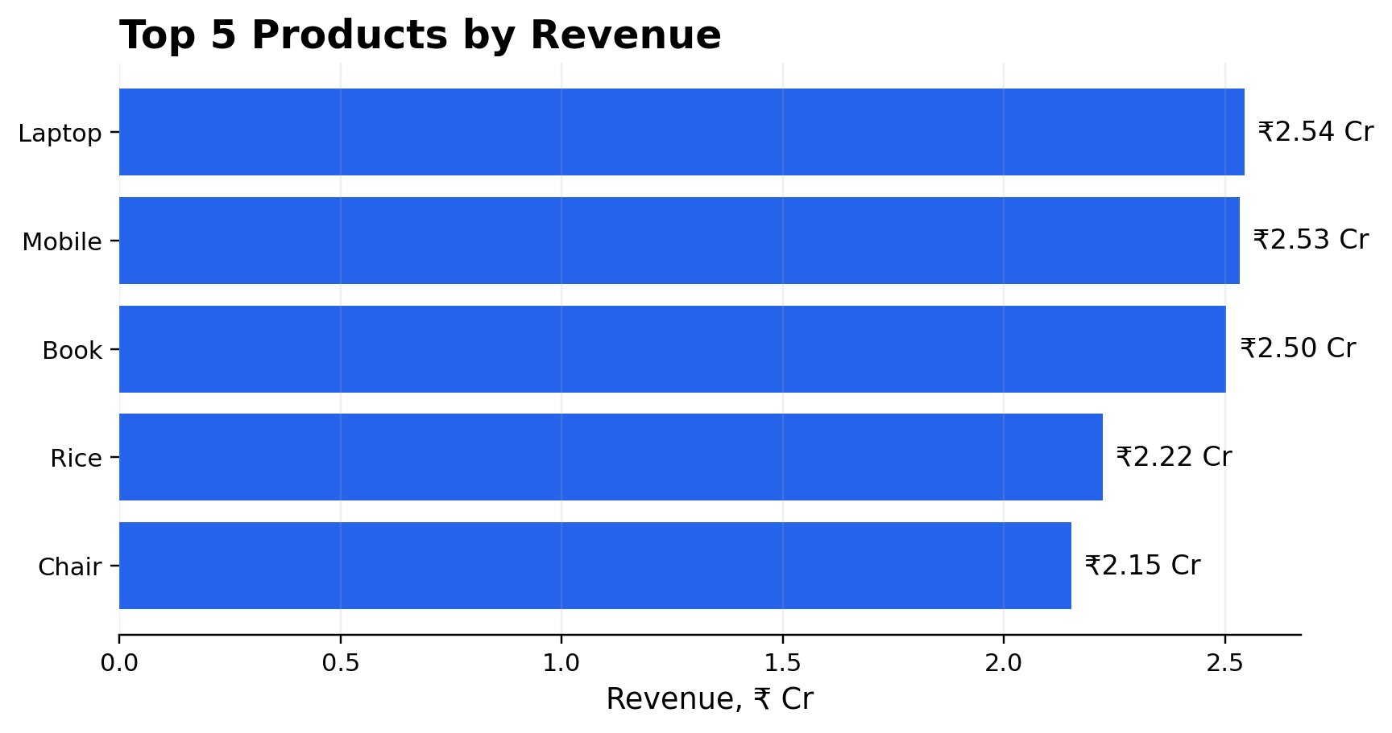
SECTION 06
07 / 13
Top Products by Revenue
#1 PRODUCT
Laptop
₹2.54 Cr
#2 PRODUCT
Mobile
₹2.53 Cr
TOP 2 CONCENTRATION
36.43%
Laptop + Mobile
ApexPlanet Data Analytics Project

Slide 8
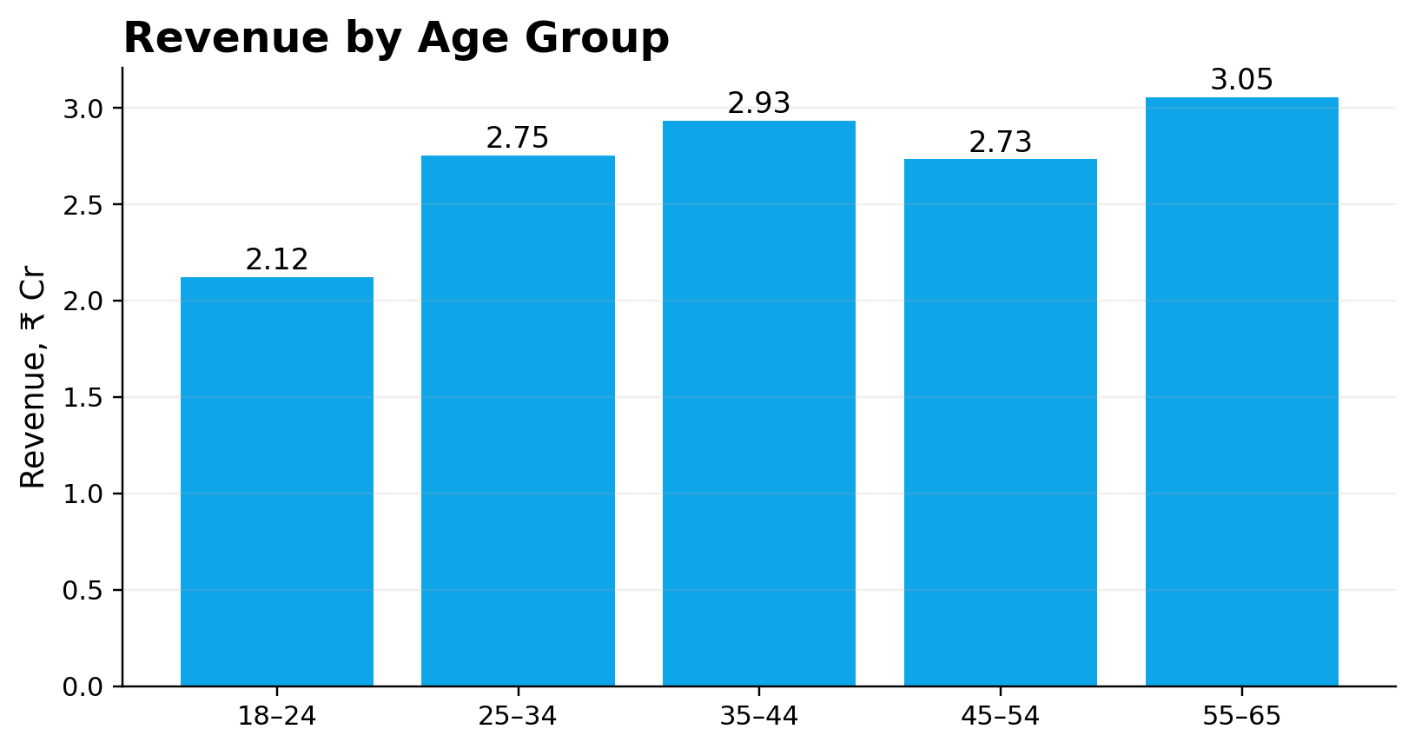
SECTION 07
08 / 13
Customer & Segment Analysis
TOTAL CUSTOMERS
ONE-TIME CUSTOMERS
REPEAT CUSTOMERS
REPEAT RATE
947
895
52
5.49%
unique Customer IDs
94.51% of customers
based on distinct Order IDs
52 of 947 customers
TOP AGE SEGMENT
55–65
₹3.05 Cr • 223 transactions
INSIGHT
Repeat customers represent 5.49%, indicating a retention opportunity.
ApexPlanet Data Analytics Project

Slide 9
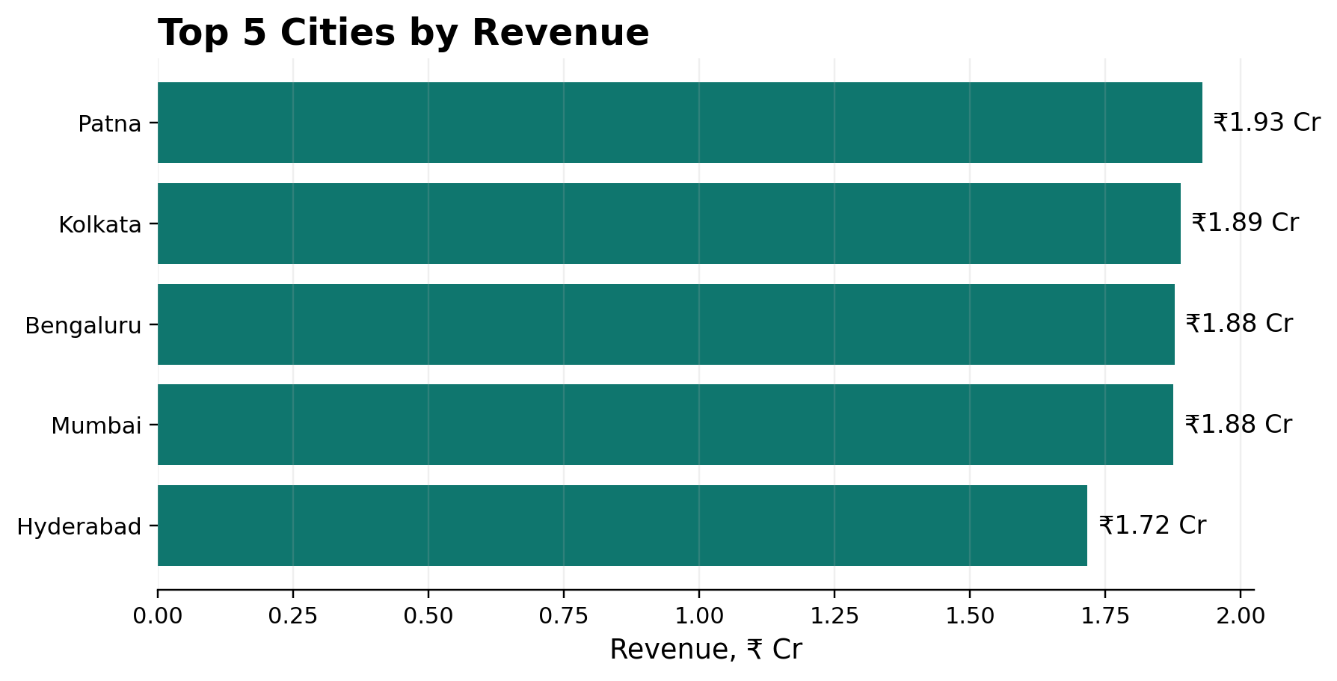
SECTION 08
09 / 13
Geographic Revenue Performance
TOP CITY
Patna
₹1.93 Cr
TOP 5 CITIES
1
Patna
₹1.93 Cr
2
Kolkata
₹1.89 Cr
3
Bengaluru
₹1.88 Cr
4
Mumbai
₹1.88 Cr
5
Hyderabad
₹1.72 Cr
ApexPlanet Data Analytics Project

Slide 10
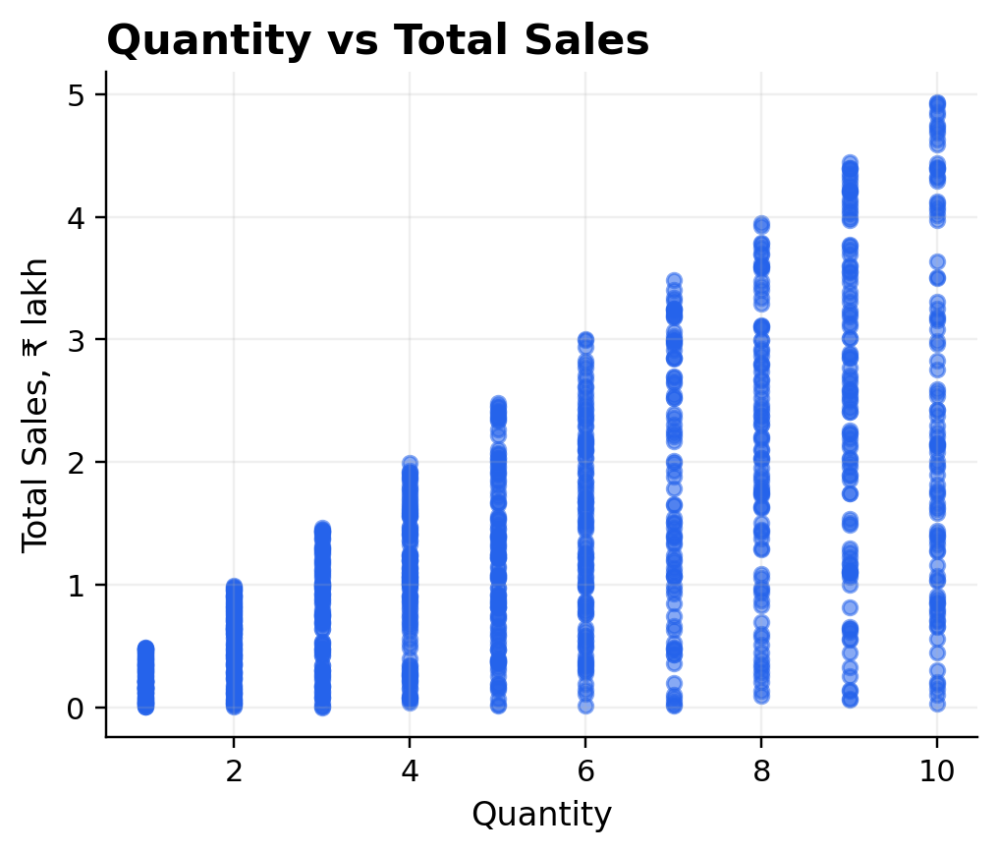
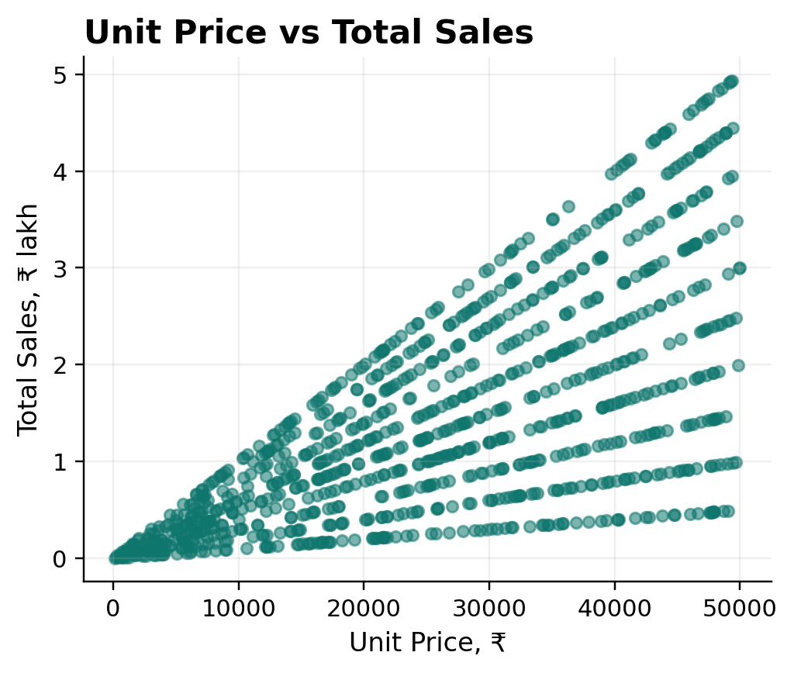
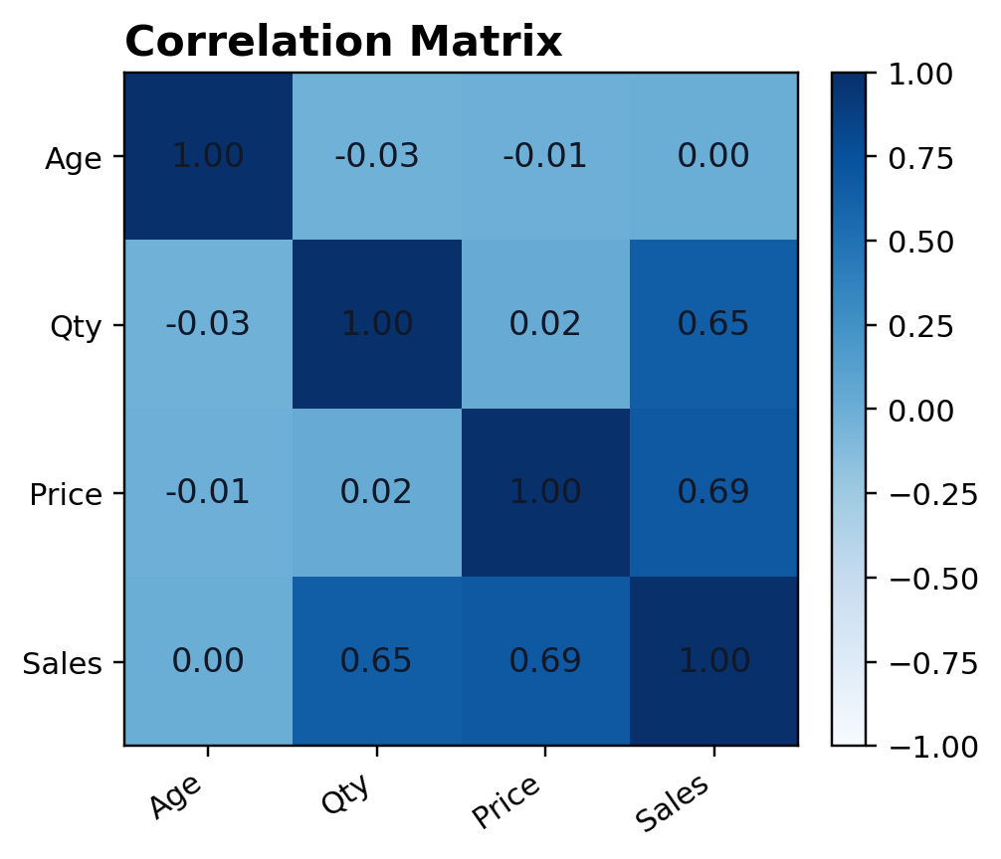
SECTION 09
10 / 13
Multivariate Analysis & Correlation
Scatter plots and correlation analysis explore relationships among numerical variables.
KEY RELATIONSHIPS
•
Quantity and Total Sales show a positive correlation of 0.65.
•
Unit Price and Total Sales show a positive correlation of 0.69.
•
Age has near-zero correlation with Total Sales, at 0.00.
ApexPlanet Data Analytics Project

Slide 11
SECTION 10
11 / 13
SQL-Driven Business Analysis
BUSINESS QUESTIONS
DATABASE
OUTPUT
7
SQLite
Excel
answered with SQLite
sales.db
SQL_Results.xlsx
BUSINESS QUESTIONS
SAMPLE QUERY • Q1
Q1
Top products by revenue
SELECT p.Product, p.Category, SUM(s.Total_Sales) AS Revenue FROM sales s JOIN products p ON s.Product = p.Product GROUP BY p.Product, p.Category ORDER BY Revenue DESC LIMIT 5;
Q2
Monthly revenue performance
Q3
City × category revenue
Q4
Repeat customer analysis
Q5
Gender performance
Q6
Age-group performance
Filtering • Aggregation • JOIN • GROUP BY
Q7
High-value transactions
ApexPlanet Data Analytics Project

Slide 12
SECTION 11
12 / 13
Key Insights & Business Recommendations
01 KEY INSIGHTS
02 BUSINESS RECOMMENDATIONS
•
Electronics contributes 36.43% of total revenue.
•
Maintain strong inventory availability for high-revenue Electronics products.
•
Laptop and Mobile are the leading revenue-generating products.
•
Use Laptop and Mobile purchases as anchors for cross-selling accessories and add-ons.
•
Patna is the highest-revenue city.
•
Investigate the revenue decline around September and address root causes.
•
March 2025 is the strongest complete month.
•
Target one-time customers with retention campaigns to lift the 5.49% repeat rate.
•
Repeat customers represent 5.49% of customers.
•
Analyze high-performing cities for location-specific strategies.
ApexPlanet Data Analytics Project

Slide 13
SECTION 12
13 / 13
Conclusion & Project Workflow
DATA VALIDATED
EDA COMPLETED
SQL COMPLETED
1,000 records
Revenue drivers
7 questions
12 columns • 0 duplicates • 0 sales-calc errors
Category, product, customer, city, monthly trends
SQLite results exported to Excel
END-TO-END WORKFLOW
01
02
03
04
05
06
Data
Validation
EDA
SQL
Visuals
Insights
Final takeaway
The analysis identifies Electronics leadership, product concentration, a September revenue dip, and a clear customer retention opportunity.
ApexPlanet Data Analytics Project • Python + SQLite + SQL

