Slide 1
01
APEXPLANET TASK - 4
Data Storytelling & Statistical Validation
Domain: E-Commerce Analytics | Role: Data Analyst Intern Presented by: Anish Raj R

Slide 2
Business Performance Snapshot
02
Peak Month
March 2025
₹12.97M Revenue
Highest monthly revenue in the analysis.
Top City
Patna
₹19.29M Revenue
Highest city-level revenue in the analysis.
Top Category
Electronics
₹50.36M Revenue
Highest category-level revenue in the analysis.
REVENUE CONTRIBUTION
REVENUE CONTRIBUTION
REVENUE CONTRIBUTION
9.41%
of total revenue
Rank #1
13.99%
of total revenue
Rank #1
36.53%
of total revenue
Rank #1
March is the highest-revenue month.
Patna is the highest-revenue city.
Electronics is the highest-revenue category.

Slide 3
Analysis Scope and Group Definition
03
Other-Category Orders
Sample Size (N):
632
Analysis Scope:
Orders outside Electronics
Order-level AOV comparison group
Goal: Compare order-level AOV by category.
Electronics Orders
Sample Size (N):
347
Analysis Scope:
Electronics category orders
Order-level AOV comparison group
Goal: Compare order-level AOV by category.
Data Quality:
987 valid descriptive records
980 distinct cleaned orders
979 hypothesis-test orders
1 mixed-category order excluded: ORD100050

Slide 4
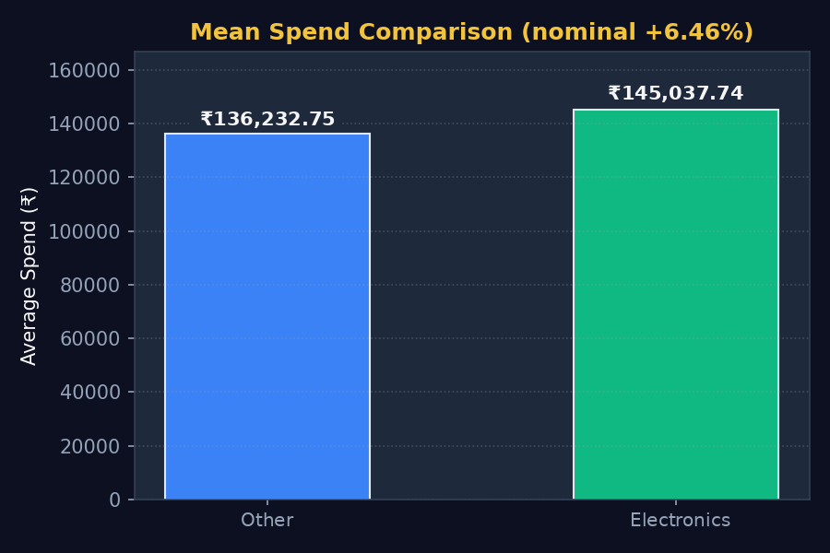
Electronics Shows a Higher Observed AOV
04
Direct Cohort Comparison
Summary Metrics:
Other: ₹136,232.75
Electronics: ₹145,037.74
Nominal Difference: ₹8,804.99 (+6.46%)
Core Analytics:
The test does not provide sufficient evidence of a statistically significant difference.

Slide 5
Hypotheses and Statistical Test
05
Null Hypothesis (H0)
Mathematical Statement:
H0: μE = μO (μE - μO = 0)
Business Definition:
There is no statistically significant difference in mean AOV between Electronics and Other-category orders.
Statistical Reality:
p = 0.2546 provides insufficient evidence against H0 at α = 0.05.
Alternative Hypothesis (H1)
Mathematical Statement:
H1: μE ≠ μO (μE - μO ≠ 0)
Business Definition:
There is a statistically significant difference in mean AOV between Electronics and Other-category orders.
Evaluation Method:
Evaluated via Welch's Independent Two-Sample T-test, two-sided, at α = 0.05.

Slide 6
Statistical Test Results
06
Core Test Outputs
p-Value: p = 0.2546
95% CI: ₹-6,356.95 to ₹23,966.94
Effect Size (Cohen's d): 0.0776 (Negligible)
Key Business Takeaway
FAIL TO REJECT H0
The test does not provide sufficient evidence of a statistically significant difference.
The confidence interval includes both negative and positive values, so the direction of the population AOV difference remains uncertain.
Cohort Specifics
Other AOV: ₹136,232.75
Electronics AOV: ₹145,037.74
Nominal Difference: ₹8,804.99 (6.46%)

Slide 7
Confidence Interval Includes Zero
07
Mathematical Grounding
Observed 95% Confidence Interval:
₹-6,356.95 to ₹23,966.94
Statistical Definition:
We are 95% confident the population mean difference lies between ₹-6,356.95 and ₹23,966.94.
This supports a non-significant result at α = 0.05.
Risk Assessment & Implications
Negative Bound (₹-6,356.95):
Negative values indicate potential downside.
Positive Bound (₹23,966.94):
Positive values indicate potential upside, but the interval remains too wide to establish a reliable AOV difference.
Business Verdict:
The confidence interval includes negative and positive values, so the direction and magnitude of the population AOV difference remain uncertain.

Slide 8
Statistical Interpretation and Next Test
08
Statistical Evidence:
p = 0.2546
Key Finding:
Cohen's d = 0.0776, a negligible effect.
Implication:
The evidence is insufficient to establish a significant AOV difference.
Future Test Design:
Future testing should be planned with adequate statistical power before data collection, with α and the minimum detectable effect defined in advance.
Statistical Planning:
▪ Predefine target power and significance level.
▪ Set α before testing.
▪ Predefine the minimum detectable effect.

Slide 9
Business Decision and Next Options
09
RECOMMENDED DECISION:
FAIL TO REJECT H0 • MONITOR AOV AND VALIDATE FUTURE CHANGES
Option A: Monitor Electronics AOV
STATUS: RECOMMENDED
▪ Track the observed AOV difference over future transactions.
▪ Monitor category and city patterns.
▪ No immediate rollout decision is supported by the test.
Option B: Segment and Investigate
STATUS: RECOMMENDED
▪ Segment AOV by product and city.
▪ Investigate high-spend cohorts.
▪ Use findings to define a clearer next hypothesis.
Option C: Controlled Validation
STATUS: FUTURE TEST
▪ Validate pricing or promotion changes with controlled testing.
▪ Use adequate sample sizing.
▪ Avoid broad rollout until reliable evidence is available.

Slide 10
Tactical Action Plan for the Next Experiment
10
FINAL STATISTICAL DECISION
FAIL TO REJECT H0 • OBSERVED ELECTRONICS AOV DIFFERENCE IS NOT STATISTICALLY ESTABLISHED
1. Monitor Electronics AOV
Action:
Track Electronics AOV and the category difference over future observations.
2. Segment Key Drivers
Action:
Analyze AOV by product and city to identify meaningful drivers and define a clearer next hypothesis.
3. Run Controlled Tests
Action:
Use controlled pricing or promotion tests with an adequately powered sample to improve statistical power and estimate precision.

