Slide 1


Slide 2
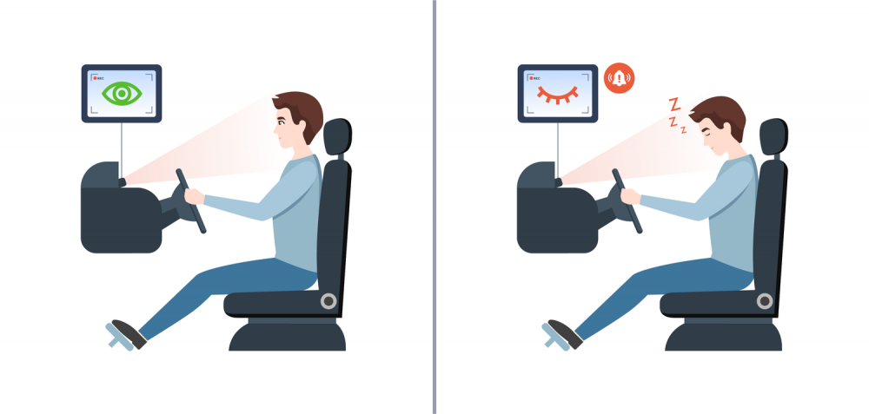
INTRODUCTION
In the realm of road safety, driving fatigue stands out as a significant contributor to accidents.
Acknowledging this challenge, we present our innovative solution the Drowsiness Alert System.
A proactive approach to enhancing driver safety, this system employs real-time monitoring through cutting-edge facial recognition and eye-tracking technology.
By promptly detecting signs of drowsiness, it provides immediate alerts, ensuring a safer and more secure driving experience.

Slide 3
METHODS AND ALGORITHMS
OpenCV (Open Source Computer Vision Library): provides a wide range of functions for reading, manipulating videos. Object detection and tracking includes tools for detecting and tracking objects in images and videos. Useful for geometric camera calibration and 3D reconstruction.
Imutils: For image processing function, face_utils for facial recognition. Functions for easily resizing and rotating images.
Dlib : Dlib is well-known for its facial landmark detection capabilities, which involves identifying key points on a face. Dlib includes tools for machine learning, making it versatile for various applications.
SciPy: SciPy builds on NumPy and provides additional functionality for scientific computing. Statistical tools for hypothesis testing, regression, Euclidean distance and more.

Slide 4
SURVEY
21 percent of all fatal accidents are due to drowsy driving.60 percent of adult drivers or about 168 million people have driven a vehicle while feeling drowsy in the past year.
About 37 percent or 103 million people have fallen asleep at the wheel, according to the National Sleep Foundation's [NSF] 2005 poll.4 percent or approximately eleven million drivers admit they have had an accident or near accident because they dozed off or were too tired to drive.
Sleepiness while driving contributes to 3% to > 30% of all road traffic accidents globally, which may involve a variety of sleep conditions but also may be caused by sleep deprivation.
More than 20% of the drivers feel a need to stop driving at least once due to sleepiness.
This systematic review was designed for a better understanding of the relationship between sleepiness and risk of road traffic accidents.

Slide 5
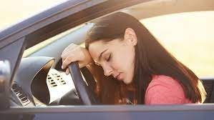
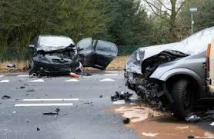
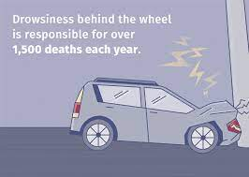
SURVEY

Slide 6
SYSTEM DESIGN
Calculation of drowsiness using distance :
Eye Aspect Ration (EAR) :
EAR = ||P0 - P3|| + ||P1 – P5|| + ||P2 – P4|| ….. where P1 …. P6 are the variation of eye length.
Setting the EAR threshold for drowsiness detection and the frame check value.
Initialize the face detector and shape predictor

