Slide 1

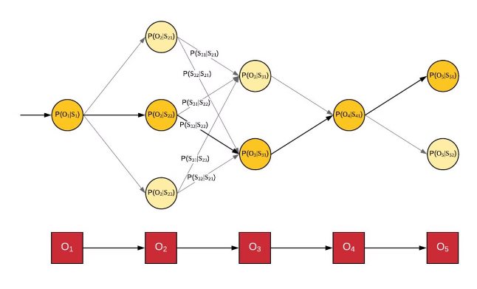
Hidden Markov Model (HMM) in Machine Learning
The Hidden Markov Model (HMM) is a powerful tool in machine learning for modeling sequential data. It finds applications in diverse fields like speech recognition, bioinformatics, and natural language processing.

Slide 2

Introduction to HMM
The HMM is a probabilistic model that describes a system with hidden states that cannot be directly observed but can be inferred through observable outputs. It assumes the system transitions between hidden states according to a Markov chain.
1
Hidden States
2
Observations
The underlying, unobservable states of the system.
The visible outputs of the system that are dependent on the hidden states.
3
Transition Probabilities
4
Emission Probabilities
The probabilities of transitioning between hidden states.
The probabilities of emitting observations given a hidden state.

Slide 3
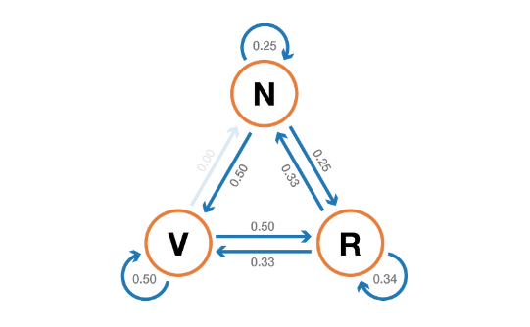
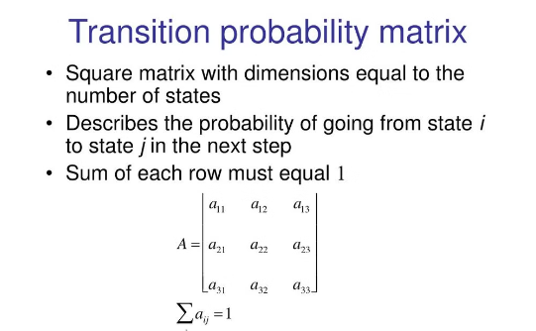
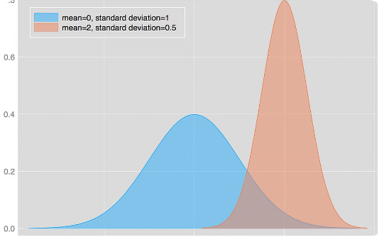
Assumptions and Properties of HMM
Markov Property
Stationary Transition Probabilities
Independent Emissions
The current hidden state depends only on the previous state, not on earlier states.
Emissions are independent of past observations, given the current state.
The transition probabilities remain constant over time.

Slide 4

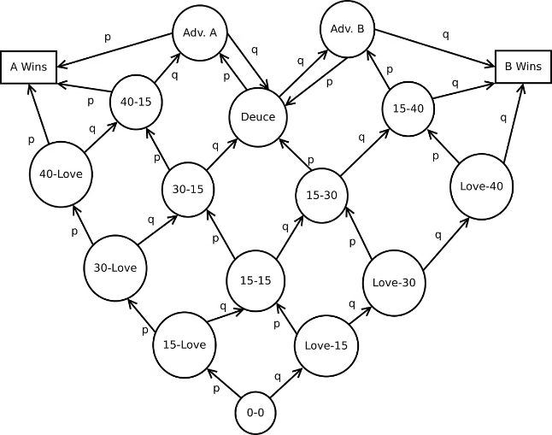
Markov Chains and Transition Probabilities
A Markov chain is a sequence of states where the probability of transitioning to the next state depends only on the current state. The transition probabilities between states are key parameters in an HMM.
State 1
State 2
State 3
0.2
0.5
0.3
0.1
0.6
0.3
0.4
0.2
0.4

Slide 5

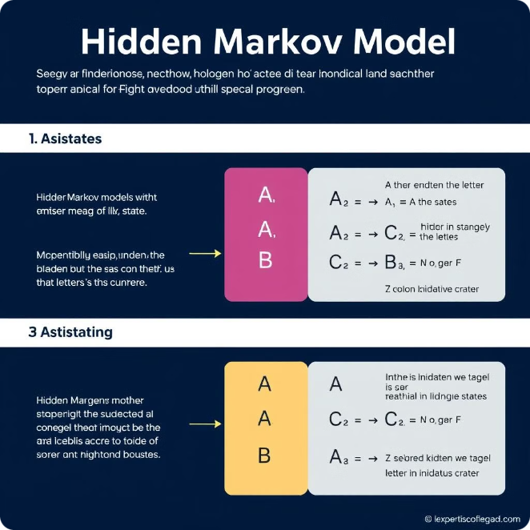



Emission Probabilities and Observation Sequences
The emission probabilities define the likelihood of observing a particular output given a hidden state. These probabilities are crucial for decoding the hidden states from an observed sequence.
State 1
Emission: 'A'
State 2
Emission: 'B'
State 3
Emission: 'C'

Slide 6

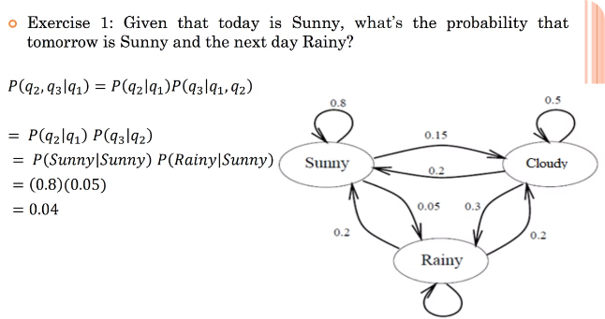
The Three Fundamental Problems of HMM
HMMs are used to solve three fundamental problems: finding the most likely sequence of hidden states given an observation sequence, evaluating the probability of an observation sequence, and learning the model parameters from training data.
Decoding
Evaluation
Find the most likely sequence of hidden states given an observation sequence.
Compute the probability of an observed sequence given the HMM parameters.
Learning
Estimate the HMM parameters from training data.

Slide 7

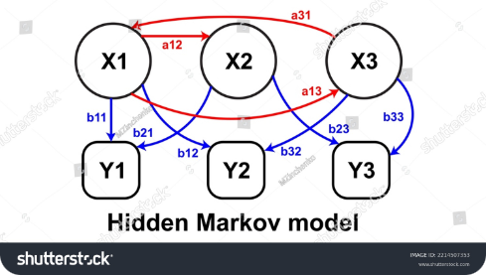



Algorithms for HMM: Forward, Backward, and Viterbi
Efficient algorithms have been developed to solve the fundamental problems of HMMs. These algorithms enable practical applications of HMMs in various domains.
Forward Algorithm
Backward Algorithm
Viterbi Algorithm
Calculates the probability of an observation sequence.
Calculates the probability of the future observations given a state.
Finds the most likely sequence of hidden states.

Slide 8


Applications of HMM in Machine Learning
HMMs have found widespread applications in various machine learning tasks, demonstrating their versatility and effectiveness in modeling sequential data.
Speech Recognition
1
HMMs are used to model the pronunciation of words and phrases.
2
Bioinformatics
HMMs are used for gene finding and protein sequence analysis.
Natural Language Processing
3
HMMs are used for part-of-speech tagging and language modeling.

Slide 9


Advantages and Limitations of HMM
HMMs offer several advantages, including their ability to handle hidden states and their mathematical tractability. However, they also have limitations, such as the Markov assumption and the difficulty of handling long sequences.
Advantages
Limitations
HMMs are mathematically tractable and have well-established algorithms.
HMMs assume the Markov property and may struggle with long sequences.

Slide 10


Conclusion and Future Developments
HMMs remain a fundamental tool in machine learning, providing a robust framework for modeling sequential data. Ongoing research is exploring more complex models and extensions to address the limitations of traditional HMMs.
Future developments in HMMs may involve incorporating non-Markovian dependencies, handling long sequences, and integrating with deep learning techniques.

