Slide 1

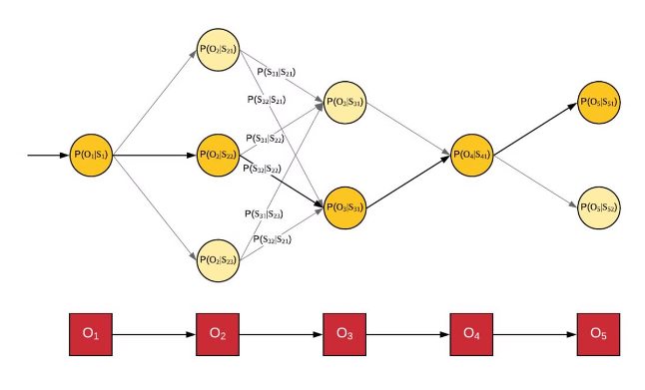
Introduction to Hidden Markov Models
Hidden Markov Models (HMMs) are powerful statistical tools used to model sequences of data where the underlying states are hidden. They have found widespread applications in various fields, including speech recognition, bioinformatics, and natural language processing.

Slide 2

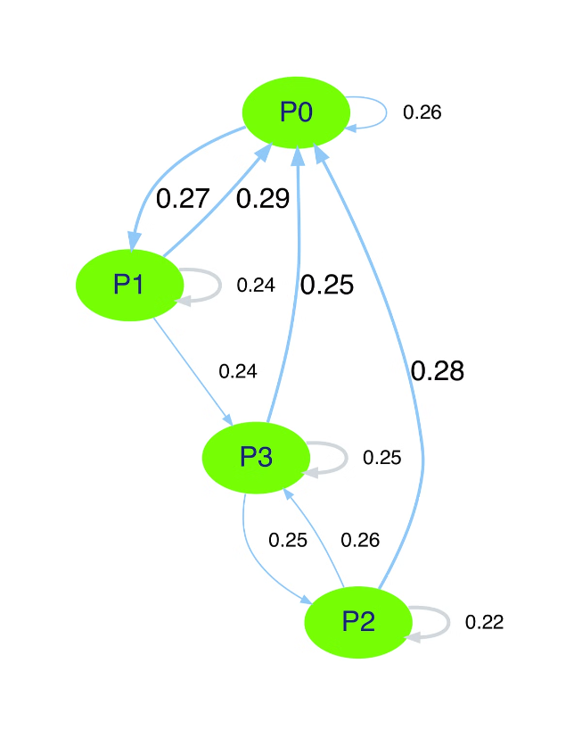
Markov Chains and Stochastic Processes
At the core of HMMs lie Markov chains, which are mathematical models that describe sequences of events where the probability of each event depends only on the previous event. They are used to represent the hidden states in an HMM.
1
State 1
Represents the first state in the sequence of events.
2
State 2
Represents the second state in the sequence of events.
3
State 3
Represents the third state in the sequence of events.

Slide 3

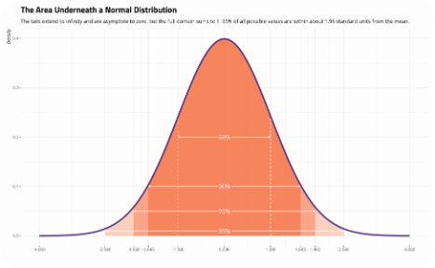
Probability Distributions in HMMs
HMMs incorporate probability distributions to model the emission of observable outputs from hidden states. These distributions, often Gaussian or multinomial, define the likelihood of observing a particular output given a specific hidden state.
State 1
State 2
State 3
Probability of observing a specific output given that the hidden state is 1.
Probability of observing a specific output given that the hidden state is 2.
Probability of observing a specific output given that the hidden state is 3.

Slide 4
The Three Fundamental Problems of HMMs
The three fundamental problems of HMMs are decoding, evaluation, and learning. Decoding aims to determine the most likely sequence of hidden states given a sequence of observations. Evaluation computes the probability of observing a particular sequence. Learning involves estimating the parameters of the HMM.
Decoding
Evaluation
Learning
Determining the most likely sequence of hidden states.
Computing the probability of observing a sequence.
Estimating the parameters of the model.

Slide 5

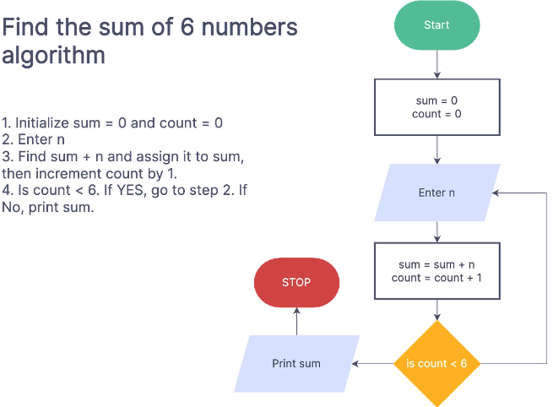



The Forward Algorithm
The Forward Algorithm is a dynamic programming algorithm used for evaluation in HMMs. It calculates the probability of observing a sequence of observations up to a specific time step, considering all possible paths leading to that time step.
Initialization
Set the initial probabilities for each state.
Recursion
Iteratively calculate the probabilities for each state.
Termination
Calculate the final probability of the observed sequence.

Slide 6

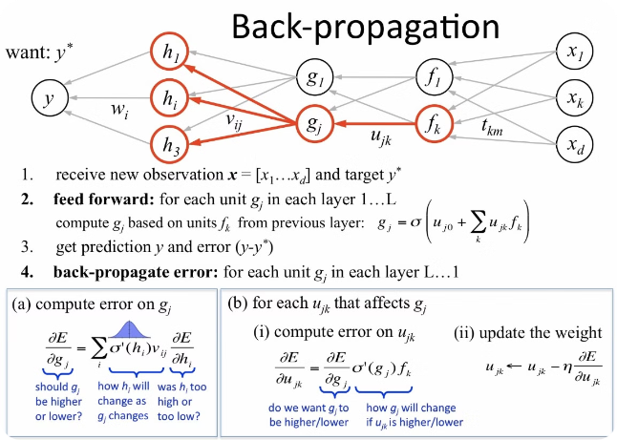
The Backward Algorithm
The Backward Algorithm is another dynamic programming algorithm used for evaluation. It computes the probability of observing a sequence of observations from a specific time step to the end of the sequence, considering all possible paths starting from that time step.
1
Initialization
2
Recursion
Set the initial probabilities for each state.
Iteratively calculate the probabilities for each state.
3
Termination
Calculate the final probability of the observed sequence.

Slide 7

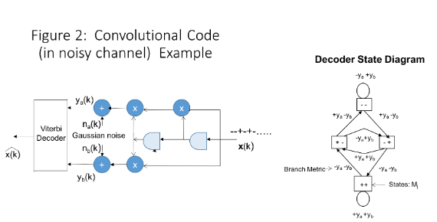
The Viterbi Algorithm
The Viterbi Algorithm is a dynamic programming algorithm used for decoding in HMMs. It finds the most likely sequence of hidden states given a sequence of observations. This algorithm is widely used in speech recognition and other applications.
Initialization
Set the initial probabilities for each state.
Recursion
Iteratively calculate the probabilities for each state.
Termination
Determine the most likely sequence of states.

Slide 8

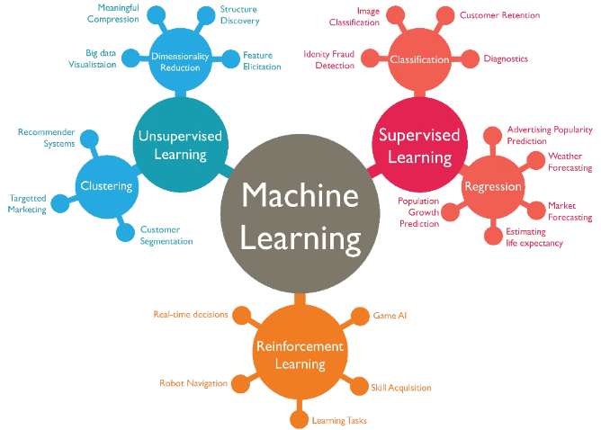



Applications of HMMs in Machine Learning
HMMs have found widespread applications in various machine learning tasks, including speech recognition, handwriting recognition, bioinformatics, and natural language processing. They are particularly useful for modeling sequential data and capturing dependencies between events.
Speech Recognition
HMMs are used to model the acoustic features of speech and recognize spoken words.
Bioinformatics
HMMs are used to analyze DNA and protein sequences, identify gene structures, and predict protein function.
Natural Language Processing
HMMs are used to model language models, tag parts of speech, and perform machine translation.

Slide 9
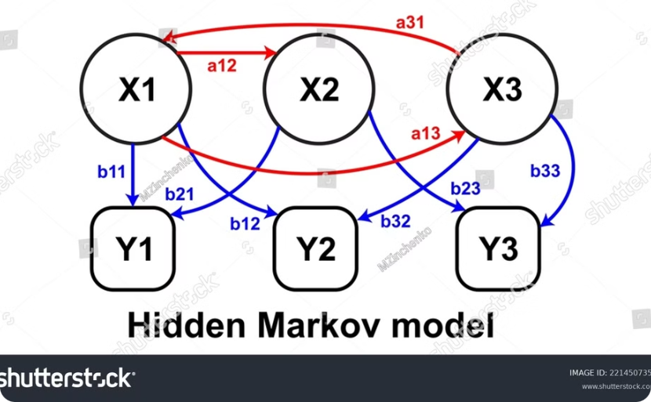
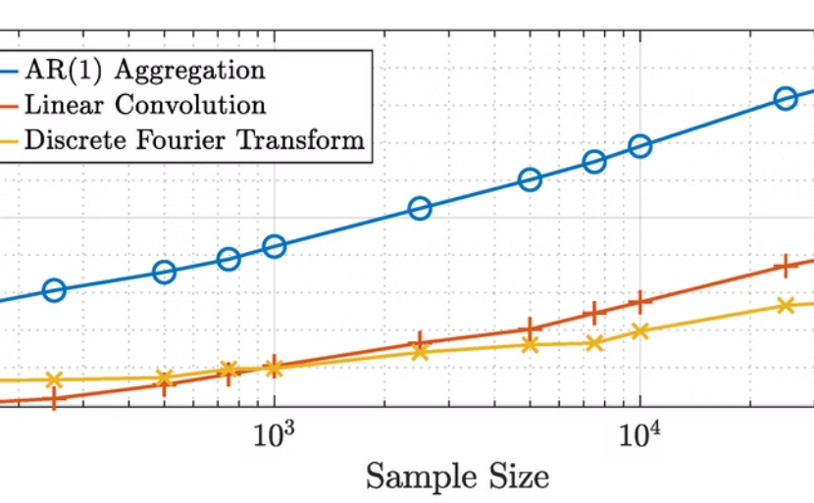
Limitations and Challenges of HMMs
HMMs have some limitations, such as their assumption of first-order Markov property and difficulty in handling long-range dependencies. Their performance can also be affected by the choice of model parameters and the quality of the training data.
First-Order Markov Property
Long-Range Dependencies
HMMs assume that the current state depends only on the previous state, which may not always hold true in real-world scenarios.
HMMs struggle to capture dependencies between events that are far apart in the sequence.

Slide 10


Conclusion and Future Directions
HMMs have proven to be a powerful tool in machine learning, but research continues to explore new variations and extensions. Future directions include developing more robust models that can handle long-range dependencies and complex data structures.

