Slide 1
Helm
Kubernetes Package and Deployment Manager
Like apt or yum in Linux World
Automated version handling during upgrade / rollback
Share the deployment instruction as scripts
Templatize the deployments for easy customization
Store templates in a repository
Search and reuse the templates
Manages the complete life cycle of the application ( Create, Install, Upgrade, Rollback, Delete, Status, Versioning)
Benefits
Repeatability
Reliability
Manage multiple environment with same template
Easy collaboration as everything will be defined in files
Manage any complex environment

Slide 2
Chart Files
Chart Files
Chart Files
Repositories
Store Charts
Export and Share
(E.g. tar file)
Entire Package
Helm
Kubernetes Cluster
Package Chart Files
-using Helm
Manage Application
Create, Install, Upgrade, Rollback, Delete, Status, Versioning

Slide 3
Helm – Components
Helm Client
Charts
Repositories
Release
Interface by which Helm can be communicated. Facilitates communication with Kubernetes
Application definition.
Collection of files in a defined structure
Stores and Manages the Charts.
Chart instance loaded into Kubernetes.
Each release will have a version

Slide 4
Template Language
Go language template
{{.foo | quote}}
Variables
Variables, Simple control structures, looping Conditionals, Nesting
Pipelines
Functions
Chain together templates functions
Date, conversions, encoding, math, crypto, etc

Slide 5
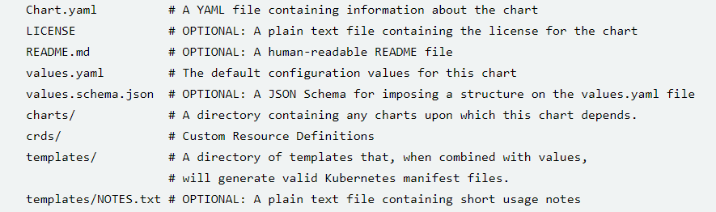
New Chart Structure

Slide 6
Version 2
charts
Helm
Kubernetes
Cluster
Tiller Service

Slide 7
Version 3
charts
Helm
Kubernetes
Cluster
RBAC

Slide 8
Worker
Worker
Master
Worker
helm
Worker

Slide 9
Test
yaml
Test
Port : 1234
Pod # 2
Prod
yaml
Prod
Port : 8080
Pod # 8

Slide 10
value-test
PORT: 1234
COUNT : 2
Test
Port : 1234
Pod # 2
port: {{PORT}}
number: {{COUNT}}
Prod
Port : 8080
Pod # 8
value-prod
PORT: 8088
COUNT : 8

Slide 11
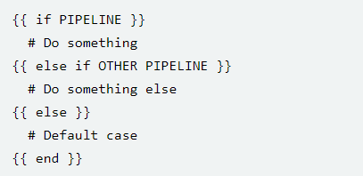
Flow Control – If/Else

Slide 12
Flow Control – If/Else – False Condition
A pipeline is evaluated as false if the value is:
a Boolean false
a numeric zero
an empty string
a nil (empty or null)
an empty collection (map, slice, tuple, dict, array)

Slide 13
Modifying scope using ‘with’
{{ with PIPELINE }}
# restricted scope
{{ end }}

Slide 14
Looping using ‘range’
Lang Used: |-
{{- range .Values.LangUsed }}
- {{ . | title | quote }}
{{- end }}

Slide 15
Variables
$name. Variables are assigned with a special assignment operator: :=
Eg: {{- $relname := .Release.Name -}}

Slide 16
Named Templates
Kubernetes manifests in templates/ except Notes.txt (Separate section)
Starting with _ may not have manifest
Eg:
{{- define "mychart.labels" }}
labels:
generator: helm
date: {{ now | htmlDate }}
{{- end }}
{{- template "mychart.labels" }}

Slide 17
Charts
Key
Repository
OCI Registry
Charts
index and push
Charts
Deploy
Deploy
Kubernetes Cluster
CI – CD Tools / Dev Env
Deploy

Slide 18
Chart Repositories
An HTTP server hosting index.yaml file along with chart packages
When charts are ready, can be uploaded to the server and shared
Multiple charts with dependency and version can be managed
Will be managed like source control system in a common location
Can be hosed as part of
Google Compute Cloud Bucket
AWS S3 Bucket
Github Pages
Own webserver (chartmuseum)

Slide 19
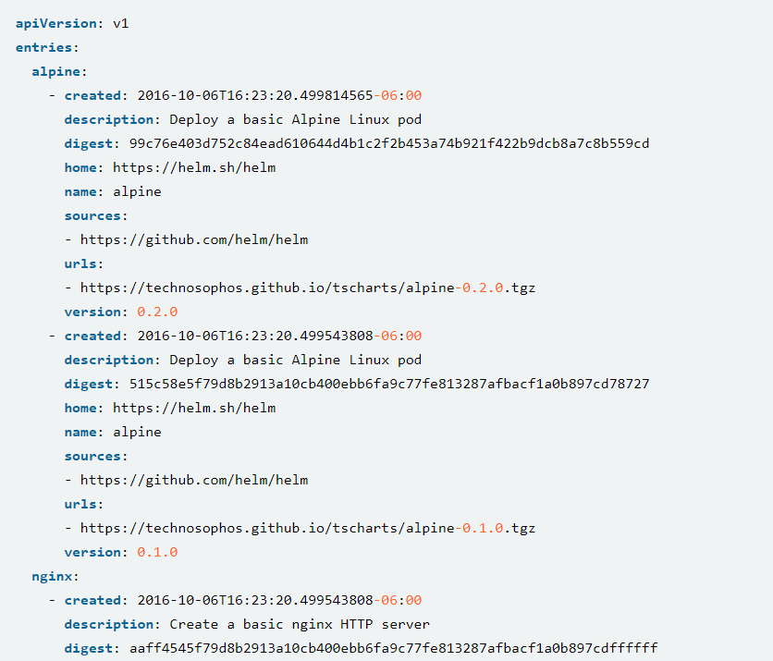

Slide 20
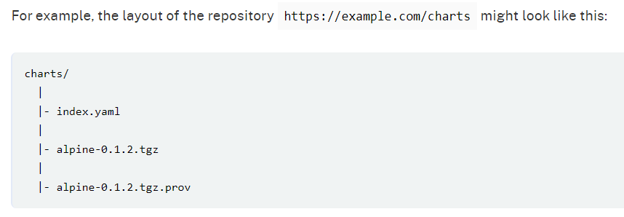

Slide 21
Charts
Charts
Charts
Repository
OCI Registry
Charts
index and push
Charts
add repo
repo list

Slide 22
Chart Hooks
Preinstall hooks run after templates are rendered and before any resources are created in Kubernetes.
Post-install hooks run after all resources are loaded into Kubernetes.
Pre-delete hooks run before any resources are deleted from Kubernetes.
Post-delete hooks run after all the release’s resources are deleted.
Pre-upgrade hooks run after templates are rendered and before any resources are loaded into Kubernetes.
Post-upgrade hooks run after all resources are upgraded.
Pre-rollback hooks run after templates are rendered and before any resources are rolled back.
Post-rollback hooks run after all resources are modified.

Slide 23
Minikube
HELM
Windows

Slide 24
Chart A: 1.0
Chart
subChart
Dep Chart A: 1.0

Slide 25
The templates file standard
Should have the extension .yaml if they produce YAML output.
The extension .tpl may be used for template files that produce no formatted content.
File names should use dashed notation (my-example- configmap.yaml), not camelcase.
Each resource definition should be in its own template file.
File names should reflect the resource kind in the name. e.g. foo-pod.yaml, bar-svc.yaml

Slide 26
Banner Infographic
Marketers must link the price to the real and perceived value of the product, but they also must take into account supply costs, seasonal discounts, and prices used by competitors.
Title One
Title Three
Marketers must link the price to the real and perceived value of the product
Title Two
Marketers must link the price to the real and perceived value of the product
Title Four
Marketers must link the price to the real and perceived value of the product
Marketers must link the price to the real and perceived value of the product

Slide 27
Title One
Marketers must link the price to the real and perceived value of the product
Banner
Infographic
Title Two
Marketers must link the price to the real and perceived value of the product
Marketers must link the price to the real and perceived value of the product, but they also must take into account supply costs, seasonal discounts, and prices used by competitors.
Title Three
Marketers must link the price to the real and perceived value of the product
Title Four
Marketers must link the price to the real and perceived value of the product

Slide 28
Title One
Banner
Infographic
Marketers must link the price to the real and perceived value of the product
Marketers must link the price to the real and perceived value of the product, but they also must take into account supply costs, seasonal discounts, and prices used by competitors.
Title Two
Marketers must link the price to the real and perceived value of the product
Title Three
Title Four
Marketers must link the price to the real and perceived value of the product
Marketers must link the price to the real and perceived value of the product

Slide 29
Banner Infographic
Marketers must link the price to the real and perceived value of the product, but they also must take into account supply costs, seasonal discounts, and prices used by competitors.
Title One
Title Two
Title Three
Title Four
Marketers must link the price to the real and perceived value of the product
Marketers must link the price to the real and perceived value of the product
Marketers must link the price to the real and perceived value of the product
Marketers must link the price to the real and perceived value of the product

Slide 30
Banner Infographic
Marketers must link the price to the real and perceived value of the product, but they also must take into account supply costs, seasonal discounts, and prices used by competitors.
Title One
Title Two
Title Three
Title Four
Marketers must link the price to the real and perceived value of the product
Marketers must link the price to the real and perceived value of the product
Marketers must link the price to the real and perceived value of the product
Marketers must link the price to the real and perceived value of the product

Slide 31
Banner Infographic
Marketers must link the price to the real and perceived value of the product, but they also must take into account supply costs, seasonal discounts, and prices used by competitors.
Title One
Title Three
Marketers must link the price to the real and perceived value of the product
Marketers must link the price to the real and perceived value of the product
Title Two
Title Four
Marketers must link the price to the real and perceived value of the product
Marketers must link the price to the real and perceived value of the product

Slide 32
Banner Infographic
Marketers must link the price to the real and perceived value of the product, but they also must take into account supply costs, seasonal discounts, and prices used by competitors.
Title Two
Title Four
Marketers must link the price to the real and perceived value of the product
Marketers must link the price to the real and perceived value of the product
Title One
Title Three
Marketers must link the price to the real and perceived value of the product
Marketers must link the price to the real and perceived value of the product

