Slide 1

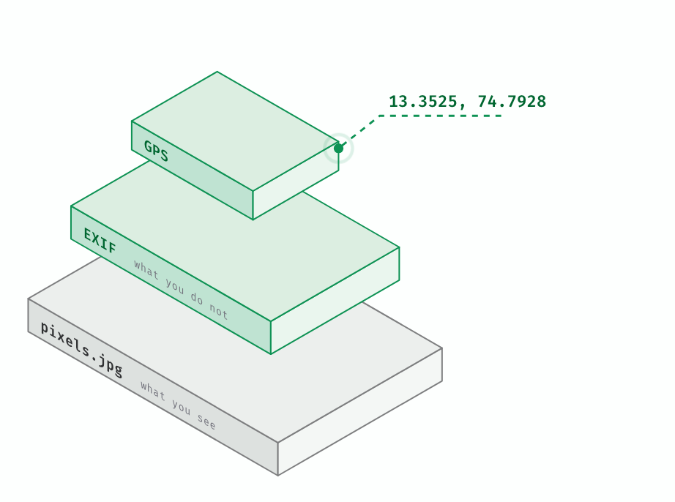
nish
EXIFLEAK
01 / 09
SHELL SCRIPTING / M.E. CYBERSECURITY
Your photos talk.
exifleak is a small Bash script. It reads the metadata a photo gives away, then wipes it.
ANISH SHOBITH P S
MSIS, MAHE
Notes:
⏱ 0:15 (ends 0:15)
SAY: Hi, I'm Anish. A photo is not just pixels. exifleak is a short Bash script that reads what a photo gives away and wipes it. The problem, the cases, the design, the code, a demo, and where it breaks.
NEXT → What is hiding in a photo.

Slide 2

nish
EXIFLEAK
02 / 09
02
THE PROBLEM
A photo is two files in one.
WHAT THE SCRIPT HUNTS
GPS Position
location
13 deg 21' 9.00" N, 74 deg 47' 34.08" E
Pixels you see, and an EXIF block you don't. The camera writes it. Every app that copies the file carries it along.
Camera Model Name
device
iPhone 15 Pro
Serial Number
device
F2LDEMO12345
USUALLY KEPT
email
cloud links
AirDrop
sent as document
Artist
identity
Anish Shobith
USUALLY STRIPPED ON UPLOAD
Instagram
Facebook
X
Signal
Software
software
iOS 18.1
Notes:
⏱ 0:30 (ends 0:45)
SAY: A JPEG carries a second payload, the EXIF block. The camera fills in where you stood, the phone model, its serial number, your name and what software touched it. These five lines are what my script hunts. Instagram, Facebook and X usually strip them on upload. Email, cloud links and sending as a file usually do not.
NEXT → Has this actually hurt anyone?

Slide 3
nish
EXIFLEAK
03 / 09
03
WHY IT MATTERS
It has already cost people.
2007
US Army, Iraq
↗
iTnews, 2012
2010
Adam Savage
↗
NYT via Benton, Aug 2010
Geotagged flightline photos helped attackers find four new Apache helicopters. Mortars destroyed them. The Army disclosed it in 2012.
He tweeted a photo of his car outside his home, captioned "off to work". The geotag gave the address.
2012
Higinio Ochoa
↗
Computerworld, 2012
2012
John McAfee
↗
The Next Web, 2012
The FBI says GPS in a photo of his girlfriend pointed to her home in Australia. He was arrested in March.
A published photo carried GPS that put him in Guatemala. He was arrested two days later, and later claimed he faked the data.
RESEARCH
Friedland and Sommer, HotSec 2010: geotags on Craigslist, YouTube and Twitter revealed homes and away-times.
Notes:
⏱ 0:35 (ends 1:20)
SAY: This is not theory. In 2007 geotagged photos of new Apaches helped attackers find and destroy four of them. In 2010 a TV host tweeted his car outside his house, with the address inside the file. In 2012 the FBI tied a hacker to his girlfriend's house through a photo, and a published photo placed John McAfee in Guatemala. A 2010 paper showed this works at scale.
NEXT → So how is the tool built?

Slide 4
nish
EXIFLEAK
04 / 09
04
DESIGN
One job per function.
01 FILES
→
02 FETCH
→
03 DETECT
→
04 REPORT
for
meta=$(exiftool)
DETECTORS
show
a file, or every image in a folder by glob
one call, kept in a variable
detect_location
one [TAG] line each
detect_device
detect_identity
detect_software
The loop never names a check. A new check is one function and one name in DETECTORS.
Notes:
⏱ 0:25 (ends 1:45)
SAY: The shape is simple. A for loop walks the files. exiftool runs once and its text is kept in a variable. Then the loop runs every function named in DETECTORS. Each detector owns one leak type, and show is the only thing that prints. So a new check is one function and one name in the list.
NEXT → The script itself.

Slide 5
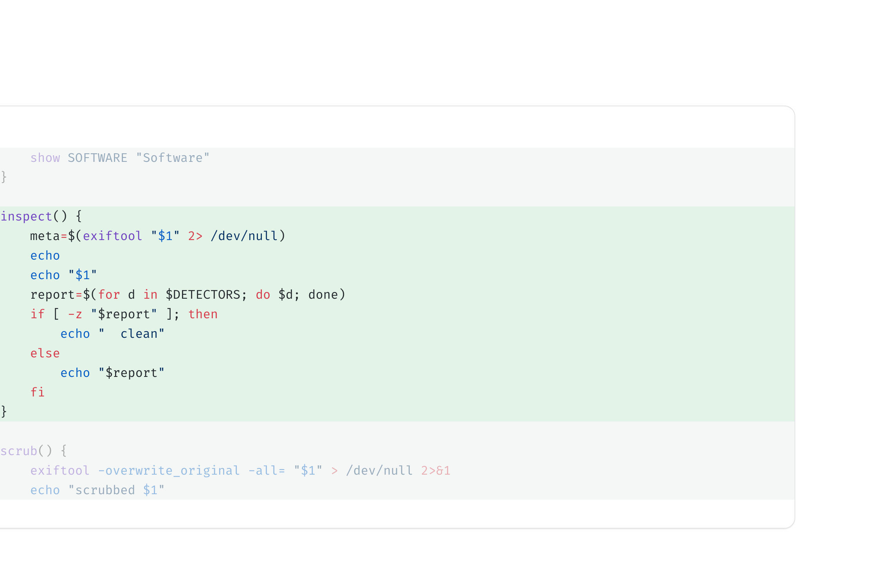
nish
EXIFLEAK
05 / 09
05
THE SCRIPT
exifleak.sh
4 / 4
run every registered detector
Notes:
⏱ 0:50 (ends 2:35)
SAY: Here is the whole script. Click. DETECTORS is just a list of names, and show is the helper: grep the line out of the exiftool text, take the first match, squeeze the spaces, print it with a label. Click. For location, awk adds degrees plus minutes over sixty plus seconds over thirty-six hundred, and flips the sign for south and west. That gives the map link. Click. The other detectors are two lines each. Click. inspect runs every name in the list.
NEXT → What commands are these?

Slide 6
nish
EXIFLEAK
06 / 09
06
HOW IT WORKS
One field, start to finish.
EVERY FIELD
LOCATION
RUN
exiftool "$1"
13 deg 21' 9.00" N
-s
prints every tag as text, kept in $meta
what exiftool prints
picks scrub, otherwise inspect
grep -i "^Artist" | head -1
13 deg 21 9.00 N
for
keeps the first line with that label
tr -d drops " ' ,
hands each file, or each image in a folder, to $action
tr -s ' '
13 + 21/60 + 9/3600
exiftool -all=
squeezes the padding
awk adds degrees, minutes, seconds; S and W go negative
scrub: removes every tag in place
echo "[IDENTITY] $line"
?q=13.3525,74.7928
clean
prints it with its leak type
the map link
inspect: printed when no detector reports
Notes:
⏱ 0:30 (ends 3:05)
SAY: Every field goes through the same four steps. exiftool prints all tags as text, grep and head keep the first line with the label, tr squeezes the padding, and echo prints it with its leak type. Location needs one more step: awk adds degrees, minutes over sixty and seconds over thirty-six hundred, and south or west flips the sign. That is the map link. Last, the dash s flag only changes which function runs for each file.
NEXT → Let's run it.

Slide 7
nish
EXIFLEAK
07 / 09
07
DEMO
~/photos
wipe it, then look again
$ ./exifleak.sh demo
$ ./exifleak.sh -s \
demo/IMG_4821.jpg
demo/IMG_4821.jpg
scrubbed demo/IMG_4821.jpg
[LOCATION] GPS Position : 13 deg 21' 9.00" N, 74 deg 47' 34.08" E
$ ./exifleak.sh \
[LOCATION] https://maps.google.com/?q=13.3525,74.7928
demo/IMG_4821.jpg
[DEVICE] Camera Model Name : iPhone 15 Pro
[DEVICE] Serial Number : F2LDEMO12345
demo/IMG_4821.jpg
[IDENTITY] Artist : Anish Shobith
clean
[SOFTWARE] Software : iOS 18.1
demo/IMG_4822.jpg
[DEVICE] Camera Model Name : Pixel 8
demo/IMG_4823.jpg
clean
Notes:
⏱ 0:35 (ends 3:40)
SAY: Real output. I point it at a folder. The first photo gives away where it was taken, with a map link, the phone, its serial number, my name and the iOS version. The second shows only a device. The third is clean. Click. Now the dash s flag: exiftool wipes the file in place. Scan again and it is clean.
NEXT → Where does it break?

Slide 8
nish
EXIFLEAK
08 / 09
08
LIMITS
Where it breaks.
BRITTLE BY DESIGN
SCOPE
It reads ExifTool's labels
One folder level
A camera that writes Model instead of Camera Model Name slips past grep. Add a pattern, or read exiftool -s names.
No **: globstar needs bash 4, and macOS ships 3.2. The script runs on both.
EXIFTOOL CAVEAT
PARSER RISK
The wipe is not total
The scanner is attack surface
PDF edits are incremental, so old metadata stays recoverable. -all= also drops orientation and colour profile on JPEGs.
ExifTool had RCE via DjVu (CVE-2021-22204, before 12.24) and filename injection (CVE-2022-23935, before 12.38). Stay patched.
↗
ExifTool docs
↗
NVD
Notes:
⏱ 0:25 (ends 4:05)
SAY: Honest limits. It parses exiftool's labels, so a camera that names a field differently slips past grep. It scans one folder level, because globstar needs bash 4 and a Mac has 3.2. The wipe is not total for PDFs. And exiftool itself has had remote code execution and filename injection bugs, so keep it patched.
NEXT → Takeaways.

Slide 9

nish
EXIFLEAK
09 / 09
Detect → Report → Scrub
Share the scrubbed copy, never the original. Questions?
ANISHSHOBITHPS.COM
GITHUB.COM/ANISHSHOBITHPS
Notes:
⏱ 0:10 (ends 4:15)
SAY: Detect, report, scrub. And one habit: share the scrubbed copy, not the original. Thank you. Questions?

