Slide 1
Security Constraints, Solution and IDS in Vehicular Network
Submitted in the partial fulfillment for the award of the degree of
BACHELOR OF ENGINEERING
IN
INFORMATION SECURITY
Submitted by:
ANISH SHOW
20BCS3655
Under the Supervision of:
ABHISHEK ANKUR
Department of AIT-CSE
DISCOVER . LEARN . EMPOWER

Slide 2
Outline
Introduction to Project
Problem Formulation
Objectives of the work
Methodology used
Results and Outputs
Conclusion
Future Scope
References

Slide 3
Introduction
Security constraints in vehicular networks are critical to ensuring the safety and reliability of communication systems in connected vehicles. Intrusion Detection Systems (IDS) play a pivotal role in addressing these constraints. IDS in vehicular networks act as vigilant guardians, monitoring network traffic for suspicious activities and potential threats. These systems employ advanced algorithms and anomaly detection techniques to identify malicious behavior, preventing unauthorized access and mitigating cyber-attacks. By promptly detecting and responding to security breaches, IDS contribute to maintaining the integrity and confidentiality of data exchanged among vehicles and infrastructure components. Effectively addressing security constraints through robust IDS solutions is essential for fostering trust in connected vehicle environments, promoting a secure and resilient ecosystem for smart transportation systems.

Slide 4
Problem Formulation
In the realm of vehicular networks, security constraints pose a significant challenge to the seamless integration and operation of connected vehicles. The increasing complexity and interconnectivity of these networks elevate the risk of cyber threats and malicious activities, necessitating robust solutions. One prominent avenue for addressing security constraints is the implementation of Intrusion Detection Systems (IDS). However, a fundamental problem lies in the dynamic and heterogeneous nature of vehicular networks, making it challenging to design IDS that are adaptive and responsive to evolving threats.

Slide 5
The problem formulation revolves around developing IDS solutions tailored to the unique characteristics of vehicular networks. The diverse communication patterns, high mobility, and resource constraints inherent in these networks demand innovative approaches. Furthermore, the IDS should not only detect anomalies effectively but also minimize false positives to avoid unnecessary disruption to legitimate communications. Another critical aspect is the integration of security mechanisms without compromising the real-time requirements of vehicular applications. Striking a balance between security and latency is vital to ensure that safety-critical messages are not delayed, preserving the overall functionality of the vehicular network.

Slide 6
Objectives of the Work
The objectives of addressing security constraints and implementing Intrusion Detection Systems (IDS) in vehicular networks are twofold. Firstly, to enhance the overall security of connected vehicles by developing robust IDS solutions capable of timely and accurate detection of cyber threats. This involves the creation of adaptive algorithms and mechanisms that can identify anomalies in network behavior, preventing unauthorized access and ensuring the confidentiality of sensitive data. Secondly, the aim is to optimize the integration of security solutions with the real-time demands of vehicular applications. This involves minimizing false positives in IDS to prevent disruptions to legitimate communication while maintaining the efficiency and responsiveness required for safety-critical systems. Together, these objectives strive to establish a secure and resilient environment within vehicular networks, fostering trust and reliability in the burgeoning field of connected vehicles. Ultimately, these objectives collectively strive to establish a secure and resilient foundation for vehicular networks, promoting the trustworthiness and stability of connected vehicles in the face of evolving cybersecurity challenges.

Slide 7
Methodology used
The methodology for addressing security constraints and implementing Intrusion Detection Systems (IDS) in vehicular networks involves a systematic and adaptive approach. Firstly, a comprehensive analysis of the dynamic nature of vehicular networks is conducted to understand the unique security challenges and constraints. This includes examining communication patterns, network topologies, and the mobility of vehicles. Next, the development of IDS algorithms takes center stage. Machine learning and anomaly detection techniques are applied to design adaptive systems capable of learning normal behavior patterns and identifying deviations indicative of potential cyber threats. This involves training the IDS on diverse datasets that capture the variability within vehicular network environments. Integration with real-time vehicular applications is a crucial aspect of the methodology. Optimization of IDS performance is achieved by fine-tuning algorithms to operate within the stringent latency constraints of safety-critical systems, ensuring timely threat detection without compromising system responsiveness.

Slide 8
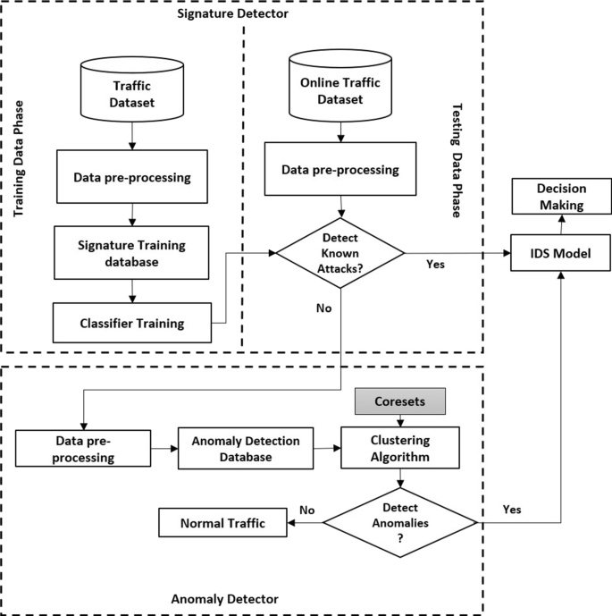

Slide 9
Results and Outputs
The results and outputs of implementing security constraints solutions and Intrusion Detection Systems (IDS) in vehicular networks are fundamental to establishing a secure and resilient connected vehicle environment. One of the primary outcomes is the enhanced detection and mitigation of cyber threats within the vehicular network. The IDS algorithms, developed through machine learning and anomaly detection techniques, exhibit a heightened ability to identify and respond to potential security breaches. This results in an improved overall security posture, safeguarding the integrity and confidentiality of data exchanged among connected vehicles and infrastructure components.Reducing false positives is a crucial output of this security framework. The fine-tuned IDS algorithms achieve a balance between sensitivity and specificity, minimizing the occurrence of false alarms. This outcome is essential for maintaining the efficiency of vehicular communication, preventing unnecessary disruptions to legitimate interactions, and ensuring that the security system does not impede normal network operations.

Slide 10
The integration of IDS solutions with the real-time requirements of vehicular applications yields tangible results in terms of optimized performance. The security framework operates within the stringent latency constraints inherent in safety-critical systems, ensuring timely threat detection and response. This outcome is vital for maintaining the responsiveness and reliability of applications crucial to the safety of connected vehicles, such as collision avoidance systems and emergency communication protocols. Validation and testing of the IDS contribute to the assurance of system effectiveness. Through simulations and real-world scenarios, the security framework undergoes rigorous evaluation, measuring its accuracy, adaptability, and resilience to diverse security threats. The validated IDS provides a tangible output in the form of a proven and reliable security solution for vehicular networks. Continuous monitoring and updates form an ongoing output of this security framework. The system remains dynamic and responsive to emerging security challenges, with regular updates incorporating new threat intelligence. This ensures the long-term effectiveness of the IDS solution, allowing it to adapt to evolving cyber landscapes and providing sustained protection for connected vehicles.

Slide 11
Conclusion
Therefore, VANET becomes a promising technology in wireless environment. A large amount of users wants too safe as much as possible safety on this path, with plenty of people around getting hurt by others’ harassment and ill-will. In the in order to have a secure VANET’s environment one need to put in more efforts on overcome future problems. This paper Most VANET security challenges and their solutions will be introduced, summarily. causes and solutions. In this section, we discuss various attacks on VANET. We explain different IDS in Comparison of the solution for various attacks in VANET. Challenges in security and their solutions at different levels. It also addresses attack or any detection for fake information in VANET. difficult problem. Various effective procedures as well as adaptable discovery methods can be used on the basis of computer. other promising research direction relates to VANET safety, for instance using intelligence designs in future studies.

Slide 12
Future Scope
The future of healthcare is very promising, considering the rapid development in sensor technology, AI and machine learning. For patients, hospitals and doctors as well as for medical device manufacturers, there are not only new opportunities but even the obligation to make use of the Internet of Things. It is obvious that challenges and substantial risks have to be mastered. Throughout the reviewed literature there is a consistency for use of smart technologies in smart cities and in particular healthcare, and AI and block chain technologies are key driving factors for enhancement and improvement of overall user experience of smart cities. Although there are potential downsides of artificial intelligence and machine learning technologies in the context of smart cities, they still also have a potential to change the way we know smart healthcare and smart cities as of now.

Slide 13
References
Shah, R.; Chircu, A. IoT and AI in healthcare: A systematic literature review. Issues Inf. Syst. 2018, 19.
Panarello, A.; Tapas, N.; Merlino, G.; Longo, F.; Puliafito, A. Blockchain and iot integration: A systematic survey. Sensors 2018, 18, 2575.
Jiang, F.; Jiang, Y.; Zhi, H.; Dong, Y.; Li, H.; Ma, S.; Wang, Y.; Dong, Q.; Shen, H.; Wang, Y. Artificial intelligence in healthcare: Past, present and future. Stroke Vasc. Neurol. 2017, 2.
Bahl, M.; Barzilay, R.; Yedidia, A.B.; Locascio, N.J.; Yu, L.; Lehman, C.D. High-risk breast lesions: A machine learning model to predict pathologic upgrade and reduce unnecessary surgical excision. Radiology 2018, 286, 810–818.
Cugurullo, F. Exposing smart cities and eco-cities: Frankenstein urbanism and the sustainability challenges of the experimental city. Environ. Plan. A Econ. Space 2018, 50, 73–92.
Cugurullo, F. Frankenstein Urbanism: Eco, Smart and Autonomous Cities, Artificial Intelligence and the End of the City; Routledge: Abingdon-on-Thames, UK, 2021.

Slide 14
Habibzadeh, H.; Soyata, T. Toward uniform smart healthcare ecosystems: A survey on prospects, security, and privacy considerations. In Connected Health in Smart Cities; Springer: Cham, Switzerland, 2019; ISBN 9783030278441.
Latif, S.; Zafar, N.A. A survey of security and privacy issues in IoT for smart cities. In Proceedings of the 5th International Conference on Aerospace Science and Engineering ICASE, Islamabad, Pakistan, 14–16 November 2017; pp. 1–5.
Huang, G.; Fang, Y.; Wang, X.; Pei, Y.; Horn, B. A Survey on the status of smart healthcare from the universal village perspective. In Proceedings of the 4th IEEE International Conference on Universal Village, Boston, MA, USA, 21–24 October 2018.
Arasteh, H.; Hosseinnezhad, V.; Loia, V.; Tommasetti, A.; Troisi, O.; Shafie-Khah, M.; Siano, P. Iot-based smart cities: A survey. In Proceedings of the EEEIC 2016 International Conference on Environment and Electrical Engineering, Florence, Italy, 7–10 June 2016; pp. 2–7
Alsamhi, S.H.; Ma, O.; Ansari, M.S.; Almalki, F.A. Survey on collaborative smart drones and internet of things for improving smartness of smart cities. IEEE Access 2019, 7, 128125–128152.
Li, W.; Chai, Y.; Khan, F.; Jan, S.R.U.; Verma, S.; Menon, V.G.; Kavita; Li, X. A Comprehensive survey on machine learning-based big data analytics for iot-enabled smart healthcare system. Mob. Netw. Appl. 2021, 26, 234–252.
Kharel, J.; Reda, H.T.; Shin, S.Y. An architecture for smart health monitoring system based on fog computing. J. Commun. 2017, 12, 228–233.
Muhammad, K.; Khan, S.; Del Ser, J.; de Albuquerque, V.H.C. Deep learning for multigrade brain tumor classification in smart healthcare systems: A prospective survey. IEEE Trans. Neural Netw. Learn. Syst. 2021, 32, 507–522.

