Slide 1
REST Web Services

Slide 2
Topics to be covered
Introduction
REST and HTTP
Resource URIs
Collection URIs
HTTP Methods
Idempotence in HTTP Method
Rest Response
HATEOAS
What is JAX-RS

Slide 3
Introduction
Developing RESTful API
with JAX-RS
Section 1 : REST API Concept
Section 2: Implementation with JAX-RS

Slide 4
Final Outcome of the training
Messenger
A Social Media Application API
Same as Facebook app.

Slide 5
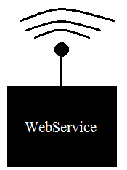
Introduction
WebServices
Web Services are services that are exposed to internet for programmatic access.
You can use online API’s that can be accessed programmatically from code.

Slide 6
Introduction
How do you use API’s in your application?
We put libraries or API in the class path of the application and then use that.
Client App
Library
Library
Library

Slide 7
Introduction
Web Services
In case of web services the services are exposed to client, which can be consumed by the client. Here different piece of code can be deployed on different machines.
Client
Example : Companies like Facebook and twitter creates WebService APIs that can be consumed by different clients.

Slide 8
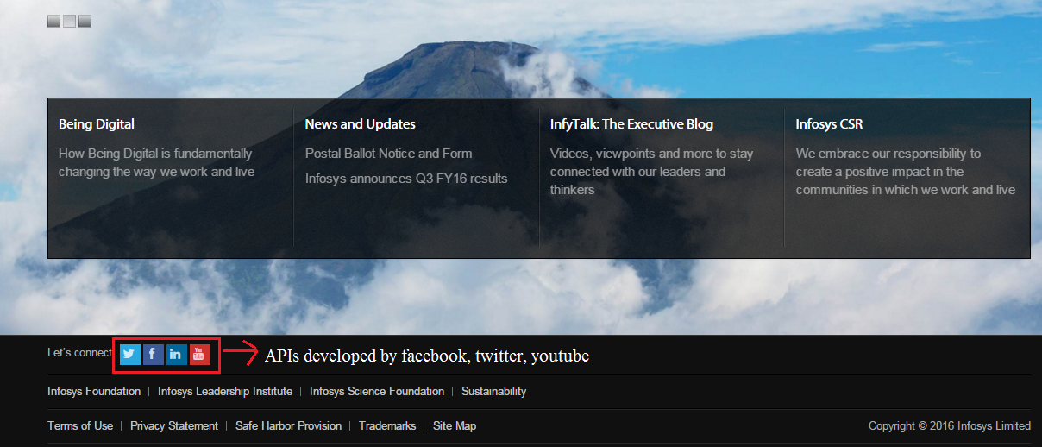
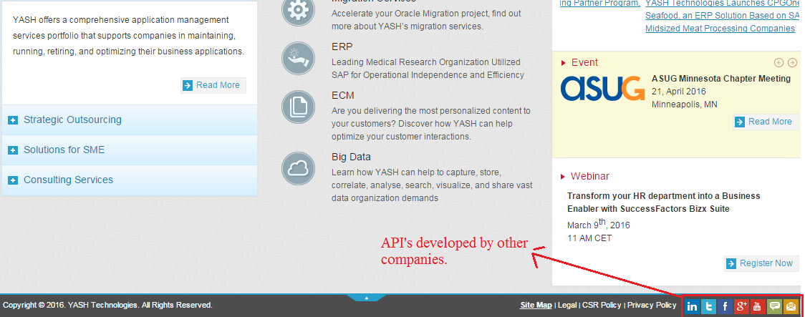
Introduction

Slide 9
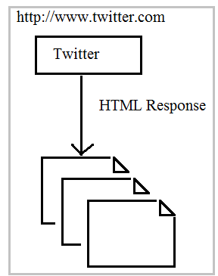
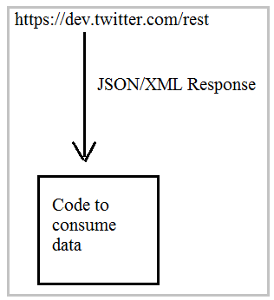
Introduction

Slide 10
Introduction
Web Services Types
REST Web Service
SOAP Web Service
Characteristics of WebService
Service Provided over web
Uses a protocol
Communication Mechanism
Service Definition

Slide 11
Introduction
Characteristics of WebService
Service Provided over web
It provides service over web and so called WebService.
<html>
…..
…..
</html>
Data
Client
Data

Slide 12
Introduction
Characteristics of WebService
Protocol
A rule that is decided between sender and receiver for data transmission.
Server
http request
Client
http response
http is a protocol or message format.
In some web services this protocol has been standarized.
For Example : SOAP (Simple Object Access Protocol)

Slide 13
Introduction
Characteristics of WebService
Protocol
Client
SOAP
SOAP
Protocol
Q: What is the protocol in case of REST?
Ans: None
Client
REST
XML
JSON
Text

Slide 14
Introduction
Characteristics of WebService
How Communication Happens
Ans : Using the HTTP Methods.
GET
POST
PUT
DELETE

Slide 15
Introduction
Characteristics of WebService
Service Definition
Coding in java while using some API. You need to know certain things.
Name of the class that you want to use.
What methods are available.
What are the parameters of methods
What is the return type of methods.
In web service as well you need to know these things.This is known as the definition of the web service.
In SOAP this service definition is represented by WSDL.
If any client wish to use SOAP this WSDL will be made available to him.
Q: What is the standard for REST?
Ans : None

Slide 16
Introduction
Introduction Summary
Messenger App
What is Web Service
Using API in application
Exposing web service to client
Examples of Facebook and twitter
Types of Web Service
Characteristics of Web Service

Slide 17
REST and HTTP
Some important things for designing RESTfull API
Resource Based URIs: In REST API each resource or entity will be identified by resource URIs.
HTTP Methods: Depending on the operation, right HTTP method need to be chosen.
HTTP Status Code: It need to send the Response code to client that will tell whether the request is successfully processed or not.
Message Header: Format of response. [ContentType]
Concept of the REST is very much closely related to HTTP.

Slide 18
REST and HTTP
HTTP (Hyper Text Transfer Protocol)
Using HTTP we exchange the HyperText (A Structured form of text)
HTML is a language to represent the HyperText on the web.
Few Concepts
Resource Location : As web resources has addresses, similarly REST resources do have address.
Response: Web Service response contains data. As HTTP response contains structured HTML

Slide 19
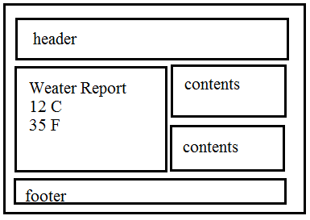
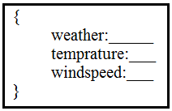
REST and HTTP
Example of Weather Web Application and Weather Web Service
This may contain an HTML page with some CSS and JS
This may contain just the data in JSON/ XML format

Slide 20
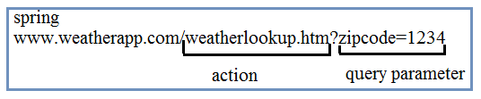
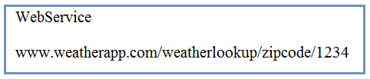
REST and HTTP
Resource Address in Web Application and Web Service
This is action based URI. It says that weatherlookup.htm is an action which takes zipcode as parameter.
This is Resource based URI. It does not give any command. Rather it fetches record which is already available on the server.

Slide 21
REST and HTTP
REST and HTTP Summary
Resource Based URIs
HTTP Methods
HTTP Status Codes
Message Header
Resource Location
Address

Slide 22
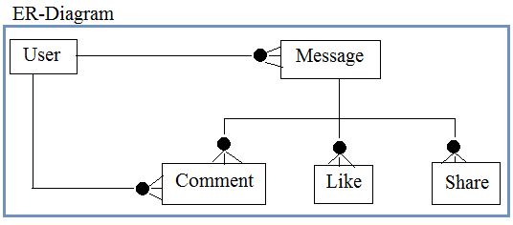
Resource URIs
Learnings
How to design Restful URI for simple Social Media Messenger App.
The Messenger App will have following features.
Post Messages
Comments of Messages
Like and Share Messages
User Profiles

Slide 23
Resource URIs
Suppose we have a web application, and we want to retrieve message of message id 10.
If we have use Spring, then following code snippet will work.
Post Messages
Comments of Messages
Like and Share Messages
User Profiles
@Controller
public void MessageController{
@RequestMapping("/getMessages.htm")
public ModelAndView getMessages(@RequestParam("id") int id){
//code to get message of message id 10 from Business service
}
}
Uri : /getMessages.htm?id=10

Slide 24
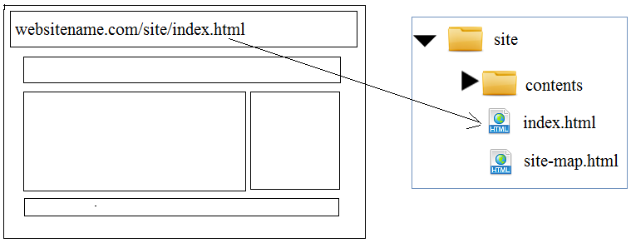
Resource URIs
In Case of RestWeb Service, URIs will be different.
For designing Rest Based URIs we need to follow some best practices.
For understanding the best practice, let’s talk about the static website.
Concept for REST URI will be same. Each REST URI will be unique.

Slide 25
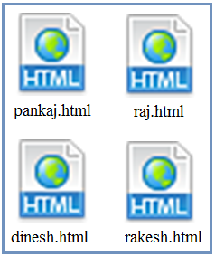
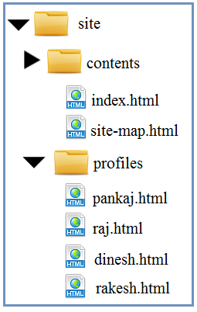
Resource URIs
For example : we want to access all the profiles. If we click on any of the profile, that profile page is dynamically generated.
Imaging if this is the static website having only four profile page.
If I want to access my profile. URI will be:
/profiles/pankaj.html
If we remove .html then it will become Resource Based URI
/profiles/pankaj
If we want to make it generic for any profile.
/profiles/{profileName}

Slide 26
Resource URIs
Some More Example
URI for Messages will be
/messages/{messageId}
/messages/1
Will give message of message id 1
/messages/10
Will give message of message id 10
Some Important Rules for designing URIs
URIs will be Nouns not verbs
URIs will be plural not singlular
/messages/{messageId}
/profiles/{profileId}
URIs will not contain .do, .htm etc, it will not have query parameter.
You don’t need to change it as per the technology

Slide 27
Resource URIs
We will have some other resources in our Messenger App
Comments
Likes
Shares

Slide 28
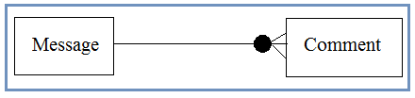
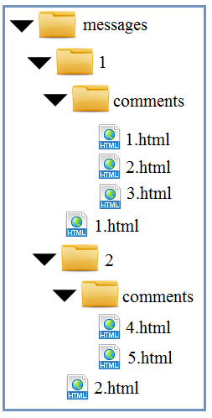
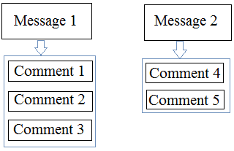
Resource URIs
Resource Relationship
One Message can have multiple comments.
Suppose we have 2 Messages. Message Id 1 is having 3 comments and Message Id 2 is having 2 comments.
/messages/1/comments/1
Generic URI for any comments
/messages/{messageId}/comments/{commentId}
/messages/{messageId}/likes/{likeId}
/messages/{messageId}/shares/{shareId}

Slide 29
Collection URIs
/messages/{messageId}/comments/{commentId}
Knows as Instant URI : A Single instance of a message or a comment is accessible by the instance resource.
Q: What about if we want all messages?
Ans: /messages
This is similar as static site with HTML page. Accessing directory gives you all the contents in that directory.
/messages/2/comments
These type of URIs do not represent single resource, but rather, a collection or list of resources.
So these are known as collection URIs

Slide 30
Collection URIs
Example
/messages
/profiles
/messages/{messageId}/comments
/messages/{messageId}/shares
/messages/{messageId}/likes
Filtering Result
/messages
/messages?offset=30 & limit=10
/messages?year=2016& offset=30 & limit=10
Offset : starting point
Limit: number of records to fetch

Slide 31
Collection URIs
Collection Summary
Two types of Resource URIs
Instance resource URI
Collection resource URI
Query parameters for pagination and filtering collection resource URI

Slide 32
HTTP Methods
URIs
/getMessages.htm?id=10
Action Based
/messages/10
Resource Based
/get Messages .htm?id= 10
Action
Information
Unique resource
/messages / 10
In resource based URIs action is missing. If we provide this URI on address bar then this will return the message of message id 10. What about other operations like edit, or delete etc.
Information
Unique resource

Slide 33
HTTP Methods
URIs
If we provide the action based URIs as
/updateMessages.htm?id= 10
/deleteMessages.htm?id= 10
It clearly tells about the operation being performed. How same resource based URI can perform different operations.
Client will have to use different HTTP methods to perform operations.
GET POST
PUT DELETE

Slide 34
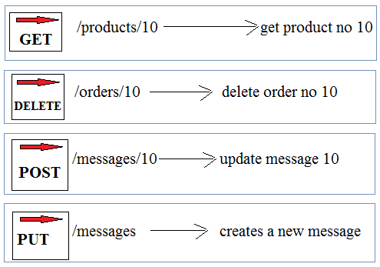
HTTP Methods
HTTP Methods

Slide 35
Idempotence in HTTP Methods
Idempotence is an important property in HTTP methods
PUT
Vs
POST
Difference between put and post would always been a confusion.
This will be clear by the end of this discussion.

Slide 36
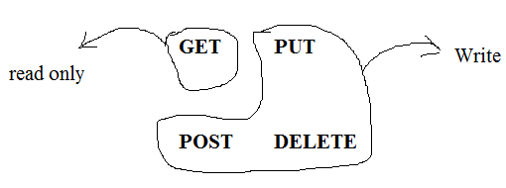
Idempotence in HTTP Methods
Method Classification
PUT, POST, DELETE are write method, they change something on the server. They either create, update or delete, but they all cause something to change on the server.
It is safe to make as many GET request you want, because it does not make any changes.
Can we make multiple request with POST, PUT and DELETE?

Slide 37
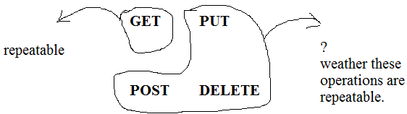
Idempotence in HTTP Methods
Example of assignment statement
count=100;
count=100;
count=100;
Will it make any changes in the final result of the count variable.

Slide 38

Idempotence in HTTP Methods
DELETE
Client
/messages/10
10
If same call is made again, this will do nothing. Because message id 10 is already delete.
So repeated delete request will not have any side effect.
DELETE is repeatable
Message of message id 10 is deleted.

Slide 39

Idempotence in HTTP Methods
PUT
Client
/messages/10
10
If same call is made again, this will do nothing. This will override on the previous message.
So repeated PUT request will not have any side effect.
PUT is repeatable
Message of message id 10 is updated.

Slide 40

Idempotence in HTTP Methods
POST
Client
/messages
10
11
If same call is made again, message will be duplicated and each time new id will be assigned.
POST is not repeatable
This will create a new message and assign on id.

Slide 41
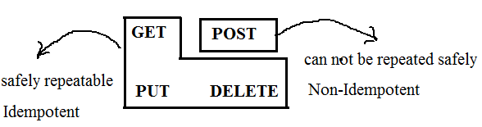
Idempotence in HTTP Methods
Repeatable and non repeatable request methods
Wikipedia definition for Idempotence
“Idempotence is the property of certain operations in mathematics and computer science, that can be applied multiple times without changing the result beyond the initial application.”

Slide 42
REST Response
Response
Client
Request URI
Client
HTML Content
(XML/JSON)
In Web Application Response is sent in the HTML format.
How to send data?
- Data could be in the XML or JSON format.

Slide 43
REST Response
Message Entity
public class MessageEntity{
private long id;
private String message;
private Date created;
private String author;
….
….
}

Slide 44
REST Response
Message Entity
Get response for message id 10 in JSON format!
{
"id":"10",
"message":"Hello World",
"created":"2016-06-01T18:06:36.902",
"author":"Pankaj"
}

Slide 45
REST Response
Message Entity
Get response for message id 10 in XML format!
<messageEntity>
<id>10</id>
<message>Hello World</message>
<created>2016-06-01T18:06:36.902</created>
<author>pankaj</author>
</messageEntity>
Note: Same message can be represented in different format. In Rest we transfer different state of Representations of data, hence it is called REST.

Slide 46


REST Response
How client will know which format can be demanded?
XML Pleas
No
JSON
ANS: Using Http Method
Headers
Message Length
Date
Content Type
Message Body

Slide 47
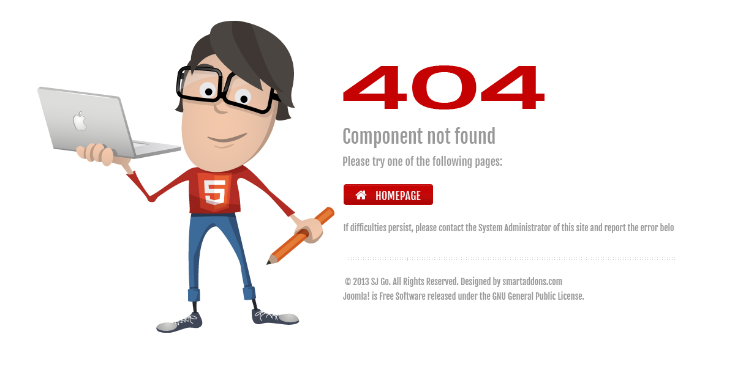
Status Code
In case of Web application if any error is there server will report those errors.
What will happen in case of web service?

Slide 48
Status Code
1XX - Informational
2XX - Success
3XX - Redirectional
4XX - Client Error
5XX - Server Error
2xx Status Codes
200 OK
201 Created – Created Ack
204 No Content – for Delete Request

Slide 49
Status Code
3xx Status Codes
302 Found
307 Temporary Redirection
304 No Modified
4xx Status Codes
400 Bad Request
401 Unauthorized
403 Forbidden
404 Not Found
415 Unsupported Media Type

