Slide 1
VEDAKARNA
SALES DASHBOARD
A visual overview of sales performance, profit, quantity,
payment modes and product/category trends
POWER BI REPORT PRESENTATION
Dashboard walkthrough • Key metrics • Business insights
Prepared from the supplied Power BI dashboard screenshot

Slide 2
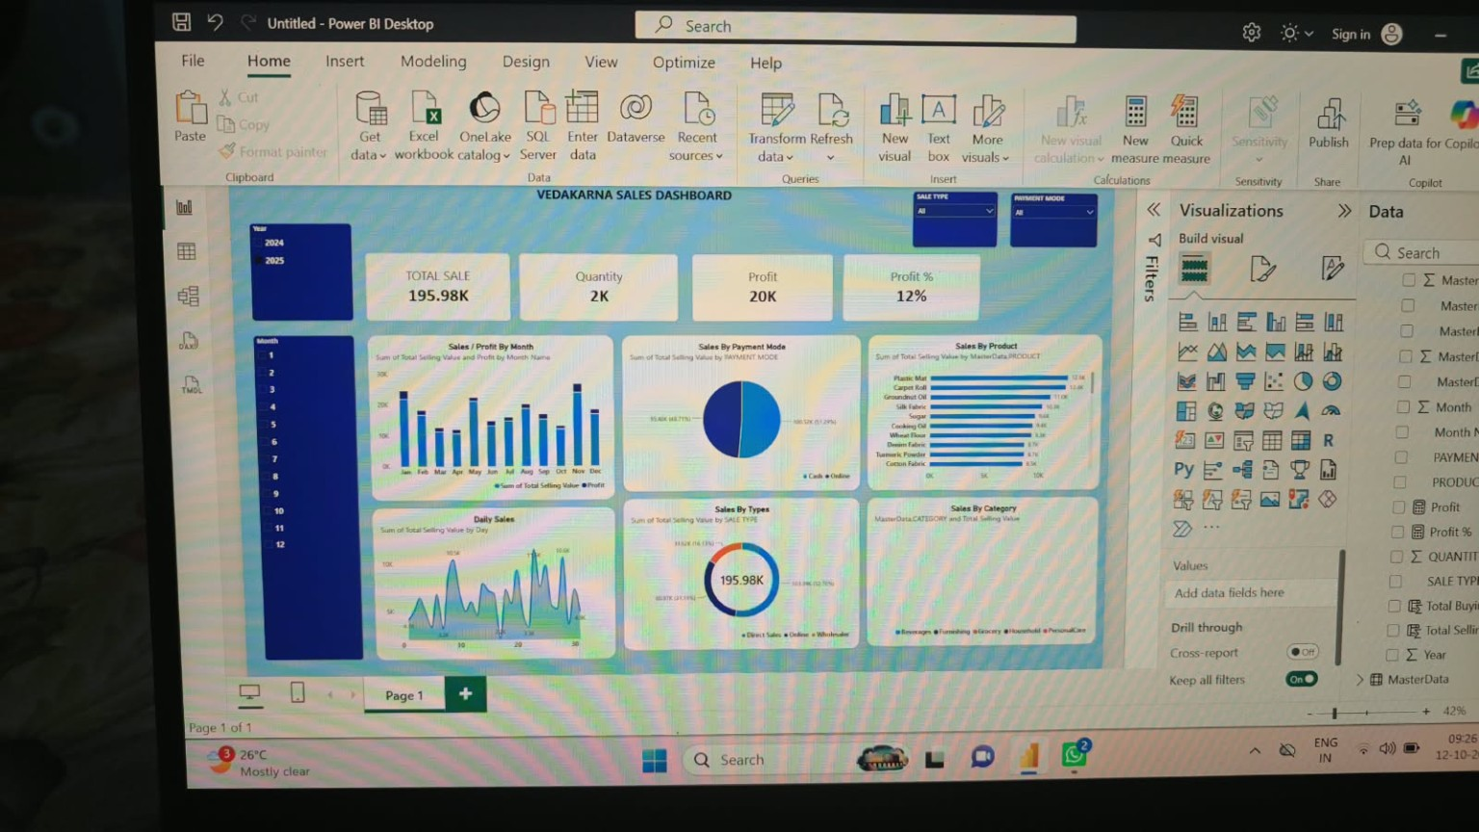
Dashboard at a Glance
The report combines headline KPIs with time, product and sales-type visuals.
Filters visible: Year, Month, Sale Type and Payment Mode
02

Slide 3
Headline Performance Indicators
The KPI cards provide a quick summary before exploring the detailed charts.
TOTAL SALE
QUANTITY
PROFIT
PROFIT %
195.98K
2K
20K
12%
Displayed sales total
Total quantity indicator
Displayed profit total
Profit percentage card
How to explain these KPIs in a viva or presentation
• Total Sale: the overall sales value shown by the dashboard.
• Quantity: the total number of units represented in the report.
• Profit: the profit value displayed for the selected filters.
• Profit %: a percentage measure used to assess profitability.
Note: figures are transcribed from the screenshot; filters may change the displayed values.
03

Slide 4
What Each Visual Tells Us
Use the charts together to understand when sales happen and what drives them.
Sales / Profit by Month
Sales by Payment Mode
Sales by Product
Compares monthly sales value with profit. Use it to identify stronger and weaker months.
Shows how sales are split between payment methods such as cash and online.
Ranks products by sales value so high-contributing products stand out.
Daily Sales
Sales by Types
Sales by Category
Shows day-wise movement and fluctuations, helping reveal peaks and low-activity days.
Summarises the mix of sales types in a circular visual.
Provides a category-level view to compare contribution across product groups.
04

Slide 5
Filters & Interactive Exploration
Slicers let the viewer focus on a specific period or transaction segment.
1
Year
Select 2024 or 2025 to compare periods.
2
Month
Choose a month to focus the charts on that period.
3
Sale Type
Filter by the type of sale represented in the data.
4
Payment Mode
Focus on a particular payment method, such as cash or online.
Presentation tip: change one filter at a time and explain how the KPI cards and charts respond.
05

Slide 6
KEY TAKEAWAYS
From data to decisions
01
Start with the KPI cards to understand the overall performance snapshot.
02
Use monthly and daily charts to examine sales patterns over time.
03
Use product and category visuals to compare contribution across items.
04
Apply slicers to investigate specific years, months, sale types and payment modes.
Thank You
Questions & discussion

