Slide 1
Three Ways to Miss a Grasp: Figures and Tables
Anish Talla, 2026-2027

Slide 2
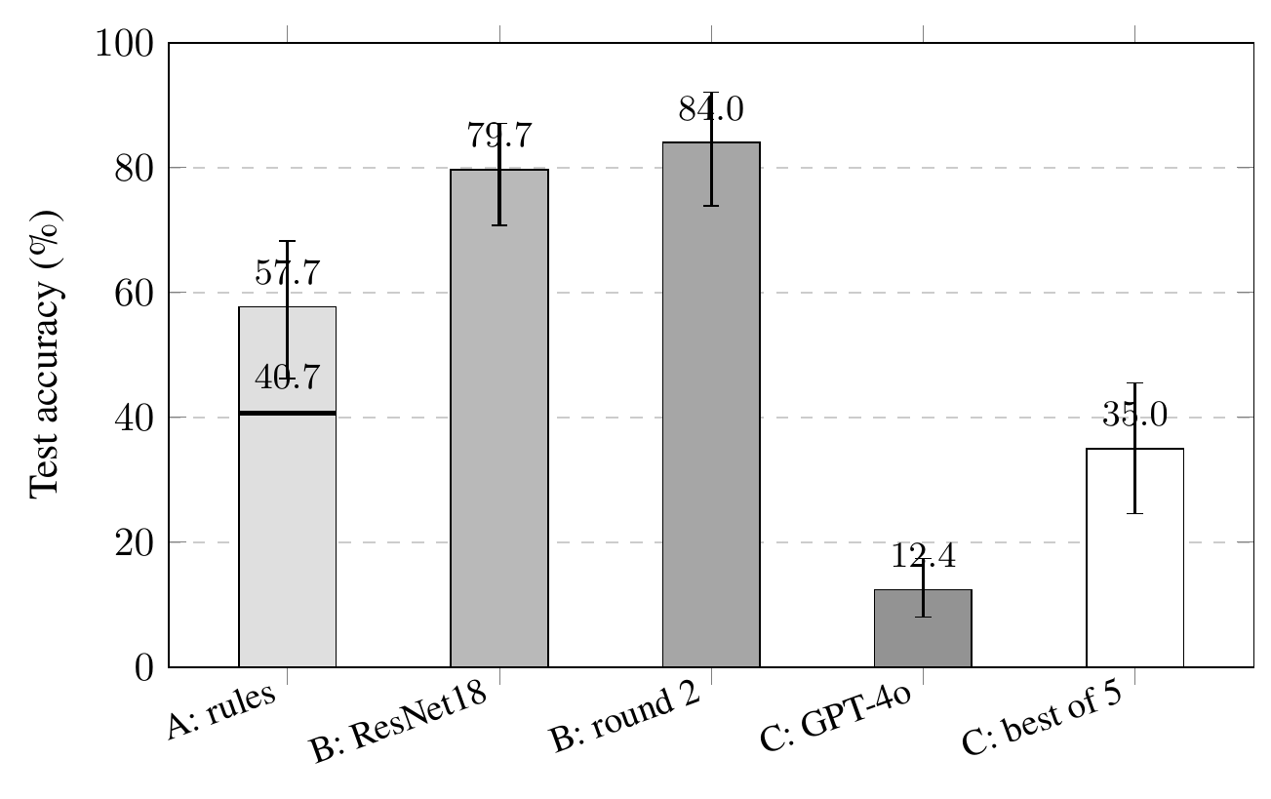
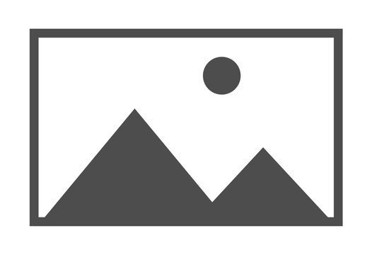
Figure 1. Test accuracy with 95% intervals from resampling whole objects. The line across the System A bar marks its 40.7% score before the fix. "B: round 2" is the ResNet34 average over three seeds. "C: best of 5" needs five calls and a way to know which one is right.

Slide 3
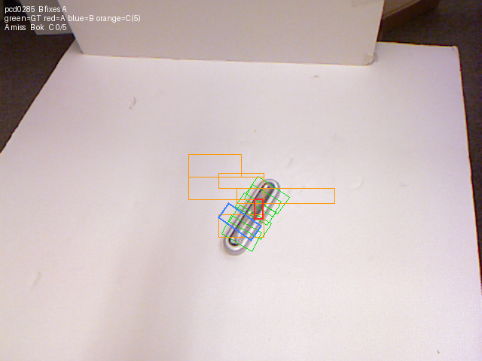
Figure 2. One test photo with every system's answer. Labeled grasps are green, System A is red, System B is blue, and System C's five calls are orange.

Slide 4
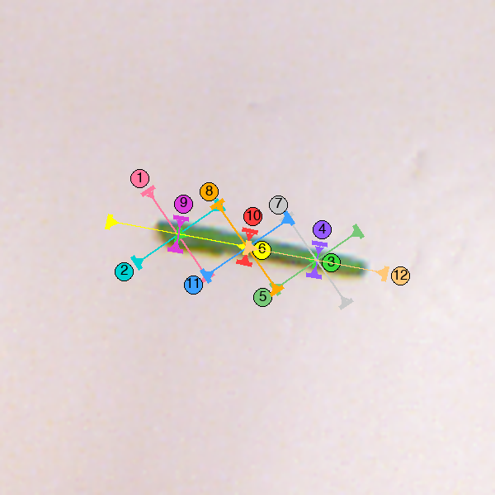
Figure 3. A test photo as System D saw it, with twelve numbered candidates. GPT-4o chose mark 6, the grasp along the bean near its end, on all five calls. Mark 10 crosses the bean at its center and is correct.

Slide 5
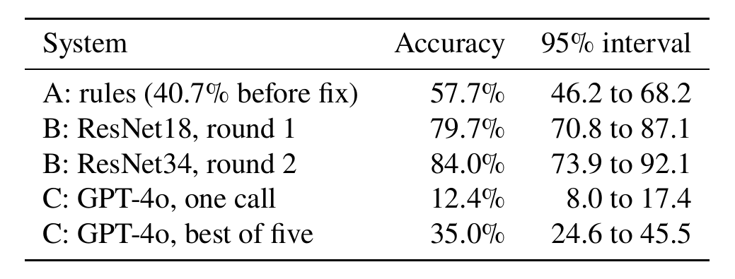
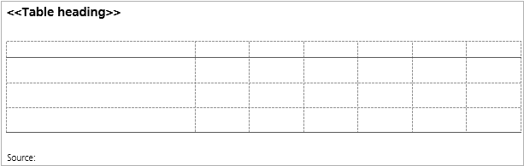
Table 1. Test accuracy with 95% confidence intervals from resampling whole objects.

Slide 6
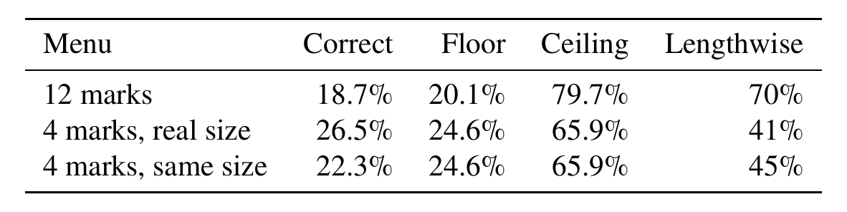
Table 2. System D on three sets of candidates. Lengthwise is the share of calls that chose a grasp closing along the object's length.

