Slide 1
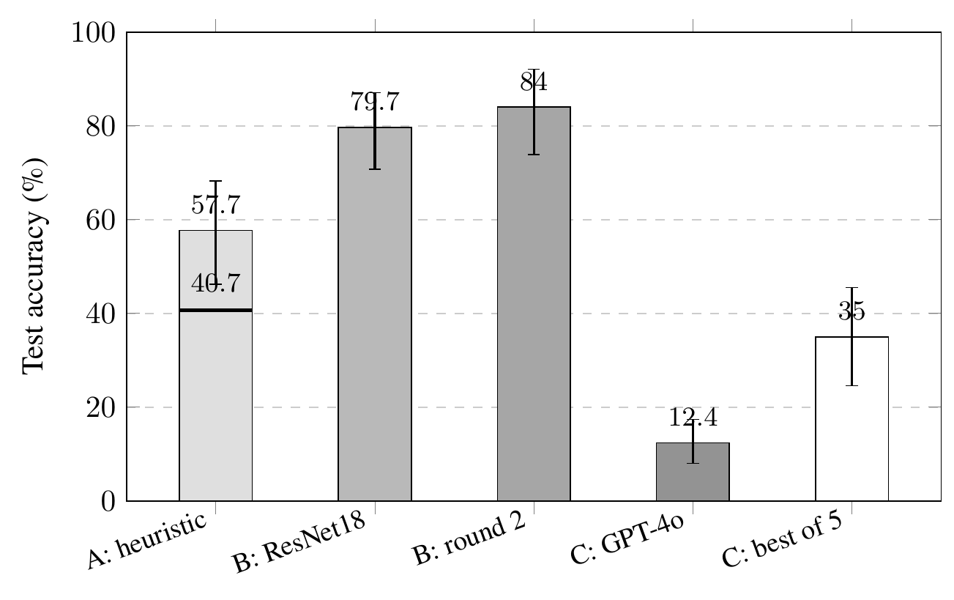
Figure 1. Test accuracy with 95% object-clustered confidence intervals. The horizontal rule on the System A bar marks its 40.7% pre-correction score. 'B: round 2' is the three-seed ResNet34 mean; 'C: best of 5' needs five calls and an oracle.

Slide 2
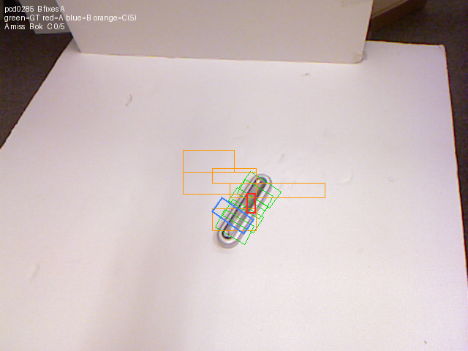
Figure 2. One test image in the shared coordinate frame. Labeled grasps are green, System A red, System B blue, and System C's five repeats orange.

Slide 3
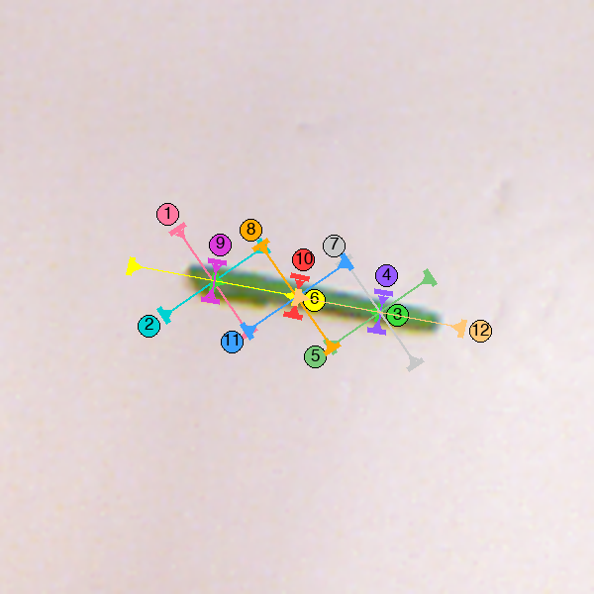
Figure 3. The marked image for one test object as System D saw it on the twelve-mark menu. The model chose mark 6, the end pinch along the bean, on all five repeats. Mark 10 crosses the bean at its center and passes the metric.

