Slide 1
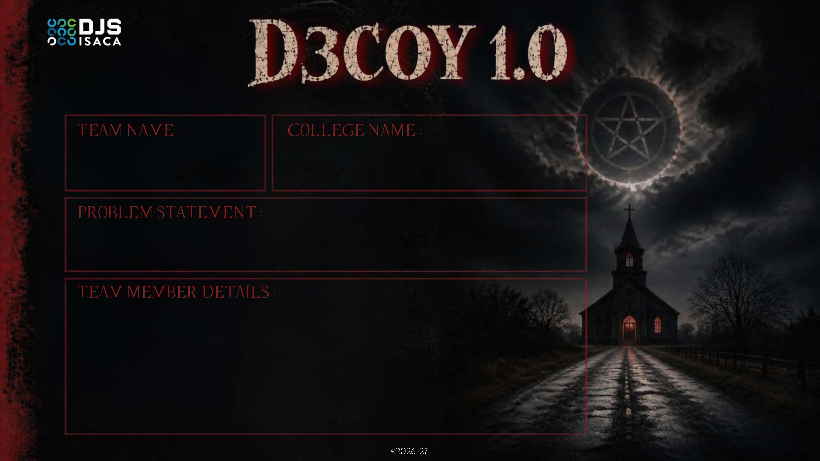
CTRL FREAKS
CHENNAI INSTITUTE OF TECHNOLOGY
Chennai, Tamil Nadu
Identity Drift Detection in Autonomous AI Agents
AI agents carry their own tokens and permissions. Access control checks whether an identity is allowed to act — never whether it still behaves like its role. A hidden prompt, a poisoned tool or a stolen token can hijack an agent while every check passes.
01
KAMESHWARAN B
+91 72008 05541
02
VS ANISHWATH
+91 88255 14383
03
LIKITH KRISHNA J
+91 92823 26251
04
SRI AARUSH TEJ
+91 86376 61221

Slide 2
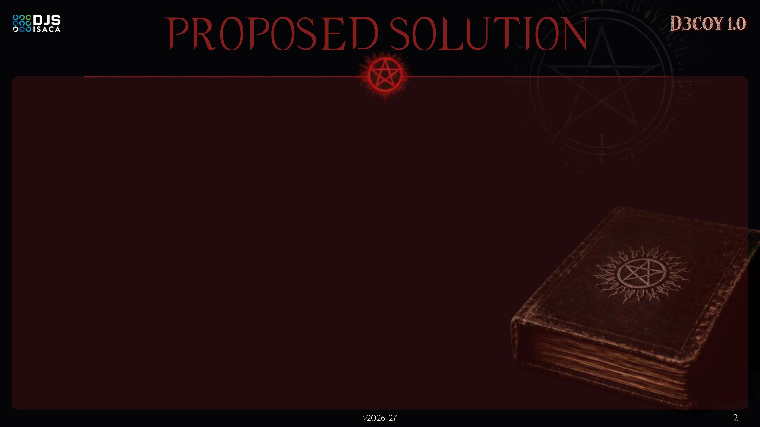












PROBLEMS FACED
SentinelTrace watches what an agent does — not just what it is allowed to do.
Agent Fleet
Capture
Behaviour AI
Drift Score
Prompt Injection
hidden instruction in a document
• Agents A · B · C
• Docs, tools & APIs
• Signed role contract
• Owner-approved scope
• Every action logged
• Trusted / untrusted tag
• Provenance lineage
• No agent code change
• Per-role sequence model
• Embedding similarity
• Resource-access graph
• Rolling-window baseline
• Role conformance
• Behavioural novelty
• Untrusted-content signal
• Fused into 0 – 100
Agent leaks data — token still valid
Poisoned Tool
malicious plugin / API response
Dashboard
Containment
Explain
Chain Risk
Tool calls redirected to attacker
Live scores, reasons & full audit trail
LOG
Names the exact action, mismatch and trigger event
Agent A calls B → B inherits a share of A's risk
Stolen Token
APPROVE
credentials replayed by attacker
ISOLATE
Attacker acts as a trusted agent
Live Drift Score — Agent B
Attack caught in 3 steps
Novelty & Uniqueness
Limitations of existing solutions
1
Reads untrusted PDF
Behaviour, not just tokens
Chain-aware risk propagation
provenance: untrusted
• IAM checks the token, never the behaviour
• Static RBAC can't see a role drifting
• Anomaly tools give black-box scores
• Kill-switch response halts the whole fleet
2
Calls export_data()
outside role contract
Plain-language explanations
Graduated, not kill-switch
3
Sends to unknown domain
new access-graph edge
Score 88 → auto-isolated

Slide 3
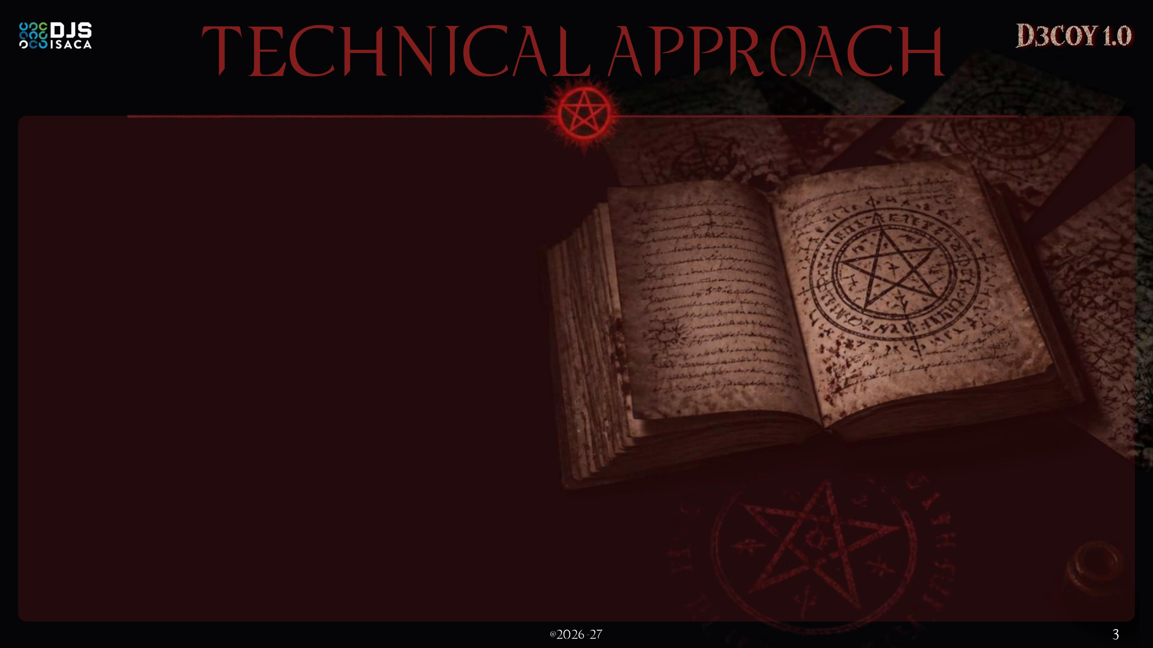






















ZONE 1
Agent Ecosystem
ZONE 2
Telemetry Layer
ZONE 3
Detection Engine
ZONE 4
Scoring & Response
Implementation Process
1. Simulate
Agent A
role: Research
Action Interceptor
SDK hook / proxy on every call
Role Conformance
action vs signed contract
Risk Fusion (0–100)
R = 0.40·Role + 0.35·Novelty + 0.25·Provenance
+ α · upstream risk (propagation)
3–5 agents · normal + injected-attack logs
Agent B
role: Finance
Sequence Anomaly
Isolation Forest / OC-SVM
2. Baseline
Event Log
time-stamped JSONL stream
fit per-role sequence & access models
Agent C
role: Ops
OPA Policy Bands
Semantic Drift
sentence-transformers + FAISS
0–39 LOG
3. Score
Inputs
Provenance Tagger
trusted vs untrusted source
40–69 APPROVE
fuse 3 signals + rule layer → 0–100
70–100 ISOLATE
Access Graph
new edge = novelty
4. Respond
Docs
Tools
APIs
Streamlit Dashboard
live scores + reasons
OPA bands + risk propagation
Role Contract
signed: tools, data, flows
Feature Builder
n-gram sequences + embeddings
Rule Layer
sensitive act ≤ N steps after untrusted read
Audit Log
every score & signal kept
5. Demo
clean run vs attack run, side by side
containment fed back to the agent: log · pause for approval · sandbox
TECH
STACK
Python
core
sklearn
IF / OC-SVM
PyOD
outliers
SBERT
embeddings
FAISS
vector search
OPA
policy
Plotly
charts
Streamlit
dashboard

Slide 4







Technical Feasibility
Deployment Viability
Feasibility
Analysis
Proven open-source ML only — Isolation Forest, One-Class SVM, SBERT, FAISS. No custom training, no GPU.
Docker sidecar that scales out per fleet; one hook plugs into any agent framework.
Viability /
Scalability
Economical Feasibility
Economic Viability
₹0 licence cost — 100% open-source. Prototype runs on one CPU-only laptop (8 GB RAM); a pilot needs one small VM.
No cloud lock-in, no per-seat licences; CPU-only scoring stays cheap at scale.
Operational Feasibility
Security Viability
Sidecar beside existing IAM — agents only need a logging hook. Built in 24 hrs with 3–5 simulated agents.
Logs stay on-prem, only drift patterns leave; every decision is audit-logged.
Challenges
Mitigations
SWOT ANALYSIS
Cold start for brand-new agents
Role-template baseline pooled from similar agents
Strengths
Weaknesses
Opportunities
Threats
False positives stop real work
Graduated response: log → approve → isolate
• Identity + behaviour in one score
• Explainable, fully open-source
• Works with any agent framework
• Needs history to baseline
• Demo uses synthetic logs
• Weights need per-org tuning
• Prompt injection is #1 in OWASP Top 10 for LLM apps
• Agent fleets growing fast
• New AI-governance rules
• Slow, low-noise attackers
• Big vendors adding features
• Alert fatigue if mis-tuned
Legitimate behaviour evolves
Rolling-window re-baselining keeps models current
One weak signal is noisy
Multi-signal fusion — no single signal decides

Slide 5









Potential Impact on Target Audience
Impact on Target Organisation
Enterprise SOC Teams
AI / MLOps Teams
1
Closes the blind spot
flags hijacked agents whose tokens are still valid
Fewer, clearer alerts that name the exact action and trigger.
Ship autonomous agents with a behavioural safety net.
2
Stops injection exfiltration
untrusted doc → sensitive action → external host
BFSI & Healthcare
Govt & Defence IT
SentinelTrace
prototype
3
Contains only the bad agent
the rest of the fleet keeps working
Stops silent data exfiltration from regulated systems.
Catches hijacked agents even with valid credentials.
4
Audit-ready AI governance
every score and signal is logged
Traditional IAM
SentinelTrace
Key Benefits
What it checks
Token & permissions only
Token + live behaviour
Cuts alert fatigue
act on an alert, not triage it
Real-time detection
every action scored live
Keeps work moving
only the bad agent is isolated
Hijacked agent, valid token
Passes silently
Flagged in real time
Alert quality
None / black-box score
Plain-language, per signal
Audit-ready
full trail for AI governance
Low cost
open-source, CPU-only
Framework-agnostic
one hook, any agent stack
Response
Revoke all, manually
Log → approve → isolate
Multi-agent chains
Blind
Risk propagates downstream
Aligned with OWASP LLM Top 10 · NIST AI RMF · DPDP Act 2023 · SDG 9 & 16

Slide 6
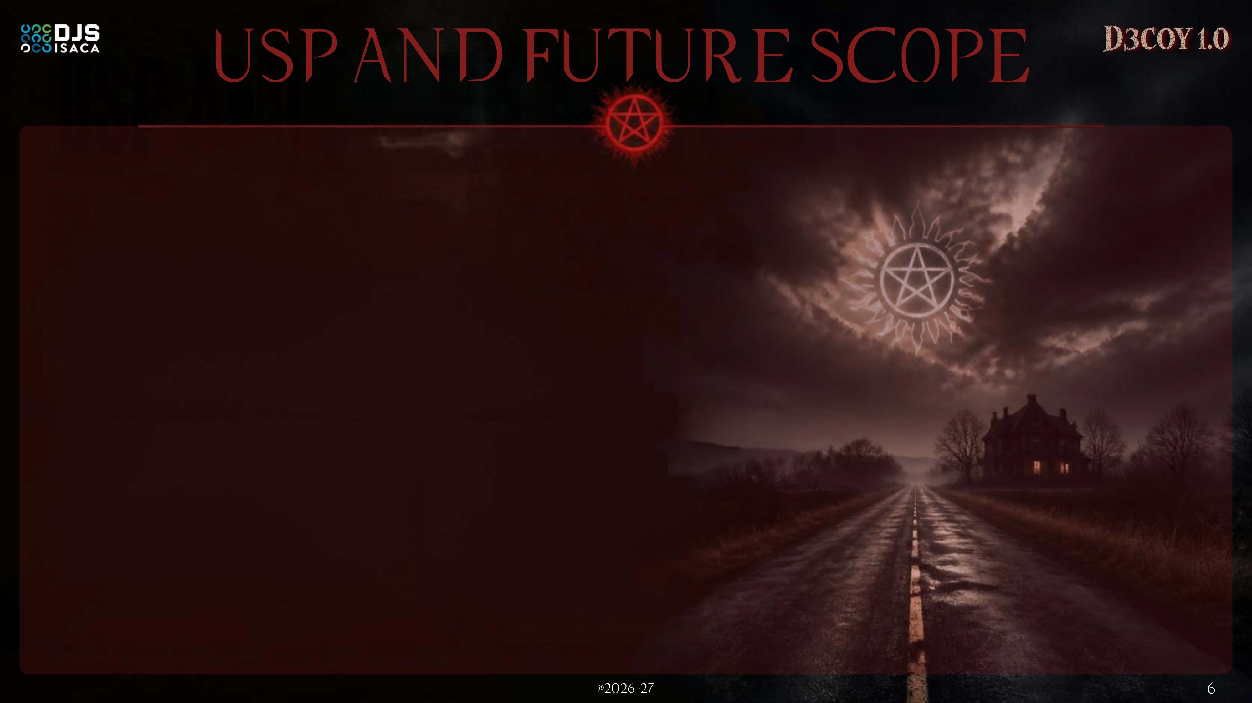







UNIQUE SELLING PROPOSITION
FUTURE SCOPE — from hackathon to platform
Most tools ask “is this token valid?”
SentinelTrace asks “is this agent still acting like its role?”
Phase 0 · Hackathon
3–5 simulated agents · 3 fused signals + rule layer · live Streamlit dashboard
24 hrs
Month 1–3
Phase 1 · Pilot
1 real agent fleet · tune thresholds on real data · target < 5% false-positive rate
Behaviour-aware identity
live actions measured against a signed role contract
Chain-aware
Month 4–6
Phase 2 · Integrate
MCP & A2A tool-call hooks · LangChain / AutoGen adapters · ready-made OPA policy packs
one compromised agent can't hide behind another's clean record
Explainable by design
Phase 3 · Standardise
Adopt emerging agent-identity standards (OAuth, SPIFFE-style workload IDs) instead of a custom role format
every alert names the action, mismatch and trigger
Month 7–12
Graduated containment
log → approve → isolate, never an all-or-nothing kill switch
Year 2
Phase 4 · Federate
Cross-org threat intel: share drift patterns, never raw logs · SaaS + on-prem editions
Open & pluggable
100% open-source; swap any signal without a rebuild
TARGET METRICS
A
risk 88
B
risk 53
C
risk 32
< 1 s
scoring per action
< 5 %
false positives post-pilot
100 %
alerts explained
0
raw logs shared
A calls B calls C — each inherits a share of upstream risk

