Slide 1

Predictions for COVID-19 by GNTM_team
Data Science in Techno-Socio-Economic Systems, ETH Zürich, 2020
Dimitrios Gkouletsos
Athina Nisioti
Marina Panteli
Chrysa Papadopoulou
Iliana Papadopoulou

Slide 2
Presentation Outline
Motivation for taking part in the Epidemic Datathon
Biological assumptions for Covid-19 & Focal groups
Data pre-processing
Characteristics of chosen models
Conclusions

Slide 3
Participation Motivation
The pandemic has undoubtedly been the defining characteristic of 2020:
Afflicted the entire planet
Ignited interest in the scientific community
Passion for Data Science (using prior experience and continuing to learn)
Chance to contribute in the scientific sphere during these seemingly ‘unpredictable’ times

Slide 4
Covid-19: Assumptions
Nature of Covid-19
Subpopulations (cumulative)
No chance of reinfection
Symptoms can be expressed within 14 days of contracting infection
Critical condition patients: 5% of cases
Infected
Recovered
Deceased
Critically ill
All countries (provinces/states)

Slide 5
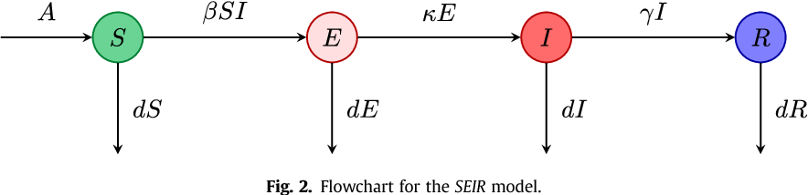
Rejected models for predictions
Epidemiological model e.g. SEIR
Reason for rejection: estimation of parameters incredibly challenging, especially because of insufficient information (e.g. initial stochasticity)
S
E
I
R

Slide 6
Data Preprocessing
Data used from the “John Hopkins Repository”
Cleaning of the dataset (removal of irrelevant features and countries with non-reasonable values)
Aggregation of all the cities/ sub-regions to acquire total cases for states
Concatenation of the global dataset with the US dataset
Complete training set

Slide 7
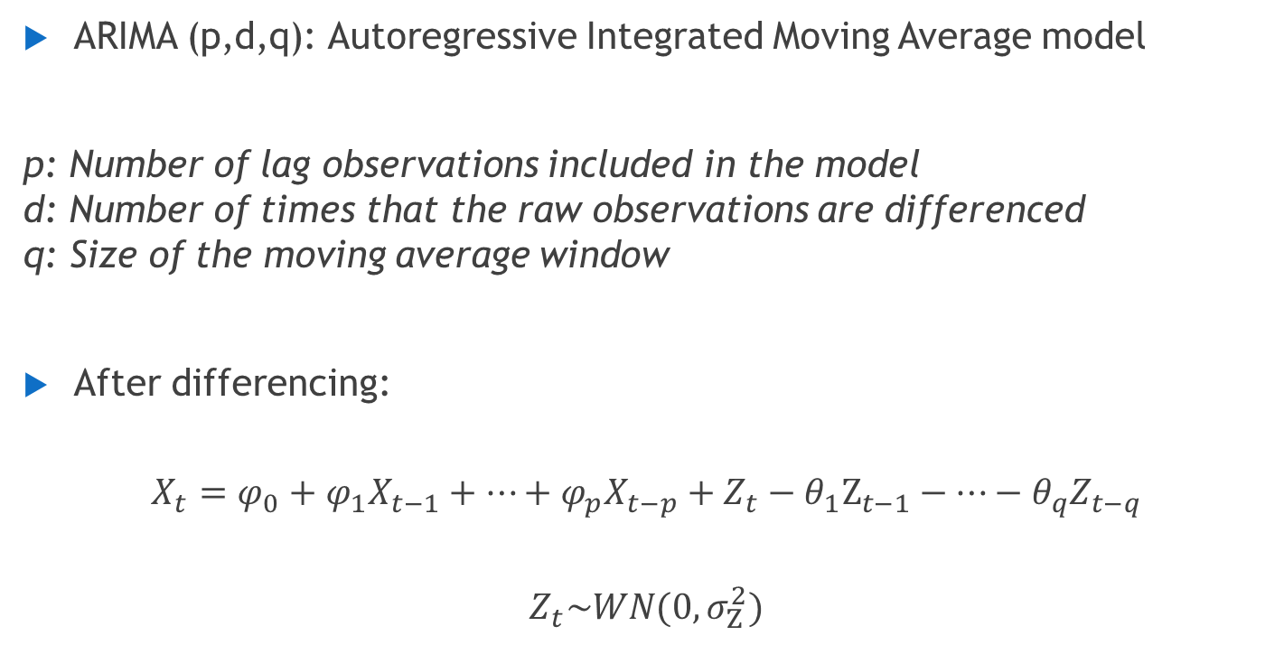
ARIMA: Characteristics
ARIMA (p,d,q): Autoregressive Integrated Moving Average model
p: Number of lag observations included in the model d: Number of times that the raw observations are differenced q: Size of the moving average window
After differencing:
$$X_{t}=φ_{0}+φ_{1}X_{t−1}+…+φ_{p}X_{t−p}+Z_{t}−θ_{1}Ζ_{t−1}−…−θ_{q}Z_{t−q}$$
$$Z_{t}\sim WN(0,σ_{Ζ}^{2})$$

Slide 8
ARIMA: Parameter estimation
Our dataset: cumulative cases → Non-stationary timeseries
Augmented Dickey - Fuller statistical test in α=0.1 to estimate d
Estimation of remaining ARIMA parameters → Akaike information criterion (AIC)

Slide 9
Random Forest
Training Dataset
Subset 1
Subset 500
Tree 1
Tree 500
( … )
Main Structure:
Consists of Regression Trees. Each tree spits out a prediction.
Builds independent parallel model
Data Preprocessing:
Primary Advantages:
Desired properties: Low-variance predictions and avoids overfitting
( … )
Covid Data
Lagged Transformation
Stationary Time Series

Slide 10
Random Forest
Features
`
Samples
…
…
…
Hyper-Parameters:
Number of trees = 500 → Tradeoff between performance - complexity
Bootstrapping:
Utilize a subset of samples for each tree (with replacement)
Random Subspace Method:
Select randomly a portion of features for each tree

Slide 11
Random Forest
Test Samples
Tree 1
Tree 2
Tree 500
( … )
Feed future days (test samples) into Random Forest model
Each tree produces an independent prediction
Random Forest Final Prediction: Average of all tree predictions
Prediction 1
Prediction 2
( … )
Prediction 500
Average all Tree-Predictions

Slide 12





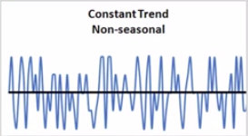
Exponential Smoothing
Forecast future values using a weighted average of all previous values in series
Level
Seasonality
Trend
Advantages
Popular
Cheap to compute
Easy to apply
Noise
Assumptions
Adaptivity
Robustness
Continuity
More emphasis to recent history
$$α$$

Slide 13
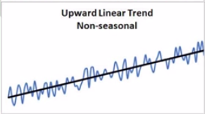

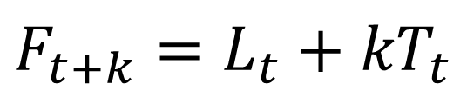
Holt’s Exponential Smoothing
Level
Different α,β
for each country
Trend
Noise
# steps in future
$$F_{t+k}=L_{t}+{kT}_{t}$$
recent trend
most recent estimated level
Update level
Update trend
$$L_{t}=αY_{t}+\left(1−α\right)\left(L_{t−1}+T_{t−1}\right)$$
$$T_{t}=β\left(L_{t}−L_{t−1}\right)+\left(1−β\right)T_{t−1}$$

Slide 14



Model Averaging
Not a single forecast
Reduction of risk of choosing the wrong hypothesis
Reduction of error variance of forecast
Average
ARIMA
DES
RF
“The accuracy of the combination of various methods outperforms, on average, the specific methods being combined and does well in comparison with other methods.”
Makridakis and Hibon (2000)

Slide 15
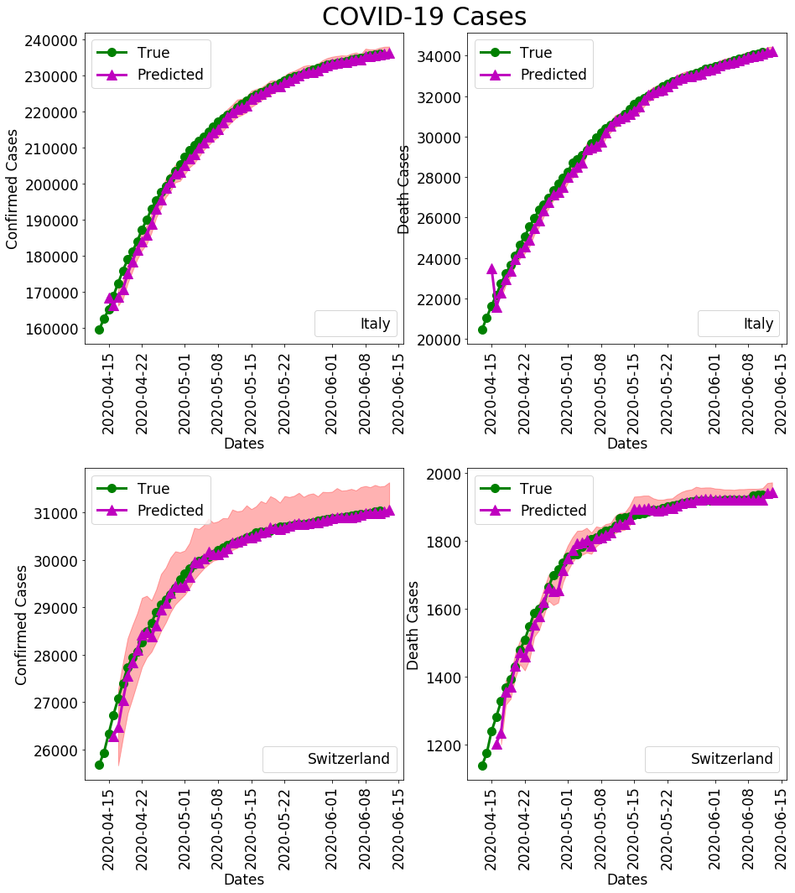
2-day Prediction
Italy
Switzerland

Slide 16
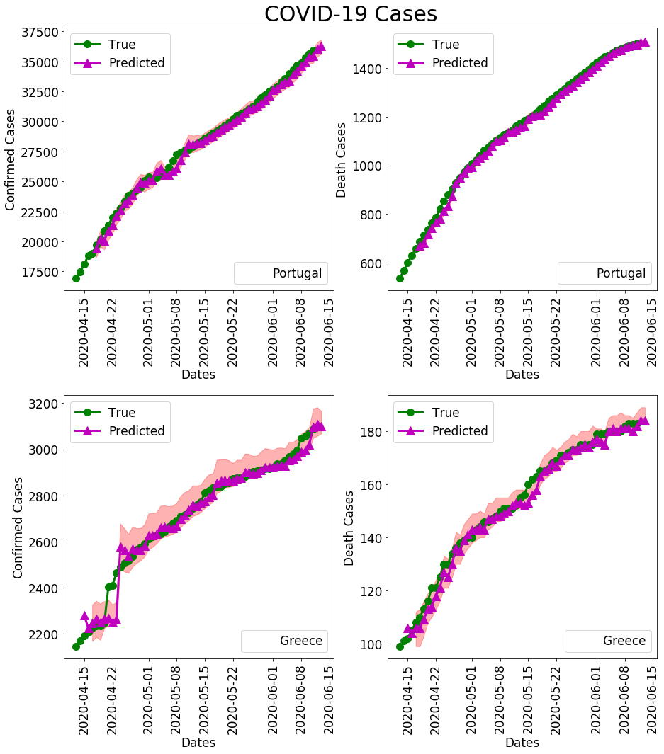
2-day Prediction
Portugal
Greece

Slide 17
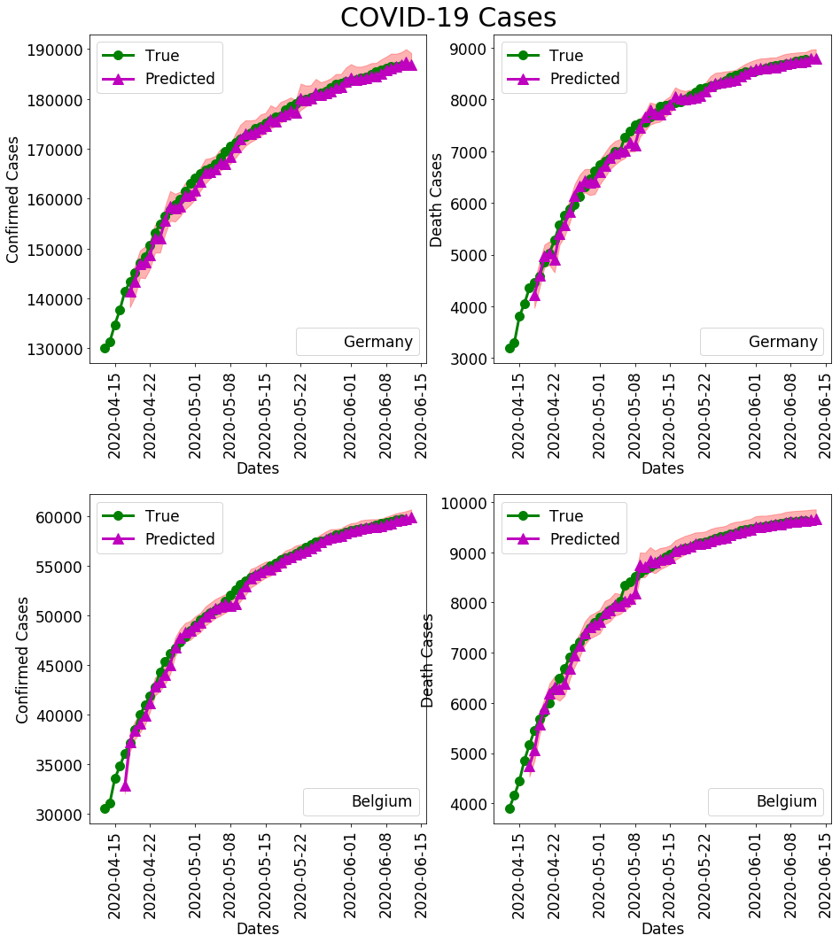
2-day Prediction
Germany
Belgium

Slide 18
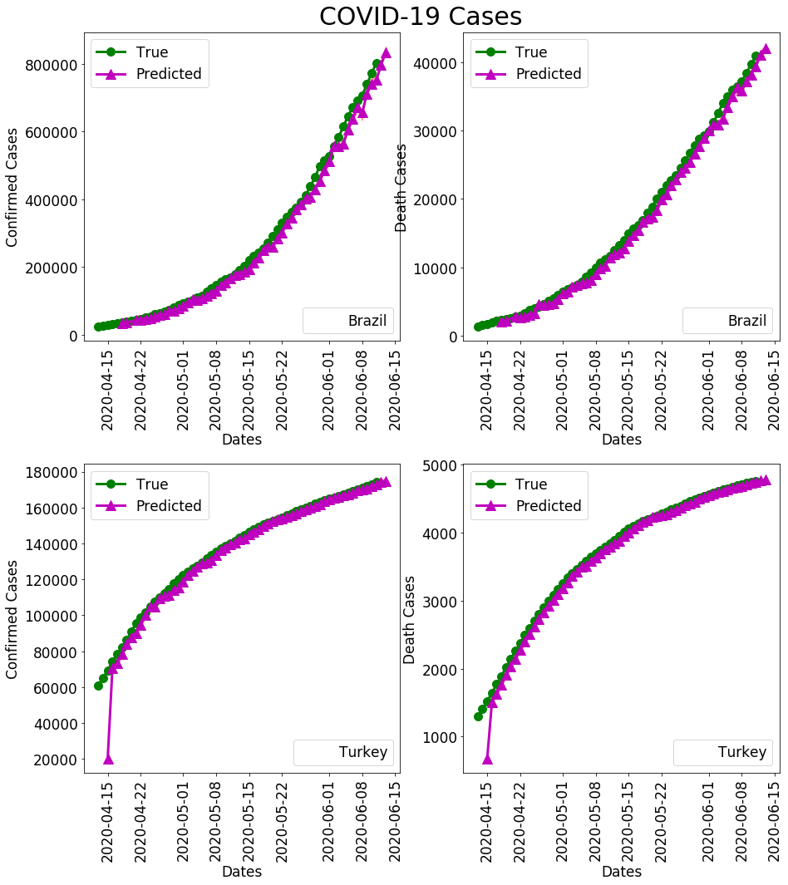
2-day Prediction
Brazil
Turkey

Slide 19
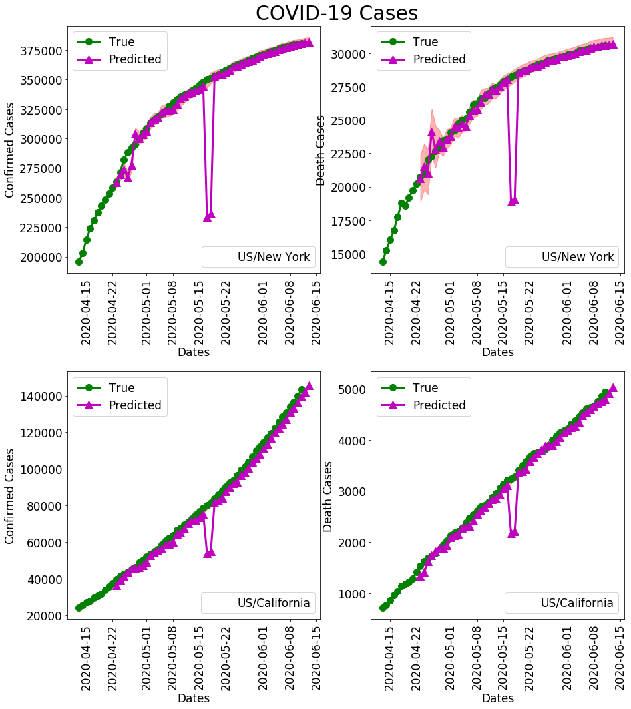
2-day Prediction
New York
California

Slide 20
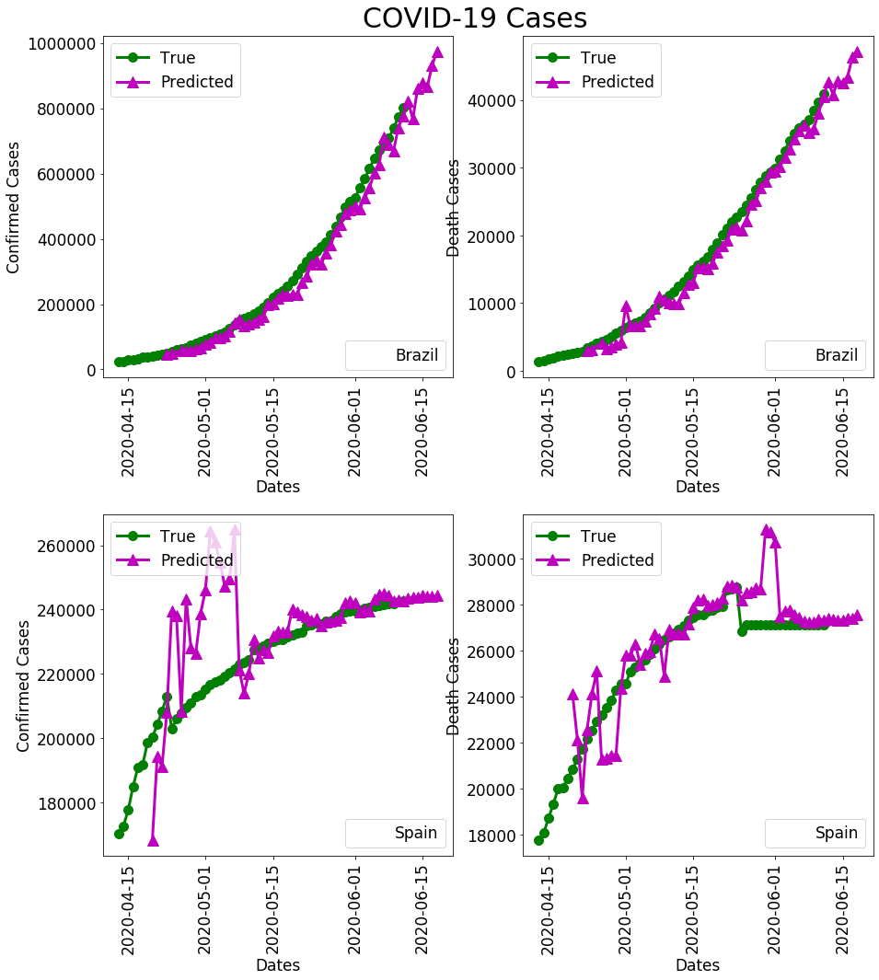
7-day Prediction
Brazil
Spain

Slide 21
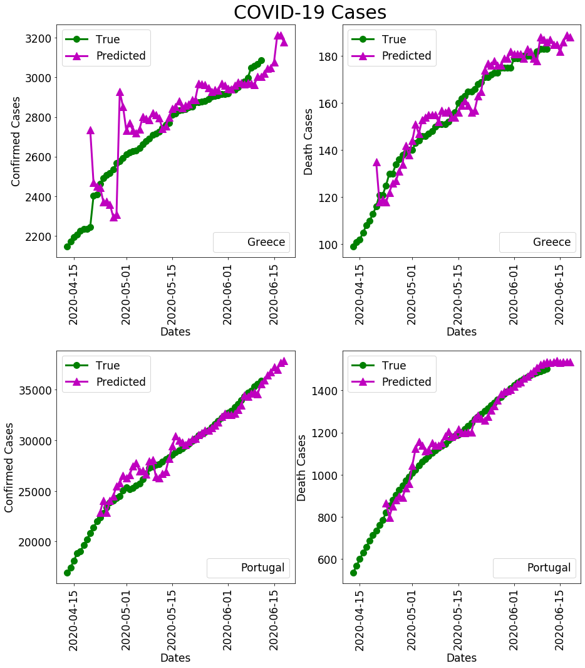
7-day Prediction
Greece
Portugal

Slide 22
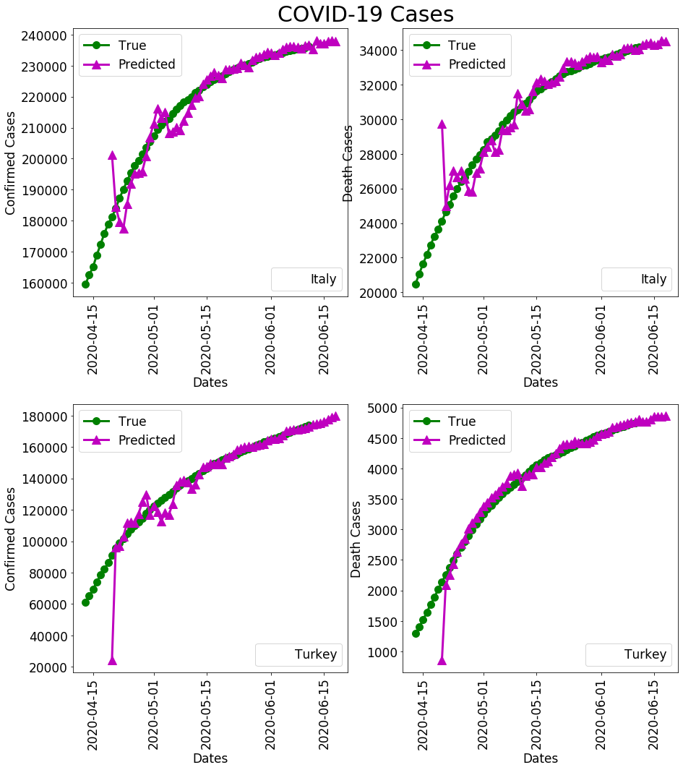
7-day Prediction
Italy
Turkey

Slide 23
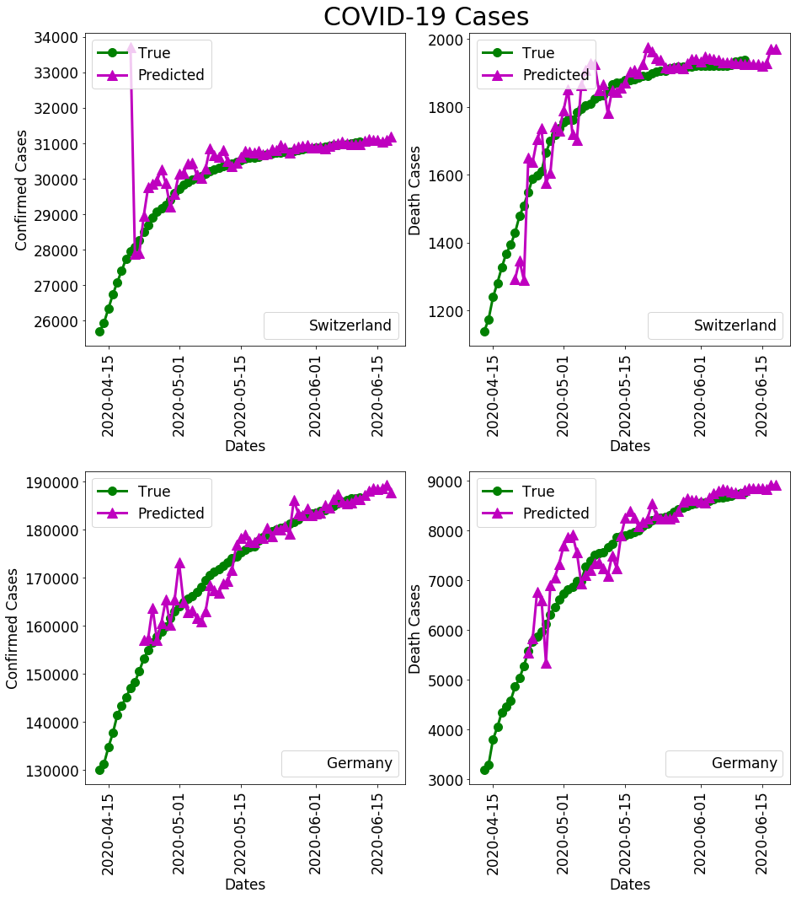
7-day Prediction
Switzerland
Germany

Slide 24
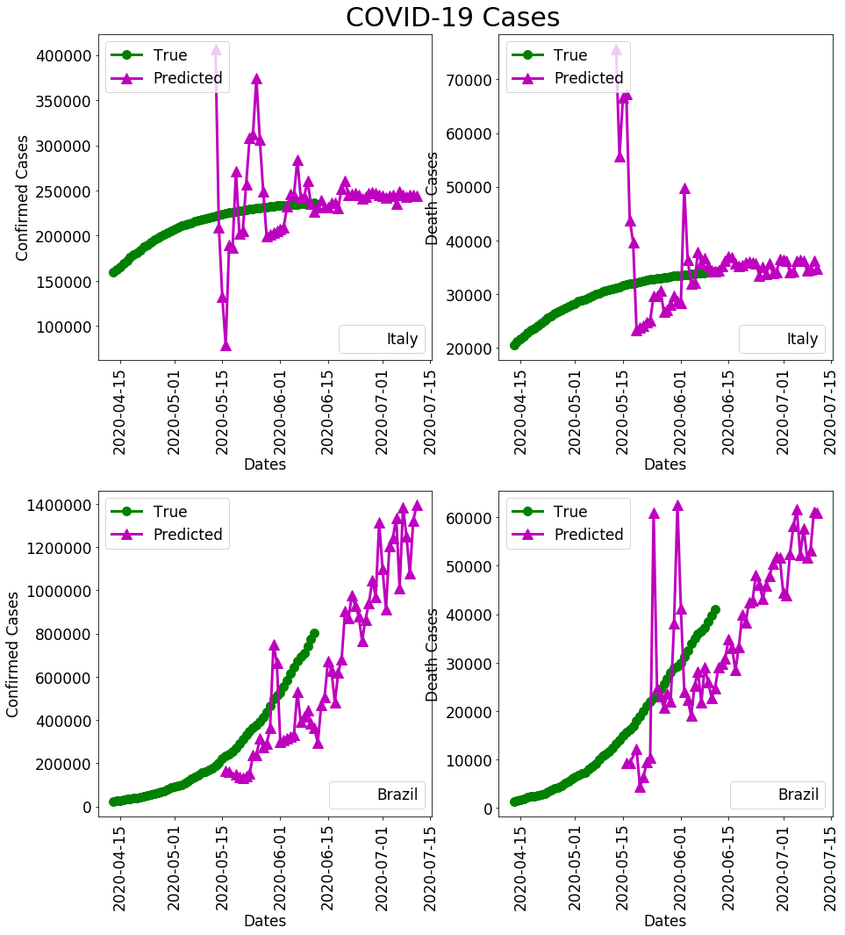
30-day Prediction
Italy
Brazil

Slide 25
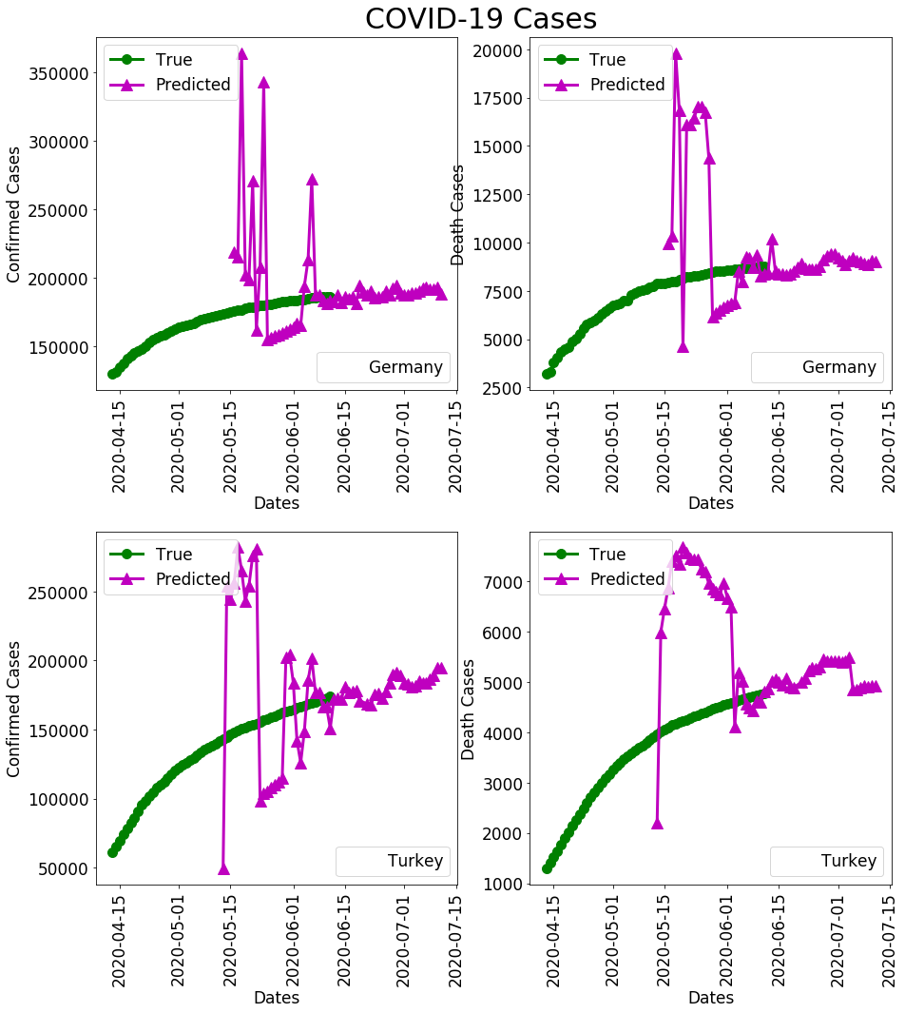
30-day Prediction
Germany
Turkey

Slide 26
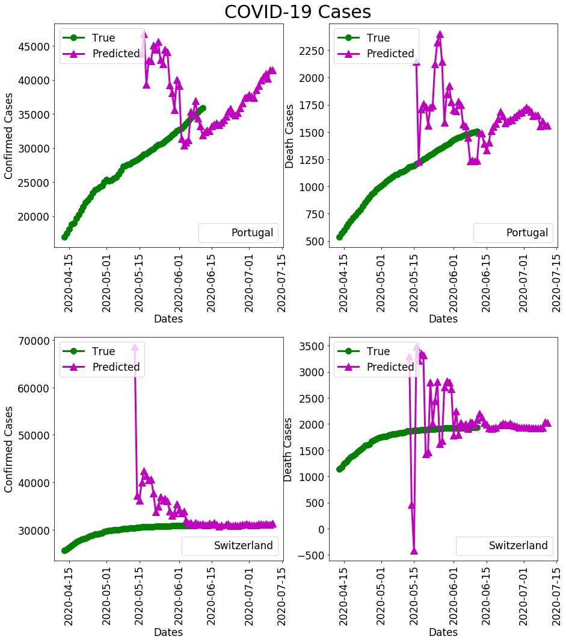
30-day Prediction
Portugal
Switzerland

Slide 27

Conclusion
COVID-19 is a serious pandemic
Use of Average Model to forecast confirmed cases, deaths, critical cases, recoveries and mortality rate for 2, 7, 30 days
Accuracy of predictions in the course of pandemic

Slide 28


















Slide 29
References
E. Blair, M. Leonard and B. Elsheimer (2012) Combined Forecasts: What to Do When One Model Isn’t Good Enough. SAS Global Forum 2012 Paper 341–2012
Benvenuto, D., et al. (2020). "Application of the ARIMA model on the COVID-2019 epidemic dataset." Data in Brief 29: 105340.

Slide 30
Thank you very much for your attention!

