Slide 1
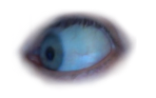
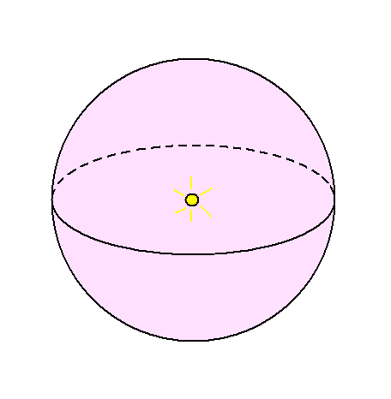

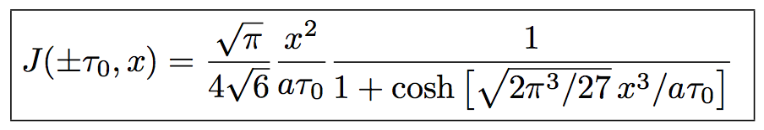
Lyman α radiative transfer – analytically
HI
Dijkstra+ 06
Gas density and temperature

