Slide 1
ROAD ACCIDENT SEVERITY PREDICTION USING MACHINE LEARNING TECHNIQUES
By
K.Prasanthi-24
M.Sukesh-34
Ch.Ani SRK-08
G.Bhargav-14
Under the Guidence of G.Karthika Mam

Slide 2
ABSTRACT
Traffic accidents are among the most critical issues facing the world as they cause many deaths, injuries, and fatalities as well as economic losses every year. Accurate models to predict the traffic accident severity is a critical task for transportation systems. This investigation effort establishes models to select a set of influential factors and to build up a model for classifying the severity of injuries. These models are formulated by various machine learning techniques. Supervised machine learning algorithms and unsupervised machine learning algorithms are implemented on traffic accident data. This project aims at analyzing an accident data set comprising of the road conditions and vehicular aspects using decision tree analysis and Bernoulli naive bayes classification methods.

Slide 3
INTRODUCTION
When a road accident occurs, there are several attributes that affect the intensity of the accident, like road conditions, weather conditions etc. The analysis of these accidents helps in identifying the features that lead to the criticality of the accident.We have used classification algorithms to obtain the relation between various attributes that lead to the criticality of the accident. Firstly, Naive Bayes classification algorithm is used to obtain the criticality of accident for the given attribute values. Then, Decision Tree algorithm is used to perform the same function. The accuracy of both the algorithms are compared so that the better algorithm can be used.

Slide 4
PROBLEM STATEMENT
Current system is manual where government sector makes use of ledger data and analyze the data manually, based on the analysis they will take the precautionary measures to reduce the number of traffic accidents and related injuries. We also get many tools and software to maintain traffic accidents and related injuries, these tools just collects the data stores in sever but no analysis is done. Current system is a manual process where they maintain traffic accidents data and injuries severity using books or ledgers. Discovering the associations among the road conditions and vehicular aspects is the key factor in reducing the traffic accidents.
Discovering the associations among the traffic accidents and
related injuries is the key factor in reducing the traffic
accidents. Identification of injuries severity is a key factor for
the proper treatment. As number of traffic accidents are
increasing and injuries severity is a critical factor to identify.
Public suffering from many major injuries even after many
years of accidents.

Slide 5
DECISION TREE CLASSIFICATION
Basically this algorithm is a tree-like structure algorithm.
It breaks down a dataset into smaller and smaller subsets while at the same time an associated decision tree is incrementally developed. The final result is a tree with decision nodes and leaf nodes
It is a Supervised Learning Technique as the labelled data is being provided before and the output depends on the already existing classified/labelled data.

Slide 6
NAIVE BAYES CLASSIFICATION
It is a supervised learning technique.
In its most simple form, a Naive Bayes classifier assumes that the existence of one function in a class is unrelated to the presence of another.
The Naive Bayes model is simple to construct and is particularly useful for large data sets.
Naive Bayes is considered to outperform even the most advanced classification methods due to its simplicity.
A Naive Bayes classifier assumes that the presence of a particular feature in a class is unrelated to the presence of any other feature.
It is easy and fast to predict class of test data set.

Slide 7
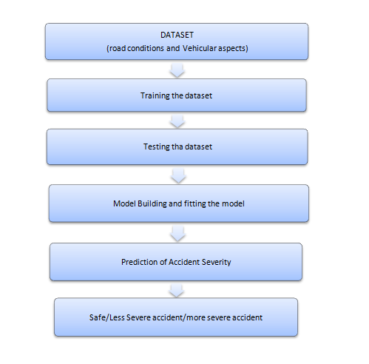
SYSTEM ARCHITECTURE

Slide 8
DATASET COLLECTION
A dataset is a collection of data or instances collected and arranged in a certain form. It could be structured in an array or a database.
A dataset is taken from Kaggle, in which it contains 5587 rows and 20 columns.
This dataset is the combination of road conditions and vehicular aspects attributes, which includes the road curvature, slantness, visibility, vision obstructers and presence of the hair pin bends the condition of the vehicle which is reflected by the age of the vehicle, engine capacity, propulsion type and transmission type, etc.
The output column accident severity has the value "0", "1", "2".

Slide 9
SOFTWARE REQUIREMENTS
1. It requires a 64-bit Ubuntu/windows Operating System.
2. Python Qt Designer for designing user interface.
3. SQLite3 for storing database Entities.
4.Python language for coding.

Slide 10
HARDWARE REQUIREMENTS
Hardware requirements specify the prerequisites required for the project to execute. These hardware equipment must be available to be able to support proper execution of the project .
Hard disk : 5GB or above
RAM : 2GB or above
Processor : i3 or above

Slide 11
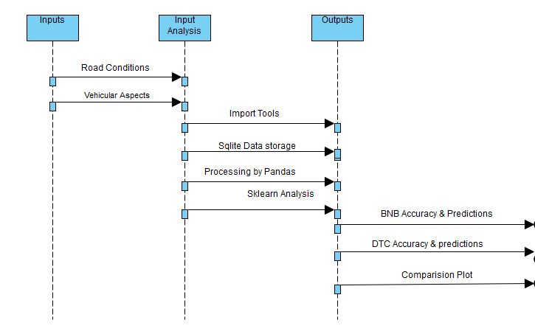
UML DIAGRAMS
SEQUENCE DIAGRAM:

Slide 12
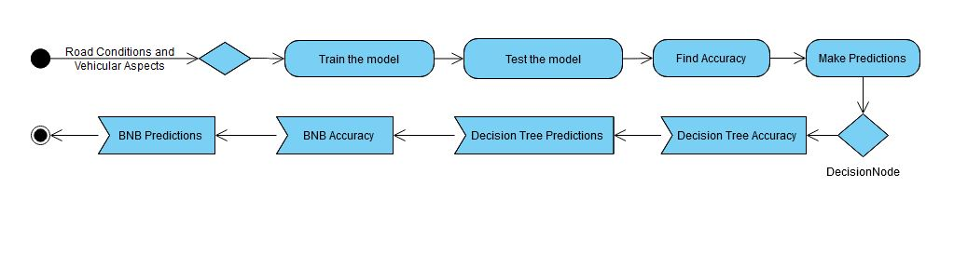
ACTIVITY DIAGRAM:

Slide 13
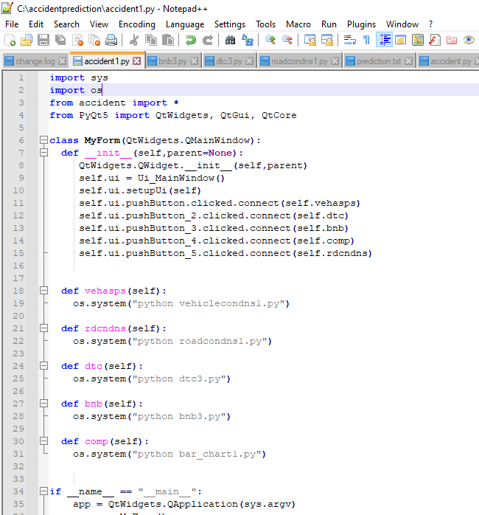
IMPLEMETATION OF GUI
Accident.py:

Slide 14
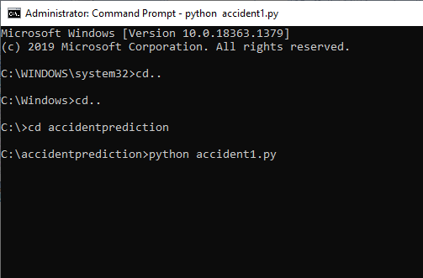
Running on command prompt:

Slide 15
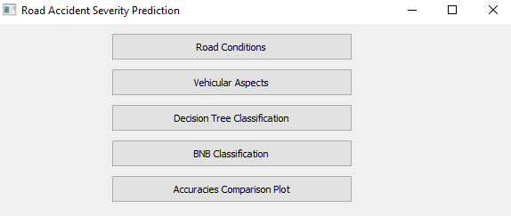

Slide 16
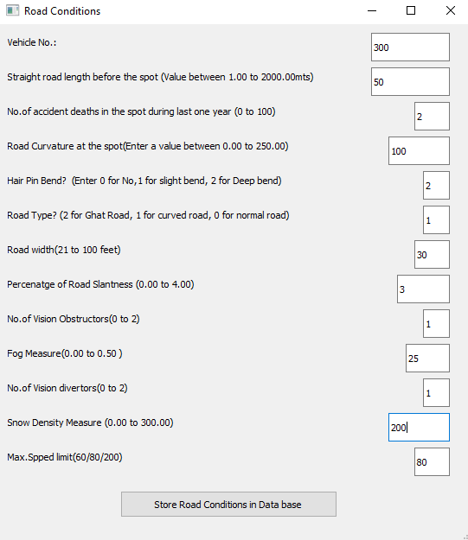
Road Conditions:

Slide 17
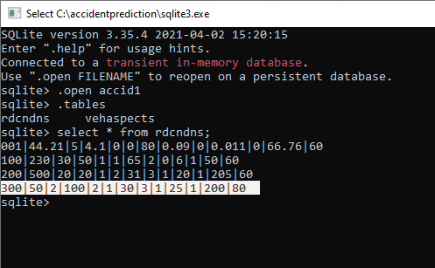
The values of road conditions attributes are stored in database.

Slide 18
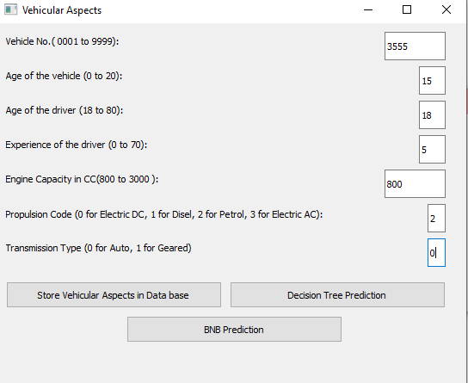
Vehicular Aspects:

Slide 19
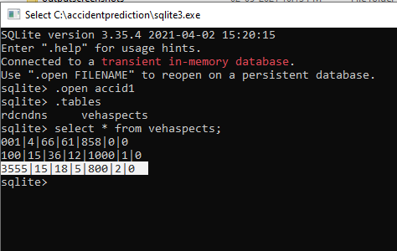
Similary,the values of vehicular aspects attributes are stored in database,

Slide 20
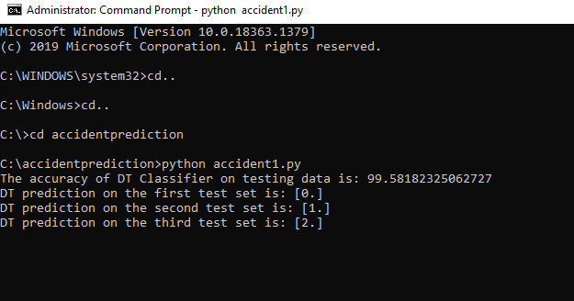
Decision Tree Classification:

Slide 21
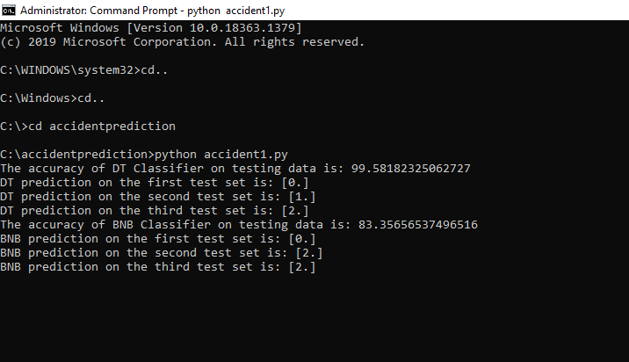
BNB Classification:

Slide 22
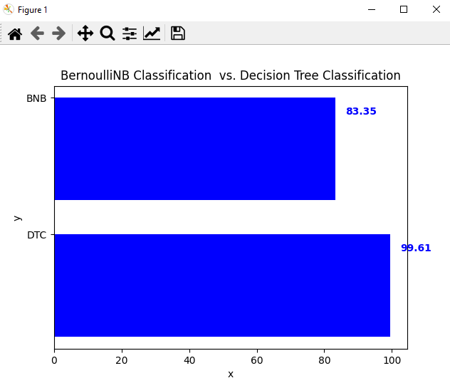
Accuracy Comparison Plot:

Slide 23
CONCLUSION
This project focuses on finding factors that affect the accident severity on expressways with the aim of providing benefits to the responsible authorities for issuing accident prevention policies or measures that are effective to alleviate or protect unexpected losses from accidents. The findings verified that speed on a road section is the only factor influencing the severity of crashes on expressway with significance; hence speed limits on expressways should be mandated for drivers by carrying out rigorous inspections of expressway-speed under the regulations.

