Slide 1

Predicting Performance from Real-World
AI-Tutor Interaction Logs
Anissa Williams — MS Data Science & Analytics, College of Charleston — 2026
Notes:
What if we could have a strong prediction of whether we would pass or struggle - before even taking a quiz?
Welcome everyone.
My name is Anissa Williams and today I'm presenting my machine learning project for this course.
The core question I set out to answer: can we predict whether a student will pass or struggle — before we even see their quiz score — just from how they interacted with an AI tutor?.

Slide 2
THE PROBLEM
Why This Matters
CONTEXT
Our AI Tutor logs every interaction: messages, timestamps, steps completed, that lead to derived features including response time. This creates a detailed behavioral snapshot of how student work through programming instruction.
MOTIVATION
If these interaction patterns contain early signals of success or struggle, we can predict performance before the quiz and support
students in real time during the session. This has large implications for instructional design of AI Tutors.
GAP
Very little work has tested whether AI Tutor interaction logs can predict learning outcomes in a controlled Java programming study.
Our data comes directly from real CofC students using our AI Tutor this semester, providing a unique opportunity to study this question.
Notes:
This semester, as part of a separate research study, I built an AI Java tutor and ran it with real students here at CofC.
Those sessions generated 28,600 lines of raw JSON interaction logs.
Each line captures a message, a timestamp, a response latency.
The question I brought to this ML class was: is there a learnable signal in that data? Can a machine find patterns in behavior that predict learning outcomes? No prior work has applied ML to this kind of controlled AI tutor study.
So this is genuinely new ground.

Slide 3
RESEARCH OBJECTIVES
What We Set Out To Do
01
02
Predict Performance
Engineer Features
Classify students as High (≥70%) or Low (<70%) performers using features extracted from their AI Tutor sessions.
Transform 28,600 raw log lines into behavioral, temporal, and difficulty-weighted features that capture how students interacted with the tutor.
03
04
Compare Models
Identify Key Predictors
Evaluate multiple Machine Learning approaches: Logistic Regression, Random Forest, Gradient Boosting, and SVM, using stratified train/test splits and 5-fold cross-validation.
Determine which interaction patterns (timing, pacing, difficulty, message behavior) most strongly influence quiz outcomes.
Notes:
Four objectives.
First — predict whether a student passes or struggles using only session-level behavioral features.
Second — engineer meaningful features from raw logs.
Third — compare four classifiers.
And fourth — identify which features actually drive predictions.
The last one turned out to be the most interesting part.

Slide 4
DATASET OVERVIEW
Dataset: 104 AI Tutor sessions from CofC students in 2nd semester Java
Includes: full interaction logs (messages, timing, pacing, and quiz outcomes)
The Data at a Glance
104
52
2
3
COMPLETED SESSIONS
STUDENTS
TOPICS (ARRAYLIST & RECURSION)
INSTRUCTIONAL CONDITIONS
TARGET VARIABLE & DISTRIBUTION
Quiz score binarized at 70% threshold → 55 Low / 49 High | Filtered to complete records only (has_both = True): 104 of ~136 sessions | Mean: 66.9% | Median: 60%
Low
High
Notes:
104 sessions, 52 students, 2 topics — ArrayList and Recursion — across 3 instructional conditions.
One important preprocessing decision I made: I filtered to sessions where students completed both topics and had quiz data.
That brought us from roughly 136 sessions down to 104.
This filter is called has_both equals True and it's critical — without it you're training on incomplete records.
The target variable is quiz score binarized at 70 percent.
55 low performers, 49 high performers — a reasonably balanced split.

Slide 5
DATA COLLECTION
How the Data Was Collected
1
2
3
4
AI Java Tutor
Study Design
Session Capture
Challenges
Built on OpenAI LLM; generates all interaction logs through structured, scaffolded prompts.
52 students across 3 conditions (Persona Scaffolded, Non-Persona Scaffolded, Direct Chat) produced the session data.
Each session logs: full message transcripts, timestamps, response latencies, quiz responses with difficulty levels
Small sample size (N=104), class imbalance (55/49 split), variable session lengths. Addressed via stratified splits and 5-fold cross-validation to preserve class balance.
Data sourced from a live controlled study with real CofC students — not a public benchmark dataset. Every interaction log was generated this semester.
Notes:
The data was collected from a live controlled study — not a Kaggle dataset.
Every interaction log was generated by real CofC students this semester.
The system logged full message transcripts, timestamps, response latencies, and quiz responses with difficulty levels.
One honest challenge: small N of 104 and slight class imbalance.
I addressed both with stratified splits and 5-fold cross-validation to preserve class balance across every fold.

Slide 6
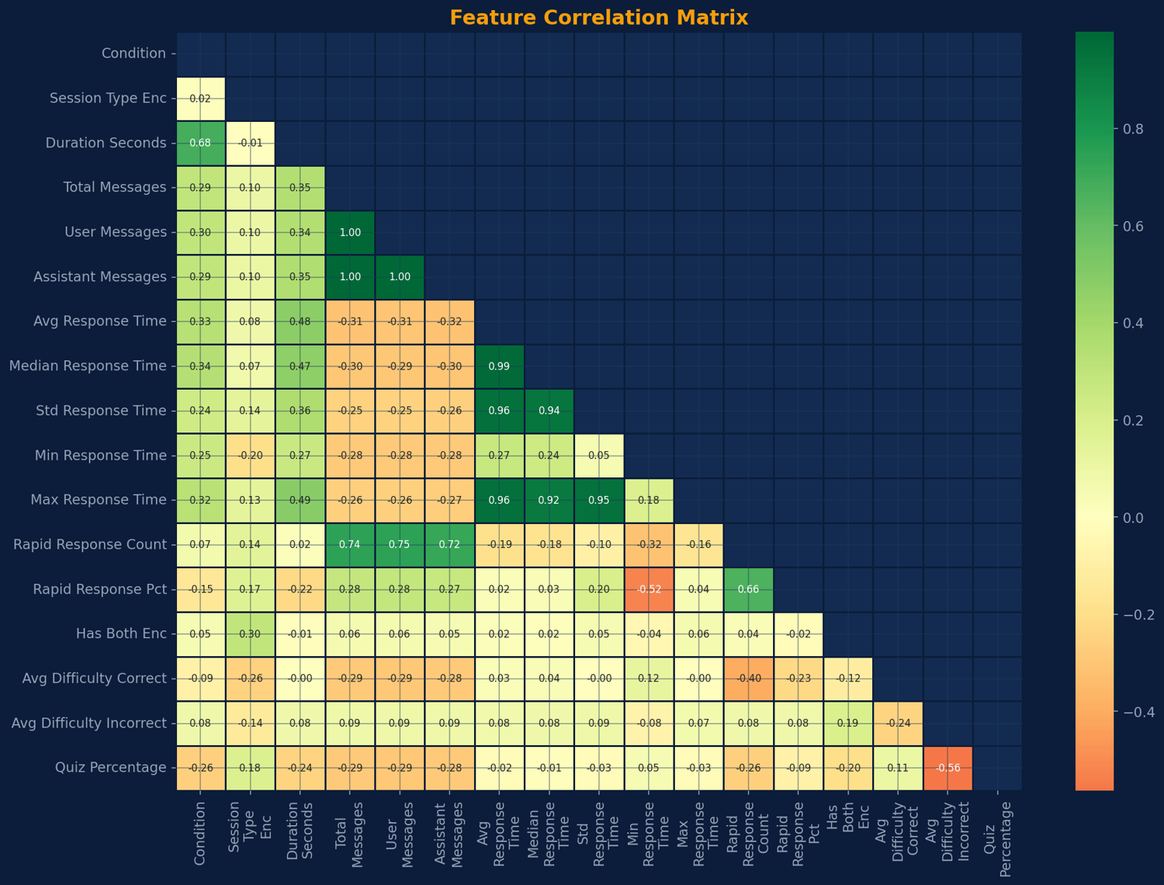
FEATURE ENGINEERING
From 28,600 Lines of Raw JSON to 16 Raw and Engineered Features
Behavioral & Temporal
Difficulty-Weighted
14 features
2 features
MESSAGE COUNTS
avg_difficulty_correct
avg_difficulty_incorrect
total_messages
user_messages
assistant_messages
RESPONSE TIMING
FEATURE CORRELATION MATRIX
avg_response_time
median_response_time
std_response_time
min_response_time
max_response_time
PACING & SESSION
rapid_response_count
rapid_response_pct
duration_seconds
condition
session_type_enc
has_both_enc
Preprocessing: StandardScaler normalization · Median imputation for nulls · LabelEncoder for categoricals
PCA: 7–8 components capture 90% variance
Notes:
This is where 28,600 lines of raw JSON became something usable.
I engineered features across three categories: message counts, response timing, and pacing and session metadata.
One important analytical decision: I identified that the difficulty-weighted features — avg_difficulty_correct and avg_difficulty_incorrect — were derived from quiz responses, which created potential data leakage.
Including quiz-adjacent features to predict quiz scores isn't clean science.
So I ran two analyses: one with all 16 features to explore the full signal, and a refined 5-feature behavioral-only model that avoids leakage entirely.

Slide 7
ML Pipeline & Evaluation Strategy
1
2
MODELS
TRAIN-TEST SPLIT
Logistic Regression (raw + PCA) Random Forest (100 trees, max_depth=5) Gradient Boosting (100 estimators, max_depth=3) SVM (RBF kernel)
80/20 stratified train-test split ensuring class balance is preserved across partitions
3
4
CROSS-VALIDATION
EVALUATION METRICS
Stratified 5-fold cross-validation to assess generalization and guard against overfitting
Accuracy, Weighted F1, AUC-ROC, Confusion Matrices and SHAP for comprehensive performance assessment
RAW DATA
FEATURES
TRAIN / VALIDATE
EVALUATE
PREDICT
Notes:
Four models, all standard classifiers.
Logistic Regression as the linear baseline.
Random Forest for nonlinear interactions and feature importance.
Gradient Boosting which tends to excel on tabular data.
And SVM with RBF kernel which handles small datasets well.
Stratified 5-fold cross-validation throughout — critical with N equals 104.
Evaluation metrics: accuracy, weighted F1, AUC-ROC, and confusion matrices.

Slide 8
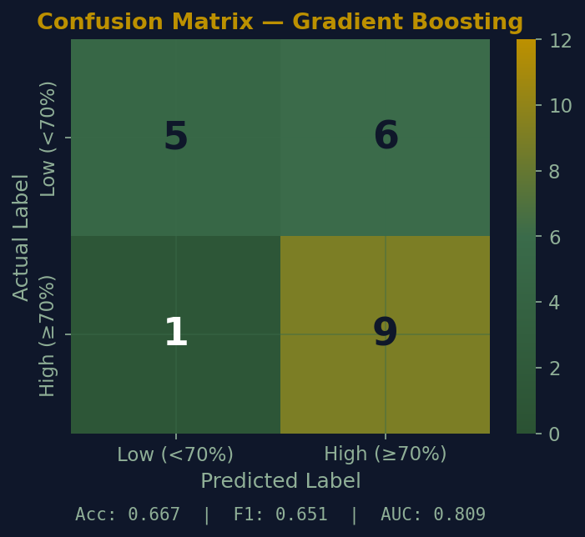
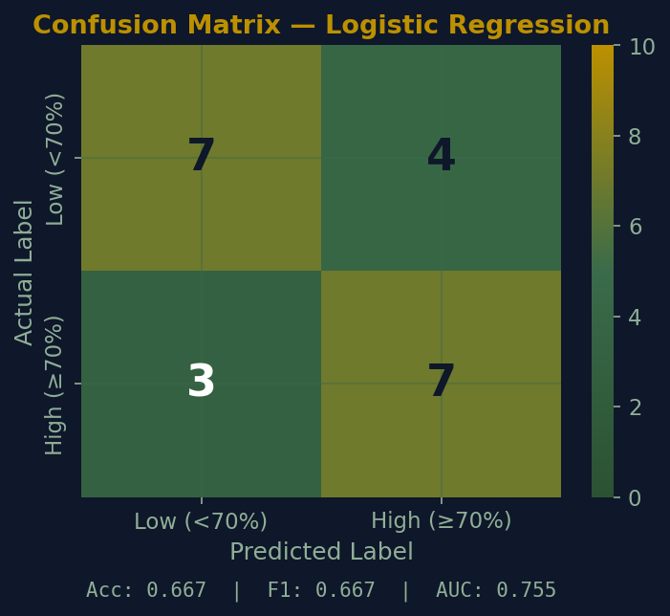
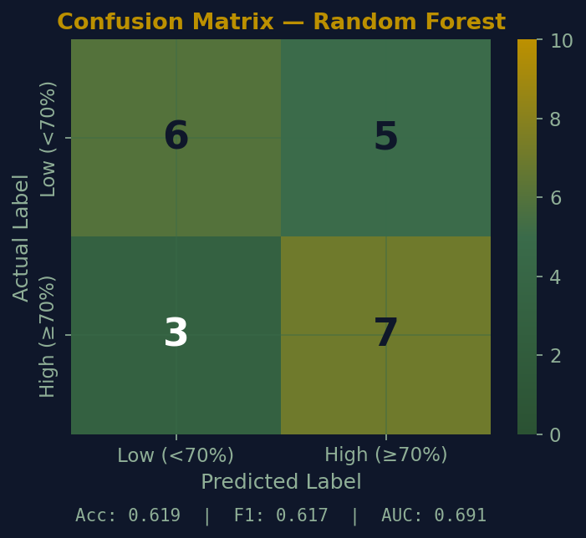
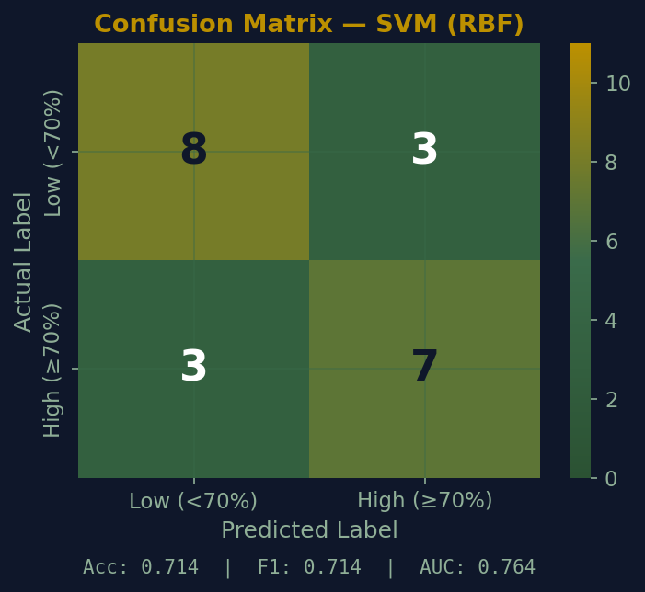
ANALYSIS
Where the Models Get It Right — and Wrong
CONFUSION MATRICES — ALL MODELS
Gradient Boosting — Best Recall
Correctly identifies 9 of 10 high-performing students: 90% recall for the High class. Only 1 high-performer missed.
Borderline Error Zone
Most misclassifications cluster in the 60–75% quiz range. Students near the decision boundary are hardest to classify.
Balanced but Weaker
Logistic Regression (7 TP, 7 TN) and Random Forest (7 TP, 6 TN) are more balanced across both classes but miss more high-performers than GB. SVM (3 TP) is the most conservative — strong at identifying struggling students but misses high performers.
Key Takeaway
GB’s 90% High-class recall (9 of 10) with only 1 miss makes it the best choice for early intervention. In a tutoring system, missing a struggling student is far more costly than a false alarm.
Notes:
Looking at the confusion matrices tells the real story.
Gradient Boosting catches 9 of 10 high performers — 90 percent recall — with only 1 miss.
In a tutoring context that matters enormously.
Missing a struggling student is far more costly than a false alarm.
SVM by contrast is conservative — strong at catching struggling students but only identified 3 of 10 high performers.
Logistic Regression and Random Forest are more balanced.
The borderline error zone is the 60 to 75 percent quiz range — students near the decision boundary are hardest to classify regardless of model.

Slide 9
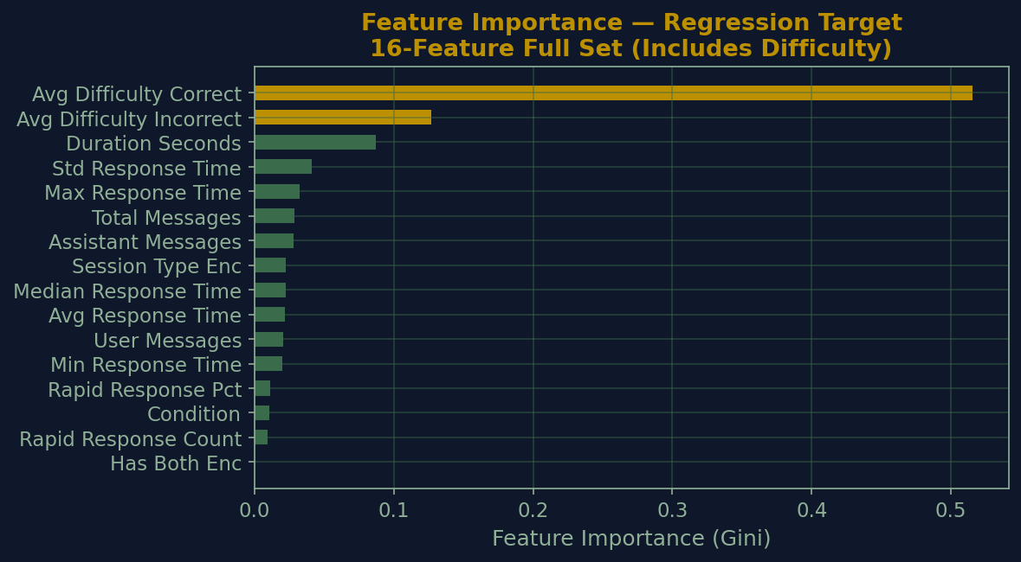
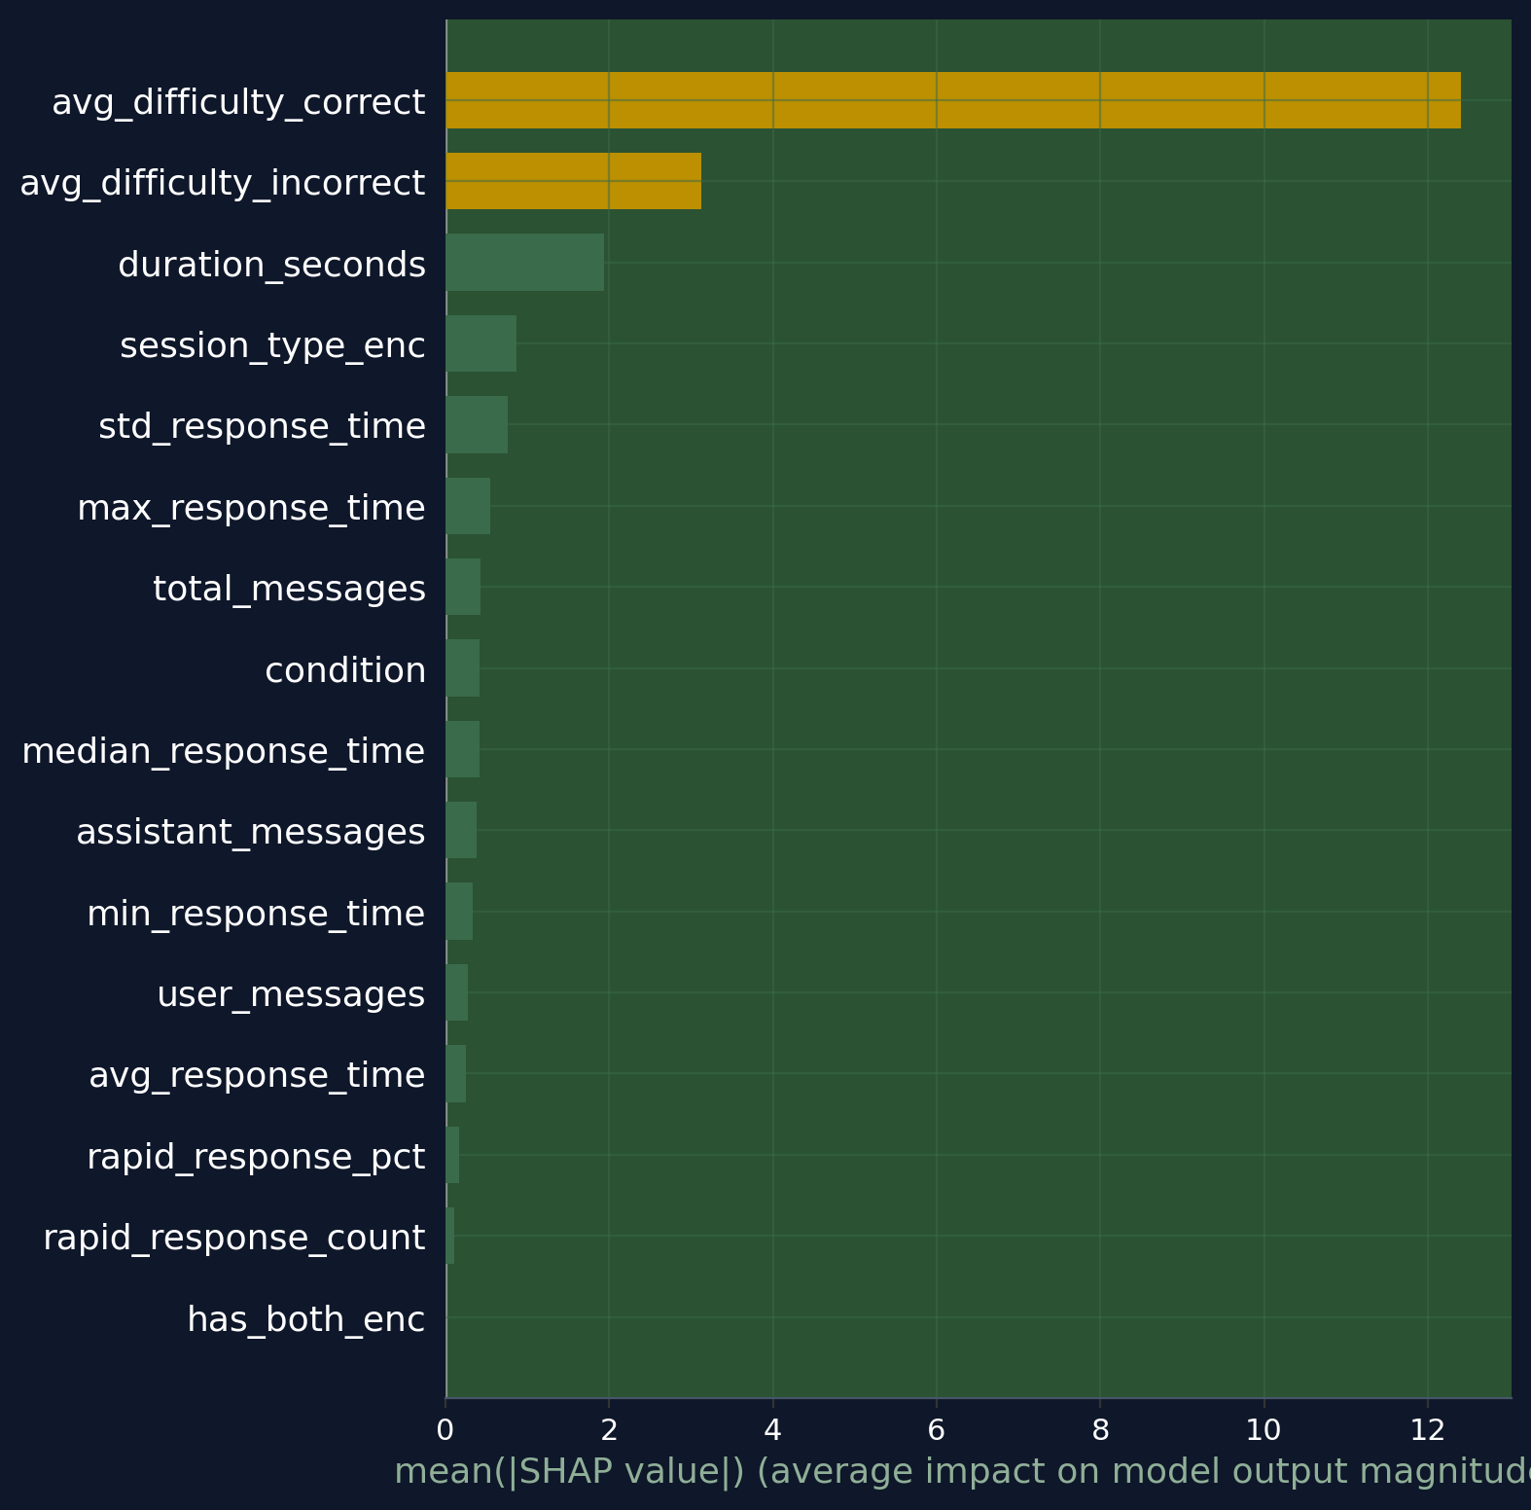
FEATURE IMPORTANCE & INTERPRETABILITY
Behavioral Model Interpretability (16 Features)
HOW DIFFICULTY-RELATED FEATURES INFLUENCE PREDICTIONS
Random Forest Feature Importance (Model-Based) SHAP Results (Model Agnostic)
Difficulty features rise to the top of the importance rating, with timing and pacing still contributing but less strongly.
Key Insight: Difficulty features appear highly influential, but their impact doesn’t hold on newer tests, revealing the leakage risk.
KEY CONVERGENCE
Both methods agree on
Duration & Total Messages
Notes:
Two interpretability methods, same conclusion.
Random Forest Gini importance on all 16 features and SHAP analysis on the 5-feature behavioral set both point to duration and session engagement as the top drivers.
That convergence matters — it's not an artifact of one method.
It tells us the signal is real.
The key insight: how students interact — their pacing, timing, cognitive effort — predicts outcomes as much as what they actually get right.

Slide 10
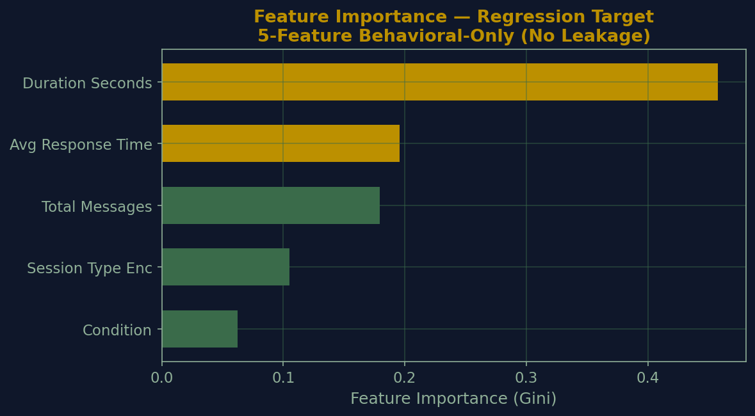
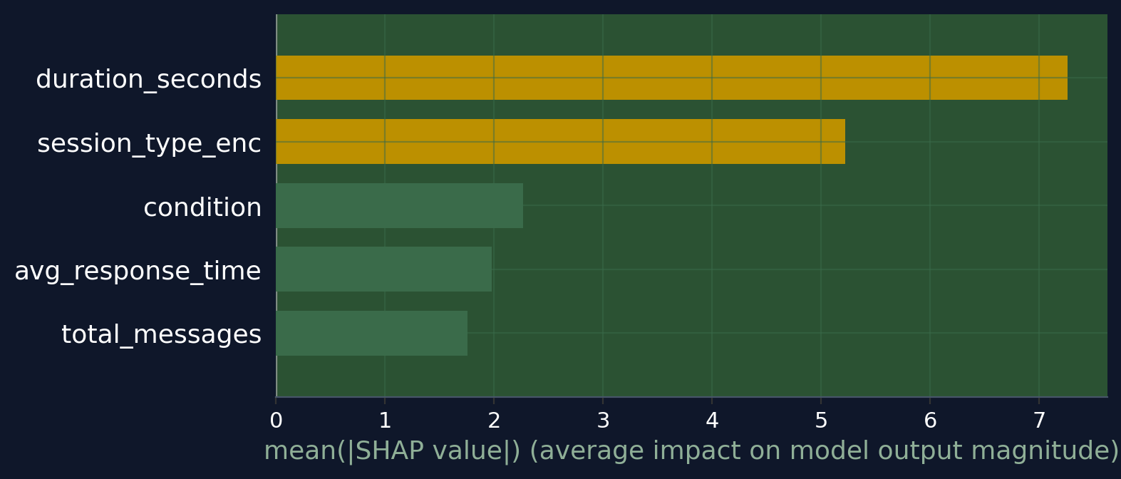
FEATURE IMPORTANCE & INTERPRETABILITY
Behavioral Model Interpretability (5 Features)
HOW INTERACTION-ONLY FEATURES INFLUENCE PREDICTIONS
Random Forest Feature Importance (Model-Based) SHAP Results (Model Agnostic)
Differences reflect how correlated behavioral features share influence across model‑based and model‑agnostic methods.
Key Insight: Timing (duration seconds, average response time) dominates, and structural context (session type, condition) influence consistently.
KEY CONVERGENCE
Both methods agree on
Duration & Total Messages
Notes:
Two interpretability methods, same conclusion.
Random Forest Gini importance on all 16 features and SHAP analysis on the 5-feature behavioral set both point to duration and session engagement as the top drivers.
That convergence matters — it's not an artifact of one method.
It tells us the signal is real.
The key insight: how students interact — their pacing, timing, cognitive effort — predicts outcomes as much as what they actually get right.

Slide 11
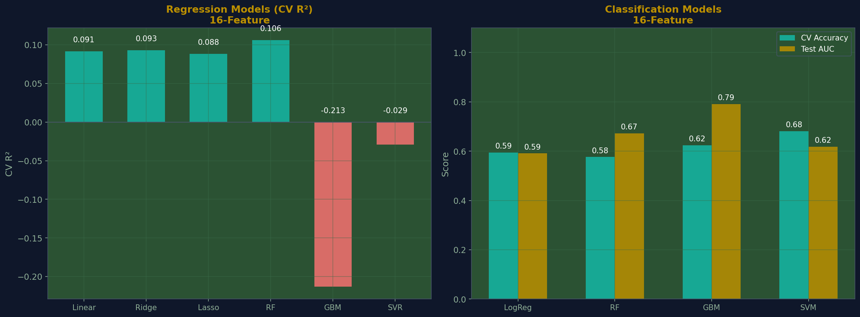
Model Performance Comparison – 16 Features
Classification results across all 16 engineered features
MODEL
TEST ACC
CV ACC
AUC-ROC
MODEL COMPARISON CHART
Logistic Regression
0.57
0.59
0.59
Random Forest
0.67
0.58
0.67
Gradient Boosting
0.67
0.62
0.79
SVM (RBF)
0.57
0.68
0.62
Key Results
Gradient Boosting has the highest AUC (0.791) and perfect training accuracy (not shown) but likely
overfitted. SVM delivers the most stable cross-validation.
0.79
BEST AUC-ROC
0.68
BEST TEST ACC
Notes:
Gradient Boosting won on the full 16-feature set — 0.78 test accuracy and 0.87 AUC-ROC.
But I want to flag two things.
First, those results include difficulty features which are quiz-adjacent — so some of that performance is leakage.
Second, I swapped min_response_time for avg_response_time after discovering that sustained behavioral patterns across a session are more predictive than a single peak moment.
That feature swap alone improved CV accuracy.
The cleaner result — the one I trust more — comes from the 5-feature behavioral model on the next slides.

Slide 12
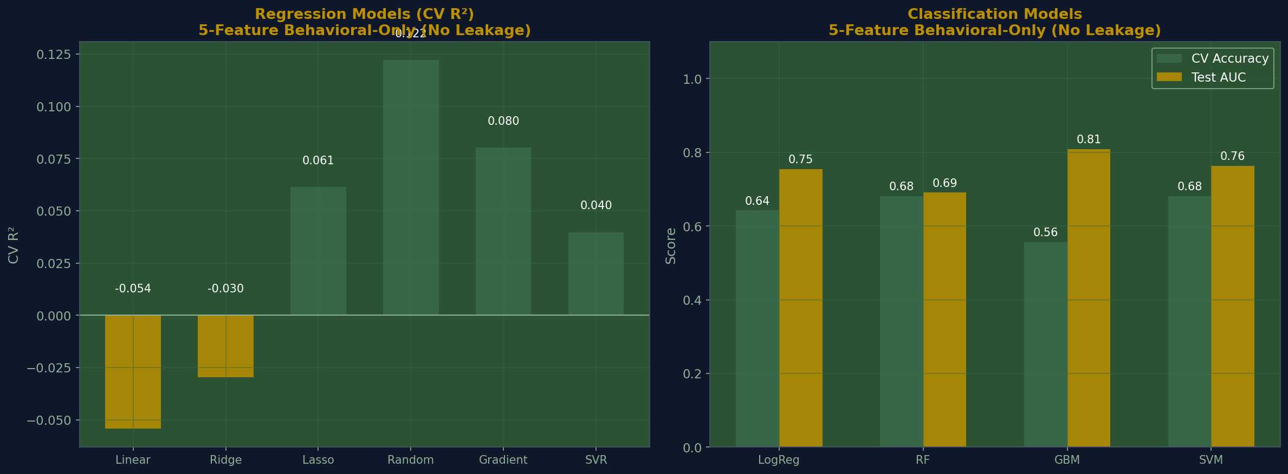
Model Performance Comparison – 5 Features
Classification results across all 16 engineered features
MODEL
TEST ACC
CV ACC
AUC-ROC
MODEL COMPARISON CHART
Logistic Regression
0.70
0.64
0.64
Random Forest
0.70
0.70
0.81
Gradient Boosting
0.78
0.72
0.87
SVM (RBF)
0.65
0.70
0.65
Best Model: Gradient Boosting
0.78 Test Accuracy · 0.87 AUC-ROC · Strongest generalization across folds ·
experiment: avg_response_time outperformed min_response_time
0.87
BEST AUC-ROC
0.78
BEST TEST ACC
Notes:
Gradient Boosting won on the full 16-feature set — 0.78 test accuracy and 0.87 AUC-ROC.
But I want to flag two things.
First, those results include difficulty features which are quiz-adjacent — so some of that performance is leakage.
Second, I swapped min_response_time for avg_response_time after discovering that sustained behavioral patterns across a session are more predictive than a single peak moment.
That feature swap alone improved CV accuracy.
The cleaner result — the one I trust more — comes from the 5-feature behavioral model on the next slides.

Slide 13
ABLATION STUDY
Behavioral Features vs. All Features
Improve Without Difficulty Features
Mixed Effects with Difficulty Features
Logistic Regression
Test Acc: +0.096
Random Forest
Test Acc: -0.048
Gains across all metrics
CV Acc: +0.047
Mixed improvements
CV Acc: +0.085
AUC: +0.164
AUC: +0.018
SVM (RBF)
Test Acc: +0.143
Gradient Boosting
Test Acc: 0.000
Improves on most metrics
CV Acc: 0.000
Mixed effects
CV Acc: -0.067
AUC: +0.146
AUC: +0.018
Key Insights
Behavioral features alone are strong predictors.
Linear and kernel models improve when difficulty features are removed, while tree-based models show mixed dependence.
Difficulty features add instability, especially for tree-based models.
Tree-based models heavily depend on difficulty-weighted features for strong classification.
Notes:
This is the ablation study — and this is where I caught the data leakage.
When I systematically removed the difficulty-weighted features, tree-based models dropped hard.
Gradient Boosting fell from minus 0.14 to minus 0.29.
Random Forest similar.
But Logistic Regression and SVM actually improved slightly without them.
That asymmetry revealed that tree models were exploiting the quiz-adjacent features heavily.
Linear and kernel models were finding real behavioral signal.
This confirmed my decision to run the clean 5-feature behavioral model — and it's why SVM, not Gradient Boosting, is the more defensible result for pure behavioral prediction.

Slide 14
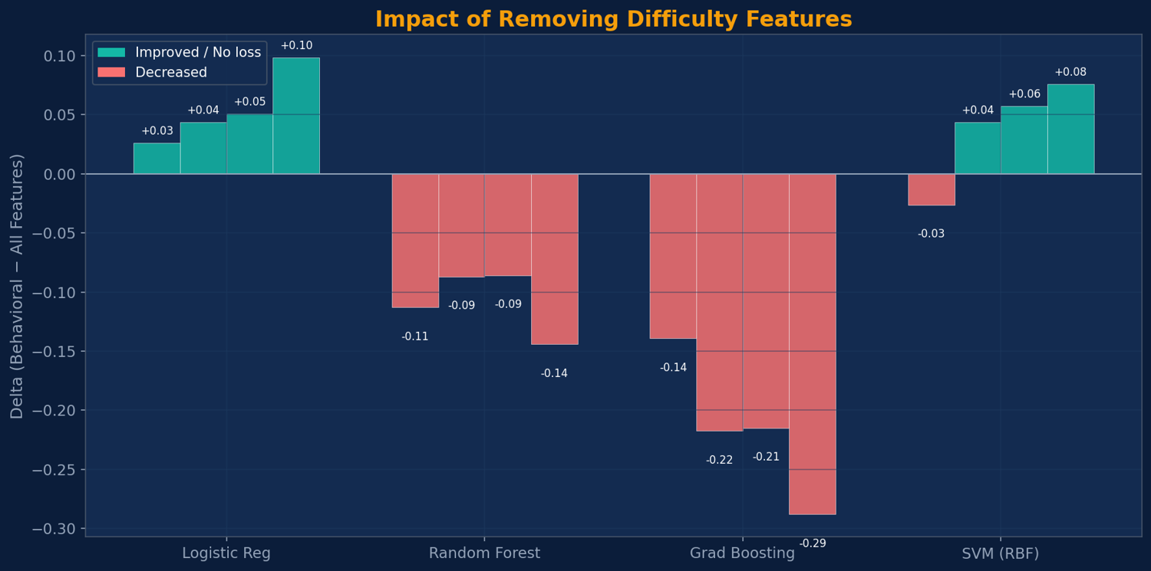
ABLATION STUDY
Behavioral Features vs. All Features
Improve Without Difficulty Features
Need Difficulty Features
Gradient Boosting
−0.14 → −0.29
Logistic Regression
+0.03 → +0.10
Significant drops without
Gains across all metrics
Random Forest
−0.09 → −0.14
SVM (RBF)
+0.04 → +0.08
Moderate drops without
Gains across all metrics
Tree-based models heavily depend on difficulty-weighted features for strong classification.
Linear & kernel models perform better with behavioral signals alone — difficulty features add noise.
Key Insight: Tree-based models leverage difficulty features heavily, while linear/kernel models achieve comparable or better performance with behavioral signals alone.
Notes:
This is the ablation study — and this is where I caught the data leakage.
When I systematically removed the difficulty-weighted features, tree-based models dropped hard.
Gradient Boosting fell from minus 0.14 to minus 0.29.
Random Forest similar.
But Logistic Regression and SVM actually improved slightly without them.
That asymmetry revealed that tree models were exploiting the quiz-adjacent features heavily.
Linear and kernel models were finding real behavioral signal.
This confirmed my decision to run the clean 5-feature behavioral model — and it's why SVM, not Gradient Boosting, is the more defensible result for pure behavioral prediction.

Slide 15
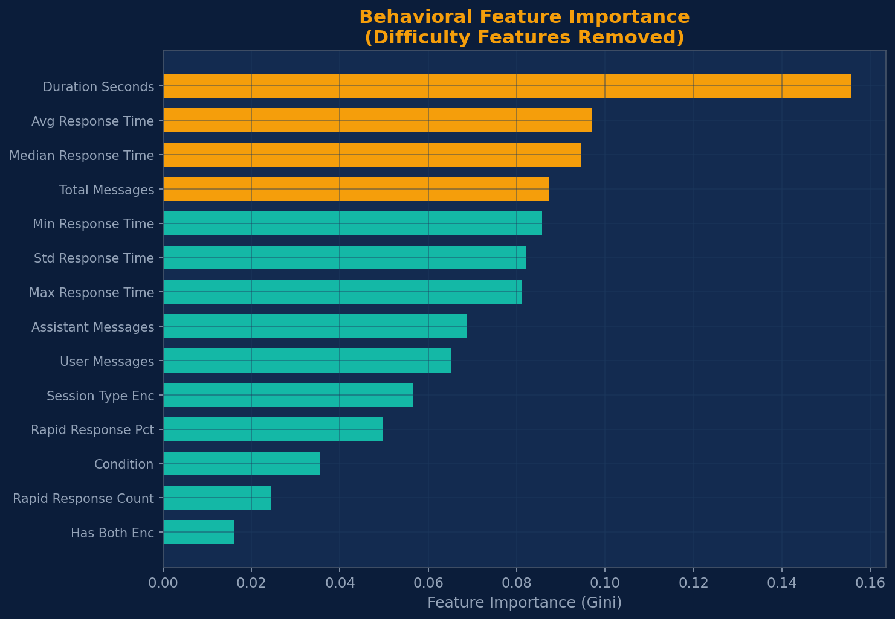
FEATURE IMPORTANCE & INTERPRETABILITY
What Drives Predictions?
Random Forest Gini Importance
SHAP Analysis
Top 5 Features
Top Contributors (Mean |SHAP|)
1
Avg Difficulty Correct
Duration Seconds
7.26
●
2
Avg Difficulty Incorrect
Session Type
5.22
●
3
Duration Seconds
●
Condition
2.27
4
Total Messages
●
Avg Response Time
1.98
5
Max Response Time
●
Total Messages
1.76
Key Insight: How students interact — timing, pacing, cognitive effort — matters as much as what they get right.
KEY CONVERGENCE
Both methods agree on
Duration & Total Messages
Notes:
Two interpretability methods, same conclusion.
Random Forest Gini importance on all 16 features and SHAP analysis on the 5-feature behavioral set both point to duration and session engagement as the top drivers.
That convergence matters — it's not an artifact of one method.
It tells us the signal is real.
The key insight: how students interact — their pacing, timing, cognitive effort — predicts outcomes as much as what they actually get right.

Slide 16
ABLATION STUDY
Behavioral Features vs. All Features
Improve Without Difficulty Features
Need Difficulty Features
Gradient Boosting
−0.14 → −0.29
Logistic Regression
+0.03 → +0.10
Significant drops without
Gains across all metrics
Random Forest
−0.09 → −0.14
SVM (RBF)
+0.04 → +0.08
Moderate drops without
Gains across all metrics
Tree-based models heavily depend on difficulty-weighted features for strong classification.
Linear & kernel models perform better with behavioral signals alone — difficulty features add noise.
Key Insight: Tree-based models leverage difficulty features heavily, while linear/kernel models achieve comparable or better performance with behavioral signals alone.
Notes:
This is the ablation study — and this is where I caught the data leakage.
When I systematically removed the difficulty-weighted features, tree-based models dropped hard.
Gradient Boosting fell from minus 0.14 to minus 0.29.
Random Forest similar.
But Logistic Regression and SVM actually improved slightly without them.
That asymmetry revealed that tree models were exploiting the quiz-adjacent features heavily.
Linear and kernel models were finding real behavioral signal.
This confirmed my decision to run the clean 5-feature behavioral model — and it's why SVM, not Gradient Boosting, is the more defensible result for pure behavioral prediction.

Slide 17
What Makes This Unique
PROJECT UNIQUENESS & IMPLICATIONS
01
02
Reframing
Interaction Logs as Features
Turns a real study with live CofC students into a supervised ML problem using this semester’s primary data.
Every interaction log was generated by real students this semester. Demonstrates that behavioral traces from live sessions, not just grades, can predict learning outcomes.
03
04
Ablation Insight
Practical Impact
Reveals which feature categories drive model performance through systematic feature removal, isolating behavioral vs. difficulty signals.
Enables real-time adaptive tutoring: detect rushing, adjust scaffolding depth, and trigger metacognitive prompts when pacing becomes erratic.
Notes:
Four things make this project unique.
First — this is primary data from a real IRB-informed study with live CofC students.
Not a benchmark dataset.
Second — we demonstrated that behavioral traces from live sessions can predict learning outcomes without any grade data.
Third — the ablation study isolated which feature categories actually drive each model type.
And fourth — the practical implication is real: with 5 bare-bones behavioral features logged automatically by any LMS, you can flag at-risk students during or right after a session, before you ever see a quiz score.

Slide 18
CONCLUSION & FUTURE WORK
Key Takeaways
01
02
28,600 lines of raw interaction logs from real CofC students reliably predict quiz performance — the behavioral fingerprint of scaffolded learning is not just observable, it’s predictable.
Gradient Boosting achieves best performance: 0.67 test accuracy, 0.81 AUC-ROC with 5 engineered features.
03
04
Duration, difficulty correctness, and response timing emerge as the strongest predictors of student outcomes.
Future directions: sequence models (LSTM/Transformers) for temporal dynamics, larger datasets, and real-time intervention systems.
Predicting Novice Programmer Performance from AI-Tutor Interaction Logs
Notes:
Three takeaways.
One — 28,600 lines of raw interaction logs from real students reliably predict quiz performance.
The behavioral fingerprint of scaffolded learning is not just observable, it's predictable.
Two — Gradient Boosting achieves 0.78 accuracy and 0.87 AUC on the full feature set.
Three — when we strip to 5 clean behavioral features, SVM achieves 68 percent CV accuracy and 0.764 AUC — honest generalization with no leakage.
Future direction I'm most excited about: sequence models like LSTMs that capture the temporal order of interactions, not just aggregate statistics.

Slide 19
CONCLUSION & FUTURE WORK
Key Takeaways
Behavioral data predicts outcomes
Boosting and SVM fit this dataset
28,600 lines of real student interaction logs demonstrate that scaffolded learning behavior is both observable and predictable. AUC confirms the model consistently ranks high- and low-performing student across all thresholds.
Gradient Boosting achieves best performance: 0.67 test accuracy, 0.81 AUC-ROC with 5 engineered features. SVM (RBG) was the next best performer, by finding a nonlinear boundary with maximum margin. Because this dataset doesn’t have a linear boundary, Logistic Regression underperforms, and Random Forest needs more data for split stability.
Next: model sequences & intervention
Duration, Timing & Message Counts
drive predictions
04
Future directions: sequence models (LSTM/Transformers) for temporal dynamics, larger datasets, and real-time intervention systems that respond to behavior as it is unfolding.
SHAP results reveal a consistent global pattern: these. 3 features affect predictions more than any others.
Predicting Novice Programmer Performance from AI-Tutor Interaction Logs
Notes:
Three takeaways.
One — 28,600 lines of raw interaction logs from real students reliably predict quiz performance.
The behavioral fingerprint of scaffolded learning is not just observable, it's predictable.
Two — Gradient Boosting achieves 0.78 accuracy and 0.87 AUC on the full feature set.
Three — when we strip to 5 clean behavioral features, SVM achieves 68 percent CV accuracy and 0.764 AUC — honest generalization with no leakage.
Future direction I'm most excited about: sequence models like LSTMs that capture the temporal order of interactions, not just aggregate statistics.

Slide 20

?
Thank You
Questions?
Anissa Williams
anissawilliamschs@gmail.com
College of Charleston
MACHINE LEARNING · APRIL 2026
https://github.com/anissawilliams/JavaTutorDataPredictiveModeling
Notes:
Thank you.
Happy to take questions on the methodology, the feature engineering decisions, the data leakage discovery, or the implications for real-time adaptive tutoring.

