Slide 1
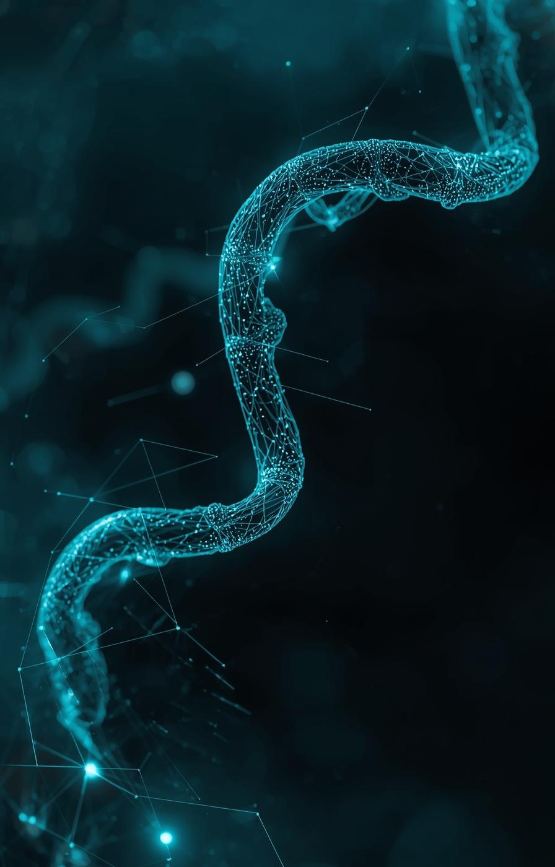

AI and the Future of Oncology R&D
Anisshka Annand Khadtale
December 11, 2025

Slide 2




My Personal Interest
Career that contributes to the public good and creates meaningful impact.
Apply economics in a way that can improve people’s lives.
Took Health Economics freshman year: intersection of economics, healthcare, and equity.
Returned to Health Economics in junior year.

Slide 3

Industry Overview
Fastest-growing sector in global pharma R&D — Spending projected to rise from $252B (2024) to $441B (2029).
Robust innovation pipeline — More than 700 oncology drugs in development; FDA approved 132 drugs (2020–24).
Geographic shift in trial execution — China now accounts for 29% of trial starts, surpassing the U.S. for the first time.
Industry structure: Big Pharma + AI-native biotech driving early-stage innovation.

Slide 4
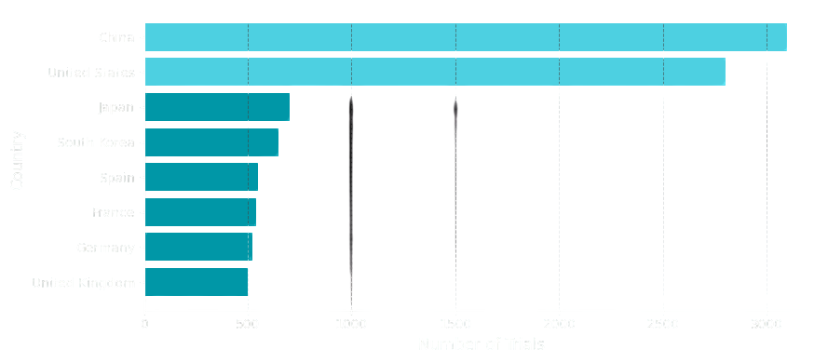
Global Oncology Trials by Country

Slide 5
Industry Growth
High firm entry & investment — Record $13.7B in cancer biotech VC funding in 2021; major acquisitions (Pfizer–Seagen).
Profitability — Blockbusters like Keytruda (> $30B projected annual sales) anchor industry margins.
Rising R&D intensity — Oncology comprises 37% of the clinical pipeline; over 2,000 trials launched in 2023.
Expanding workforce — U.S. pharma employment rose from 283K → 352K (2015–2023), partly driven by oncology demand.

Slide 6
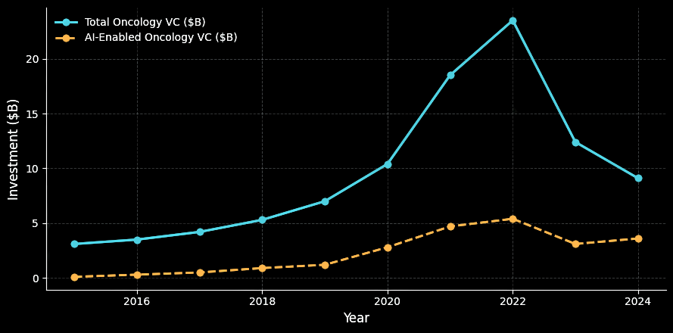
Venture Capital Investment in Oncology Startups

Slide 7

How GenAI Is Reshaping Oncology R&D
Rising Skill Requirements
AstraZeneca upskilled 12,000+ employees to use algorithmic tools in discovery and trial design.
Productivity Gains
ML speeds screening, biomarker detection, and adaptive trials → up to 40% R&D cost reduction.
Changing Competition
Partnerships like Merck–BenevolentAI and Exelixis–Insilico show early adopters gaining speed-to-market.
Risks + New Opportunities
Bias in datasets may worsen disparities, but 70+ AI-designed drug candidates and platforms like Trials.ai expand innovation.
7

Slide 8
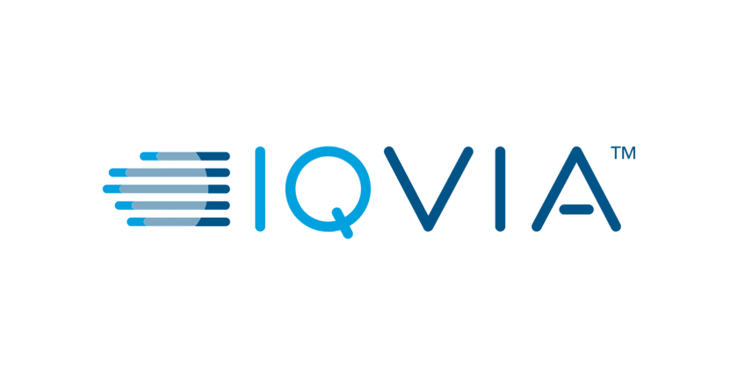
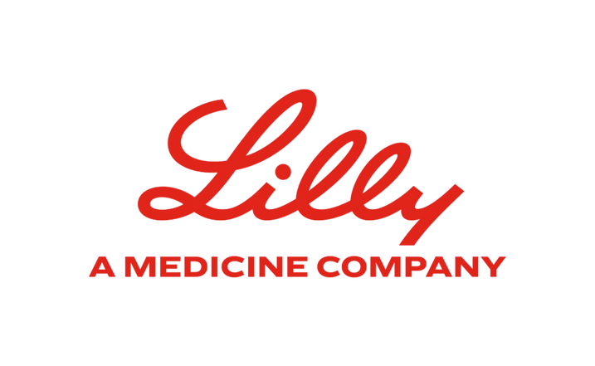

Personal Opportunity
Health Economics & Outcomes Research (HEOR): analyzing how AI-enabled therapies deliver value, improve outcomes, and shape cost-effectiveness.
Apply interdisciplinary strengths across economics, data analysis, and healthcare systems.
Translating clinical evidence into economic insights.

Slide 9
Upskilling Plan (6-12 months)
Build technical skills in R and Python for health data analysis.
Coursera, Udemy certificate.
Work on oncology basics (trial endpoints, biomarkers, immunotherapy).
YouTube, online learning platforms, university courses have several resources.
Take this project further and enhance it for my Public Interest Technology capstone credit.
Therefore, explore the impact of AI on the oncology R&D industry in more detail.

Slide 10
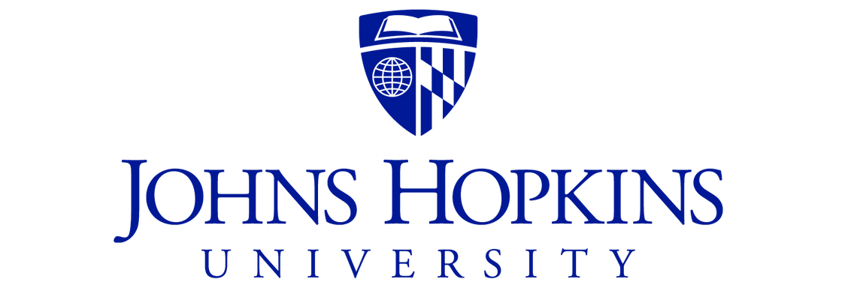
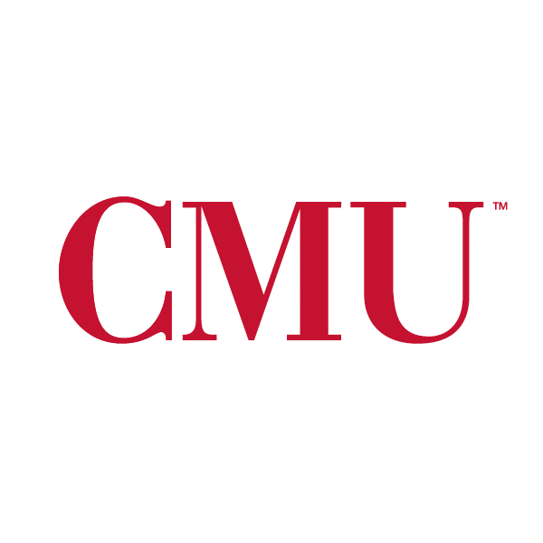
Reflection and Takeaways
From basic prompting to a more iterative, intentional approach that produces stronger analytical work.
AI may reshape entry-level work, but it also expands opportunities once you build strong skills.
This project confirmed my interest in Health Economics, especially the parts of the field that intersect with data, policy, and innovation.
Long-term path: gain a few years of experience, then pursue a master’s or PhD in Health Economics with a stronger AI skillset.

Slide 11
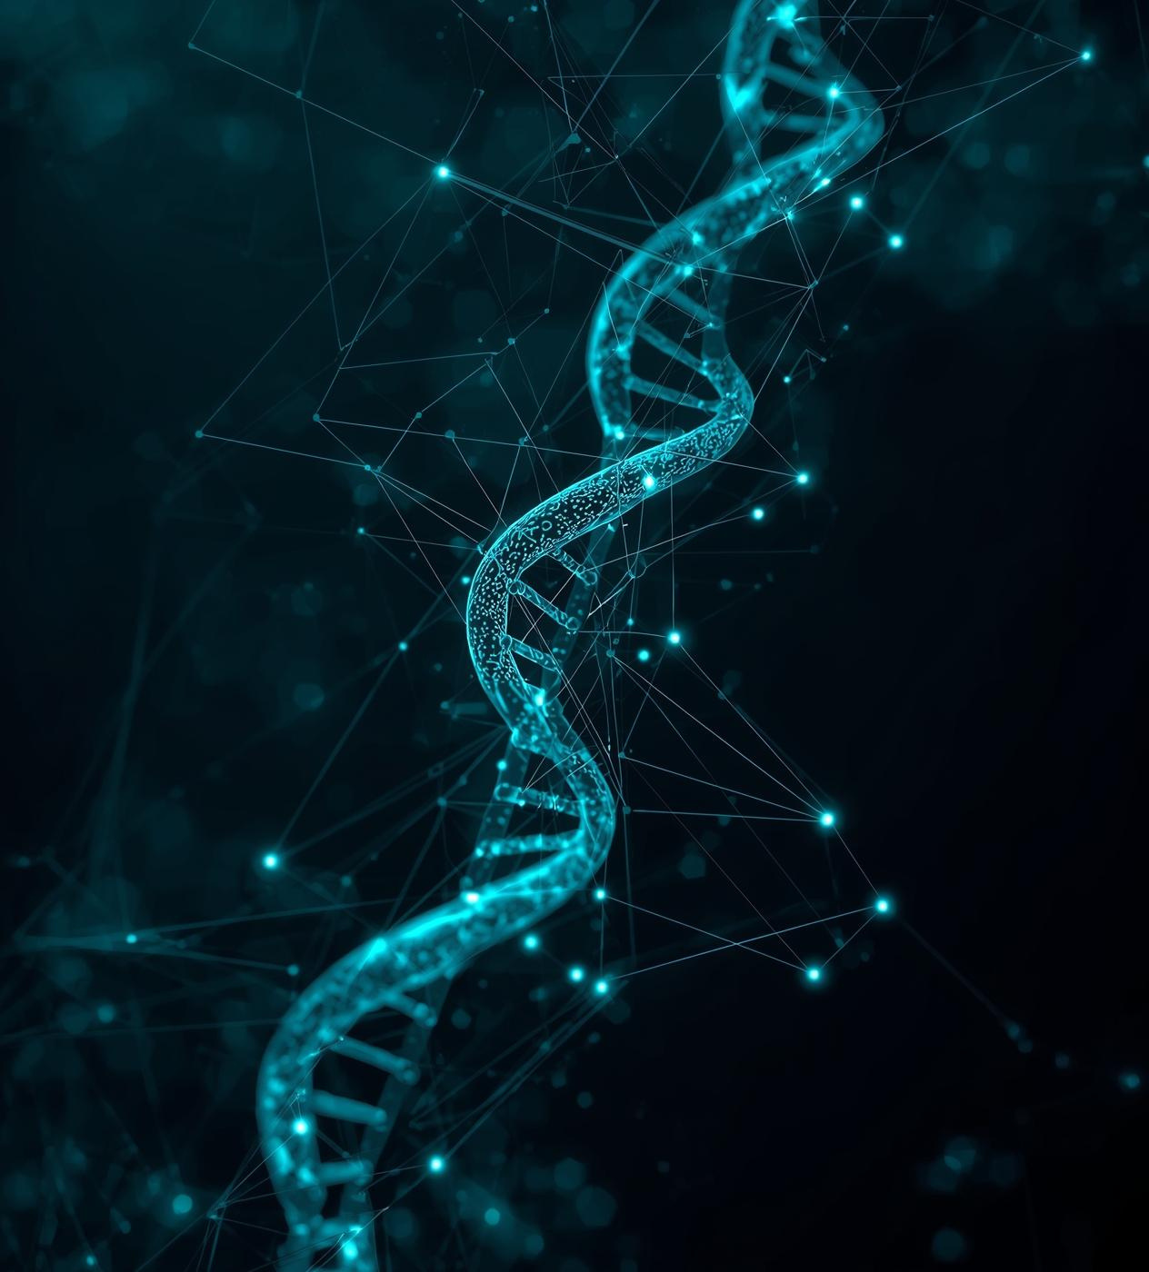
Ownership and AI Use
I take ownership of all the content and design ideas.
AI (ChatGPT, NotebookLM, Canva AI) was used as a personal assistant.
In addition to the ways we used AI in class, I used it to customize my data visulizations, generate designs for the presentation, and organize my presentation.

Slide 12
Thank you for your attention!
Anisshka Annand Khadtale
akhadtale@umass.edu

