Slide 1
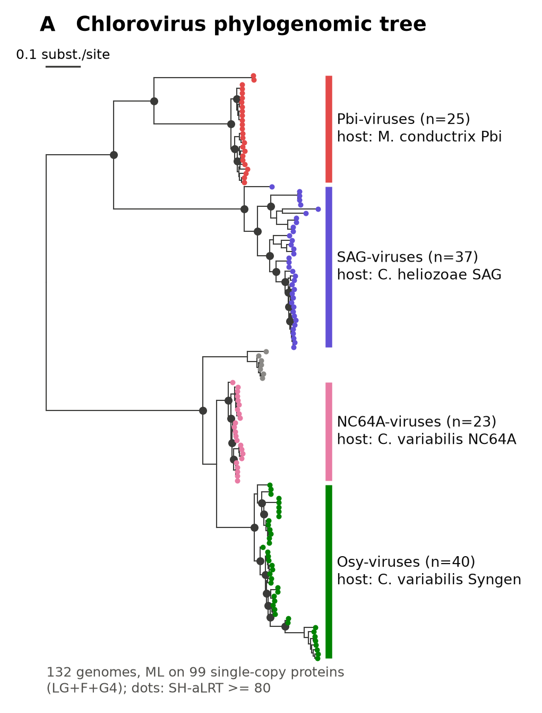
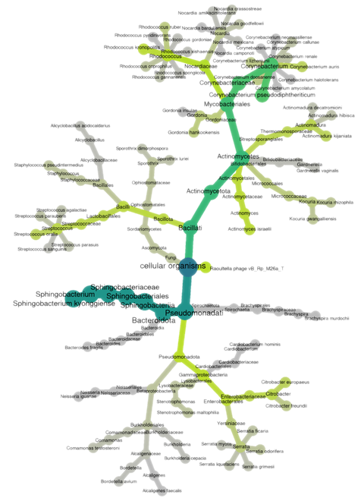
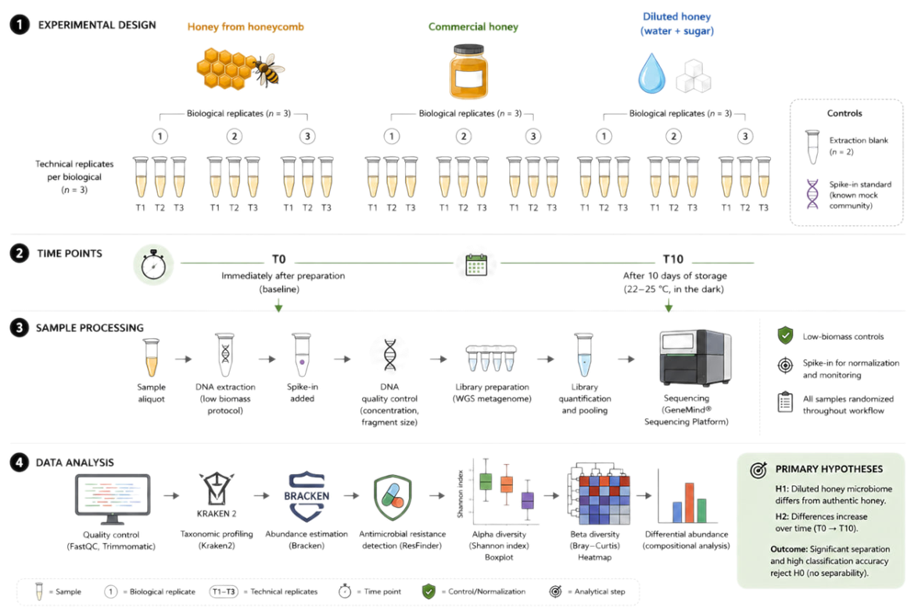
Problem: is the viral “gene package” neutral?
Giant viruses (NCLDV) carry many genes stolen from hosts
Model: chloroviruses (4 clades)
Host alga
Chlorella proteome
HGT
Virus genome, ~330 kb
~7 % of genes: algal-like accessory
After the transfer, what does evolution do with the gene?
H0: neutral cargo
• dN/dS (ω) ≈ 1
• gene copies decay
• promoter drifts like synonymous sites
H1: domesticated
• ω < 1 (purifying)
• conserved blocks in the inherited host domain
• constrained promoter
Anna Chesnokova · code: GitHub ncldv-gene-package
Van Etten et al. 2020 Viruses; Moniruzzaman et al. 2020 Nat Commun; Irwin et al. 2022 Nat Microbiol
Notes:
Giant viruses (NCLDV) have huge genomes, and a big part of them is genes taken from the host by horizontal transfer. Many of these genes have no known role. The question: once a gene is stolen, is it neutral cargo that drifts and decays, or does the virus keep it under selection? If it is kept, the conserved parts should tell us how it is used and expressed. The model is the chloroviruses: 132 complete genomes, 4 clades by host, and the host proteome is sequenced. The 4 clades are 4 independent replicates.

Slide 2
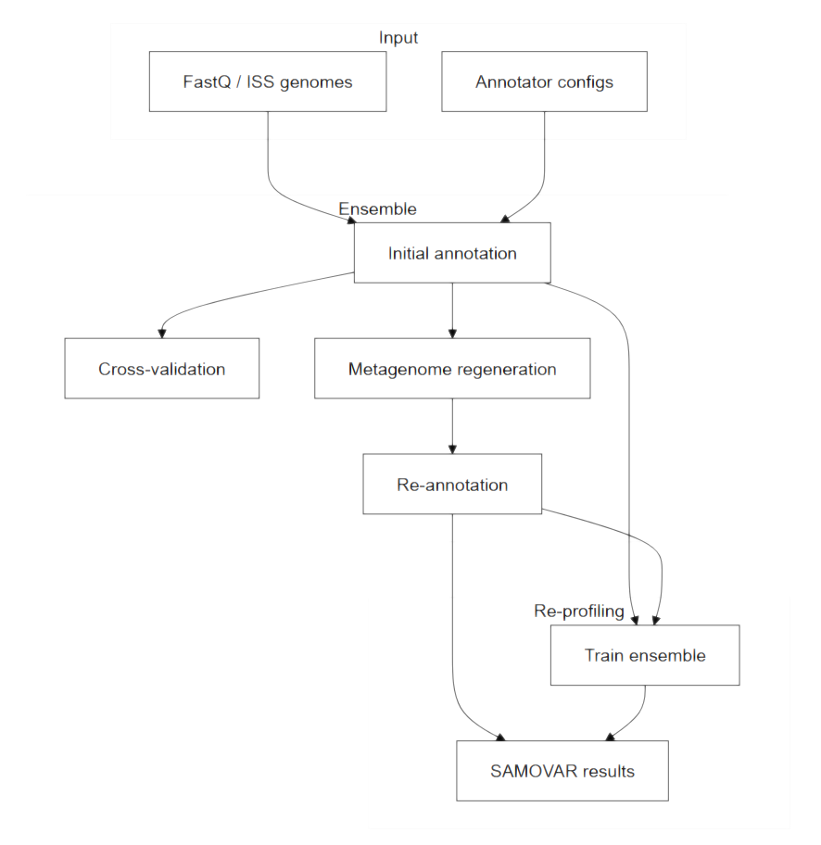
Methods: phylogenomics + per-gene selection tests
Data: 132 chlorovirus genomes (NCBI, 20 Oct 2026); proteomes of C. variabilis + 3 green algae
Classes: core = OG in ≥ 90 % genomes; algal-like = DIAMOND hit (e ≤ 1e-5) in ≥ 50 % of members
Stolen gene package = accessory + algal-like (144 OGs, 7 % of genes)
Selection: codeml M0 per gene × clade, LRT vs ω = 1 (BH); filter 0.01 < dS < 1.5
Stats: Wilcoxon, Kruskal–Wallis, Mann–Whitney + Cliff’s δ, OLS (clade, dS, length; SE clustered by OG)
Pipeline (Python + bioconda; run_all.sh)
1 132 genomes → Prodigal → MMseqs2
1,642 orthogroups
2 99 single-copy OGs → IQ-TREE
species tree → 4 host-range clades
3 DIAMOND vs algae × prevalence
4 gene classes
4 codon alignments → codeml M0
ω per gene × clade + LRT vs ω = 1
5 site π_aa · host-domain map · upstream
where is the conservation?
Prodigal · MMseqs2 · DIAMOND · MAFFT · IQ-TREE 3 · PAML 4.10
Notes:
Genes were called the same way in every genome with Prodigal and clustered into 1,642 orthogroups with MMseqs2. 99 single-copy core proteins gave the species tree and the 4 clades. Each orthogroup was classed by prevalence and by whether it has a green-algal homolog; accessory algal-like genes are the stolen package. For every gene in every clade: codon alignment, gene tree, codeml one-ratio model, and a likelihood-ratio test against a neutral model with omega fixed to 1. Then per-site diversity inside the gene and the divergence of the upstream region relative to synonymous sites. Everything runs from run_all.sh.

Slide 3
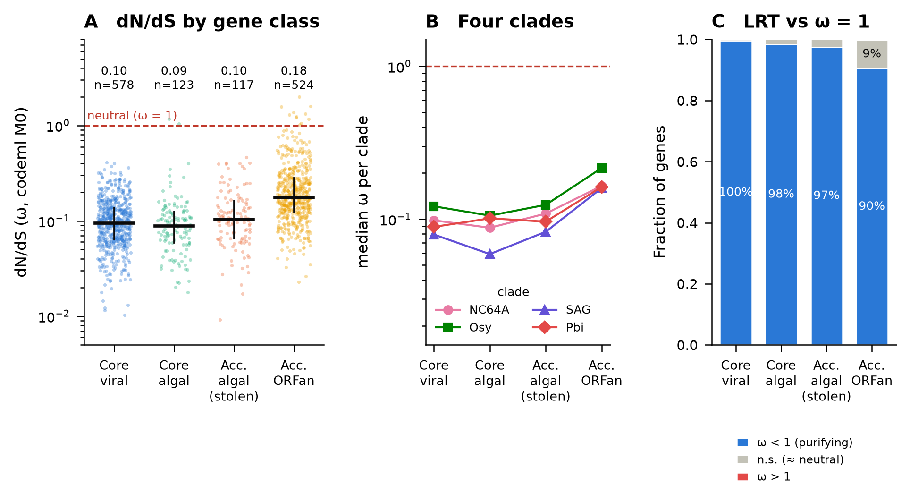
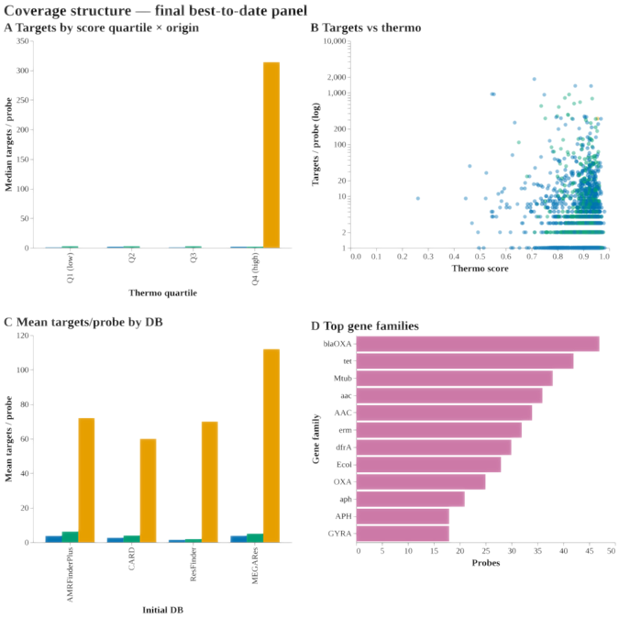
Results 1: stolen genes are under purifying selection
97 %
of stolen genes reject ω = 1 (114/117, LRT q < 0.05)
0.10
median ω, same as core viral genes (0.095); OLS β = +0.04, p = 0.34
ORFans are the loosest: ω = 0.18, 9 % not different from neutral
Same in all 4 clades; ω does not depend on identity to the host homolog (ρ = −0.10, p = 0.36)
→ H0 (neutral cargo) is rejected
Fig. 2. dN/dS per gene × clade (n = 1,342). A: by class; B: median per clade; C: per-gene LRT against ω = 1
codeml M0 (PAML); BH correction; all numbers in results/stats.txt
Notes:
Main result. Stolen genes have a median dN/dS of about 0.1, the same as the essential viral core. 97 percent of them reject omega = 1 individually, and none has omega above 1. A regression with clade, dS and gene length shows no difference from core genes. The same holds in each of the four clades, and it does not depend on how similar the gene still is to the host homolog, so it is not a trace of a recent transfer. The more neutral-looking part of the genome is the ORFans, not the host-derived genes.

Slide 4
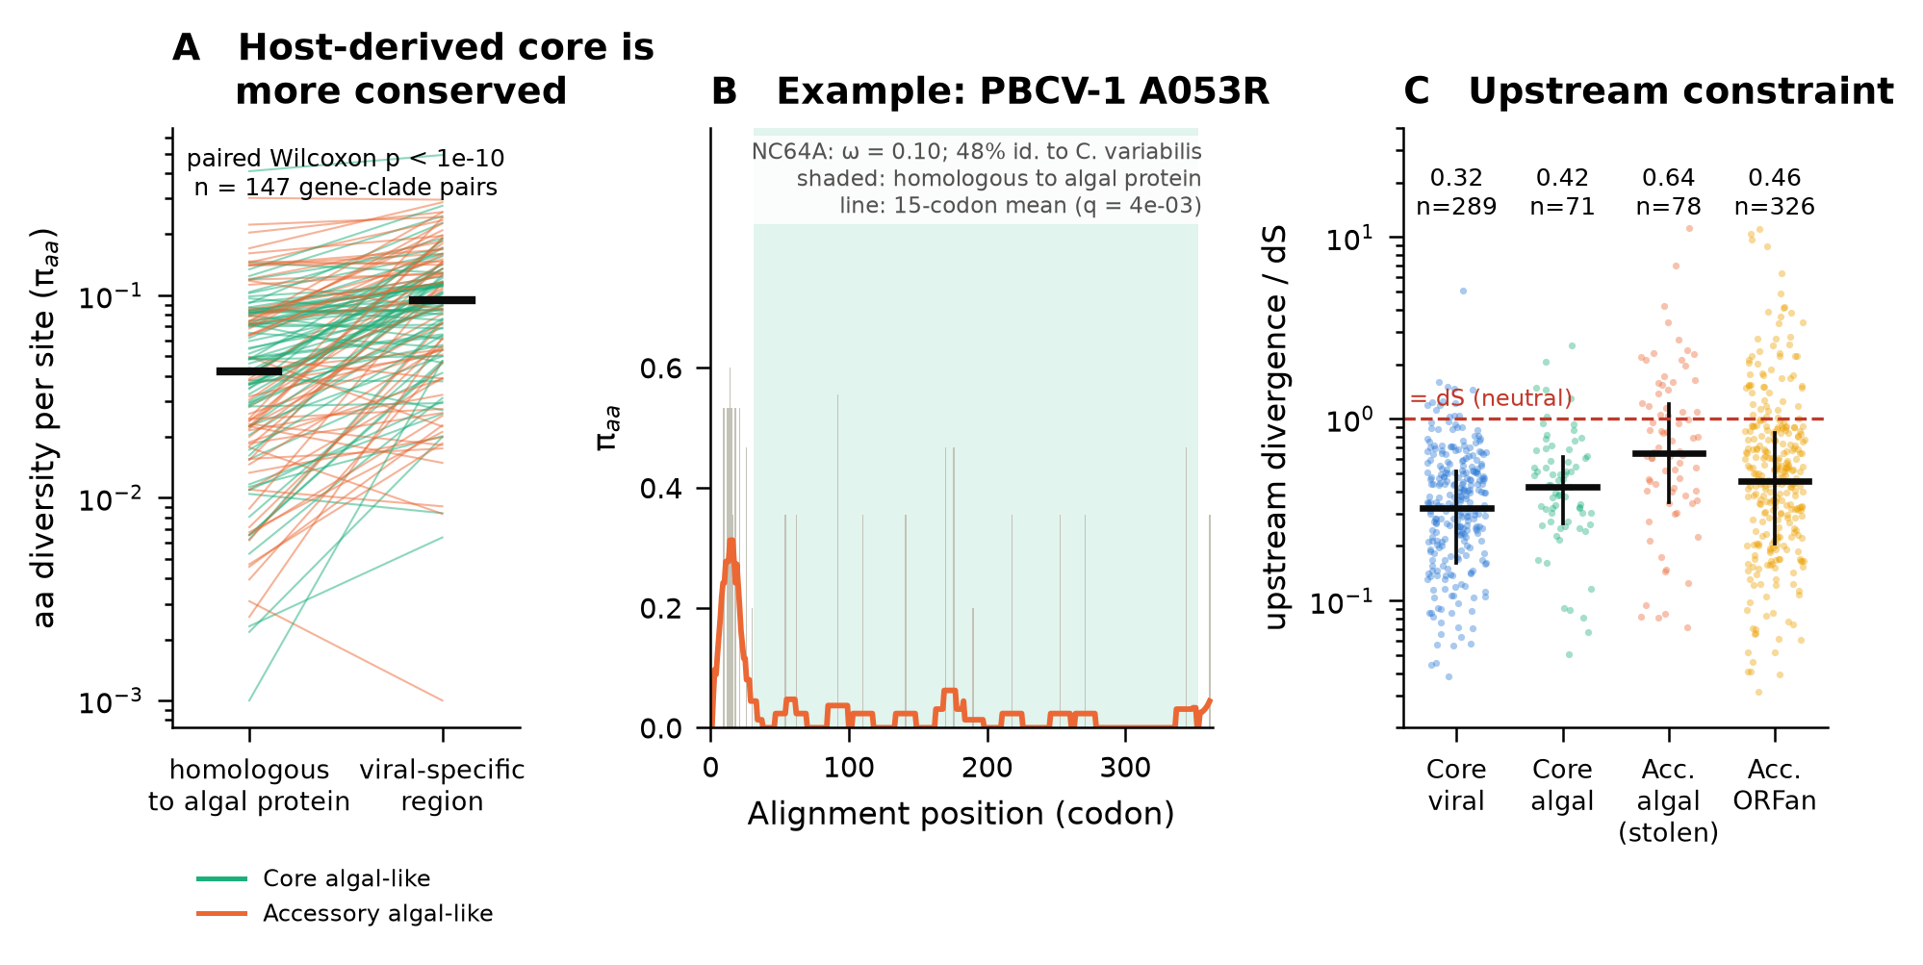
Results 2: the host domain is kept, the promoter is looser
Host domain conserved: π_aa 0.031 vs 0.108 in viral additions (p = 1e-10; 84 % of stolen genes)
Conserved blocks in 51 % of stolen vs 38 % of core genes (χ² p = 0.03)
Promoter constrained but looser: d_up/dS 0.64 vs 0.32 in core genes (p = 8e-9, δ = 0.43)
Fig. 3. A: aa diversity in host-homologous vs viral-specific regions; B: example gene PBCV-1 A053R; C: upstream divergence / dS
Conclusion
The stolen package is domesticated: the virus keeps the host function, while its regulation is still being wired in. The truly neutral candidates are the ORFans.
Limits: algal homology ≠ proven host origin; one ω per gene (M0); promoters only where intergenic ≥ 40 nt
Notes:
Where is the conservation? Inside algal-like genes, the part homologous to the algal protein is about three and a half times less variable than the parts the virus added. The example A053R is conserved along the whole host domain; only its N-terminal viral extension varies. Promoters of stolen genes are constrained too, since they diverge slower than synonymous sites, but about twice as fast as promoters of core genes. So the protein is domesticated and the regulation is looser. Conclusion: the host-derived package is not neutral cargo; the neutral candidates are the ORFans.

