Slide 1
Revolutionizing Food Delivery: The Taste Taxi Experience

Slide 2
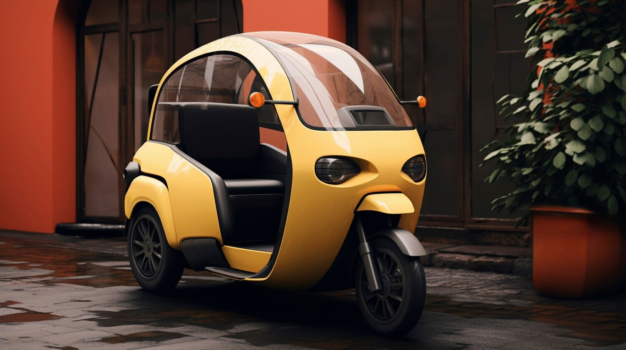

Welcome to Taste Taxi where every bite is a journey, and our company is revolutionizing food delivery . Our mission is to provide a satisfying dining experience at your doorstep . So that you can enjoy your meal anytime anywhere

Slide 3



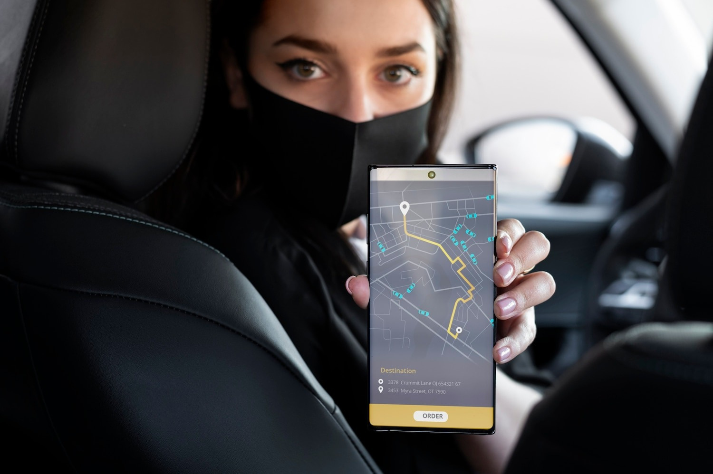
Taste Taxi utilizes an easy-to-use app that connects customers with local restaurants. Simply select your meal, track your order in real-time, and enjoy fast delivery. Our platform ensures that every order is handled with care and efﬁciency, making your experience enjoyable.

Slide 4





Unique Features
Our service includes customized meal options tailored to your preferences. Enjoy dietary ﬁlters, meal recommendations, and exclusive deals from partner restaurants. Taste Taxi is dedicated to enhancing your ordering experience with features that cater to your individual tastes.

Slide 5


Customer Satisfaction
At Taste Taxi, customer satisfaction is our top priority. We gather feedback to continually improve our service and ensure that every delivery meets your expectations. Our dedicated support team is always available to address any concerns, ensuring Positive experience

Slide 6
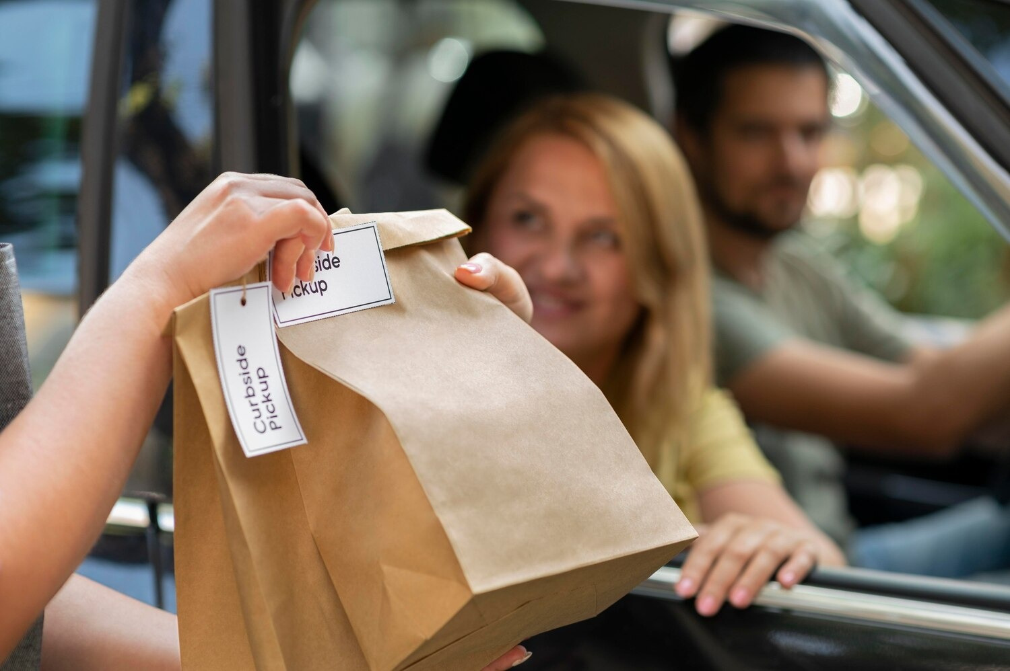
Taste taxi is committed with sustainable practices in food delivery. We partner with eco friendly restaurants and use biodegradable packaging for food packaging inorder to protect the environment. Therefore we can also enjoy our meal and we are also keeping our planet clean

Slide 7



Conclusion: Join the Revolution
In conclusion, Taste Taxi is not just about food delivery; it's about creating a revolutionary dining experience. Join us in transforming how you enjoy meals, with a focus on quality, convenience, and sustainability. Experience the future of food delivery today!

Slide 8

Thanks!
Do you have any questions? youremail@email.com
+91 XXXXXXXXXX www.yourwebsite.com @yourusername

