Slide 1

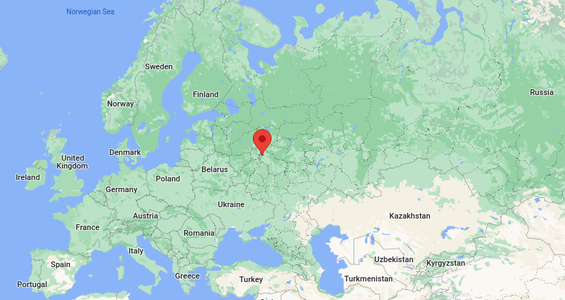


Name: Aleksandr Anisimov
Project: D.O.N.T.F.O.R.G.E.T
https://github.com/anisyanka
https://www.linkedin.com/in/anisyanka
Moscow, Russia

Slide 2
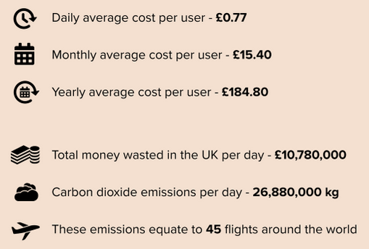
The problem:
A lot of people over the world sometimes leave their light on.
It leads to:
- increasing power consumption
- increasing carbon emission
- wasting money
The solution:
Home automation.
https://www.utilitydesign.co.uk/blog/leaving-lights-on

Slide 5
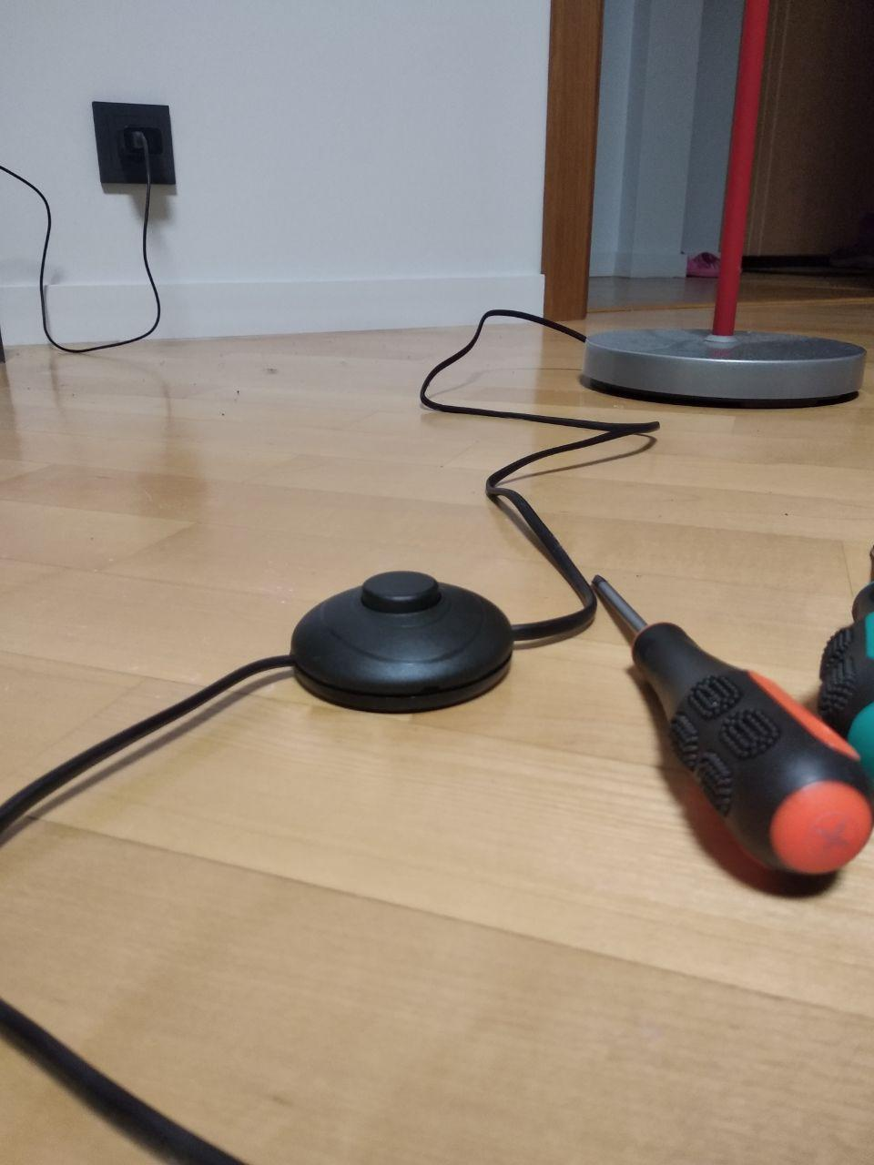
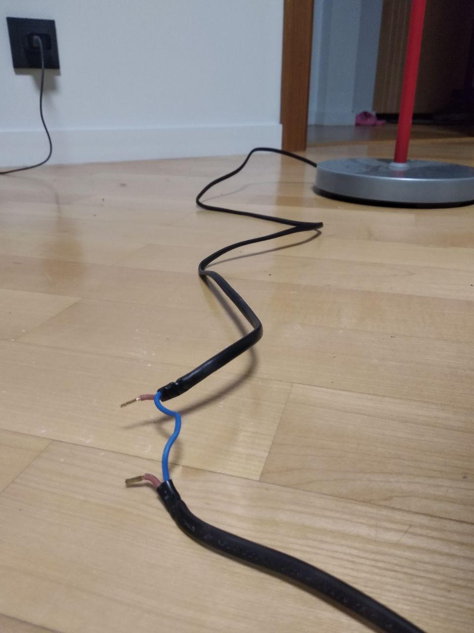
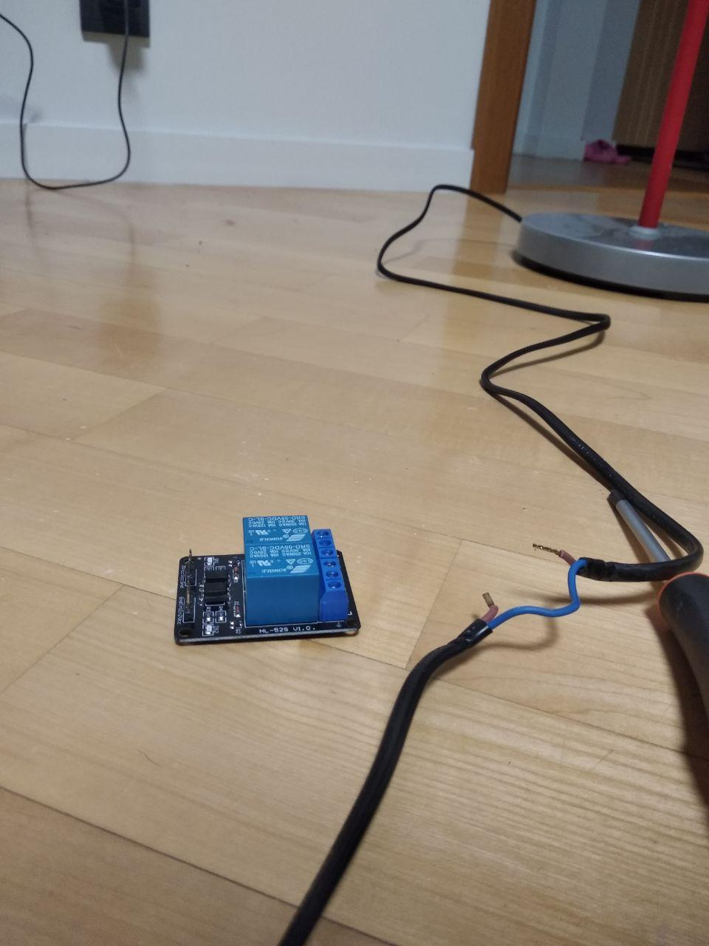
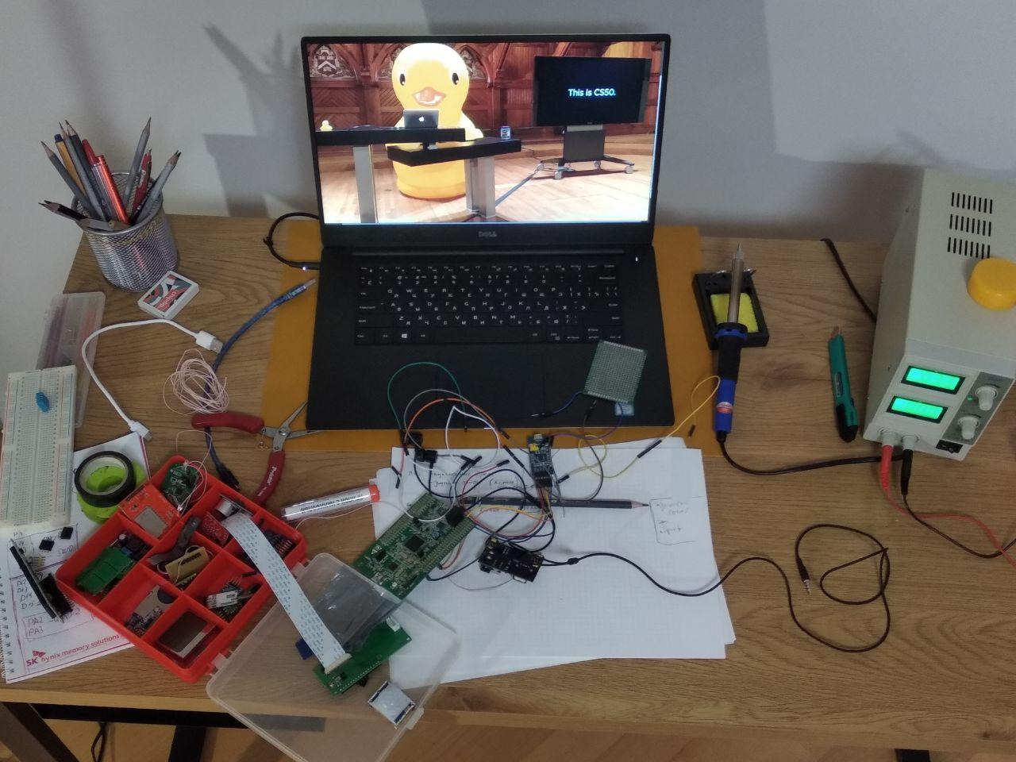
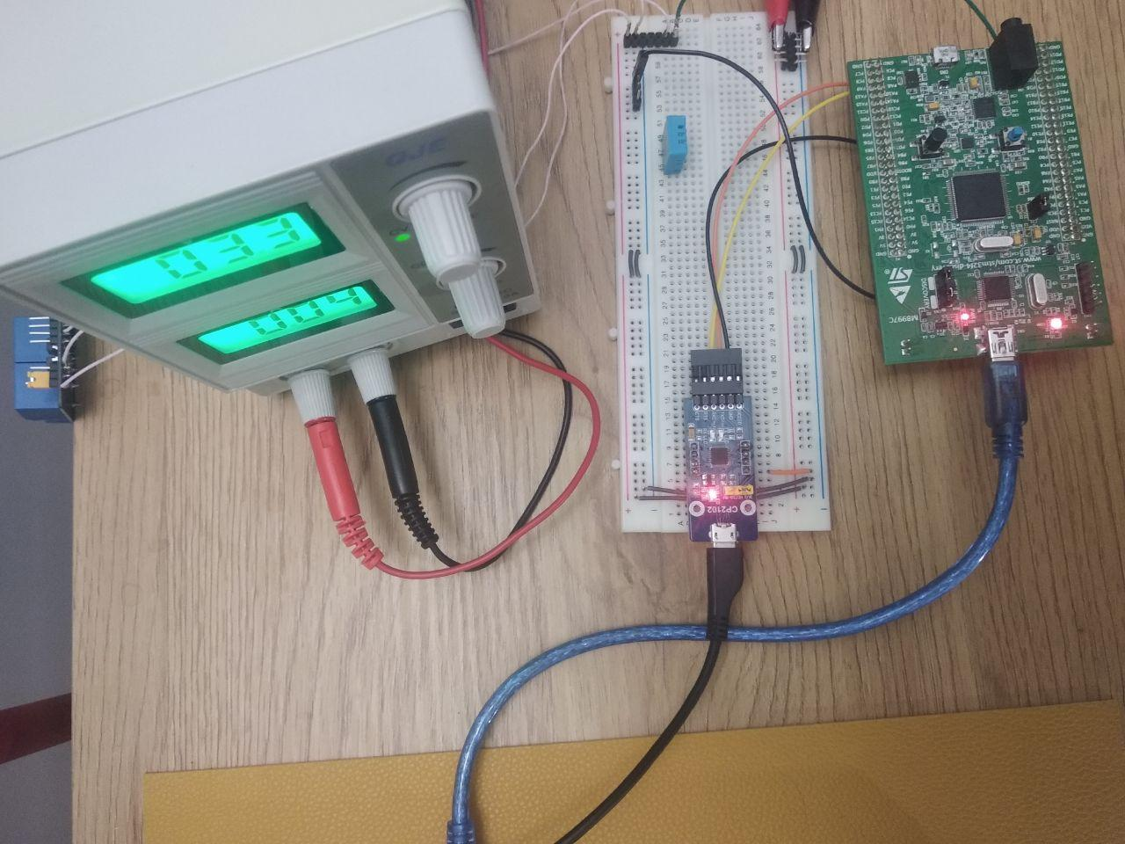
How it works

Slide 6
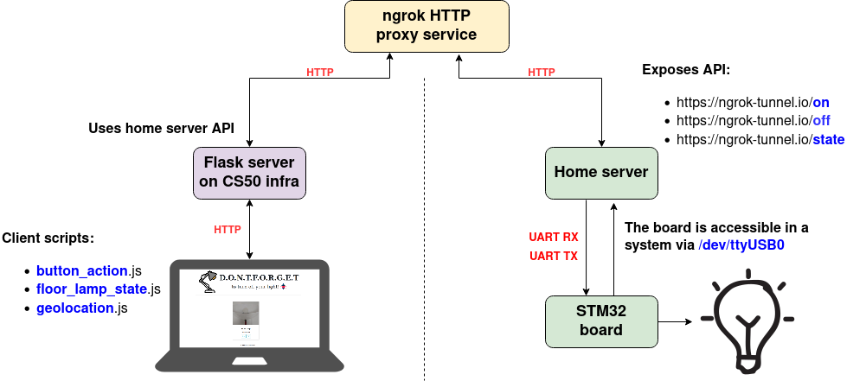
How it works

Slide 7
Thank you for attention!
https://github.com/anisyanka/dont_forget
https://www.linkedin.com/in/anisyanka

